Slide 1
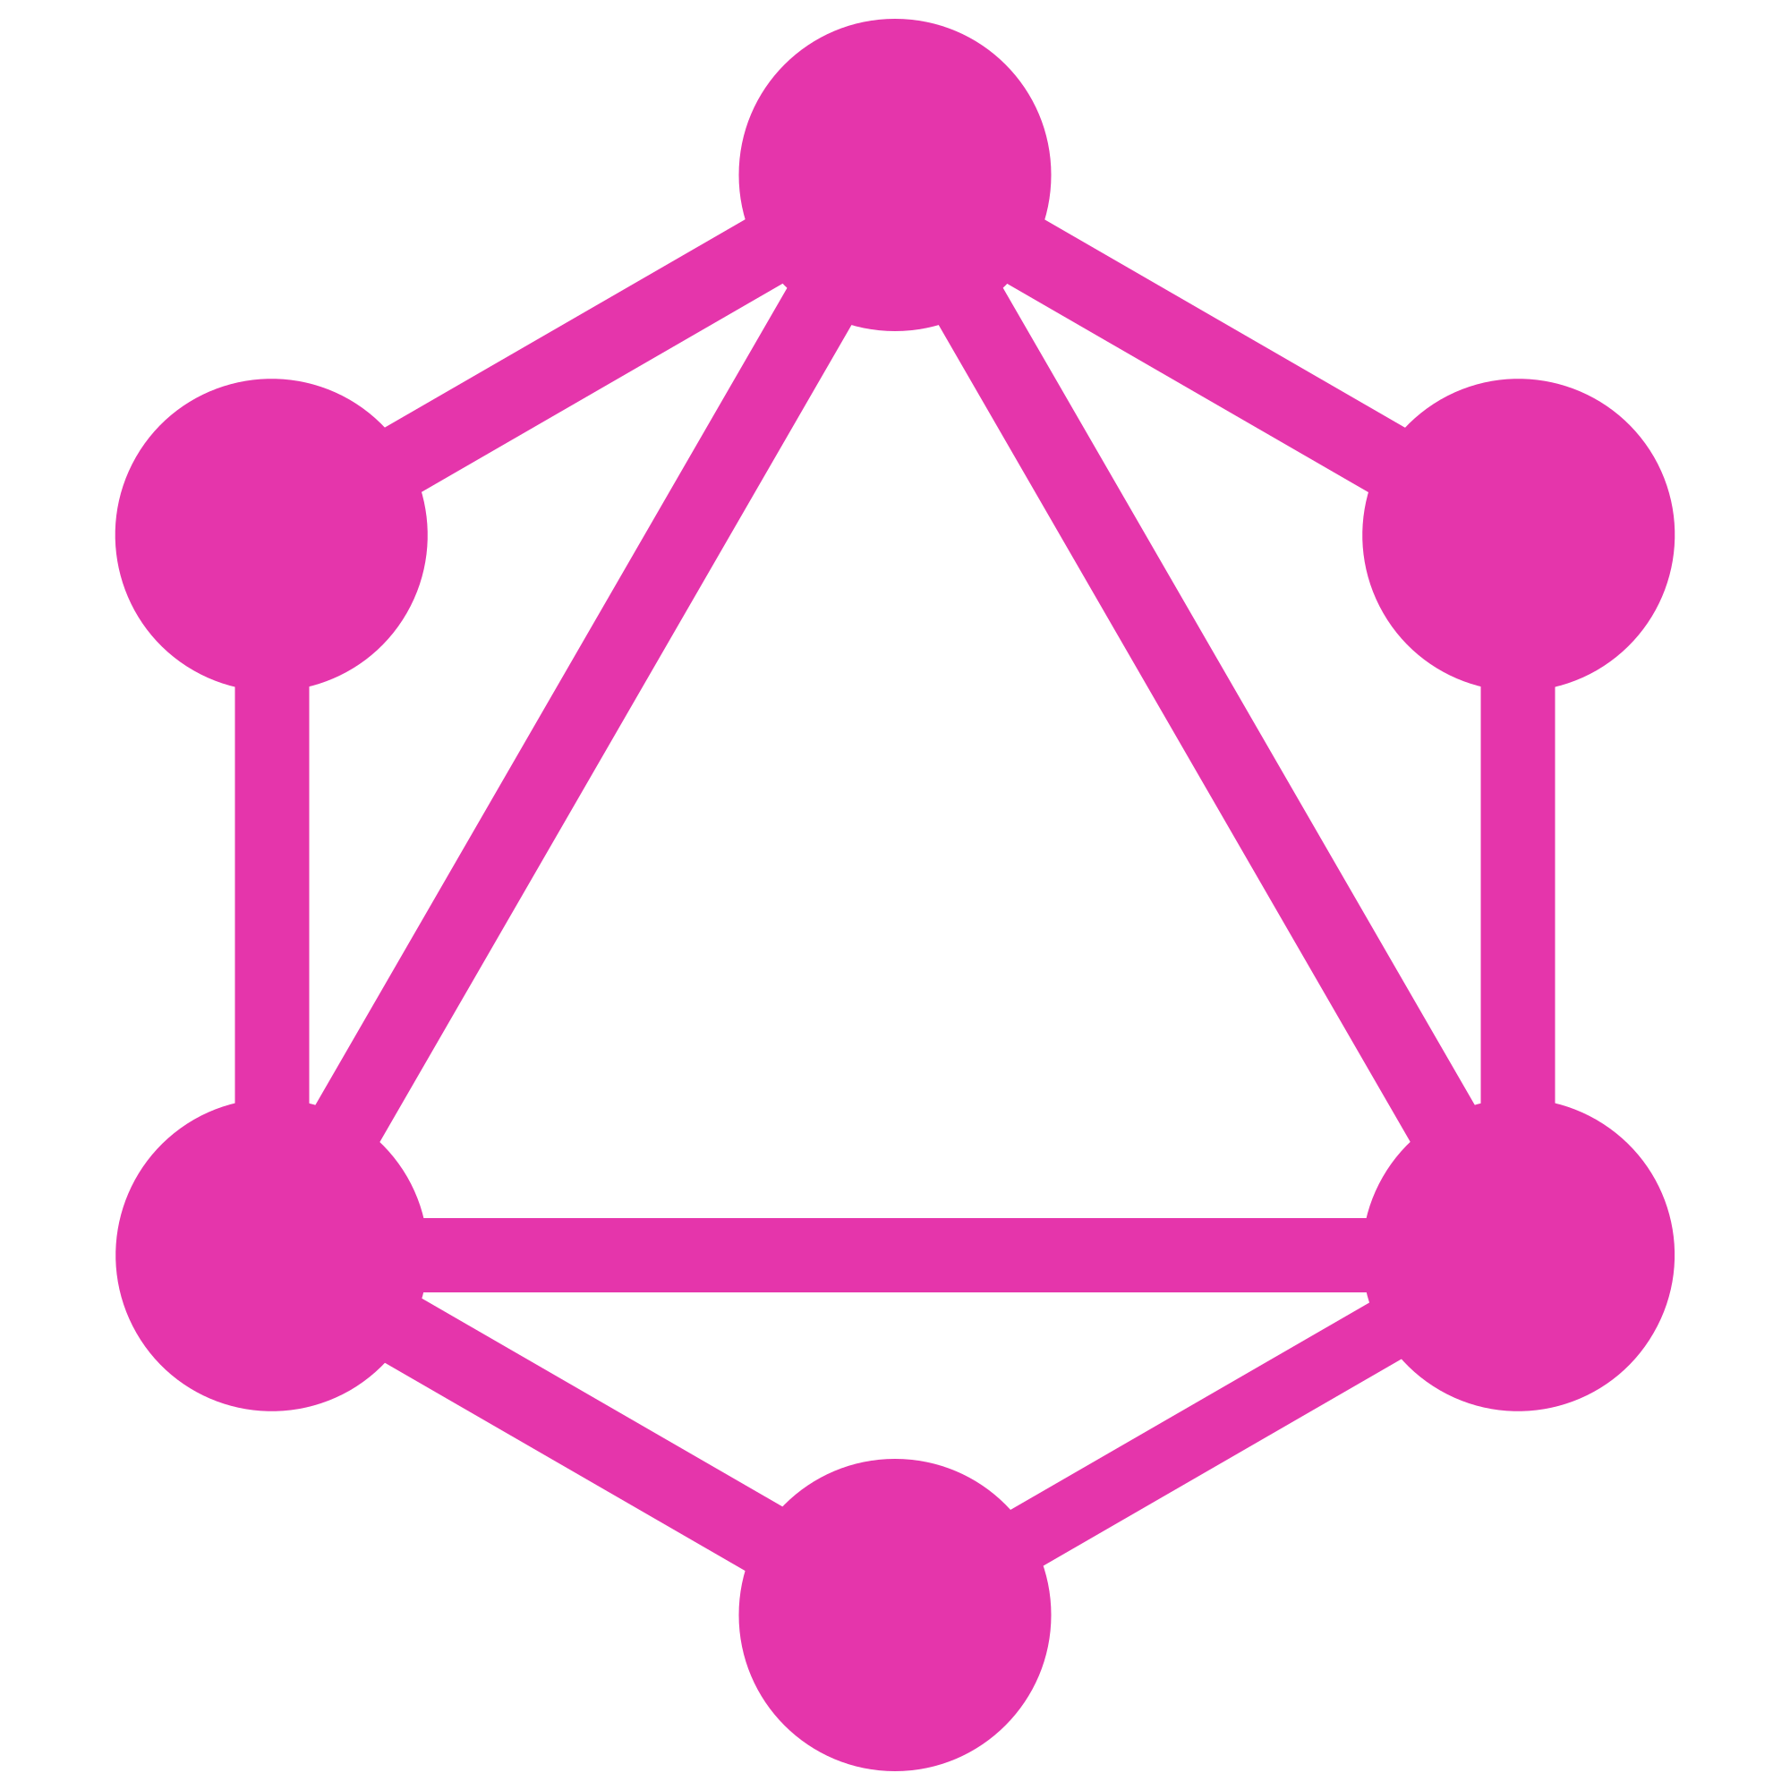
GraphQL
API protocol layer

Slide 2
What is GraphQL?
Query language (protocol)
Interface
Developed by Facebook
Open-source
Typed system
NOT: database, server

Slide 3
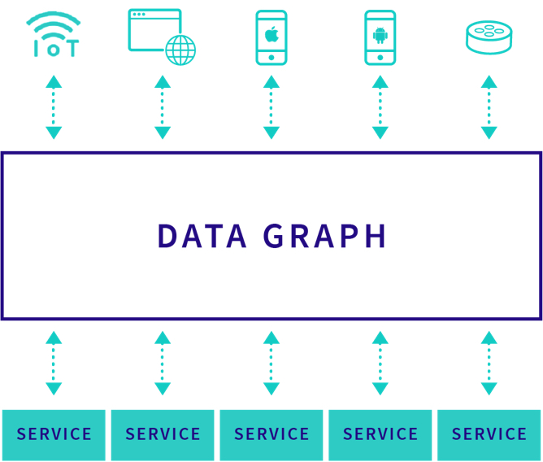

Slide 4
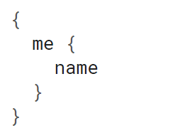
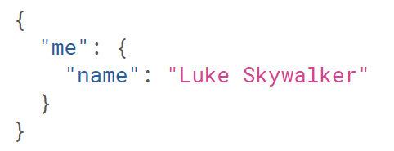
How does it look?
Request
Response

Slide 5
Benefits
Auto generated docs
Predictable response
Ask what you need (enforced)
Retrieve multiple resources in a single request
Strongly typed
Backward compatible
Simple and clean

Slide 6
Auto docs
Auto generated docs by graphiql
Tied to code and not comments
API playground

Slide 7
Predictable response

Slide 8
Enforce specifying fields
Ask the fields you want for the entity
Minimal size
Backward compatible

Slide 9
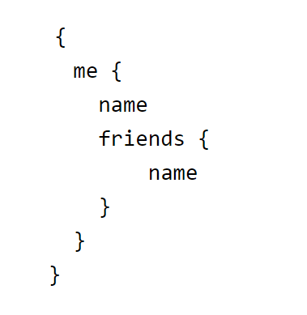
Retrieve multiple resources
N + 1 problem
User + friends
REST: 1 * /user/:id + N * /user/:id
Graphql

Slide 10
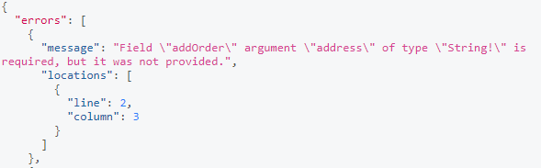
Strongly typed
Enforce and validate input
Int, String, Enum, Union types
Not null validations

Slide 11
Backward compatible
Field level deprecation
Single route

