Slide 1
Functional Programming
Fundamental concepts in JavaScript

Slide 2
Goals
Understand the paradigm
Learn how to use it
Learn how to combine it in JS

Slide 3
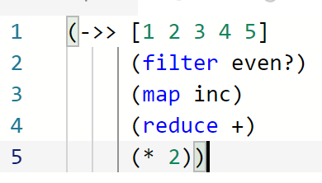

Slide 4
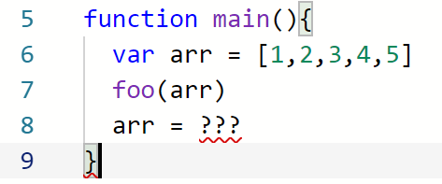
Software Difficulties
State: inner (hidden) data
Control: the order of things
https://github.com/papers-we-love/papers-we-love/blob/master/design/out-of-the-tar-pit.pdf

Slide 5
What is FP?
Immutable data
Declarative code
What instead of how
No side effects
Pure functions
Running a function always return the same value
No globals

Slide 6
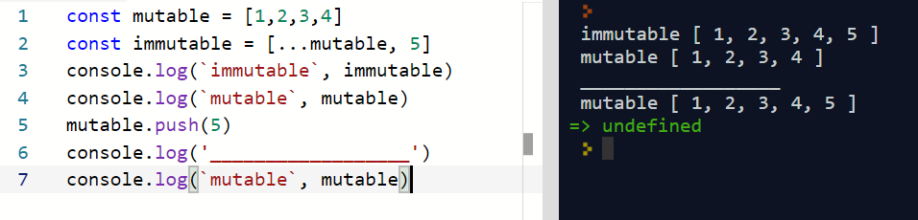
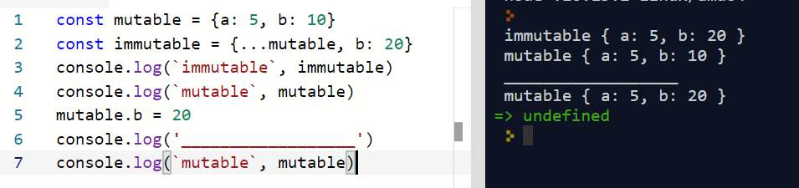
Immutable

Slide 7
Benefits
Predictable code
Testable code
Readable code
Reusable code

Slide 8
Declarative
Say what you want the machine to do, not how to do it
Words, not commands
Let the language describe the process
https://repl.it/repls/GleefulLatestRectangles

Slide 9
Testable
A pure function receive all of its dependencies as arguments
Every execute return the same value
Easy setup
Unit test => very fast

Slide 10
Composable
Function’s output can be another’s input
Data never changes (mutate) => easily compose

Slide 11
Ramda
Curried pure functions
Immutable functions
Null / undefined handling

Slide 12
Where is FP?
Facebook (React, Immutable)
Core JavaScript functions (array.append)
Java Collections and Streams
Lots of blogs and articles

Slide 13
Getting started
Get rid of “for” and “while”
Don’t mutate data
Make use of ramda or lodash/fp

