Slide 1
Micro architecture
Opinionated web application design

Slide 2
Goals
Manage state in a system
Maintainable (readable)
Testable

Slide 3
FP recap
Pure functions
Immutable data structures
Composition
Map, reduce, filter

Slide 4
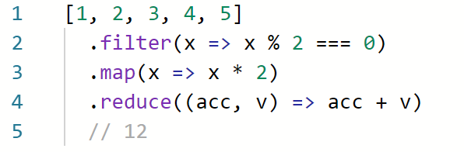

Slide 5
Pure system?
No input
No output
No side-effects
Doesn’t run !

Slide 6
Pure functions
HTTP
Stateful handlers
Database
Messages
Queue

Slide 7
Clojure Component
Pure and impure parts
Impure parts are objects (stateful)
Components have “start” and “stop” methods
Components may depend on each another
A system is a collection of components

Slide 8
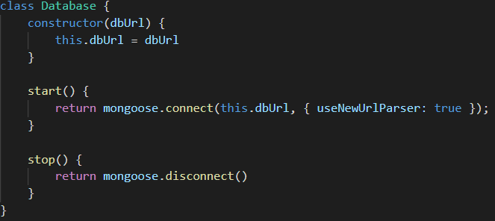
Component example

Slide 9
Benefits
A single place to manage complex (stateful) stuff
Easy to understand external services
Dependency injection
Simple to mock (for unit tests)
Simple to run (for integration tests)

Slide 10
Example project

Slide 11
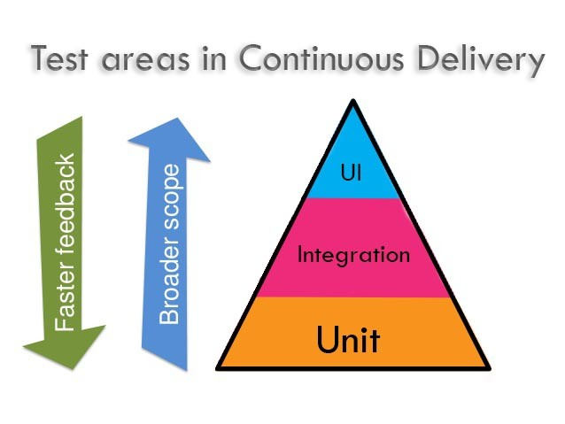

Slide 12
Why tests?
Confidence
Faster development pace
Solid system

Slide 13
Unit tests
Fast
Cheap
Informative
Not much value
Subject to change (break)

Slide 14


Slide 15
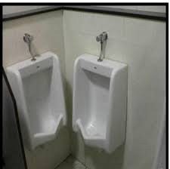

Slide 16


Slide 17
Integration tests
Slow
Difficult to setup
Require real services (database, queue, storage)
Less informative
Does not subject to change
Wider scope => offer wider confidence

Slide 18
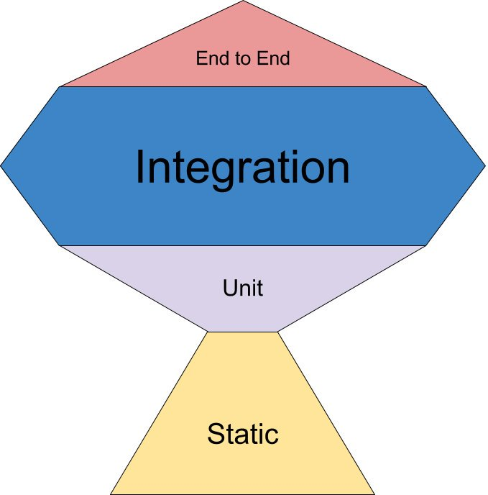

Slide 19
Tests example

Slide 20
Summary
Functional programming simplifies the system
Manage state in a controlled environment
Implements dependency injection design pattern
Helps writing solid integration tests

Slide 21


