Slide 1
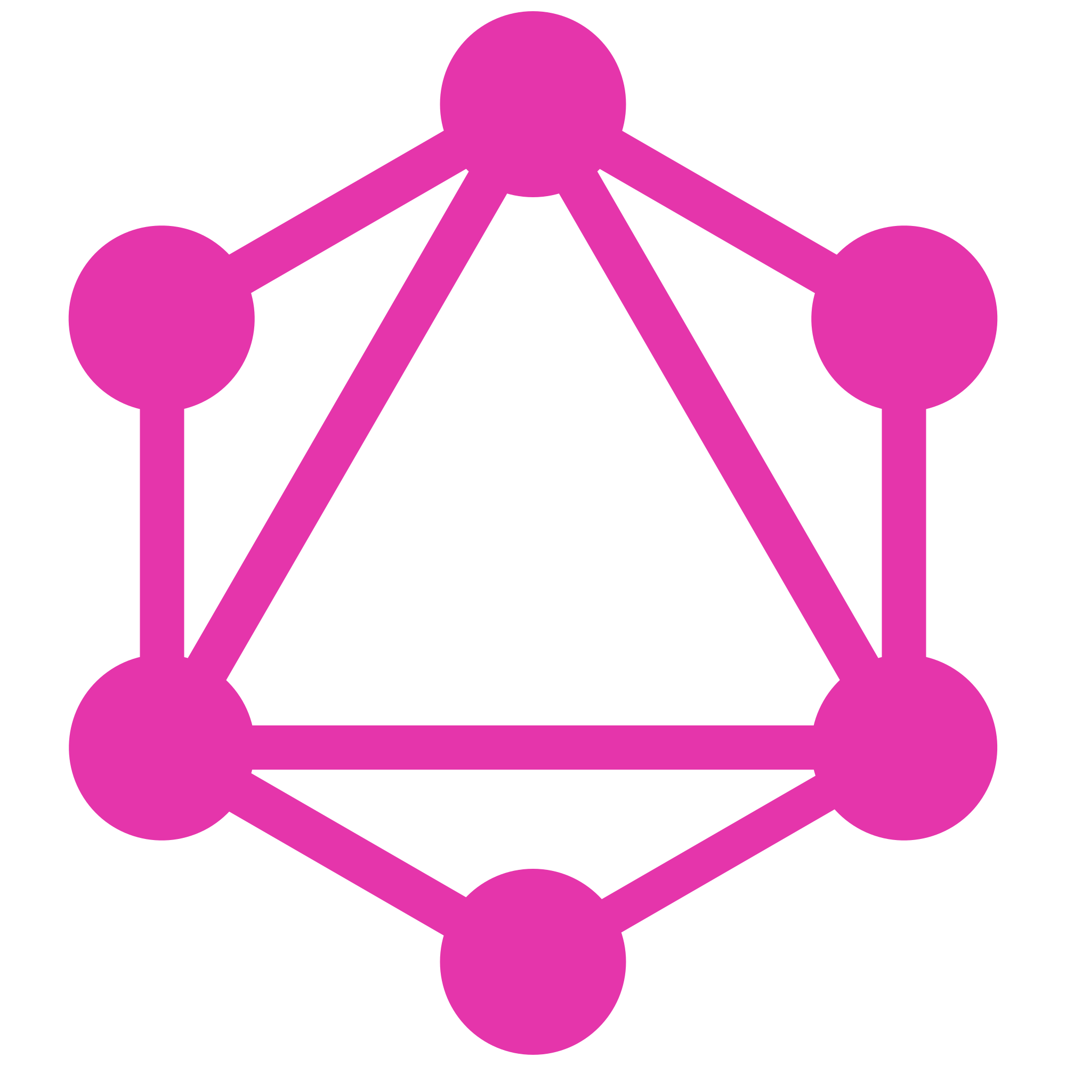
GraphQL
API protocol layer

Slide 2
What is GraphQL?
Query language (protocol)
Interface
Developed by Facebook
Open-source
Typed system
NOT: database, server

Slide 3
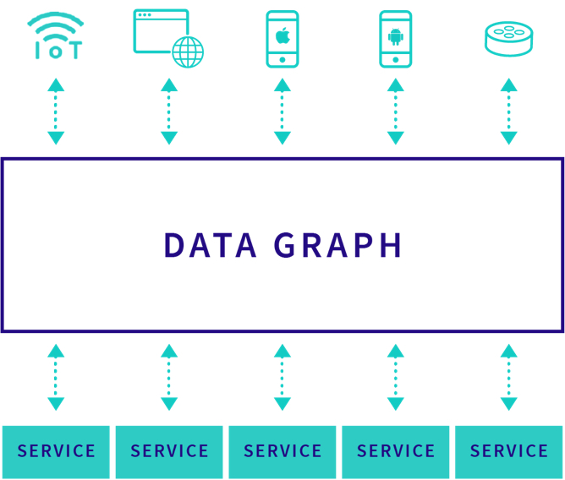

Slide 4
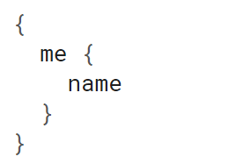
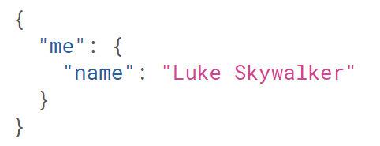
How does it look?
Request
Response

Slide 5
Benefits
Auto generated docs
Predictable response
Ask what you need (enforced)
Retrieve multiple resources in a single request
Strongly typed
Backward compatible
Simple and clean

Slide 6
Hello World Demo

Slide 7
Auto docs
Auto generated docs by graphiql
Tied to code and not comments
API playground

Slide 8
Predictable response

Slide 9
Enforce specifying fields
Ask the fields you want for the entity
Minimal size
Backward compatible

Slide 10
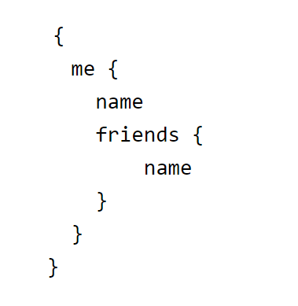
Retrieve multiple resources
N + 1 problem
User + friends
REST: 1 * /user/:id + N * /user/:id
Graphql

Slide 11
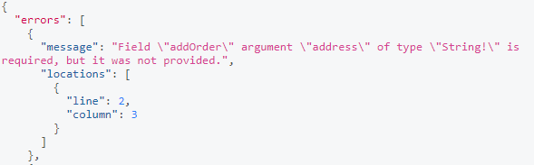
Strongly typed
Enforce and validate input
Int, String, Enum, Union types
Not null validations

Slide 12
Backward compatible
Field level deprecation
Field level usage monitoring
Adding new fields

Slide 13
Simple and Clean
Backend code is maintainable
Client code is readable

Slide 14
Pizza Demo

Slide 15
Downsides
Limited libs
Difficult to cache

Slide 16
Conclusion
GraphQL is an API layer (not db, cache, programming language …)
GraphQL focus on data, not endpoints
Industry is moving towards GraphQL (GitHub, GitLab…)
May be adopted incrementally

Slide 17
Questions?

