Slide 1

Finding the best location for a Hotel

Slide 2

Introduction
São Paulo is the biggest city of Latin America and receive thousands of tourists for business trips every year.
A new Hotel can help the city to better accommodate their visitors and can be a good investment as well. However there are many hotels in the city and the main question for a stakeholder would be which neighborhoods does not have a hotel?
This project aims to find a good location for a hotel

Slide 3
Data
I got a list of São Paulo neighborhoods from http://g1.globo.com/sao-paulo/noticia/2013/11/veja-distribuicao-oficial-dos-bairros-nas-cinco-regioes-da-cidade.html
Coordinates were found using Google Maps API and added to the main data frame.
The main companies of each neighborhood were found using Foursquare and added to the main data frame as well.

Slide 4
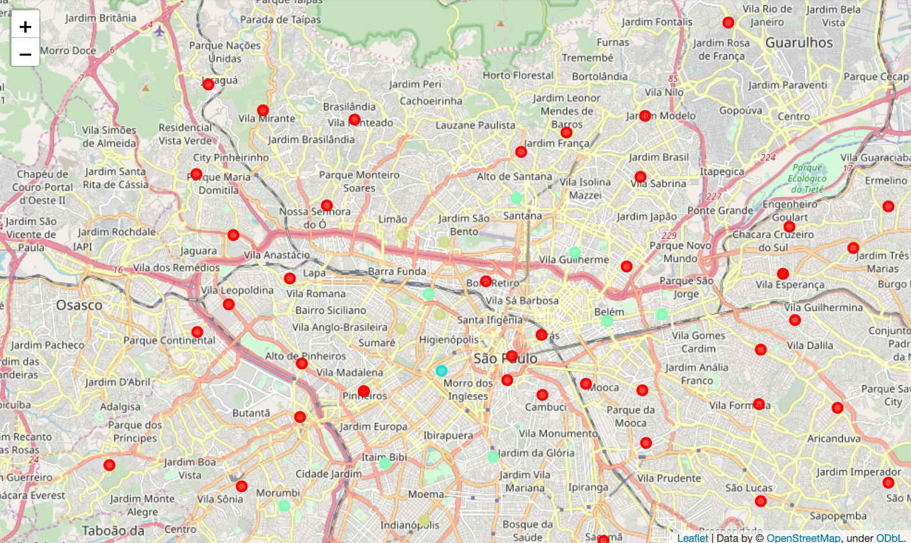
Results
As we can see in map, the hotels are concentrated near the center of São Paulo. Neighborhoods as Perdizes, Morumbi, Indianópolis, Itaim Bibi, Barra Funda and others have four or five hotels in the same neighborhood. The most part of the neighborhoods has no hotels, as we can see in red on the map.

Slide 5
Discussion
As a stakeholder I would choose a neighborhood marked in red which means there is no hotels in that neighborhood.

Slide 6
Conclusion
Built a map clustering the neighborhoods by number of hotels in São Paulo
I concluded the best place for a new hotel is neighborhoods marked in red because there is no other hotel in the neighborhood.
Ideas to include
Find main companies per neighborhoods.
Identify which neighborhoods have metro around.
Find the malls, parks and other places to visit.

