Slide 1
Getting to know your Programming Environment

Slide 2
Objectives
At the end of the lesson, the student should be able to:
Create a Java program using text editor and console in the Linux, Solaris, Windows, Mac OS, or any other OS environment
Differentiate between syntax-errors and runtime errors
Create a Java program using NetBeans

Slide 3
Definitions
Console
This is where you type in commands
Examples are Terminal (Linux), MSDOS Command Prompt (Windows)

Slide 4
Definitions
Text Editor
Examples: Notepad, Wordpad, Vim, Etc.

Slide 5
Definitions
Integrated Development Environment or IDE
a programming environment integrated into a software application that provides a GUI builder, a text or code editor, a compiler and/or interpreter and a debugger.

Slide 6
My First Java Program
public class Hello {
/**
* My first Java program
*/
public static void main( String[] args ){
//prints the string “Hello world” on screen
System.out.println(“Hello world”);
}
}

Slide 7
Using Text Editor and Console
NOTE:
This will be demonstrated by the teacher
Environment used: Red Hat Linux
For Windows Environment: Refer to Appendix B in your student Manual

Slide 8
Using Text Editor and Console
Step 1: Start the Text Editor
To start the Text Editor in Linux, click on Menu-> Accessories-> Text Editor
Step 2: Open Terminal
To open Terminal in Linux, click on Menu-> System Tools-> Terminal
Step 3: Write your the source code of your Java program in the Text Editor

Slide 9
Using Text Editor and Console
Step 4: Save your Java Program
Filename: Hello.java
Folder name: Workspace/myjavaprograms
To open the Save dialog box, click on the File menu found on the menubar and then click on Save.
If the folder Workspace/myjavaprograms does not exist yet, create the folder

Slide 10
Using Text Editor and Console
Step 5: Compiling your program
Go to the Terminal window
Go to the folder myjavaprograms where you saved the program
To compile a Java program, we type in the command:
javac [filename]
So in this case, type in:
javac Hello.java
During compilation, javac adds a file to the disk called [filename].class, or in this case, Hello.class, which is the actual bytecode.

Slide 11
Using Text Editor and Console
Step 6: Running the Program
To run your Java program, type in the command:
java [filename without the extension]
so in the case of our example, type in:
java Hello
You can see on the screen after running the program:
"Hello world!"

Slide 12
Errors : Syntax Errors
Syntax Errors Syntax
errors are usually typing errors
Common Syntax Errors:
misspelled a command in Java
forgot to write a semi-colon at the end of a statement

Slide 13
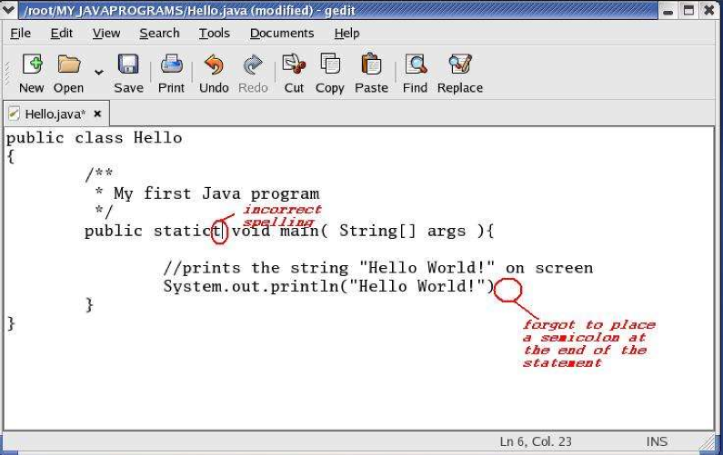
Example: Syntax Error

Slide 14
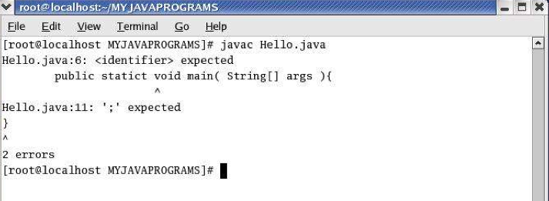
Example: Syntax Error

Slide 15
Errors: Runtime Errors
Run-time Errors
errors that will not display until you run or execute your program
Even programs that compile successfully may display wrong answers if the programmer has not thought through the logical processes and structures of the program.
Examples:
You want your program to print 100 strings of “Hello world”, but it only printed 99.
Your program gets an input from the user, but the user inputted a character, and so your program crashes/terminates

Slide 16
Summary
My First Java Program
Using a Text Editor and Console
Write program
Compile program
Run program
Errors
Syntax Errors
Runtime Errors

