Slide 1
New Code Base
Paul Pridham
9/14/2022

Slide 2
Why New Code?
Nano:
Pro: has built in Bluetooth
Con: Slow clock
Con: Noisy ADC
Teensy:
Pro: Fast Clock
Pro: Good ADC
Con: Needs external Bluetooth that can cause controls to hang while message is being sent
Each controllers’ cons are not an issue with the other so by having the Teensy offload Bluetooth communication to the Nano we should end up with an overall faster system
Expected possible control loop speed is ~600µs for 4 motors using 2 CAN busses and custom libraries.

Slide 3
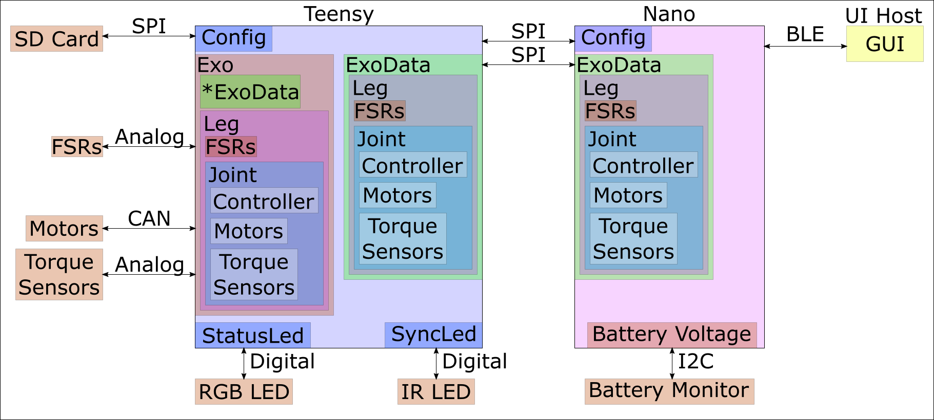
Overview

Slide 4
UI Host
Interface the user touches, app on phone or tablet
Packages and sends individual Bluetooth messages.

Slide 5
Nano
Handles Bluetooth communication
Mirrors ExoData stored on the Teensy
Handles low frequency sensor reading

Slide 6
Teensy
Handles most of the computation
Configures System
Does primary sensor readings
FSR
Torque Sensors
Does primary output
Motors
Sync LED
Status LED

Slide 7
ExoData
Stores the data and parameters used to control the system
Mirrors setup of Exo

Slide 8
Exo
Handles the computation
Reads sensors and puts data in ExoData instance.
FSR
Torque Sensors
Calculates output commands and sends to components
Motors
Sync LED
Status LED

Slide 9
SD Card
Stores system configuration
Till app fully set up:
Contains parameter sets for different controllers.

Slide 10
Motors
Currently CAN motors but other types can be added
Takes in torque commands

Slide 11
Torque Sensors
Measures torques at the joint
Controllers have flag to use PID
Select if torque sensor present
Don’t use if there is no torque sensor

Slide 12
FSR
Used to determine pressure at the heel and toe.
Used to determine foot strike and percent gait based on that.
Some controllers use one or both of these sensors.

Slide 13
Status LED
Displays messages based on exoskeleton status.
Colors (RGB)
Patterns
Solid (Color)
Blink (Color, Freq)
Pulse (Color, Freq)
Rainbow (Freq)

Slide 14
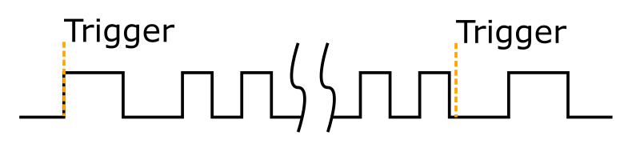
Sync LED
Used to synchronize the exoskeleton with infrared(IR) motion capture through an IR LED
Pulse Pattern
Long pulse at start and end
Small pulses in middle

Slide 15
Concept of Operations
Check/update configuration on the SD Card
Turn on
Teensy reads config
Sends info to Nano
Both boards create ExoData object
Teensy creates Exo object
Calibrates sensors
Select controllers to use for the joints
Start trial
End trial
500+ Hz*
Teensy reads data from sensors
Teensy updates motor commands/Sync Led
100 Hz*
Teensy pulls updated app info from Nano
Teensy pushes data to Nano
Nano updates app
* These loops happen regardless of trial state

Slide 16
Concept of Operations
Check/update configuration on the SD Card
Turn on
Teensy reads config
Sends info to Nano
Both boards create ExoData object
Teensy creates Exo object
Calibrates sensors
Select controllers to use for the joints
Start trial
End trial
500+ Hz*
Teensy reads data from sensors
Teensy updates motor commands/Sync Led
100 Hz*
Teensy pulls updated app info from Nano
Teensy pushes data to Nano
Nano updates app
* These loops happen regardless of trial state

Slide 17
Concept of Operations
Check/update configuration on the SD Card
Turn on
Teensy reads config
Sends info to Nano
Both boards create ExoData object
Teensy creates Exo object
Calibrates sensors
Select controllers to use for the joints
Start trial
End trial
500+ Hz*
Teensy reads data from sensors
Teensy updates motor commands/Sync Led
100 Hz*
Teensy pulls updated app info from Nano
Teensy pushes data to Nano
Nano updates app
* These loops happen regardless of trial state

Slide 18
Concept of Operations
Check/update configuration on the SD Card
Turn on
Teensy reads config
Sends info to Nano
Both boards create ExoData object
Teensy creates Exo object
Calibrates sensors
Select controllers to use for the joints
Start trial
End trial
500+ Hz*
Teensy reads data from sensors
Teensy updates motor commands/Sync Led
100 Hz*
Teensy pulls updated app info from Nano
Teensy pushes data to Nano
Nano updates app
* These loops happen regardless of trial state

Slide 19
Concept of Operations
Check/update configuration on the SD Card
Turn on
Teensy reads config
Sends info to Nano
Both boards create ExoData object
Teensy creates Exo object
Calibrates sensors
Select controllers to use for the joints
Start trial
End trial
500+ Hz*
Teensy reads data from sensors
Teensy updates motor commands/Sync Led
100 Hz*
Teensy pulls updated app info from Nano
Teensy pushes data to Nano
Nano updates app
* These loops happen regardless of trial state

Slide 20
Concept of Operations
Check/update configuration on the SD Card
Turn on
Teensy reads config
Sends info to Nano
Both boards create ExoData object
Teensy creates Exo object
Calibrates sensors
Select controllers to use for the joints
Start trial
End trial
500+ Hz*
Teensy reads data from sensors
Teensy updates motor commands/Sync Led
100 Hz*
Teensy pulls updated app info from Nano
Teensy pushes data to Nano
Nano updates app
* These loops happen regardless of trial state

Slide 21
Concept of Operations
Check/update configuration on the SD Card
Turn on
Teensy reads config
Sends info to Nano
Both boards create ExoData object
Teensy creates Exo object
Calibrates sensors
Select controllers to use for the joints
Start trial
End trial
500+ Hz*
Teensy reads data from sensors
Teensy updates motor commands/Sync Led
100 Hz*
Nano pushes updated app info to the Teensy
Nano pulls new sensor data from the Teensy
Nano updates app
* These loops happen regardless of trial state

Slide 22
Code Location
https://github.com/naubiomech/ExoCode/tree/nano_teensy_board
User Guide
https://github.com/naubiomech/ExoCode/tree/nano_teensy_board/Documentation

