Slide 1
Code Rewrite

Slide 2
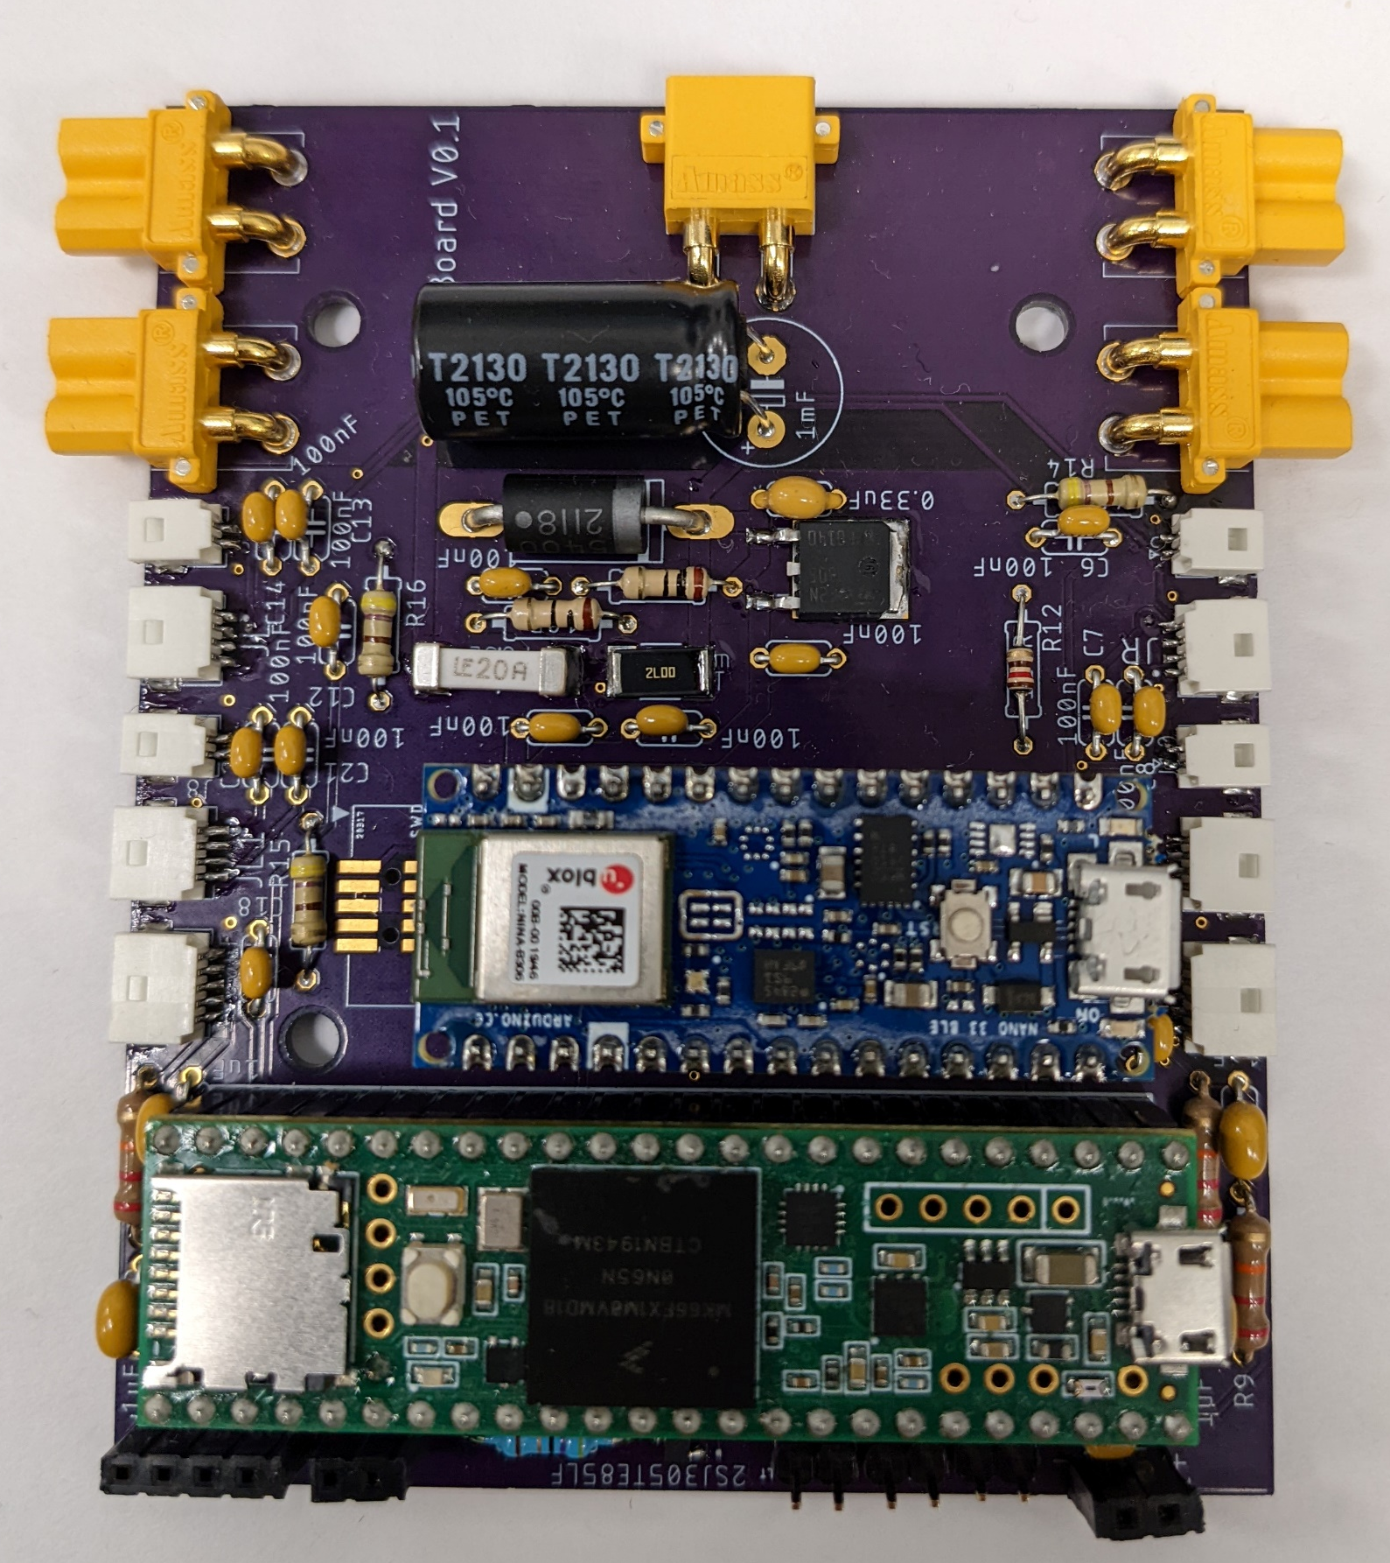
Goals
Separate Bluetooth communication from exo control
Have nano for COMs and Teensy for control
Prevent need to reflash boards when switching systems
Use SD card with config file
Have single file that compiles for both boards with preprocessor directives
Update for use with CAN motors
Make code more modular and flexible
Use object-oriented programing

Slide 3
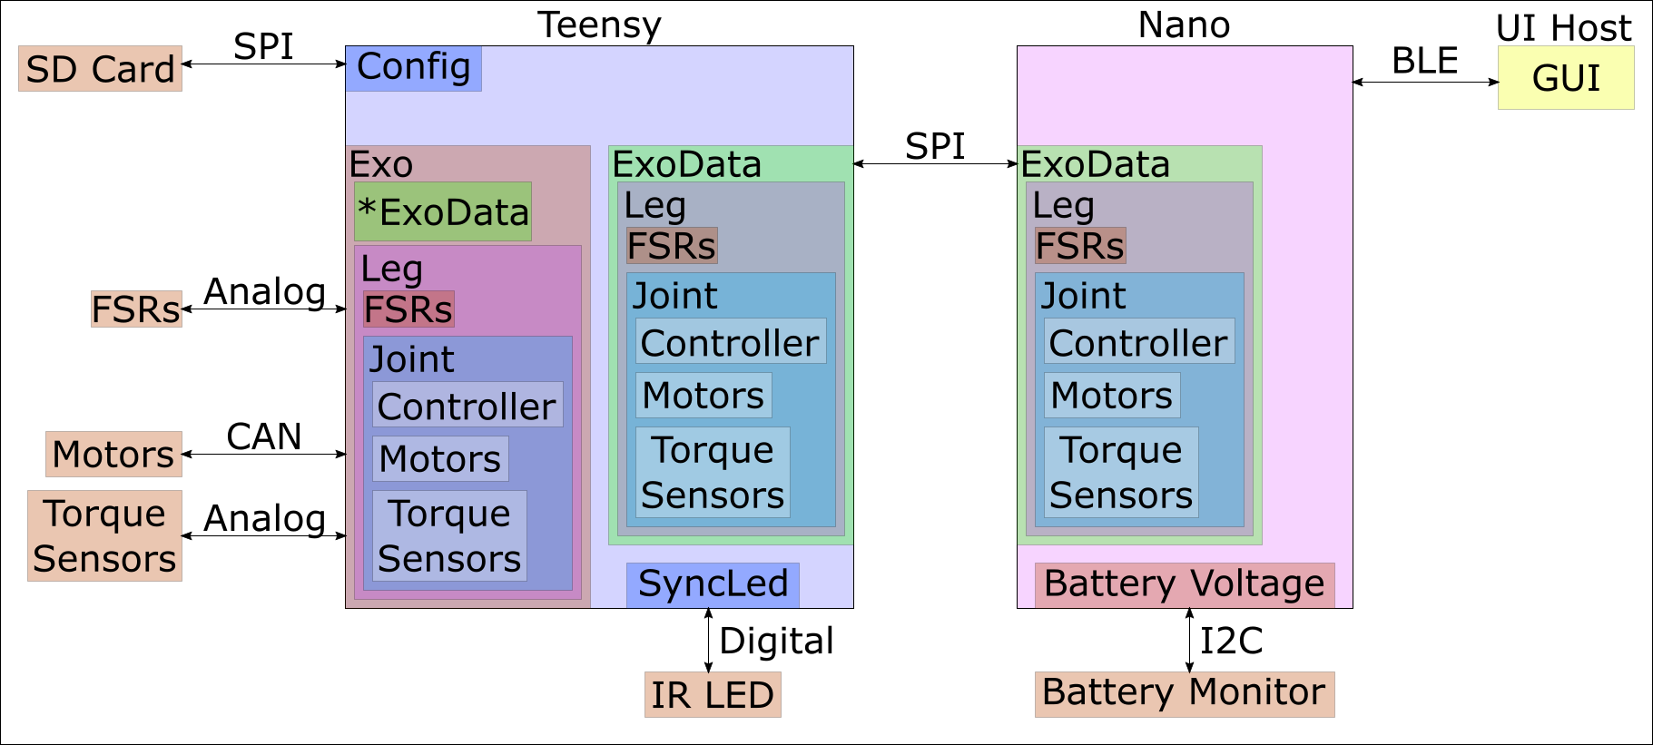
System Structure

Slide 4
Concept of Operations
Check/update configuration on the SD Card
Turn on
Teensy reads config
Sends info to Nano
Both boards create ExoData object
Teensy creates Exo object
Calibrates sensors
Select controllers to use for the joints
Start trial
Teensy pulls updates from Nano
Teensy reads data from sensors
Teensy updates motor commands/Sync Led
Teensy pushes data to Nano
End Trial

Slide 5
Current Status
Done
Config file reading done
ExoData structure in place and compiles on both boards
Partially Done
Exo structure in place but needs functions filled in
LED objects work but need to be update to new style guide
To Do
Board to board COMs
Nano to UI COMs
Battery Monitor

Slide 6
Next Steps
Fill in Functions
Start with external interfaces and work in from there.

Slide 7
Open Questions
Anything missing or needs changed in the style guide?
Other things we should consider in the rewrite?
SPI protocol data as large chunk or just read specific updates.

Slide 8
ExoData
{
ExoStatus
sync_led_state
LegData : left, right
{
percent_gait
heel_fsr
toe_fsr
is_left
is_used
JointData : hip, knee, ankle
{
id
torque_reading
is_left
is_used
motor
{
id
motor_type
is_left
p
v
i
p_des
v_des
kp
kd
t_ff
}
controller
{
controller
JointType
setpoint
parameter1
parameter2
}
}
}
}

