Slide 1
New Code Base
Paul Pridham
9/14/2022

Slide 2
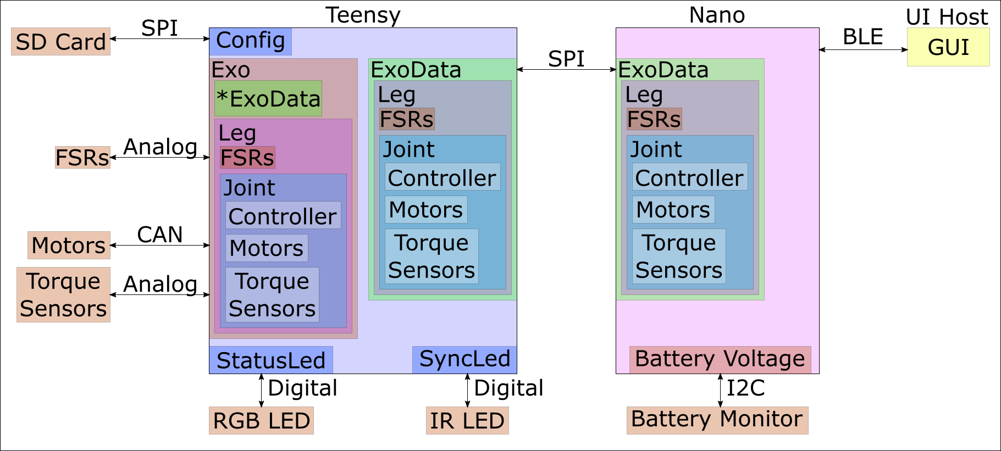
Overview

Slide 3
Exo
Handles most of the computation
Configures System
Does primary sensor readings
FSR
Torque Sensors
Does primary output
Motors
Sync LED
Status LED

Slide 4
ExoData
Stores the data and parameters used to control the system
Mirrors setup of Exo

Slide 5
Teensy
Handles most of the computation
Configures System
Does primary sensor readings
FSR
Torque Sensors
Does primary output
Motors
Sync LED
Status LED

Slide 6
SD Card
Stores system configuration
Till app fully set up:
Contains parameter sets for different controllers.

Slide 7
Motors
Currently CAN motors but other types can be added
Takes in torque commands

Slide 8
Torque Sensors
Measures torques at the joint
Controllers have flag to use PID
Select if torque sensor present
Don’t use if there is no torque sensor

Slide 9
FSR
Used to determine pressure at the heel and toe.
Used to determine foot strike and percent gait based on that.
Some controllers use one or both of these sensors.

Slide 10
Status LED
Displays messages based on exoskeleton status.
Colors (RGB)
Patterns
Solid (Color)
Blink (Color, Freq)
Pulse (Color, Freq)
Rainbow (Freq)

Slide 11
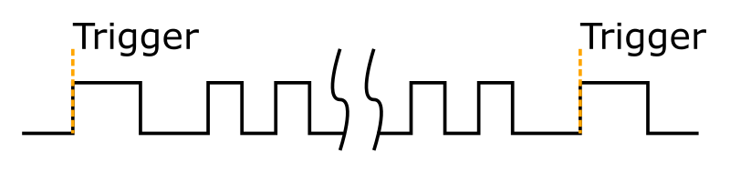
Sync LED
Used to synchronize the exoskeleton with infrared(IR) motion capture through an IR LED
Pulse Pattern
Long pulse at start and end
Small pulses in middle

Slide 12
Nano
Handles Bluetooth communication
Mirrors ExoData stored on the Teensy
Handles low frequency sensor reading

Slide 13
UI Host
Interface the user touches, app on phone or tablet
Packages and sends individual Bluetooth messages.

