Slide 1
Terraform on AWS
Naufal Bayuaji Pawenang

Slide 2
Table of Contents
Introduction
Managing AWS - Life without Terraform
Managing AWS - Life with Terraform
Summary

Slide 3
Terraform on AWS

Slide 4
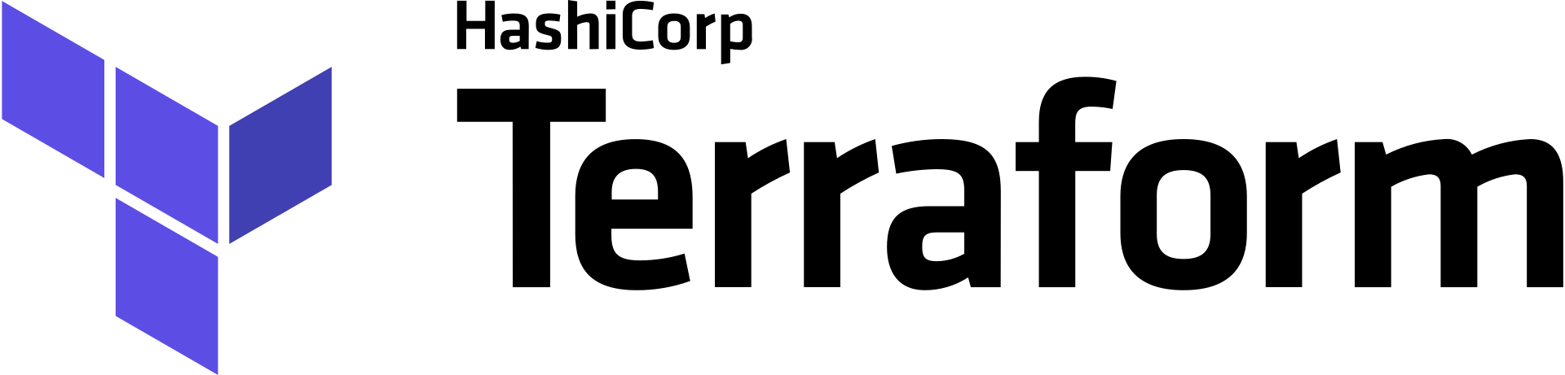
What is Terraform
Terraform is an Open-Source, Infrastructure as code tool developed by HashiCorp
Terraform can manage external resources, such as cloud infrastructure, network appliances, SaaS and PaaS.
Terraform can help users create environments in fewer steps (and also faster) compared to deploying them manually
Terraform supports major cloud infrastructure such as AWS, Azure, IBM, GCP, VMWare and OpenStack.

Slide 5
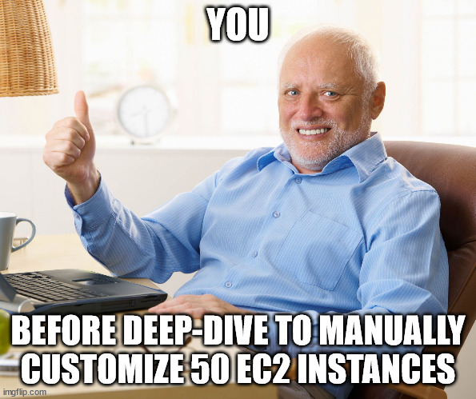

Why Terraform is Very Useful
Life without terraform
Life with terraform

Slide 6
Life Without Terraform
Manually provisioning environment (especially large one) is time consuming and prone to input errors
Difficult to trace deployment errors in a complex environment
Audits? Uniformity? Standardization of Deployments? Traceability?
Provisioning is difficult enough. How about dismantling them?

Slide 7
Life with Terraform
Defining Infrastructure resources in a more, humane manner.
Deploy Cloud environment with just writing some lines of code that we can version, reuse and share.
Big or Small, Simple or Complex, Terraform can handle it.
Have a consistent workflow. Helps you in policy compliance and management.
Deploy Multi-Cloud Environment, like both on AWS and Azure? You got it. N-tier application infrastructure? Gotcha fam. PaaS setup? Can do that sir.

Slide 8
Deployment

Slide 9
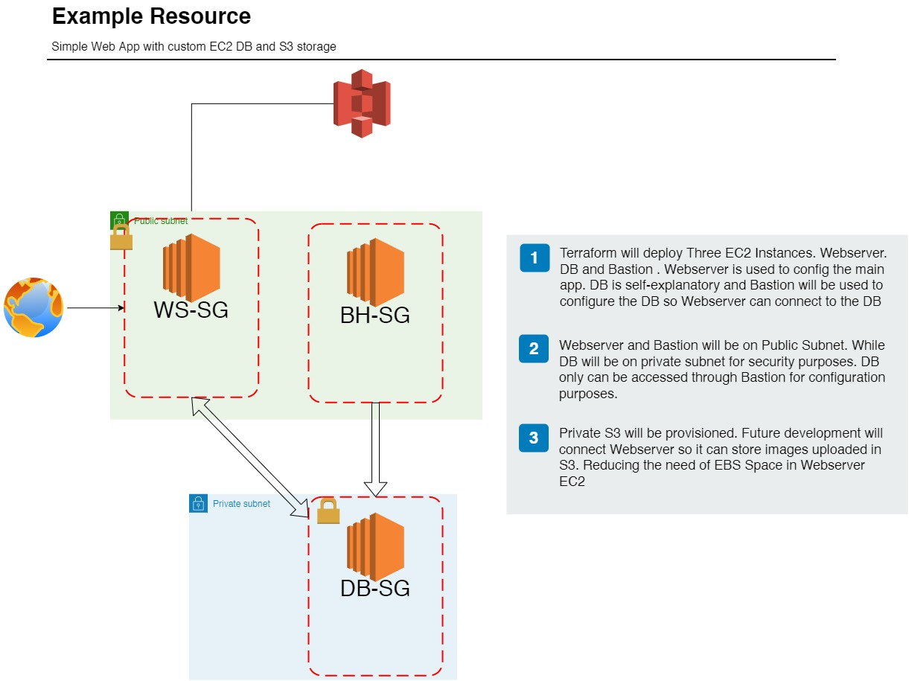
Resource deployment
Deploying three EC2 Instances in Three different Security Groups and two different subnets.
Managing DB EC2 can be only accessed through Bastion. The rest is only accessed for MySQL from Webserver
Later, S3 deployed and shall be connected to Webserver so Non-DB data can be stored in S3
Separate IAMs will be configured later to access each resources. We will not using global account/admins to manage them.

Slide 10
Summary
Terraform helps us to provide cloud environment as code.
Deploy AWS EC2, VPC, Security Groups, S3, IAMs, and much more with a single script.
Automates a lot of manual configuration (no more sliding across pages to config something)
Terraform also able to manage multi-cloud settings (eg. AWS & GCP for maximum robustness)
Sidenote: be careful when reconfiguring a resource with Terraform.

Slide 11


