Slide 1


Slide 2

Enhancing Learning Management System (LMS) User Experience

Slide 3
Group Members Introduction
Member 1: Nouman Ali (BC220424776)

Slide 4

INTRODUCTION OF PROJECT
This project aims to revolutionize the user experience (UX) of our Learning Management System (LMS) through the application of HCI principles.
By focusing on redesigning the interface and incorporating user-centric design strategies.

Slide 5
By this project we aim to gain a deep understanding of HCI principle relevant to LMS design and the specific needs of our diverse user base, including students, instructors, and administrators.

Slide 6
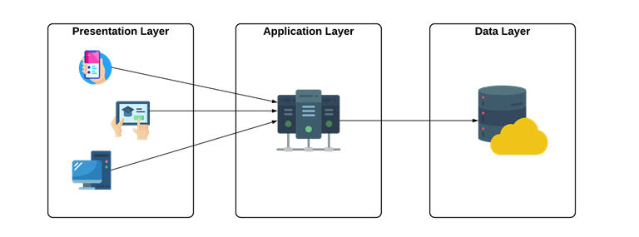
Process Model.

Slide 7
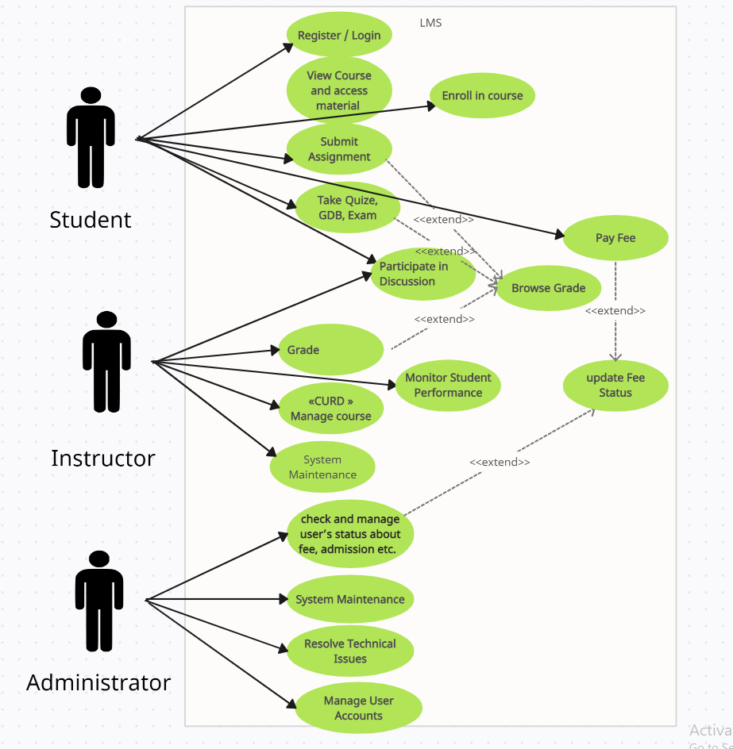
Use Case Diagram

Slide 8
Business Rules Catalog
1. User Authentication: users must be authenticated before accessing any functionality with in the LMS.
2. User Roles and Permissions: difference between student and admin roles with distinct permissions.

Slide 9
Business Rules Catalog
3. Course Management: Instructor should be able to create, edit and manage course.
4. Communication Features: Provide tools for instructors to communicate with students through announcements.

Slide 10
Business Rules Catalog
5. Security and Privacy: secure login mechanism and role base access control to ensure data privacy and prevent unauthorized access.
6. Support system: provide a support system for users to report issues, ask question, offer documentation and FAQs.

Slide 11
Architectural Design
Provide Architecture Diagram Here

Slide 12
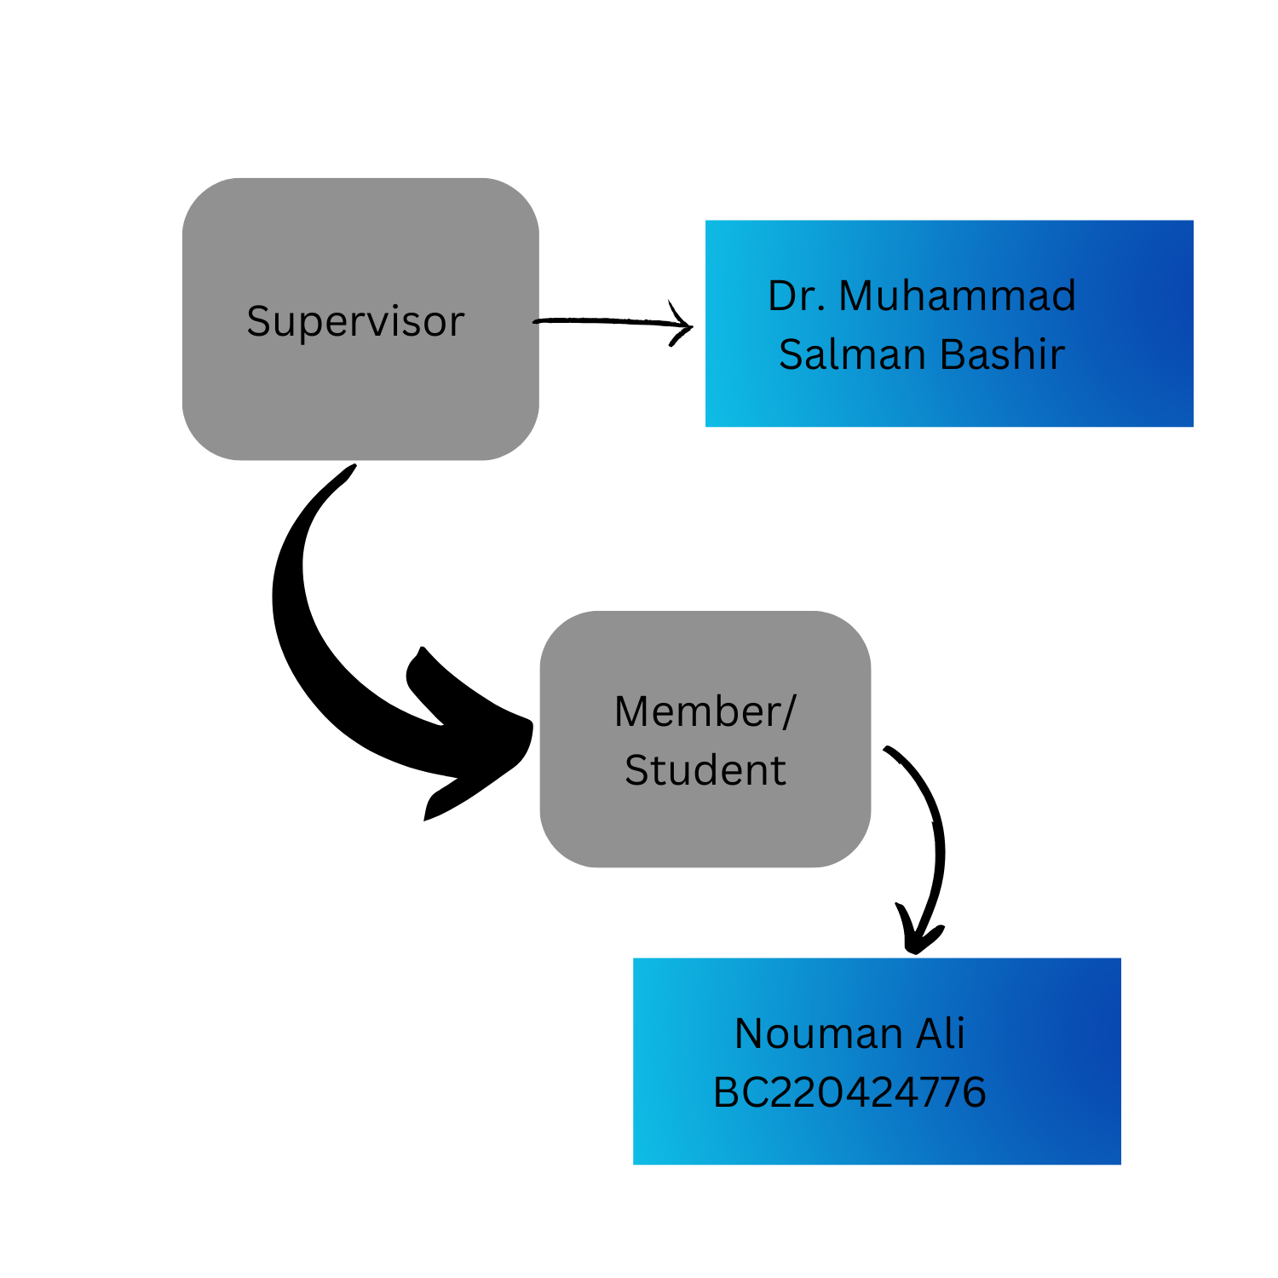
Team Structure

Slide 13
Project Schedule
1. Understanding Requirements:
Duration: 1 week
Tasks: Analyze project requirements and clarify scope.
project here.
2. Design and planning phase:
Duration: 2 weeks
Tasks: create SRS document, design database schema, plan system architecture.

Slide 14
3. User Interface Design:
Duration: 1 week
Tasks: Design wireframes and mock-ups using Figma.
4. FrontEnd Development:
Duration: 1 week
Tasks: Develop frontend using core HTML, CSS and JavaScript and ensure compatibility on different browsers.

Slide 15
5. Backend Development:
Duration: 1 week
Task: Develop backend functionalities using PHP, integrate with frontend, ensure data integrity and security.
6. QA, Testing and Debugging:
Duration: 2 weeks
Tasks: test project on different browsers, ensure security and privacy of users and fix bugs and issues (R_and_D).

Slide 16
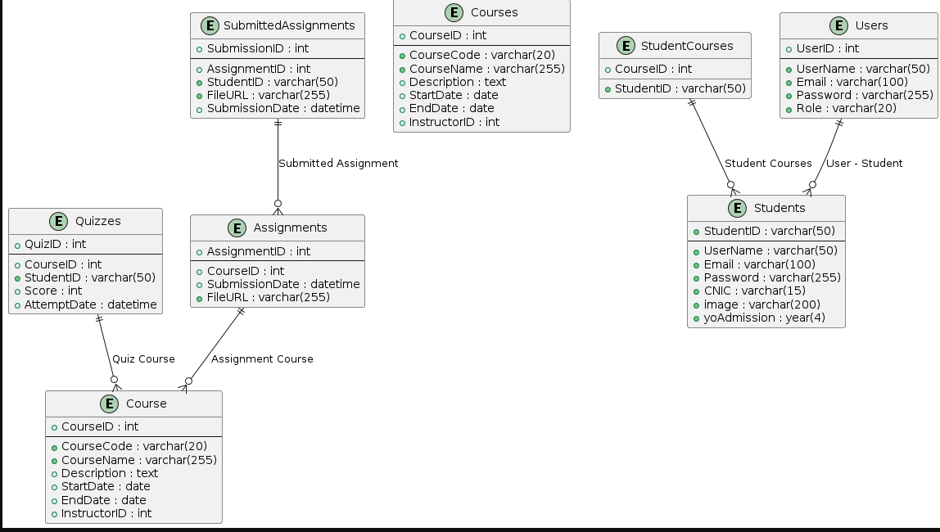
Sequence Diagrams

Slide 17
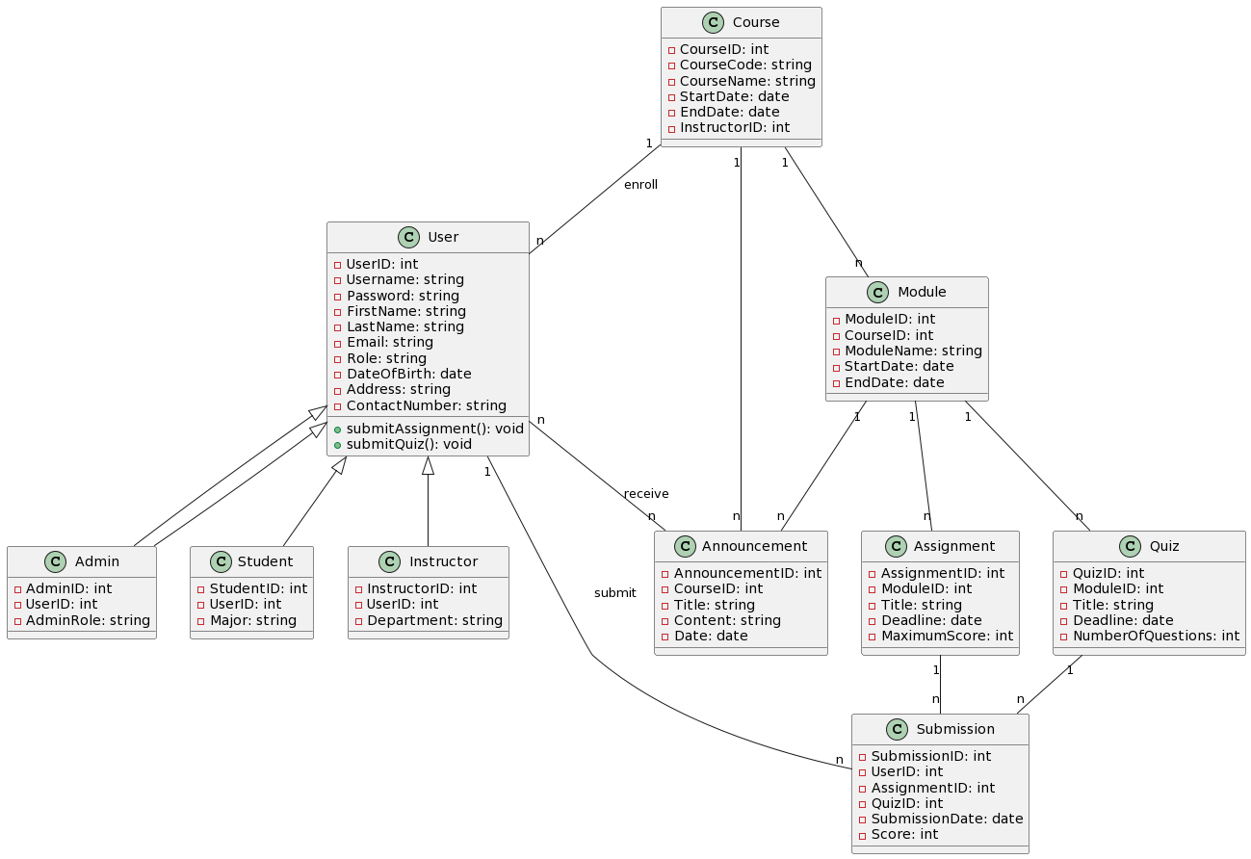
Logical Model/Class Diagram

Slide 18
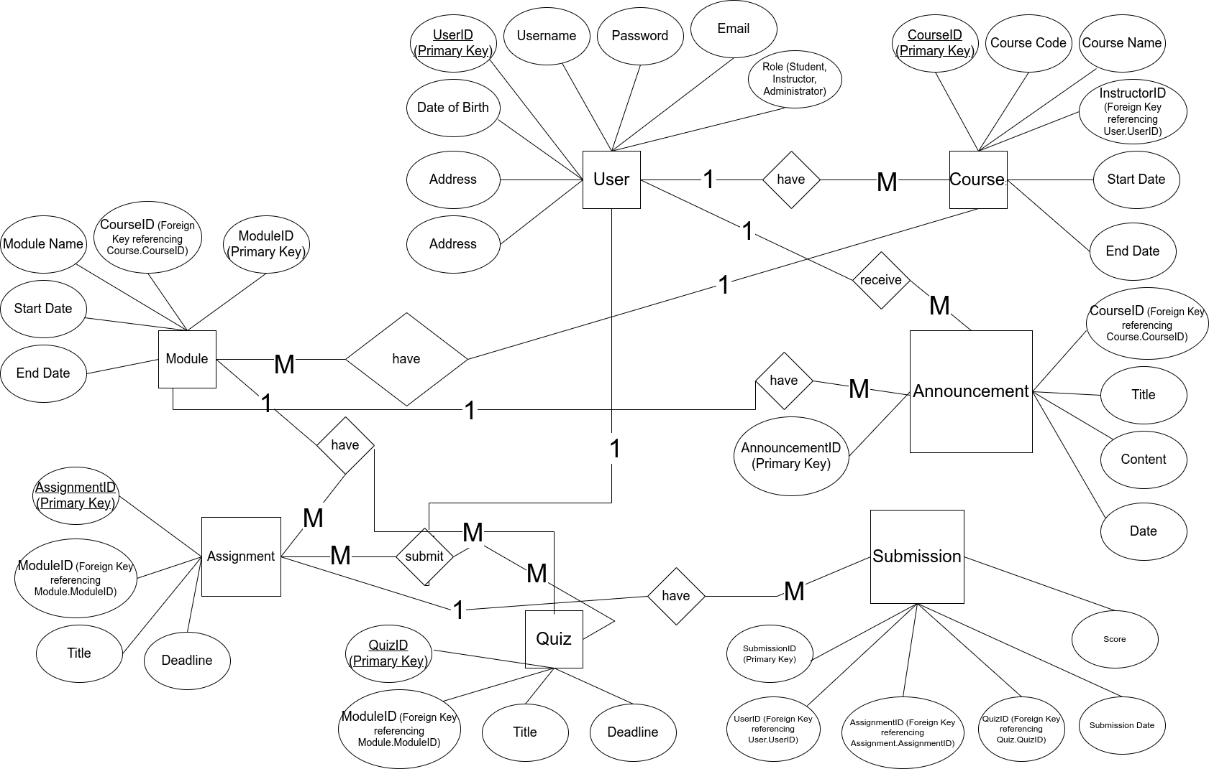
Entity-Relationship Diagram

Slide 19
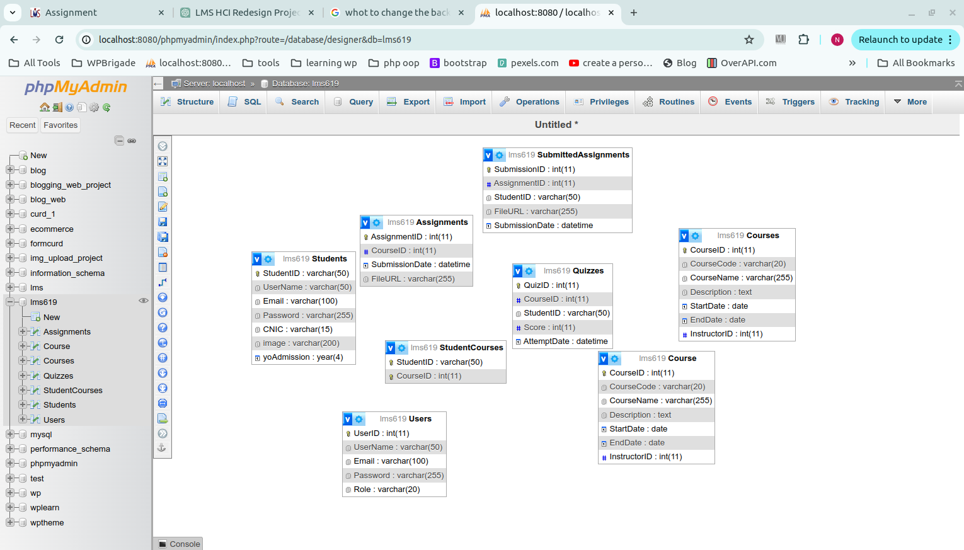
Database Diagram

Slide 20
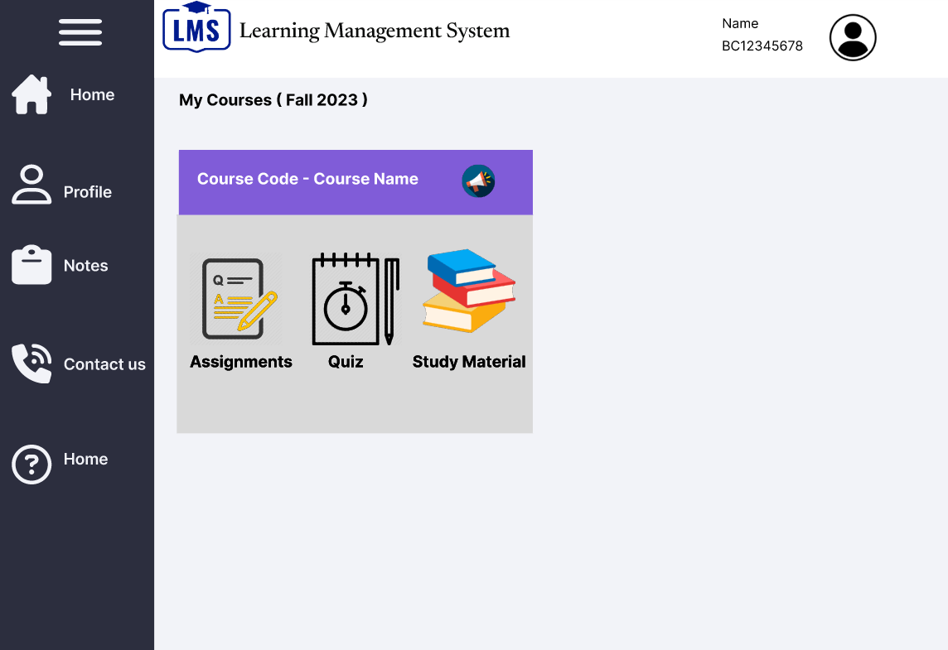
User Interfaces

Slide 21
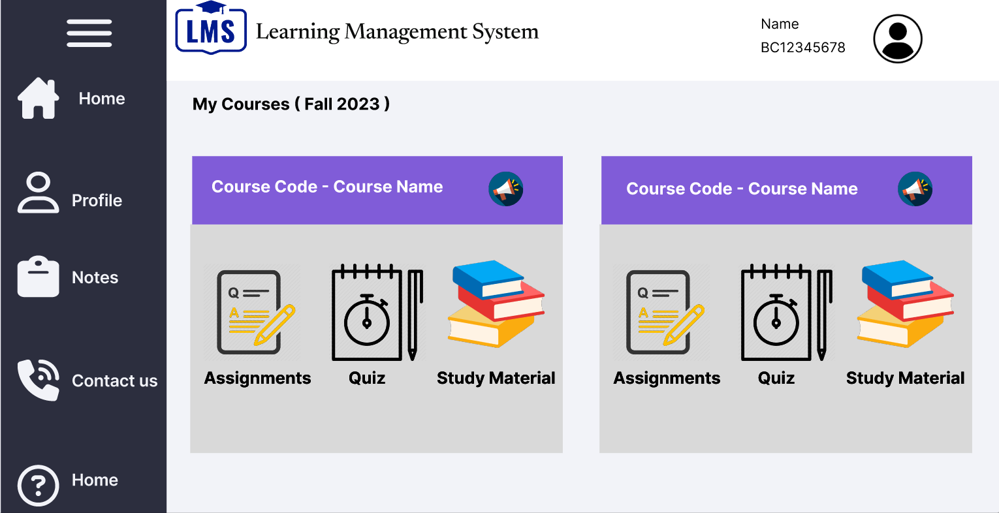
User Interfaces

Slide 22
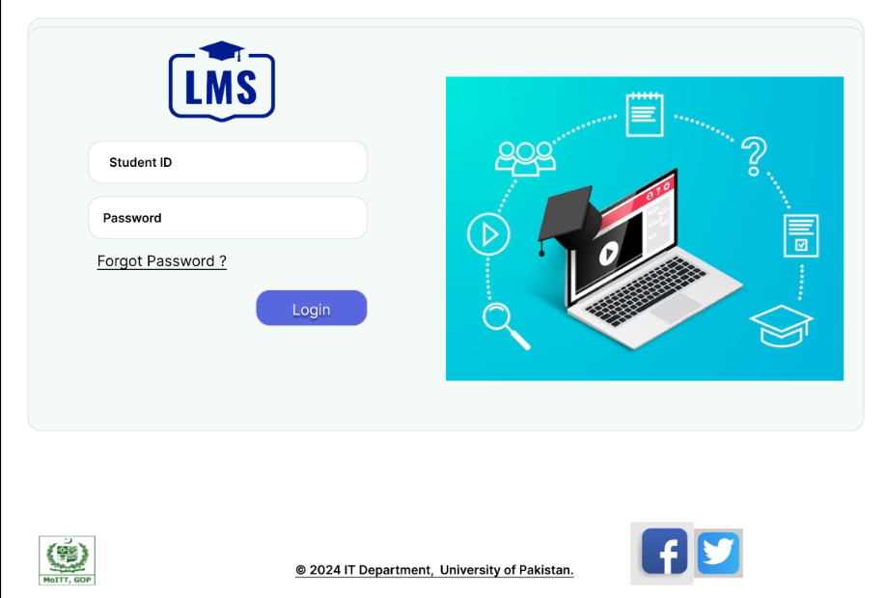
User Interfaces

Slide 23
Tools
Languages: HTML CSS JavaScript PHP | Technologies: Figma (for design) Libreoffice datatables.net

