Slide 1
LAZY PRESERVATION: RECONSTRUCTING WEBSITES FROM THE WEB INFRASTRUCTURE
Frank McCown, Ph.D. 2007
Advisor: Michael L. Nelson
CS 791/ 891 Web Archiving Seminar
Presented By: Mohammed Nauman Siddique
Date: 11/29/2017

Slide 2
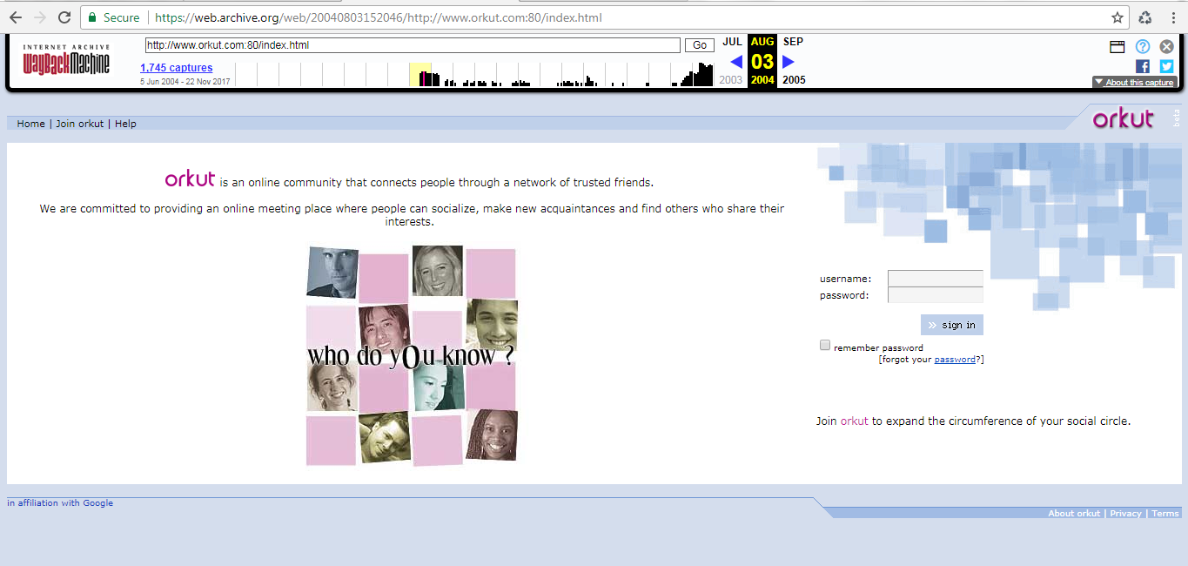
Orkut- Popular social networking site from 2004

Slide 3
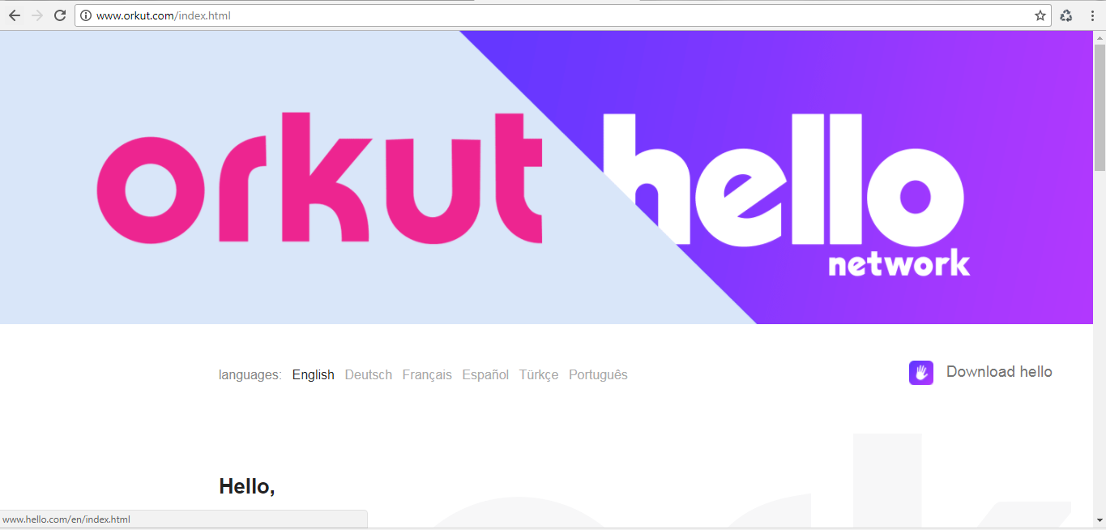
Orkut in 2017

Slide 4
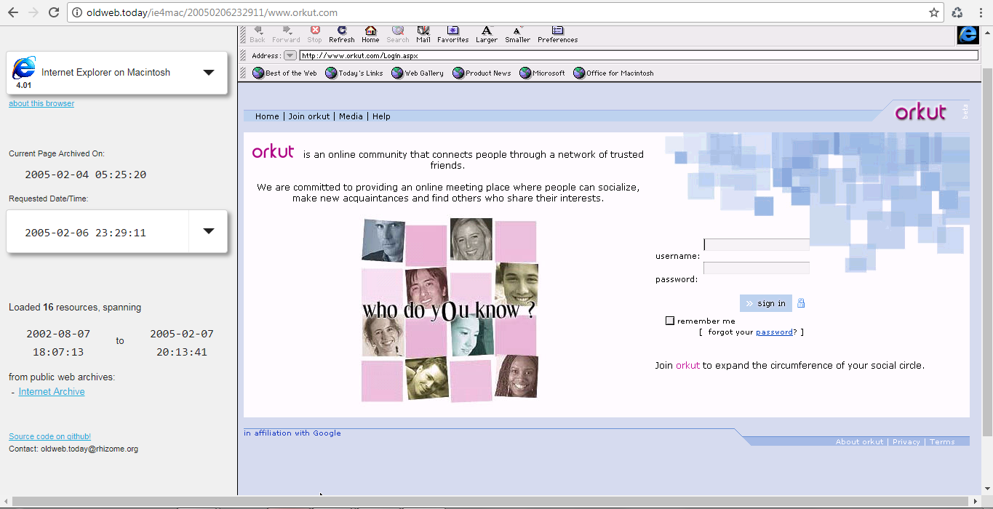
Orkut 2004 version from oldweb.today
Taken from: oldweb.today

Slide 5
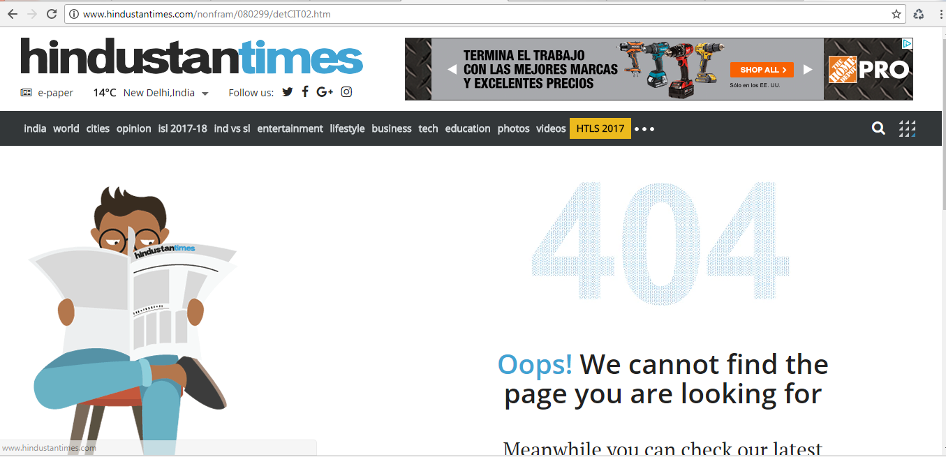
Link Rot or Web Decay
Web pages that are here today may not be here tomorrow, or at least not at the same location.
Taken from: www.hindustantimes.com

Slide 6
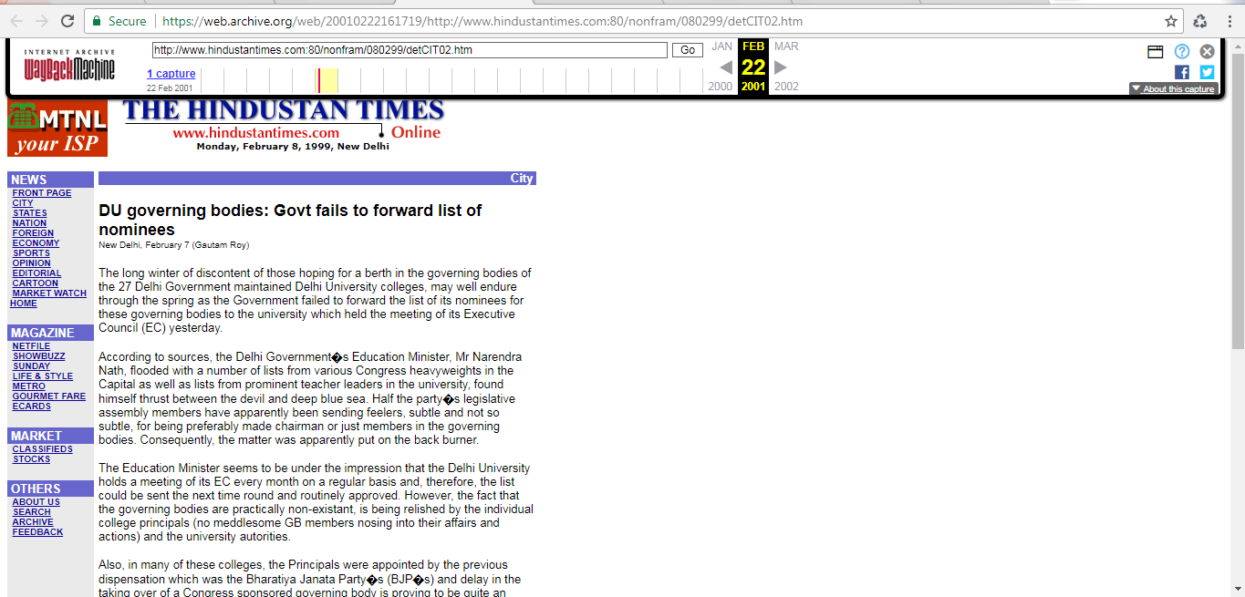
Archival Copy of the news from 2009
Taken from: https://archive.org/

Slide 7
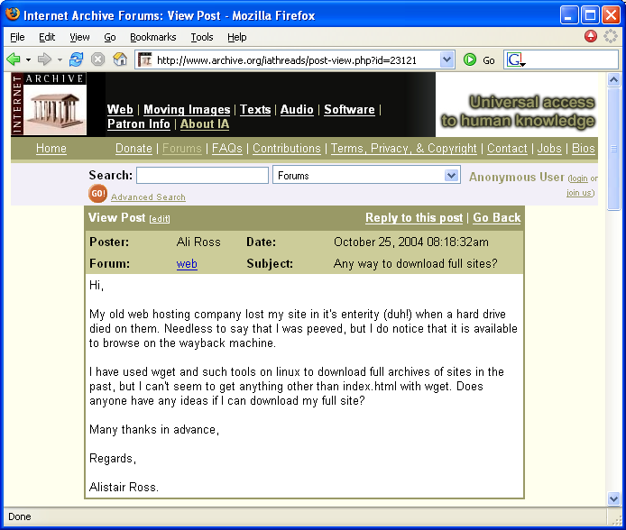
Archives and wget not the complete solution

Slide 8
Lazy Preservation using Web Infrastructure(WI)
Organizations and individuals are sometimes unwilling to incur personal cost to ensure long-term access to their websites.
Lazy Preservation utilizes the WI as a passive preservation service to reconstruct the lost websites.

Slide 9
Scenarios where Lazy Preservation mechanism is effective
When the website owner has not backed-up their website.
When the backup of a lost website is not accessible, was not performed properly or is incomplete.
When a third party with no access to a backup wishes to recover a lost website.

Slide 10






Web Infrastructure
Commercial web search engines
Personal web archives
Web archives operated by non-profit companies
Research projects

Slide 11
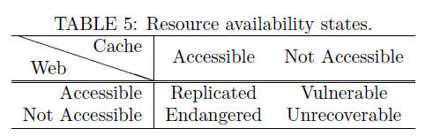
Resource Availability States

Slide 12
Web Caching Experiment
4 synthetic web collection made
Each collection had same number of PDFs, HTML and image resources
Deployed on 4 different websites
Queries were made to the search engines to see if the collections were accessible from the cache

Slide 13
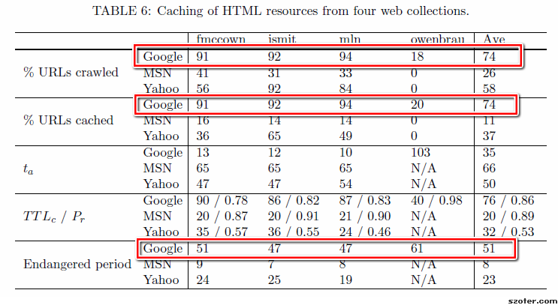
Google winner in caching web resources

Slide 14
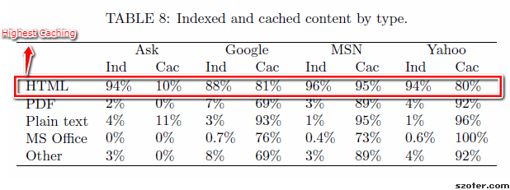
Distribution of cached web resources in each search engine

Slide 15
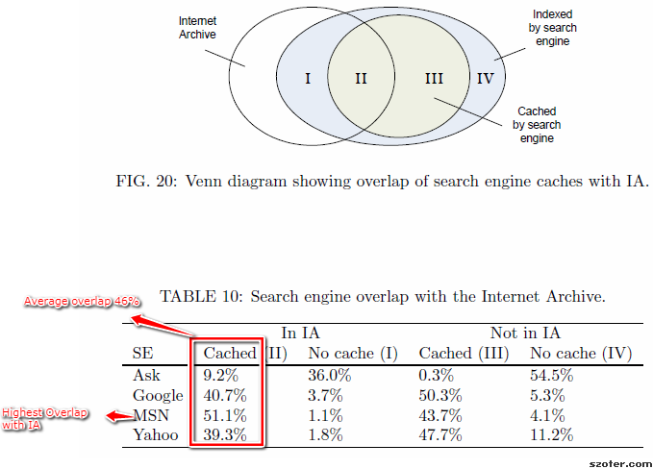
Overlap of Search Engines with IA

Slide 16
Web-Repository Crawling

Slide 17
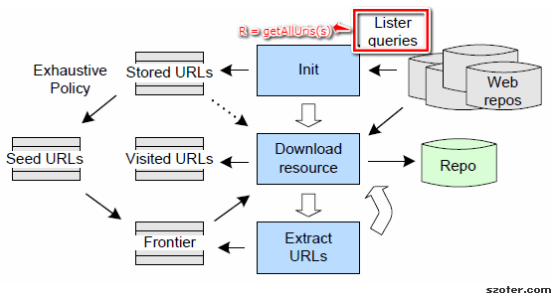
Web Repository Crawlers

Slide 18
Warrick – a web repository crawler
Tool for web reconstruction
Written in Perl
Uses Internet Archive, Google, Yahoo and MSN web repository
Search engine APIs and page scraping was used to recover resources
Accessed via command line

Slide 19
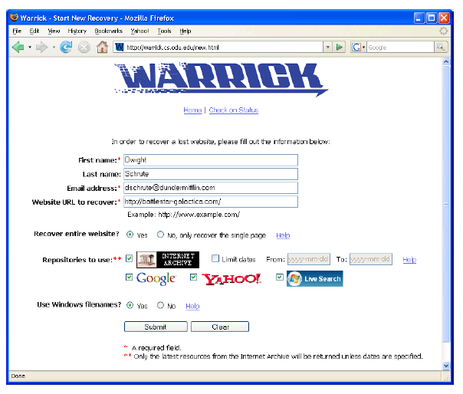
Brass (A queuing system)

Slide 20
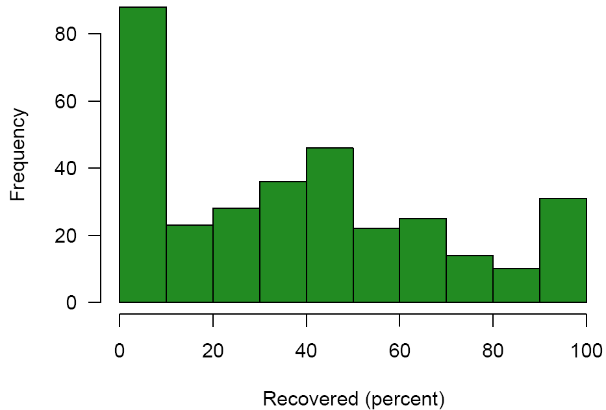
Discovery of resources using Warrick
Average 38.2%

Slide 21
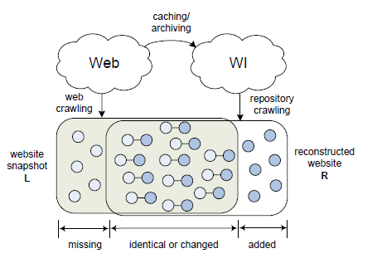
Measuring Reconstruction Effectiveness

Slide 22
Experiment to evaluate contribution of Web Repositories
24 live websites selected from DMOZ
8 small (<150 URIs), 8 medium (150-499 URIs) and 8 large (>500 URIs)
5 different versions of reconstructed websites created
4 from each web repo individually and 1 by combining resources from all the repos

Slide 23
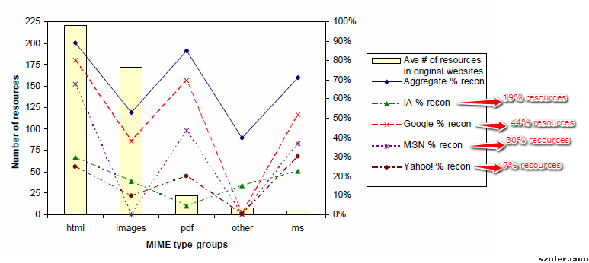
Contribution of each Web Repository in reconstruction of websites
Google:
All the four web repositories must be used in reconstruction.
HTML resources are most recoverable
Website reconstruction can be very useful for some and futile for others.

Slide 24
Warrick Crawling Policies
Naïve Policy
Knowledge Policy
Exhaustive Policies

Slide 25
Experiment to understand crawling policies
Same set of 24 URLs used from previous experiment
Upon downloading websites, three concurrent reconstructions were started using each crawl policy.

Slide 26
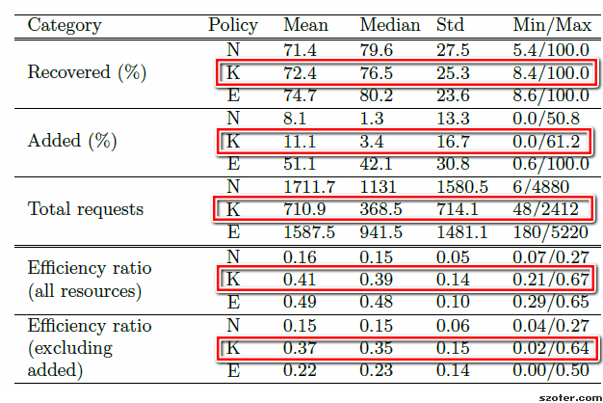
Knowledgeable Policy is the optimal crawling policy

Slide 27
Experiment for Evaluating Reconstruction Effectiveness
300 randomly selected URLs from DMOZ
Websites in 40 languages unlike previous experiments using English language experiments
Unlike previous experiments Heretrix was used instead of Wget

Slide 28
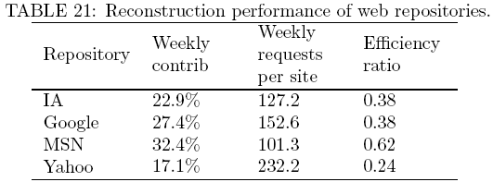
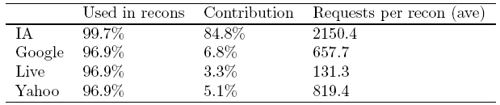
Web Repository Contributions
Experimental results
Real usage data

Slide 29
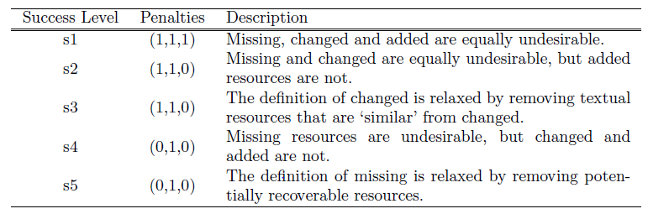
Penalty policy for false positives and true negatives

Slide 30
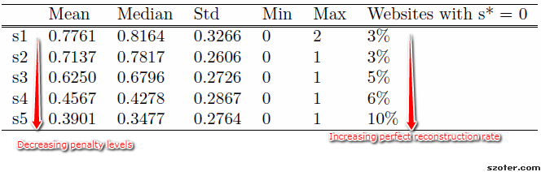
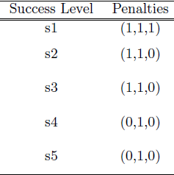
Reconstruction success levels

Slide 31
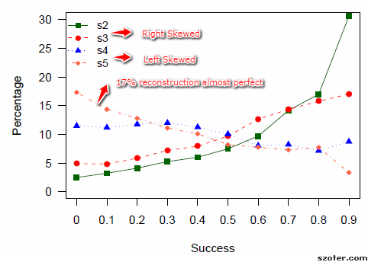
Distribution of Success

Slide 32
Factors affecting website reconstruction
External backlinks
Internal backlinks
Google’s PageRank
Hops from root page
Path depth
MIME type
Query string params
Age
Resource birth rate
TLD
Website size
Size of resources

Slide 33
Tips of Getting your website recovered
Improve Page Rank
Decrease the number of hops a crawler must take to find the website’s resources
Create stable URLs for all the resources

Slide 34
Recovering the web server’s components
Static files (html files, PDFs, images, style sheets, Javascript, etc.)
Web Infrastructure
Recoverable
config
Perl script
Dynamic page
Database
Not Recoverable
Web Server
34

Slide 35
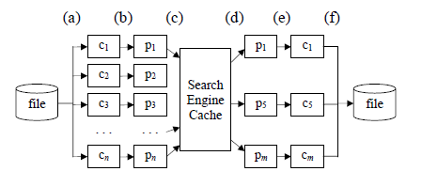
Injecting server components into crawlable pages

Slide 36
Experiment demonstrating server injection techniques
Digital library created using Eprints to populate 100 academic papers in PDF format
Encode Eprints server components (Perl scripts, MySQL database, configuration files) and inject into all HTML pages
Reconstruct each week

Slide 37
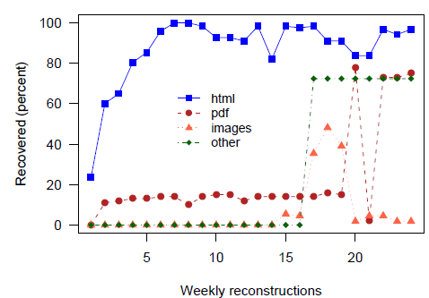
Percentage of recovered DL resources

Slide 38
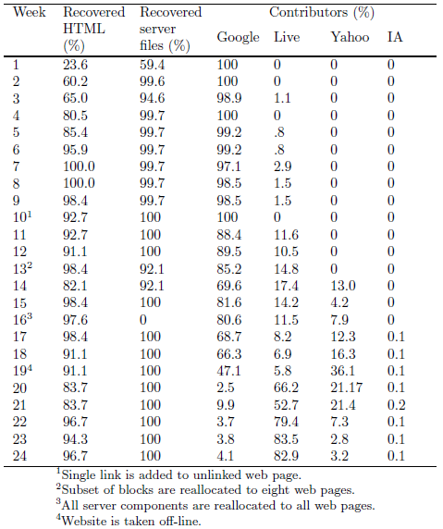
Weekly Evaluation of Recovered Server Files

Slide 39
Contributions of the Dissertation
A novel solution called Lazy Preservation is offered which allows after-the-fact-recovery for little to no work required for the content creator
WI is characterized in terms of behavior to consume and retain new web content, and the type of resources it contains
A new type of crawler is introduced: Web-repository crawler
A statistical model has been developed to measure the characteristics of a reconstructed website

Slide 40
Contributions (Continued)
A novel solution to recovering a webserver’s component is proposed
A website reconstruction service was created which was used by people to reconstruct websites

Slide 41
Future Work
Improvements to Warrick: increase used repositories, discovery of URLs, soft 404s
Determining or predicting loss- save websites if detecting they are about to or already have disappeared
Investigate other sources of lazy preservation: browser caches
More extensive overlap studies of WI

Slide 42
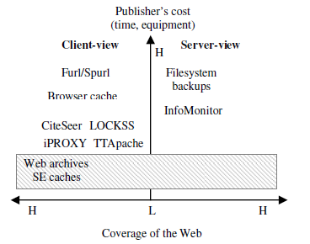
Publisher's cost and Web coverage of preservation systems/mechanisms

Slide 43
Limitations of Current Approach
TTApache and iPROXY: require installation and extra measures to ensure a complete website is preserved
Furl, Hanzo:Web and Archive-It: helpful if action was not taken prior to the loss.
Access to browser caches are generally not made public.
LOCKSS dedicated to preserving content from a small group of sites and do not provide large coverage of the Web.

Slide 44
Crawling the Deep Web
Dynamic content
Unlinked content
Limited-access content
Contextual web
Non-textual content

Slide 45
Solution of Lazy Preservation
Utilizes the WI to provide a passive but broad preservation service for the Web.
Rather than relying on an institutional commitment to preserve small collections of known worth,
lazy preservation makes use of the distributed, uncoordinated nature of the WI to provide large-scale preservation of web resources of unknown importance.

Slide 46
Warrick Algorithm
Uses Web Repo: Google, MSN, Yahoo,IA
Starting URL Supplied
For exhaustive and Knowledge policy : lister query made
Return URL are canonicalized for getResource query
If exhaustive then placed on frontier
Examines URLs: for images IA is first queried
Non-image: Resource is downloaded from all the repository , first Search engines caches are queried
Non- html pages: IA is used first
Most recent version is saved to a filename and path that mirror the URL

Slide 47
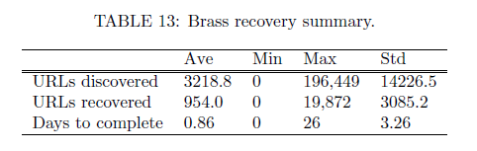
Warrick usage

Slide 48
Lost Website
No longer accessible from its original location and can not be mirrored at any other location.
Unresponsive Server
Missing content
Expired Domain Name
Hijacked

Slide 49
Injection Mechanics
Exposing the raw component
Robot Vaults
Dispersion through Preeixsting Content

