Slide 1
Exploring genome variation using GEMINI framework in R
The Centre for Computational Medicine
The Hospital for Sick Children
Sergey Naumenko
2016-11-30

Slide 2
Variation
Chr20 23432 A C

Slide 3
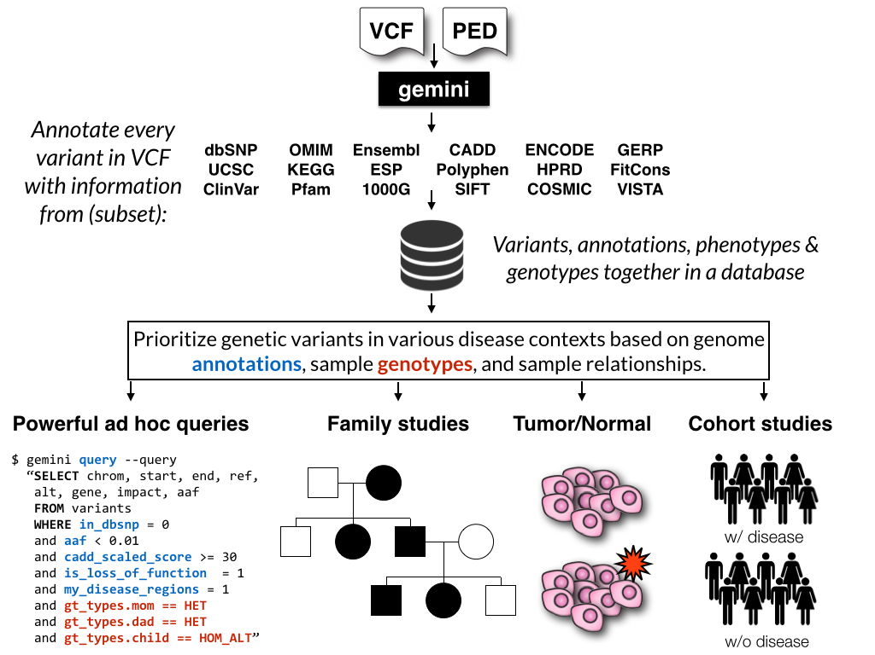
http://gemini.readthedocs.io/en/latest/index.html

Slide 4
Data processing workflow
Samples
Sequencing machine
Reads (fastq)
Variant calling pipeline
Variation (vcf)
Analysis
We are here

Slide 5
Old school
GEMINI-R way
fastq
fastq
vcf
Excel
R
R

Slide 6
GEMINI: a flexible framework for exploring genome variation
http://gemini.readthedocs.io/en/latest/index.html
https://github.com/arq5x/gemini
Paila U, Chapman BA, Kirchner R, Quinlan AR (2013) GEMINI: Integrative Exploration of Genetic Variation and Genome Annotations. PLoS Comput Biol 9(7): e1003153. doi:10.1371/journal.pcbi.1003153
Bash, SQLite or Python interface.

Slide 7
How GEMINI works
VCF
Ensembl Variant Effect Predictor (VEP) or snpEFF
Annotated VCF
GEMINI database
Python
Linux bash
R

Slide 8
What it database?
Database is a collection of related dataframes (tables);
GEMINI uses SQLite database which does not require database server or database engine;
Variants
Chrom
start
Gemini Database Schema
http://gemini.readthedocs.io/en/latest/content/database_schema.html

