Slide 1


Employee Management System
Nauneet Agarwal

Slide 2
E M S
Employee Management System is an application developed to maintain the details of Employees working in an organization.
The Employee Management System has been developed to override the problems prevailing in the practicing manual system .
It maintains the information of the employees.

Slide 3

Existing System
The Records are maintained in registers.
Time Consuming process.
Complicated searching , editing and updating.

Slide 4

Proposed System
Helps in maintaining the computerized employee details.
Calculate the salary.
Create new Employee/user

Slide 5
Advantages
Provide Computerized system for maintain records.
More efficient and reliable.
Less time consuming and easy to use.
Huge data storage with less

Slide 6
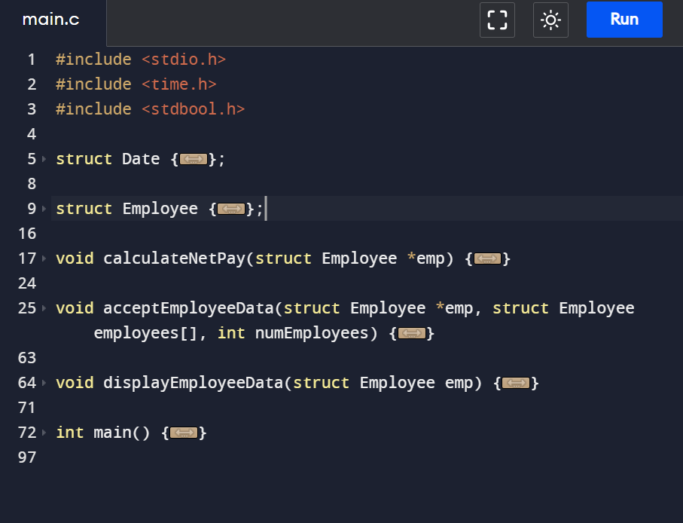
Implementation

Slide 7
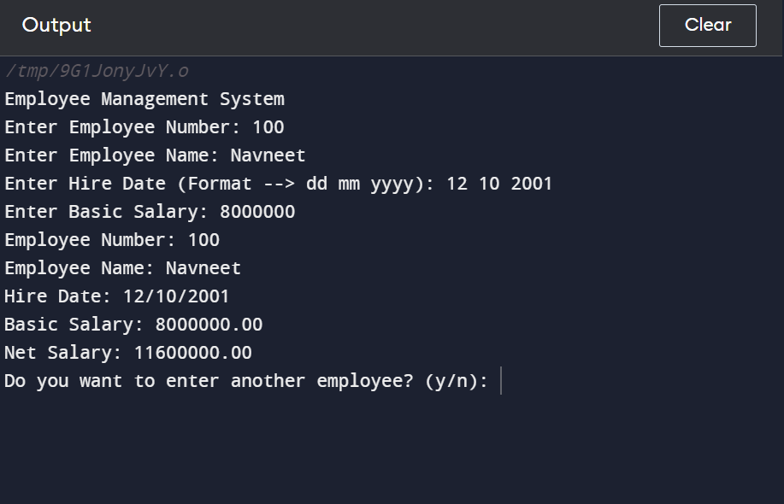
Output

Slide 8
References
https://www.geeksforgeeks.org/
https://www.javatpoint.com/
https://stackoverflow.com/

Slide 9


