Slide 1
Benchmarking Storage Access Patterns – BeeGFS and CephFS
Ayush Garg
Naunidh Singh
Phd Lead : Neeraj Rajesh

Slide 2
Introduction
We aim to implement and assess performance comparisons and evaluate system overheads between two PFSs: CephFS and BeeGFS running on multiple file systems –EXT4, XFS, BTRFS and provide detailed analysis.

Slide 3
Motivation
The performance of a PFS depends heavily on the underlying PFS design and deployment. It is critical to characterize the performance and design trade-offs of PFSs with respect to different Filesystems, and their configurations.
With the latest releases for the File systems, older benchmark results may not be usable.

Slide 4

Ceph
Ceph is a software-defined storage solution designed to address the object, block, and file storage needs of data centres adopting open source as the new norm for high-growth block storage, object stores and data lakes.
Version Used : Nautilus

Slide 5
Ceph : Pros and Cons
Its scalability and integrated redundancy ensure data security and flexibility within the network.
Availability is also guaranteed by the CRUSH algorithm.
Extremely Fault tolerance.
Open Source.
Due to the variety of components provided, a comprehensive network is required.
Set-up is very complex and time consuming.
Transparent : User cannot be entirely sure where the data is physically being stored.

Slide 6
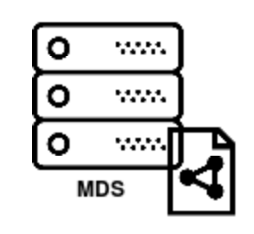



Ceph Cluster
Cluster monitors : maintain the map of the cluster state
Object storage devices : Store data on behalf of Ceph clients.
Managers: that maintain cluster runtime metrics, enable dashboarding
Metadata servers : that store metadata. Mapping filenames and directories of the file system.

Slide 7
System Configuration And Architecture
Admin
OS : Centos 7
Node1 (Admin, Manager):
Cpu Cores: 48, RAM: 128GB
Node2 (Mon1, OSD1):
Cpu Cores: 48, RAM: Storage: HDD
Node3 (Mon2, OSD2)
Cpu Cores: 40, RAM: 64GB Storage: HDD
Node4 (Client1):
Cpu Cores: 48, RAM: 128GB
Node5 (Client2):
Cpu Cores: 96, RAM: 192GB
Mon1
Mon2
OSD1
OSD2
Client1
Client2

Slide 8
Experiment Configuration
Filesystem – Ext4, Xfs, Btrfs (F2fs dropped since using HDD)
Block Size – 1KB, 2KB, 4KB (Btrfs only 4KB)
Transfer Size – 1MB, 16MB, 64KB.
Mode – Sequential and Random

Slide 9
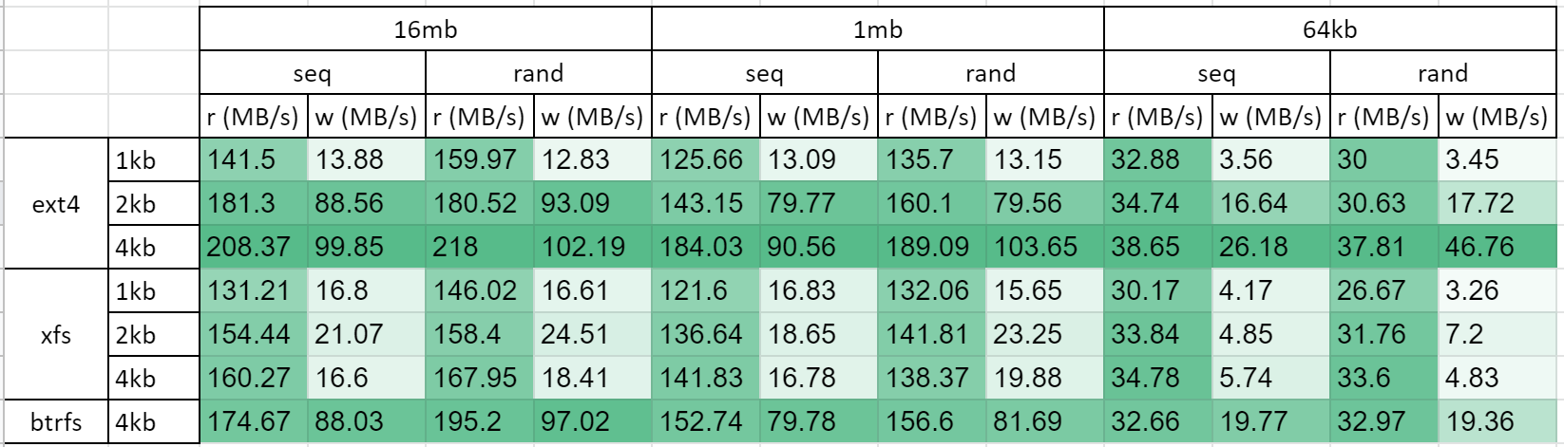
Results

Slide 10
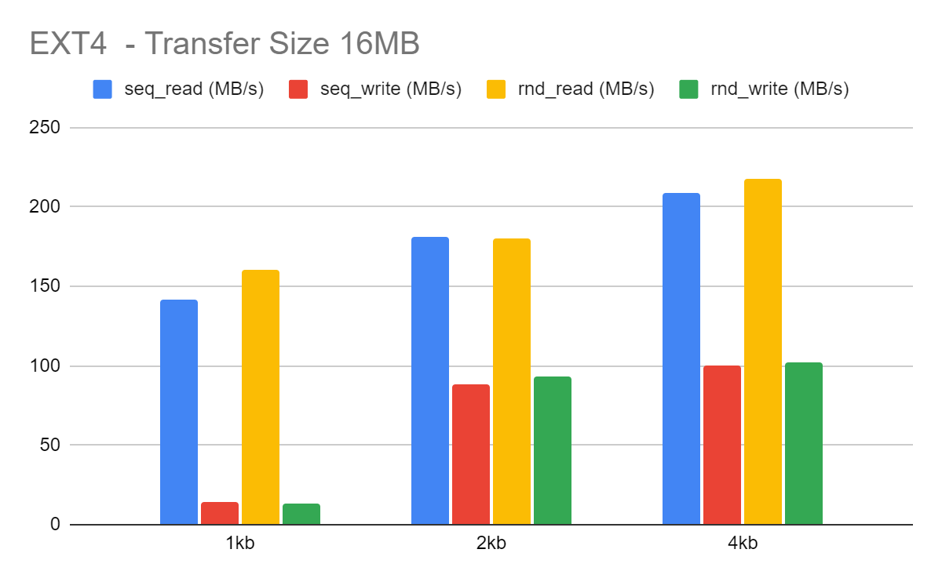
Results – Varying FS block sizes

Slide 11
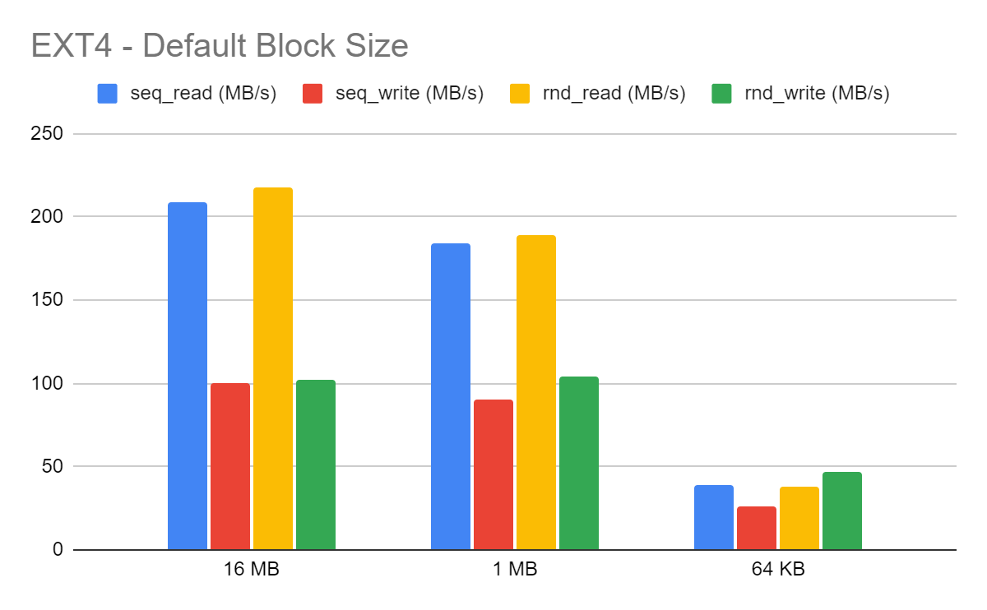
Result – Varying transfer size.

Slide 12
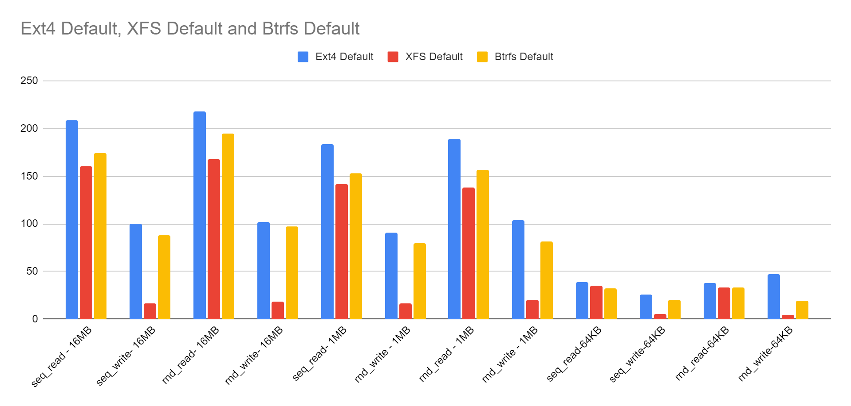

Slide 13
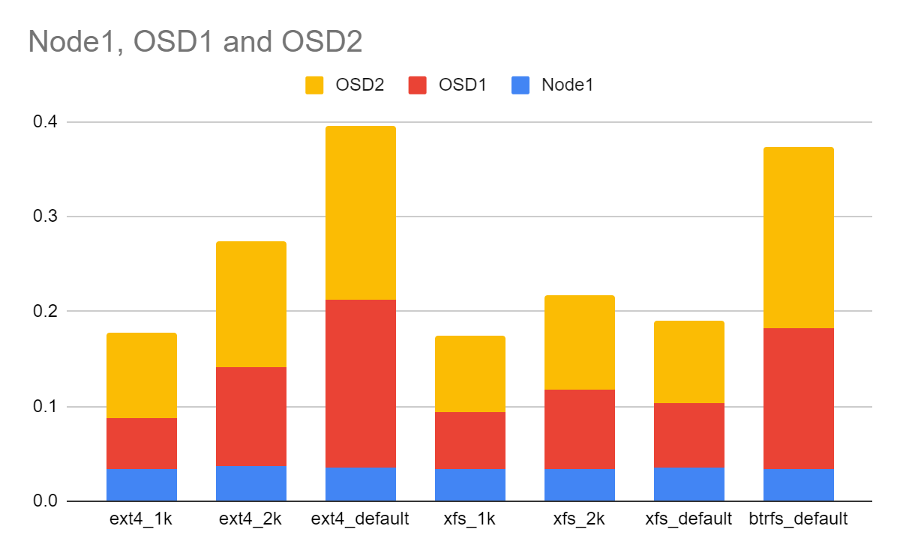
System Utilization -

Slide 14
Network Overhead: Data Received vs Data Written

Slide 15
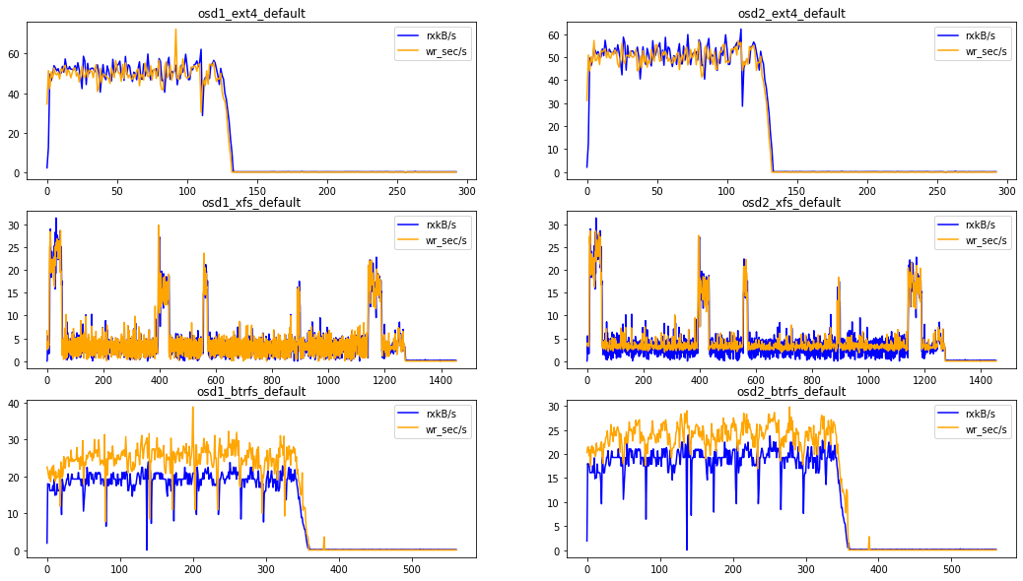

Slide 16
Network Overhead : Data Transferred vs Data Read

Slide 17
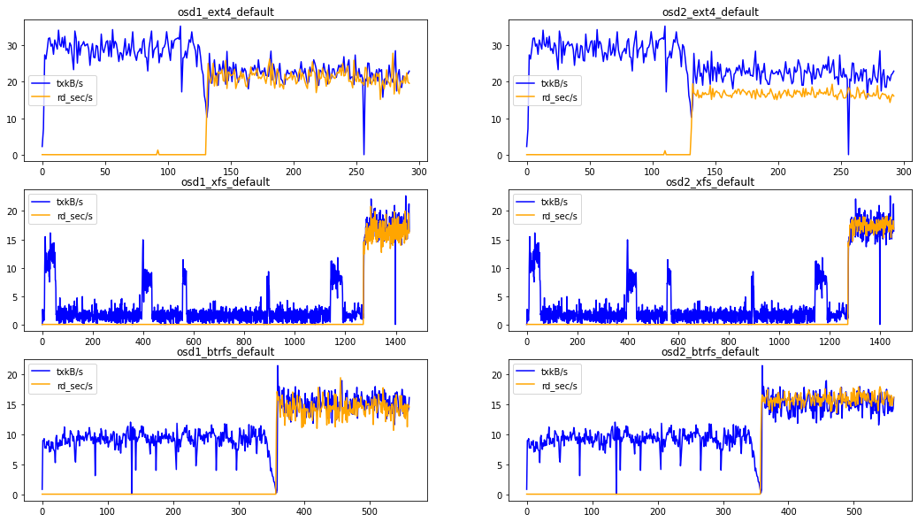

Slide 18
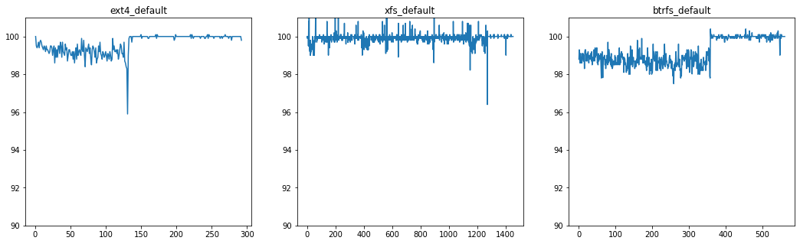
Disk Utilization -
Disk utilization appears to be the bottleneck.

Slide 19
Insights
Ext4 (Default)– Performs most optimum for all the transfer sizes we tested on.
Xfs – Underperforms w.r.t. write speed.
Btrfs – Performance is slightly less than Ext4, with the current set of configurations.
Overheads
Average System utilization < 0.25% even with co-hosting
Disk utilization is 100% for write nearly 100% for read
Network closely follows the data read/written on to the disk, except in Btrfs.

Slide 20

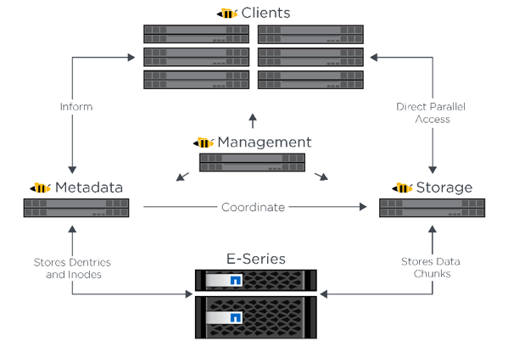
BeeGFS
Distributed File Contents and Metadata
Easy To Use
Any File System
Client and Servers On Any Machine
Notes:
Distributed File Contents and Metadata Easy To Use BeeGFS requires no kernel patches, comes with graphical cluster installation tools Client and Servers On Any Machine Any OS
client and servers can even run on the same machine
Any FS

Slide 21

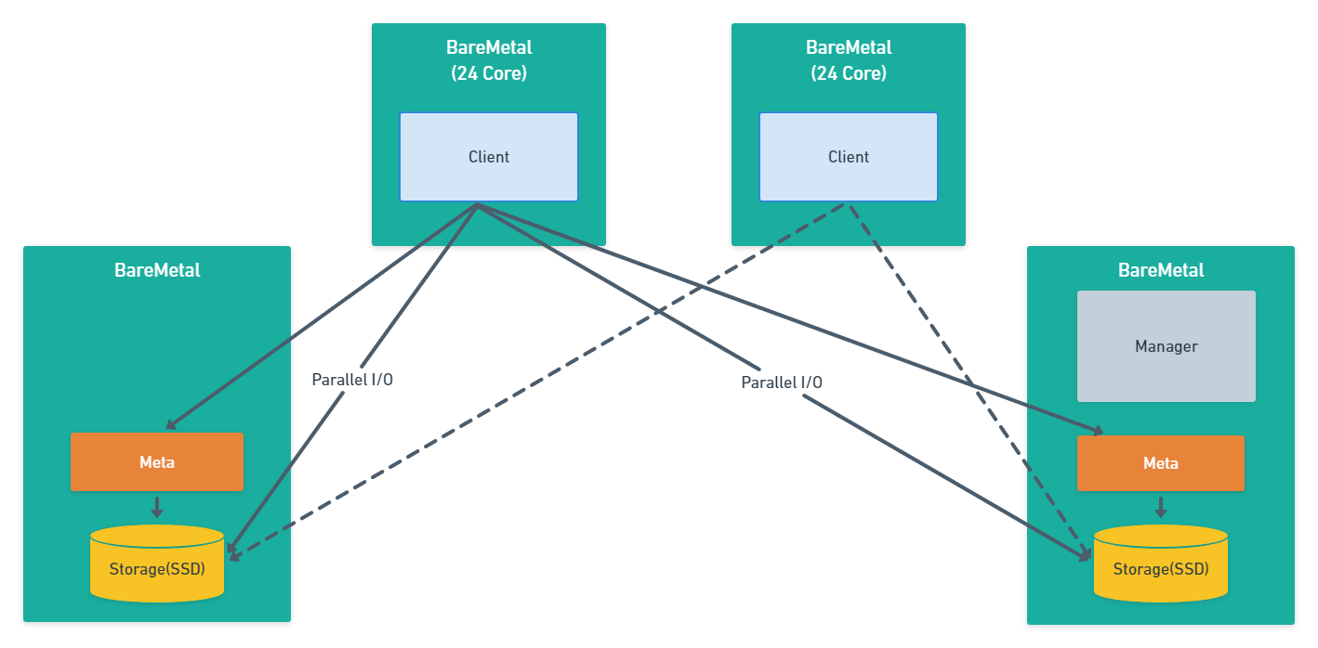
System Setup

Slide 22
Bandwidth results
 |  | 16mb |  |  |  | 1mb |  |  |  | 64kb
 |  | seq |  | rand |  | seq |  | rand |  | seq |  | rand
 |  | r (MB/s) | w (MB/s) | r (MB/s) | w (MB/s) | r (MB/s) | w (MB/s) | r (MB/s) | w (MB/s) | r (MB/s) | w (MB/s) | r (MB/s) | w (MB/s)
ext4 | 1kb | 100.76 | 157.14 | 99.43 | 154.75 | 102.82 | 152.35 | 91.38 | 123.77 | 51.26 | 132.59 | 30.37 | 36.08
 | 2kb | 102.87 | 164.35 | 102.71 | 166.31 | 100.4 | 163.08 | 96.84 | 122.67 | 51.35 | 142.78 | 31.12 | 35.84
 | 4kb | 103.61 | 168.81 | 104.63 | 167.55 | 103.09 | 159.41 | 96.24 | 120.13 | 48.43 | 146.96 | 31.62 | 36.27
xfs | 1kb | 101.92 | 141.59 | 97.61 | 140.26 | 98.84 | 141.56 | 93.71 | 138.66 | 47.82 | 132.38 | 27.84 | 95.44
 | 2kb | 100.49 | 160.56 | 99.83 | 150.69 | 100.98 | 149.03 | 95.16 | 152.32 | 43.38 | 142.29 | 31.96 | 106.89
 | 4kb | 97.53 | 159.21 | 96.46 | 148.67 | 98.81 | 162.26 | 94.03 | 171.06 | 42.44 | 148.89 | 31.06 | 129.65
btrfs | 4kb | 96.01 | 170.54 | 97.14 | 178.86 | 95.98 | 177.1 | 95.06 | 184 | 41.64 | 140.54 | 29.67 | 132.72

Slide 23
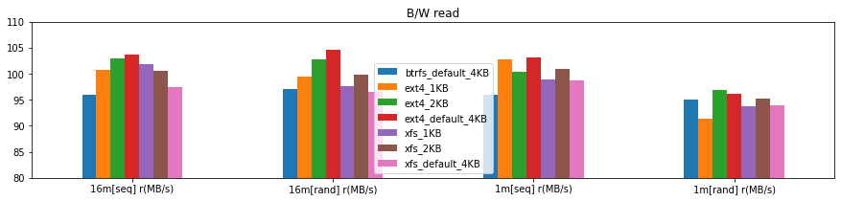
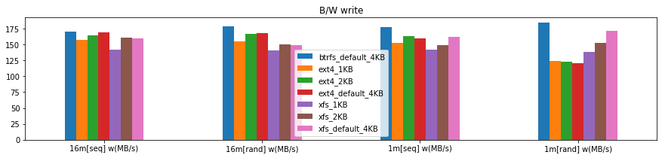
Larger transfer

Slide 24
Larger transfer
 |  | 16mb |  |  |  | 1mb
 |  | seq |  | rand |  | seq |  | rand
 |  | r (MB/s) | w (MB/s) | r (MB/s) | w (MB/s) | r (MB/s) | w (MB/s) | r (MB/s) | w (MB/s)
ext4 | 1kb | 100.76 | 157.14 | 99.43 | 154.75 | 102.82 | 152.35 | 91.38 | 123.77
 | 2kb | 102.87 | 164.35 | 102.71 | 166.31 | 100.4 | 163.08 | 96.84 | 122.67
 | 4kb | 103.61 | 168.81 | 104.63 | 167.55 | 103.09 | 159.41 | 96.24 | 120.13
xfs | 1kb | 101.92 | 141.59 | 97.61 | 140.26 | 98.84 | 141.56 | 93.71 | 138.66
 | 2kb | 100.49 | 160.56 | 99.83 | 150.69 | 100.98 | 149.03 | 95.16 | 152.32
 | 4kb | 97.53 | 159.21 | 96.46 | 148.67 | 98.81 | 162.26 | 94.03 | 171.06
btrfs | 4kb | 96.01 | 170.54 | 97.14 | 178.86 | 95.98 | 177.1 | 95.06 | 184
Read ops
Ext4 with 4kb block size
Write ops
Btrfs with default size

Slide 25
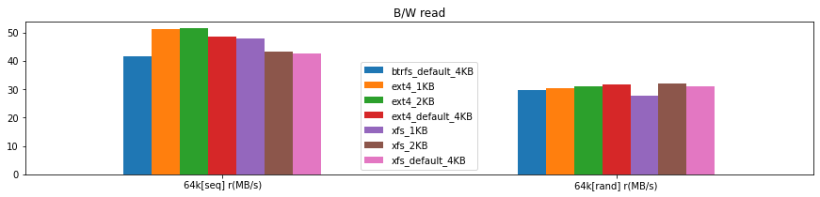
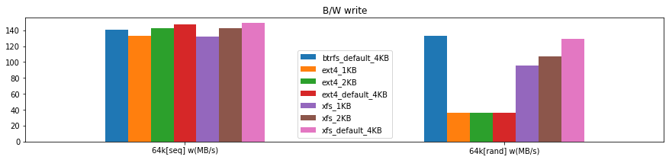
Smaller transfer

Slide 26
Smaller transfer
 |  | 64kb
 |  | seq |  | rand
 |  | r (MB/s) | w (MB/s) | r (MB/s) | w (MB/s)
ext4 | 1kb | 51.26 | 132.59 | 30.37 | 36.08
 | 2kb | 51.35 | 142.78 | 31.12 | 35.84
 | 4kb | 48.43 | 146.96 | 31.62 | 36.27
xfs | 1kb | 47.82 | 132.38 | 27.84 | 95.44
 | 2kb | 43.38 | 142.29 | 31.96 | 106.89
 | 4kb | 42.44 | 148.89 | 31.06 | 129.65
btrfs | 4kb | 41.64 | 140.54 | 29.67 | 132.72
Read ops
Ext4 and xfs perform equally well
Write ops
Xfs with default 4kb block size

Slide 27
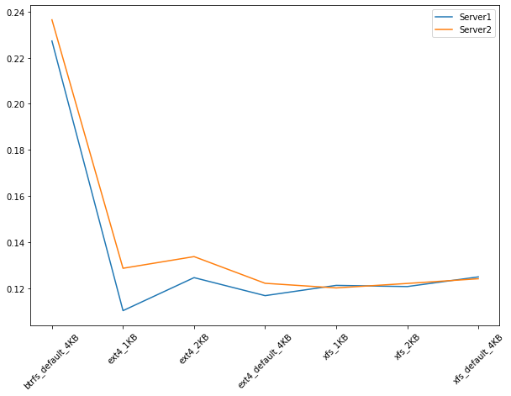
Average System Utilization
System utilization is < 0.25%

Slide 28
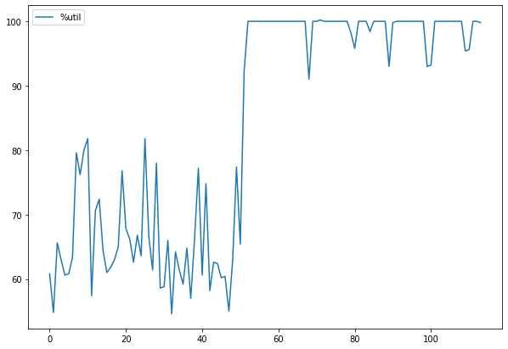
Average Disk Utilization (ext4 1MB)
Saturates while reading

Slide 29
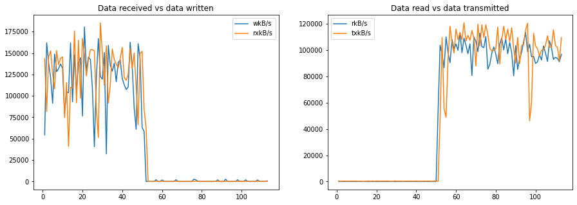
Total Network Overhead (ext4 1MB)

Slide 30
Insights
Workloads
Large Reads: ext4 (4kB block)
Large Writes: btrfs (default block)
Small Reads: ext4 or xfs (default block)
Small Writes: xfs (default block)
Overheads
Average System utilization < 0.25% even with co-hosting
Disk utilization is 100% for read operations
Network closely follows the data read/written on to the disk

Slide 31
Conclusion
Deploy BeeGFS and CephFS on Chameleon Cloud.
Benchmark 3 Filesystems – Ext4, Btrfs, Xfs
Multiple configurations of each filesystem.
Conclude which filesystem may perform most optimum for different workloads.

Slide 32
Future Work
SSD
F2FS
Homogeneous Network.
More no. of nodes.
Different RAID configurations.
Different BeeGFS and Ceph Configurations.

Slide 33
Learnings
Shell Scripting
Partitioning
mounting different file systems
communication over ssh
random data generation
MPI
IOR
Clock Synchronization for cluster (Chrony).
Terminator
Management through Git
Chameleon Cloud

