Slide 1
Fundamential of IS Get Chance UNT
U.Ayan
R. Nauryz
IT1-2016

Slide 2
Table of Contents
01
02
03
04
05
06
The relevance of chosen theme
The purpose of the work
Formalization of the problem
Selection of the model
IS capabilities
Technologies

Slide 3
The relevance of chosen theme.
01
The relevance of our project lies in the problem of choosing a university. In order to help the applicant after receiving the results of the UNT. This topic touches on the problems when an applicant does not know where to enroll and what opportunities open to him. For them, it can be a big step into adulthood, such as moving to a new city for new opportunities.

Slide 4
The purpose of the work
The ideology of "Get Chance UNT" is to create a platform that can help and set guidelines about its future. The main task of the system is to help you see your capabilities and make your choice more clearly.

Slide 5
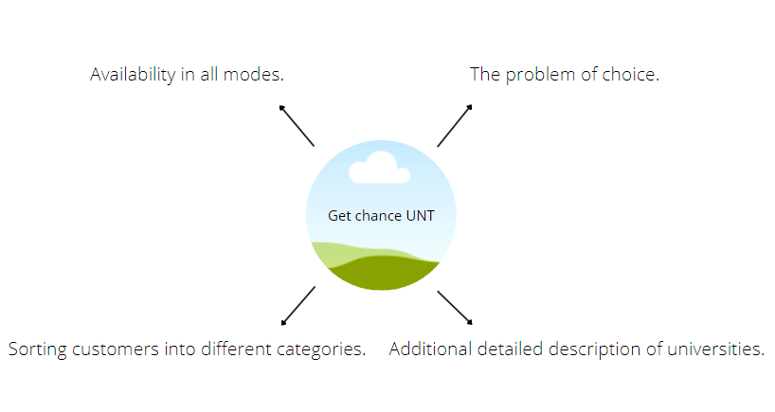
Formalization of the problem
- Problem of choice
Due to the lack of skills, in most cases we are faced with the wrong choice of the right university. To solve this problem, we will create a separate guide page with recommendations for prospective students.
- Sorting customers into different categories.
Our application will have all the available universities that young citizens of the country can enroll in.
- Additional detailed description of universities.
Nowadays it is difficult to find plausible information, and even more so for schoolchildren who are just taking steps into adulthood. On our platform there will be a description of each university and what pros and cons it has. This will help in choosing a future university for admission.

Slide 6
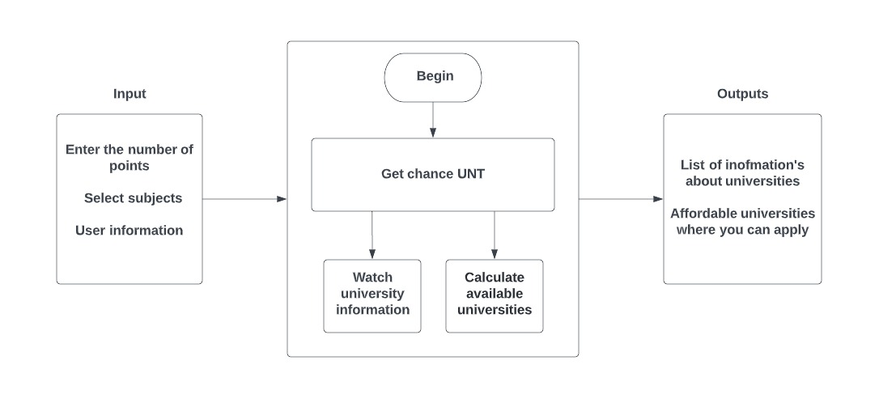
Construction of the general model
Venus has a
beautiful name,
but it’s very hot

Slide 7
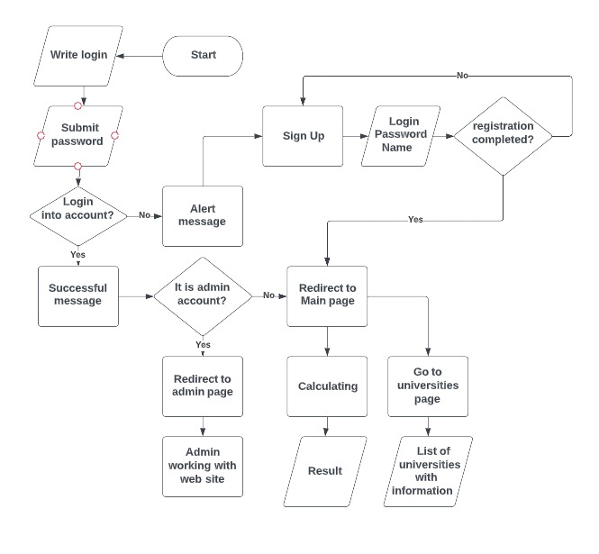
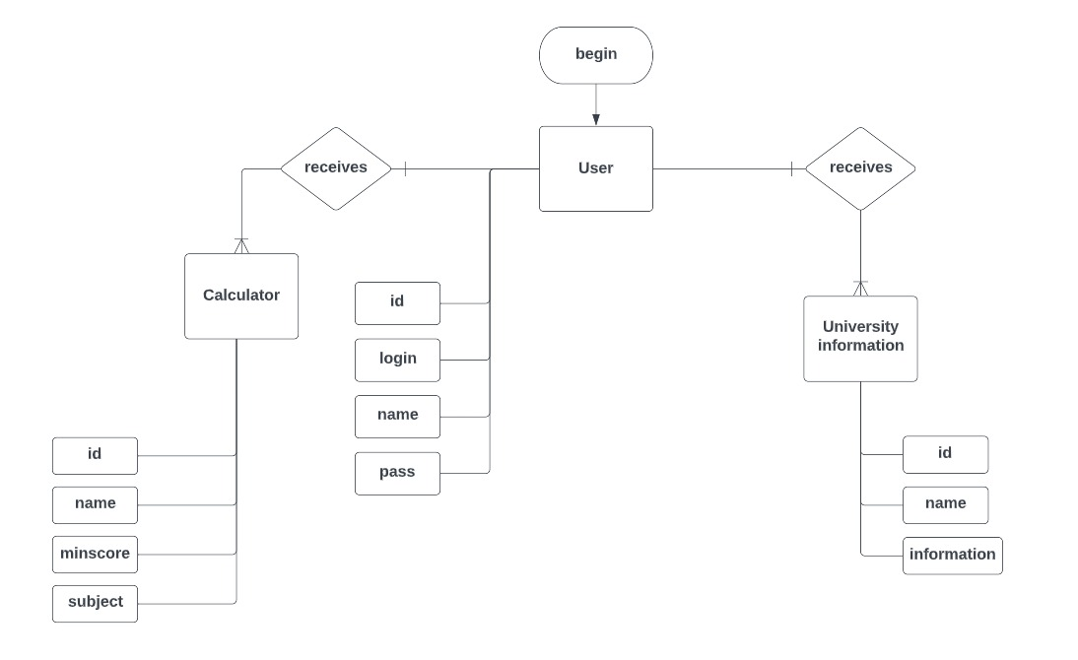
Alghoritm ERD

Slide 8
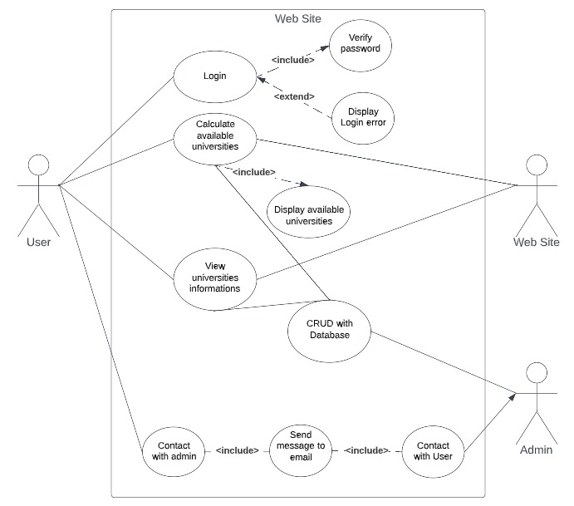
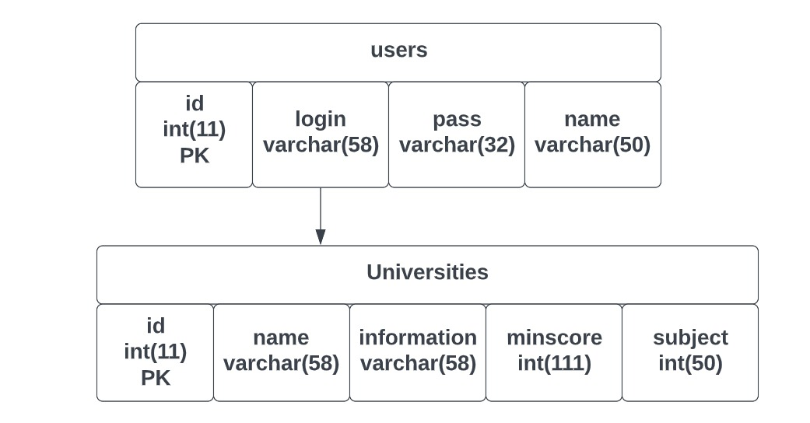
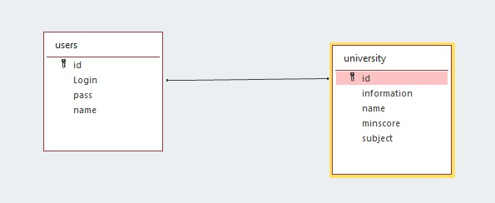
Use Case Diagram Database structure

Slide 9
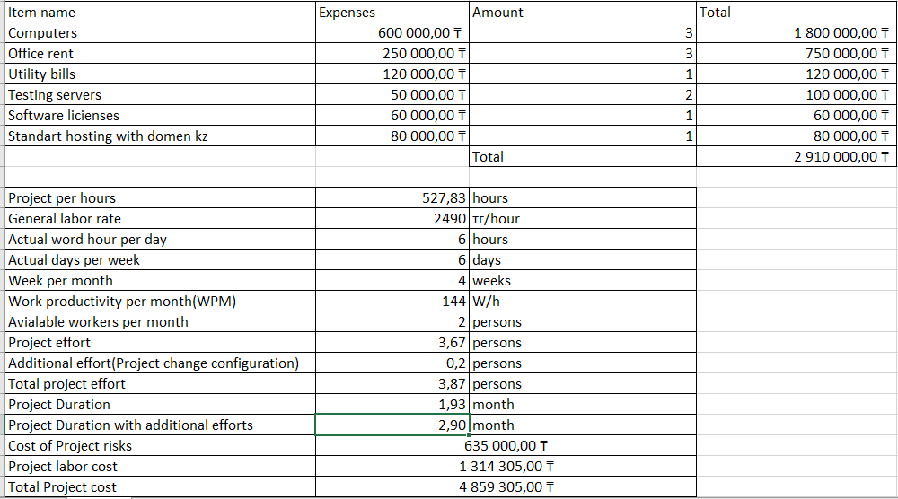
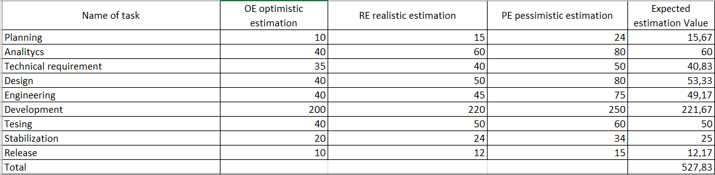
Project cost calculation

Slide 10
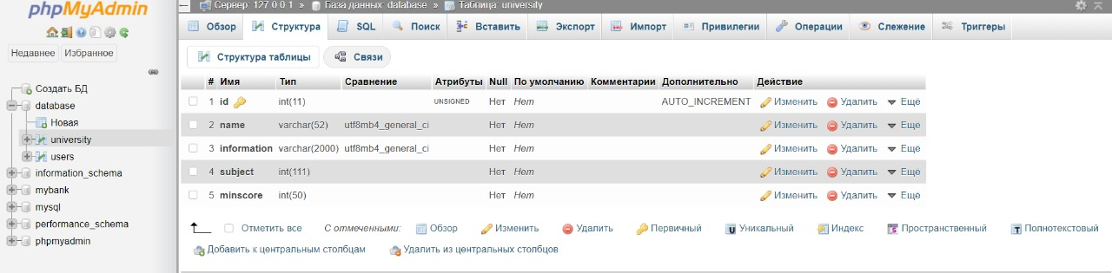
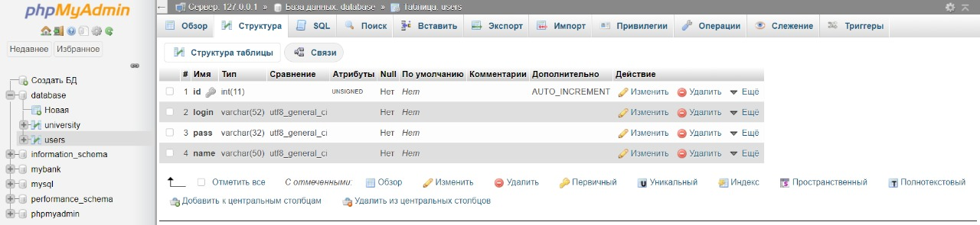
Database

Slide 11
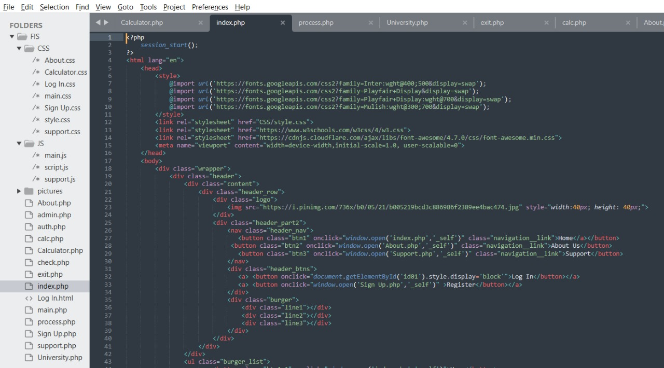
Technologies used
MySQL
HTML/CSS
JS
PHP
XAMPP

Slide 12
THANK YOU FOR YOUR ATTENTION

