Slide 1

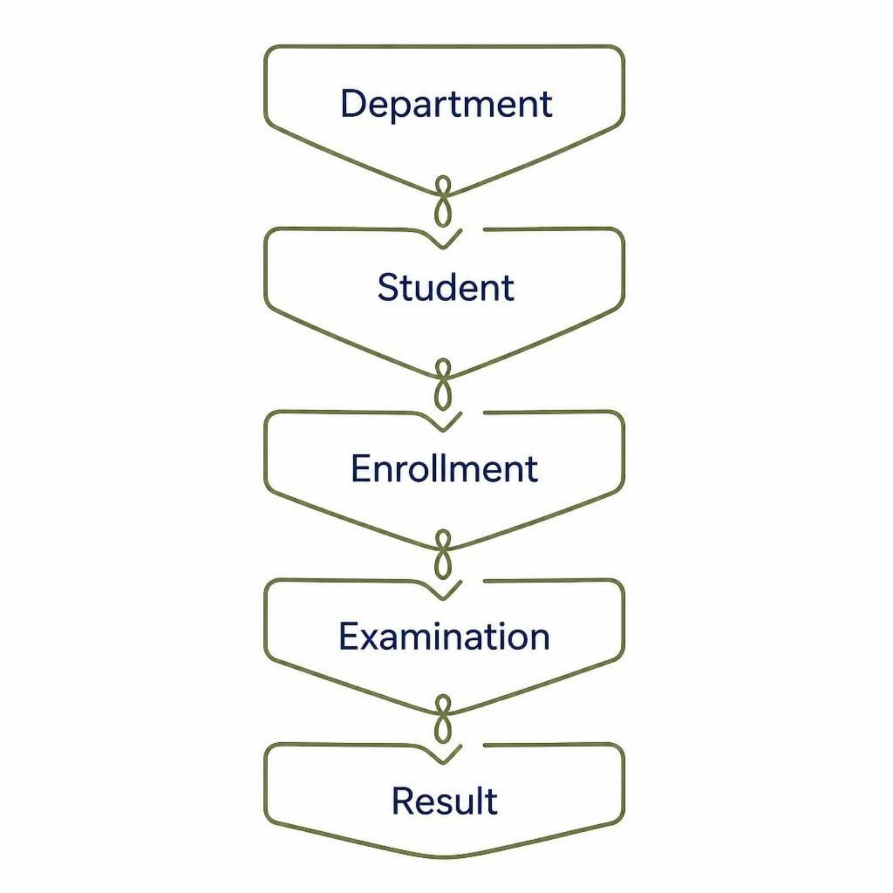

College Management System
Advanced SQL Implementation & Performance Tuning
Domain: Education
Database: MySQL
Design: 3NF Relational Database
Purpose: Manage student academic information
Manages students, courses, faculty, examinations, attendance,
and results.

Slide 2

System Architecture & Tools
Workbench
Database
Open MySQL Workbench
Select target schema
Connect Server
Authenticate to MySQL database
Tables
Browse and query tables
MySQL is used to store and manage all student data.
MySQL
MySQL Workbench
Database server
GUI tool
SQL
GitHub
Query language
Version control

Slide 3
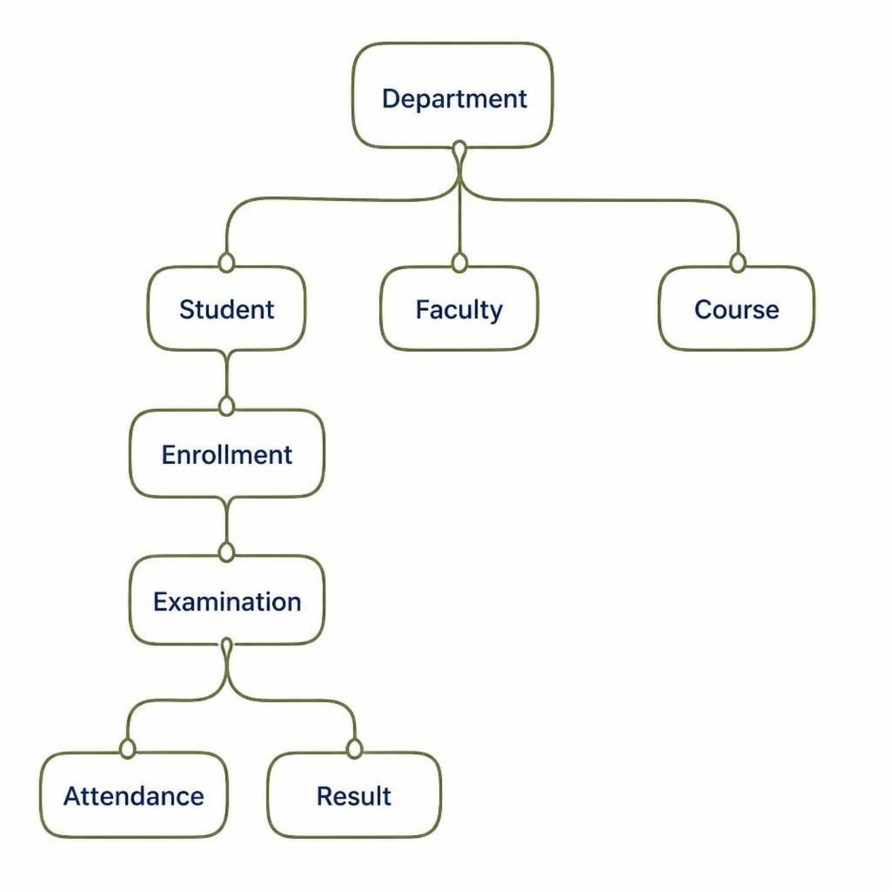
3NF Relational Schema
Key Concepts
Primary Key — Uniquely identifies each record in a table.
Foreign Key — Connects related tables together.
3NF — Third Normal Form reduces data redundancy and improves data integrity.

Slide 4
Advanced SQL Queries
1
INNER JOIN
Combines related data from two tables.
2
LEFT JOIN
Shows all students, even without enrollment.
3
SELF JOIN
Compares faculty within the same department.
4
Correlated Subquery
Compares student marks with course average.
5
GROUP BY
Creates group-wise results.
6
HAVING
Filters grouped results.
Used SQL to generate useful academic reports.

Slide 5
Database Automation
Stored Procedure
Trigger
Views
EnrollStudent()
Marks → Automatic Grade
vw_student_performance
vw_course_performance
Checks if student exists
Checks if course exists
Checks faculty availability
Creates enrollment record
Pass / Fail / Pending
Procedures perform tasks, Triggers perform automatic actions, and Views simplify reporting.

Slide 6
Performance Tuning
Without Index
Indexes Created
EXPLAIN → Full table scan → Slow query
idx_enrollment_faculty_date (FacultyID, EnrolledOn)
idx_examination_type_date (ExamType, ExamDate)
With Index
EXPLAIN Commands
EXPLAIN → Index scan → Fast query
Indexes help MySQL find required data efficiently.
EXPLAIN — Shows the query execution plan
EXPLAIN ANALYZE — Shows actual execution details

Slide 7
Live MySQL Demonstration
Demonstration using MySQL Workbench
01
02
Create / Show Database
Run Complex JOIN Query
03
04
Execute Stored Procedure
Demonstrate Trigger
05
06
Run EXPLAIN
Show Index & EXPLAIN ANALYZE

Slide 8
Key Technical Concepts
3NF
Primary Key
Foreign Key
Reduces data redundancy.
Uniquely identifies a record.
Connects tables together.
ACID
Index
EXPLAIN
Atomicity, Consistency, Isolation, Durability.
Improves query performance.
Shows how MySQL plans a query.
Trigger
Automatically acts when data changes.
Thank You

