Slide 1
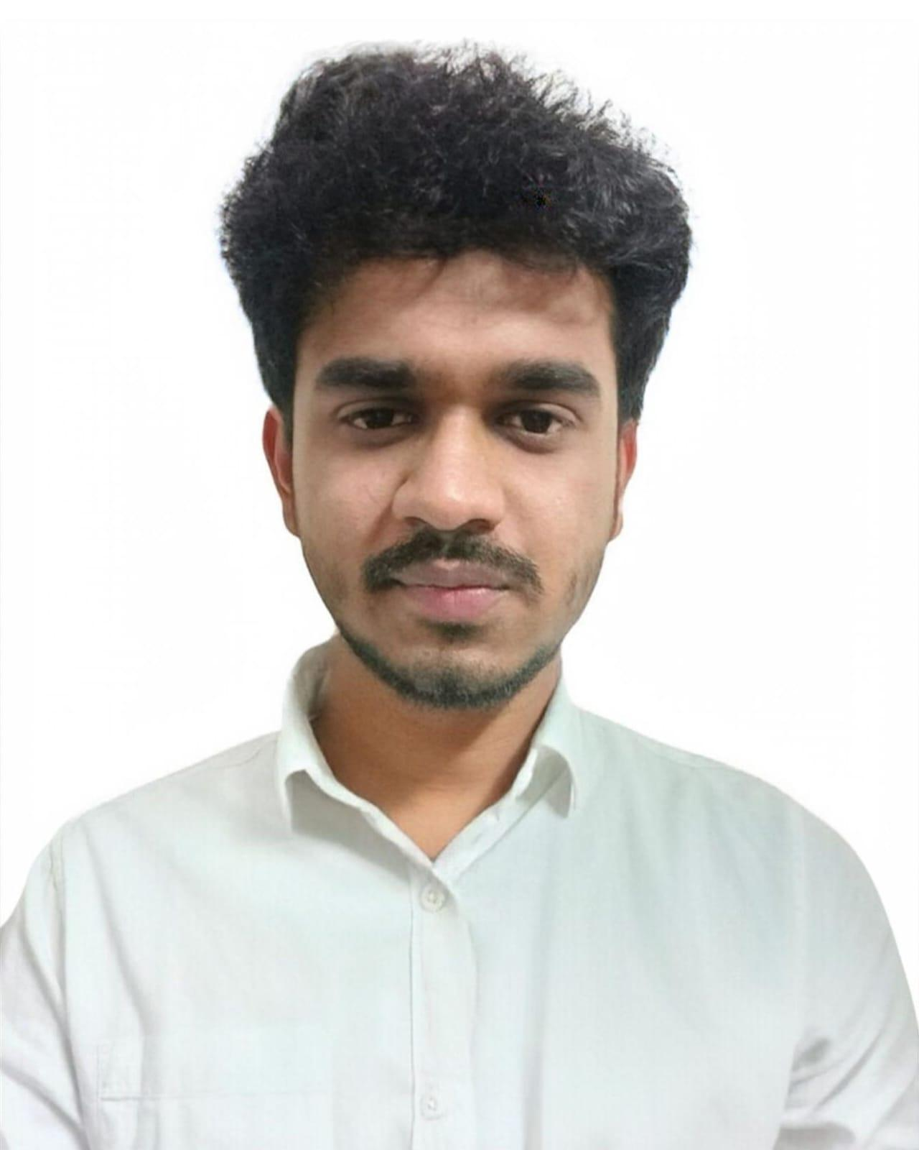
Naushad Ali
Paste Your Photo
MuleSoft Developer
B.Tech (CSE) Dr. A. P. J. Abdul Kalam Technical University, Lucknow
Certification
Salesforce MuleSoft Certified Developer level 1 (June 2023)
Career
Associate Software Engineer
(Infinite Computer Solutions
Bengaluru, India) Sep 2022 to May 2025
Skills
MuleSoft - Mule ESB, Anypoint Platform, RAML, REST API, Mule 4.x, Anypoint Studio, JSON, XML, DataWeave, Postman, SoapUI.
Repository – Azure (ADO).
CICD – Azure CICD
Databases – Oracle and MySQL
Grade:
B1
City:
Bengaluru
Email:
NAUSHAD.A.ALI@CAPGEMINI.com
Mobile:
  +91 9554387642
Naushad is a seasoned Associate Software Engineer with 2.8 years of overall technical experience 2.8 years of MuleSoft Experience following API-Led Architecture.
Widely Experience with Mule ESB in designing and implementing core platform components for API/ Services Gateway as well as other technological cross-cutting capabilities and also a contributor to Mule ESB.
Developed Restful/SOAP webservices in MuleESB.
Good Experience in expose the REST endpoint using RAML (API) kit)in Mule.
Working on Transformation tools like Data weave and Mule connectors.
Having good experience to write DataWeave Language (DWL)
The Medica Health Insurance Migration from Tibco to MuleSoft modernizes legacy integration using an API-Led Architecture for improved agility, scalability and compliance. The project leverages System, Process and Experience APIs to streamline healthcare data flows like claims, eligibility and Enrollment.
Naushad was responsible for the development of various Mule applications and their deployment of applications in CloudHub through CI/CD. Created REST API’s using RAML, implemented flows with the API kit Router in Anypoint Studio. Applied security policies for new APIs to secure management through API Manager. Implemented DataWeave transformation and error handling strategies. Wrote MUnit test flows for both success and error scenarios, ensuring a minimum code coverage of 50%. The Record test feature was used to automatically generate test suites. Integrated with Object Stores, SFTP, Database, JMS, HTTP, File and JSON modules during application development.

