Slide 1
The Shortest Tour Finder
By -
Naushin(19EE10073)
Saicharan(19EC10057)
Sravya(19EC10018)

Slide 2
Problem Statement and Motivation
Problem Statement: A fresher wants to visit every prominent place in IITKGP. We are given a list of places and possible routes connecting them with distances. We have to find the shortest possible route such that he/she gets to visit every place and returns back to his/her hostel.
Motivation:As a fresher one should know all the important places of the campus.It gives the student a sense of belongingness and makes him understand the reputation of the college.It can also motivate the student. We often come across this problem in man day to day activities.We try to minimise the distance travelled owing to many reasons like time constraint and fuel efficiency (the increasing fuel price is also a factor).We have to make sure that no important place is left out and maximise the number of trips in a given time so that every student can get a chance to take the trip.All these factors point to the need of having to find the shortest path covering all places.This is where the following algorithm steps in.

Slide 3
Input and Output Specifications
The input is given as an adjacency matrix.We assume that every node is connected to all other nodes and the distance between the same node is zero. Let the adjacency matrix be A and let there be n nodes. The size of A is nxn and all diagonal elements are zero. Also the matrix is symmetric
Aij = 0 for i=j
Aij = Aji !=0 for all other i,j
The shortest tour is given along with the cost of the tour as the output.

Slide 4
Brute Force Method
In this method the optimum solution is found out by checking all possible combinations of the route and returning the path with the shortest length. The path should start and end at the same node to complete one round trip.
All the places are assumed as nodes of a graph. Assuming all the nodes are connected by nodes which are branches. All the roads allow two directional traffic hence the graph is non directional. The distance between two places is the weight of the branch in between the two nodes. So, it becomes a case of undirected weighted graph. The input is given in the form of an adjacency matrix A such that the distance ‘d’ between two nodes i,j is given by Aij =d.

Slide 5
Pseudocode
Let N be the list of nodes,N1 be the initial node.Let Mfinal be final list.
Mfinal={}
M={}
Min=infinite;
Shortest_path( matrix A, node Ni, nodelist N, nodelist M){
N=N-Ni ;/N-Ni indicates to remove the current node from list of nodes to prevent it from being selected again/
M=M+Ni;/Adding Ni to the final path list/

Slide 6
Continuation...
If(number of rows of A =1){
Return Ai1+Distance;
}
For all Nj in nodes {
Distance= (Aij+Shortest_path(A-Ai,node Nj,nodelist N,nodelist M);
If(Distance<min){min =Distance;
Mfinal=M;};
/A-Ai indicates removing the ith row from the matrix A/
}}
The value of min gives the shortest distance and Mfinal gives order in which nodes are to be visited.

Slide 7
Proof of correctness
The algorithm checks all possible combinations of the path. In the for loop all the nodes are considered in each iteration and the distance is measured . A global value of minimum is initialised to a large value . If the measured value is less than the existing minimum then the value is stored as minimum. Hence the returned value is always the minimum . We can also prove it by contradiction. If there is a solution that is more optimal than the solution given by this brute force algorithm it means that the distance is lesser than the solution given by brute force. But this path is already followed once in the brute force algorithm and was not the minimum which is a contradiction . Hence the algorithm is correct.

Slide 8
Time complexity analysis:
In the first call the algorithm checks all n-1 possibilities. It checks all n-2 in second call ,n-3 in the third call and so on until the number of nodes remaining become 1.
T(n) = (n-1)T(n-1) if n>1
= 1 if n=1
T(n) = (n-1)(n-2)(n-3).......2.1
= O((n-1)!)
= O(n!)
This algorithm works with n! complexity which is very high even for small numbers of the range 500..

Slide 9
Dynamic Programming method
Now here we use dynamic programming approach for solving this as here we have to pick the minimum route among all possible routes which connects the list of places
Pseudo code of this dynamic approach
Let us define our variables
S = starting point (where we start) in this case it is hostel
N = subset of list of places given
Dist() = distance among places given
Initialise visited array initially to all places it is 0
Visited[N] = 0
Still not yet started so min_distance=0

Slide 10
Continuation..
Shortest_path(N,s)
{
visited[s]=1;
If(|N|=2)
{
If(k!=s) min_distance(N,k)=dist(s,k);
Return min_distance;
}
Else
{
for( j=1 to N)
{

Slide 11
Continuation...
for (i=1 to N)
{
If ( j!=i and j!=s)
{
Then min_distance(N,j)=min(shortest path (N-{i},j)+dist(j,i))
Visited(j)=1
}
}
}
}
Return min distance
}

Slide 12
Time complexity analysis
Using the above recurrence relation, we can write dynamic programming based solution. There are at most O(n*2^n) subproblems, and each one takes linear time to solve. The total running time is therefore O(n^2*2^n). The time complexity is much less than O(n!), but still exponential. Space required is also exponential.

Slide 13
Branch and Bound Method
In the Branch and Bound method, there are two types of costs,for a given node in the decision tree,
Cost of reaching a particular node from the root
Cost of reaching a solution from current node (this is estimated by a lower bound)
For current node in the decision tree, we compute a bound on best possible solution that we can get if we down this node. If the bound on best possible solution itself is worse than current best (best computed so far,and it is stored), then we ignore the subtree rooted with the node

Slide 14
Pseudocode
G[N][N] #the array which contains the distances between two places
Visited[N] # tells us about the place is visited or not
Final_result=infinity #intializing it to infinity at present and we can update it further
Final_plath={ } # first we take it as empty then we can add each place in such
a way that we get shortest path
Initial call
{
Current_bound=0
For(i=0 to N-1)
{
Current_bound+=firstmin(i)+second min(i)
Current_bound=current_bound/2 #we divide by two because here we have
considered every edge twice
}
Visited[0]=1
Current_path+={0}(#adding starting path)
Shortest_tour rec(currentbound,0,1,currentpath)

Slide 15
Continuation...
Shortest_tour_rec(current_bound,current_weight,level,current_path)
{
If(level==N)
{
If(path exist from the Nth level place to starting position )
{
Current_result=current_weigth+G[current_path.last][current_path.first]
If(current_result<final_result)
{
Update final_path=curret_path
Final_result=current_result
}
Return
}
}

Slide 16
Continuation...
For(i=0 to N-1)
{
If((path exists from our current_path to i) and visited[i]=0)
{
Temp_visit = visited[N]
Temp_1 = curent_bound
Temp_2 = current_weight
Current_weight + = G[current_path][i];
If(level!=1)
Current_bound-=(first_min(current_path last)+second_min(i))/2
If(level==1)
Current_bound-=(first_min(current_path last)+firstmin(i))/2

Slide 17
Continuation...
If(current_bound weight<final result)
{
current path + = {i}
Visited[i]=1
Shortest_tour_rec(currnt_bound,current_weight,L+i,current_path)
}
Current_weight=temp2
Current_bound=temp1
Visited=temp_visit
}
}
}

Slide 18
Proof of Correctness
Cost of a tour T = (1/2) * ∑ (Sum of cost of two edges adjacent to u and in the tour T)
where u ∈ V
Cost of any tour >= 1/2) * ∑ (Sum of cost of two minimum weight edges adjacent to u)
where u ∈ V
As we go further in the recursion we update the bound (that is the value of current bound+current weight) by removing the minimum edge cost(from current bound) and adding the cost of the edge( to the current weight).
This value of (current bound + current weight) gives us the minimum cost of the tour that is possible following the current recursion. If it is greater than the current best value then it can’t give a solution better than the current best. Hence it can be avoided.
We check all the valid permutation whose (current bound + current weight) is less than current best, and hence we will be able to find the optimal solution.

Slide 19
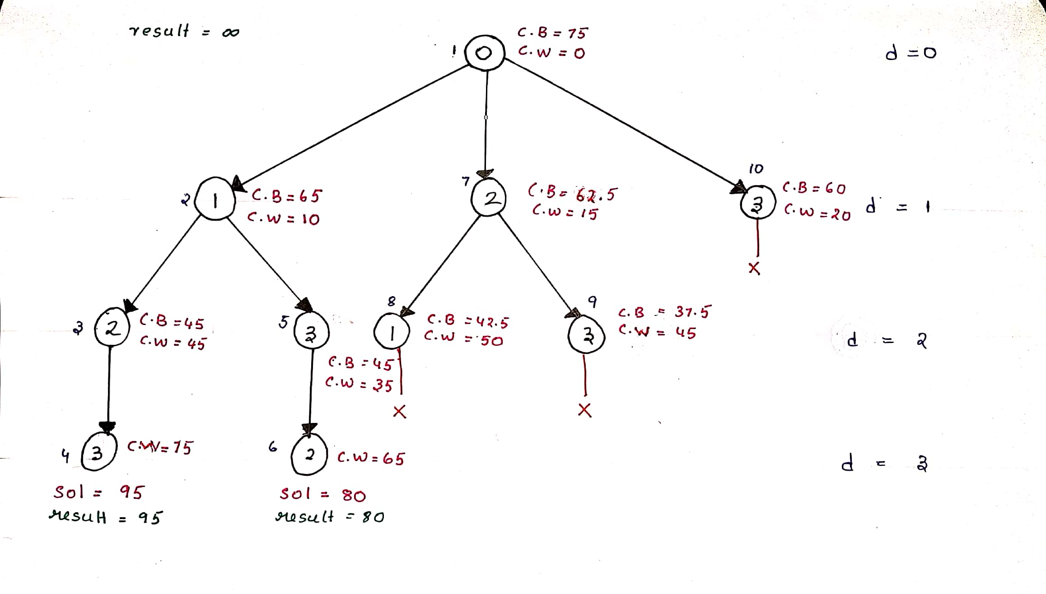
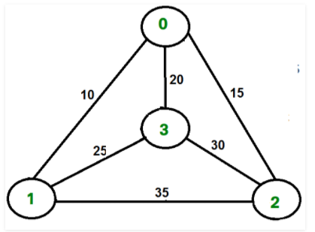
Working on an Example

Slide 20
Time complexity analysis
In the worst case we are actually creating all the possible extensions of nodes(permutations) in terms of tree nodes as we may not get the chance to prune at any step.
Suppose we have N places, then we need to generate all the permutations of the (N-1) places, excluding the starting point. Hence the time complexity for generating the permutation is O((n-1)!), which is equal to O(2^(n-1)).
Hence the final time complexity of the algorithm(including the intermediate steps) is O(n^2 * 2^n).

Slide 21
Implementation of Branch and Bound in C

Slide 22
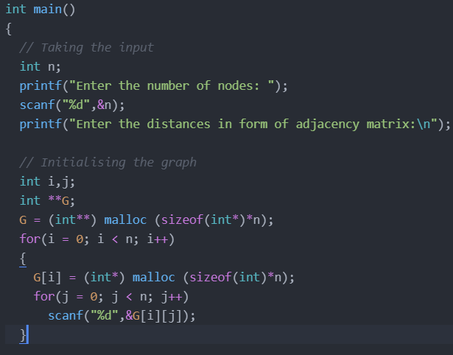
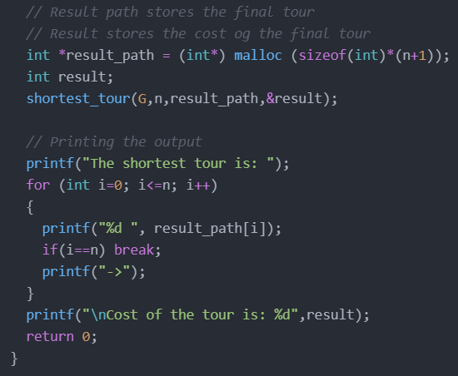

Slide 23
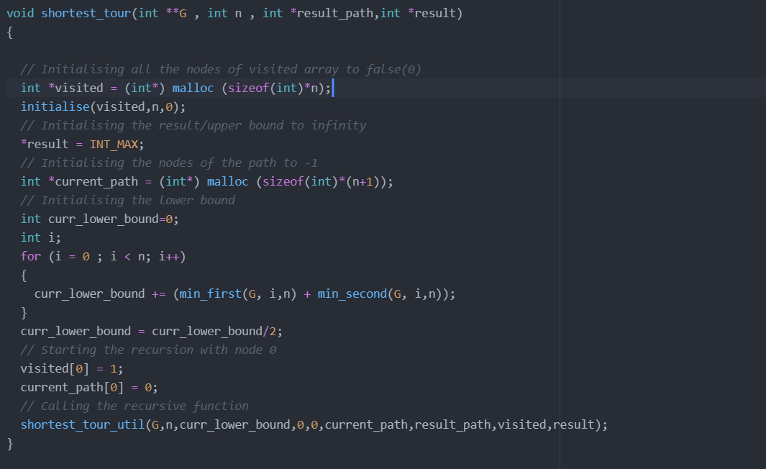

Slide 24
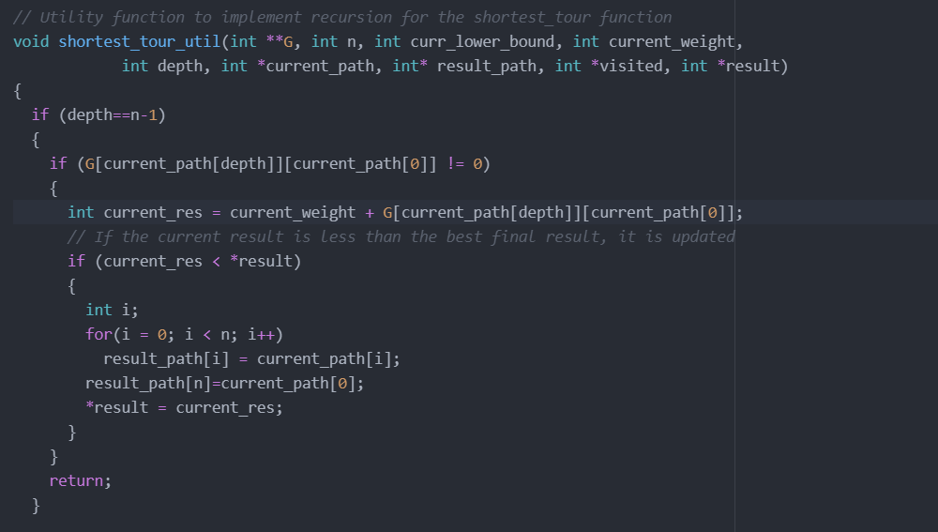

Slide 25
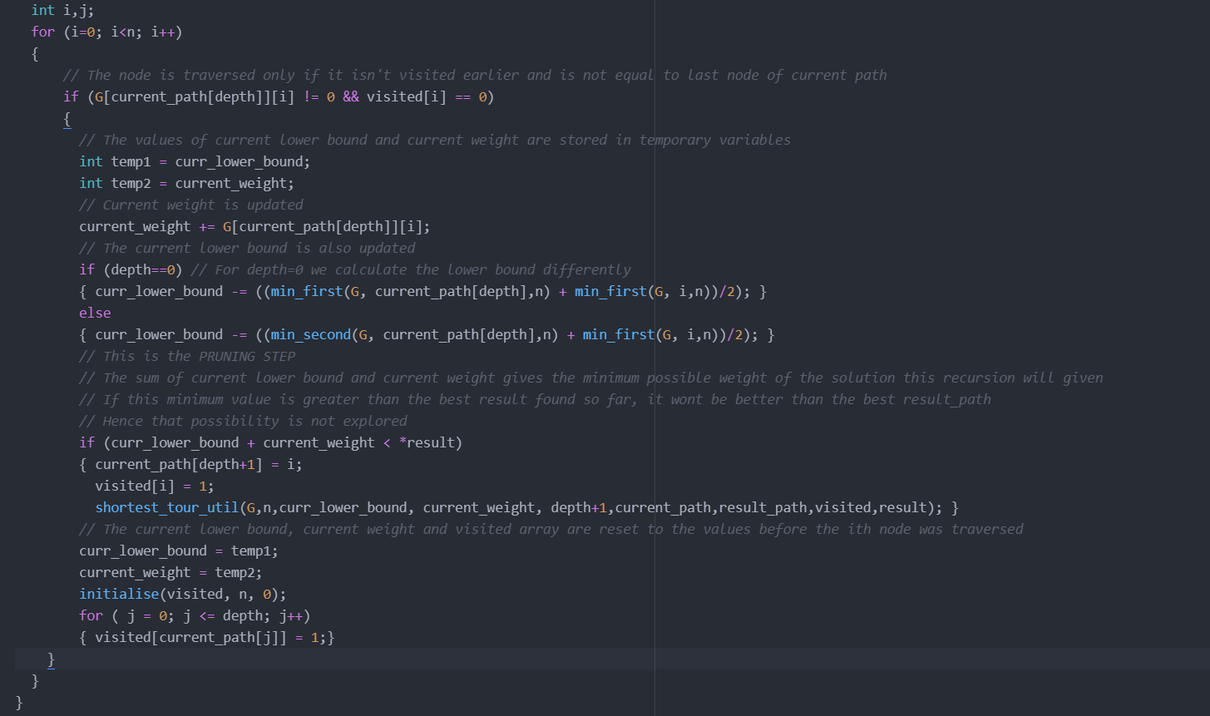

Slide 26
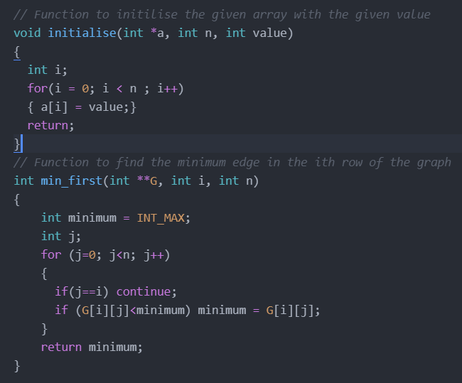
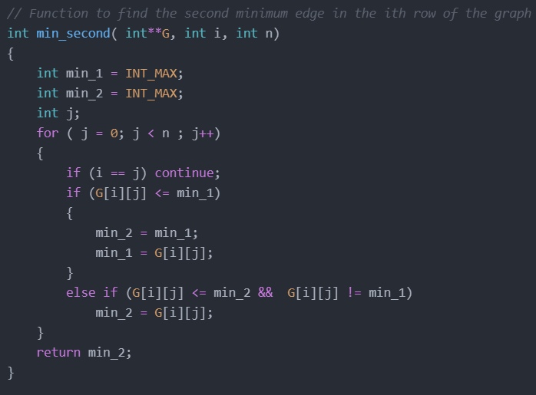

Slide 27
Thank You!

