Slide 1
Status Report:
*Nautatava Navlakha - 160040007
Sarvind Rankawat - 160040057
Arsh Akhtar Ansari - 160040024
*Team leader

Slide 2
Goal and Objectives
Created as an idea to change the traditional approach of pen-paper based survey, this project gives surveyor a way to both decrease the chances of errors and ease the survey taking procedure

Slide 3
No | Major Tasks | Completion Date | Personal Responsible | Weight
 | Inception report | Mar. 03 | <Group leader> | 15%
1 | Building the interface for user | Mar. 15 | Nautatava | 5%
2 | Building the API for receiving Data from app | Mar. 22 | Arsh | 5%
3 | Connecting to Maps API | Mar. 29 | Sarvind | 5%
4 | Build interface for surveyor to change questions | Mar. 30 | Arsh and Nautatava | 10%
5 | Building the questionnaire to be asked in survey | Apr. 1 | All | 15%
6 | Take survey from inmates to practically use the app | Apr. 5 | All | 15%
7 | Analyze data to look out for trends | Apr. 7 | All | 15%
 | Final report in ppt and presentation | Apr. 10 | All | 15%

Slide 4
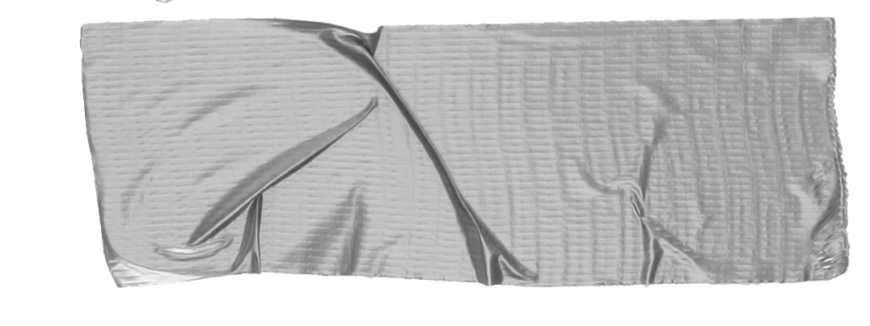

Interface development
App built on Java.
This is the first point where users get a touch of questions. Includes images so that the questions are self explanatory.
types of interfaces:
User interface to answer questions
Admin interface to change questions
Look for the responses given
Option to export to sheet
Specifications
App built on android studio and supported on any smartphone with Android 5.0 or higher.
According to Google, almost 85% devices are supported

Slide 5
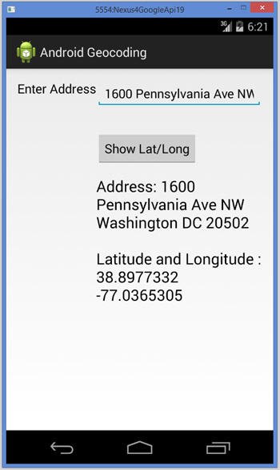
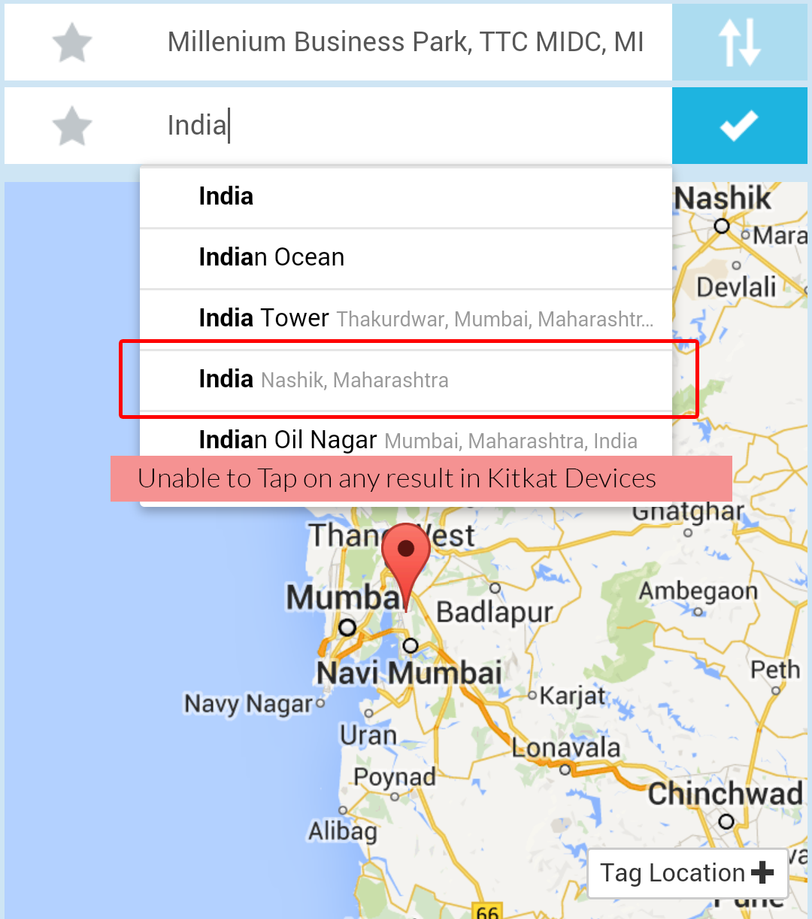
Geocode data extraction
Finding textual location using text entered
Calibrating the location data using the map
A
B

Slide 6
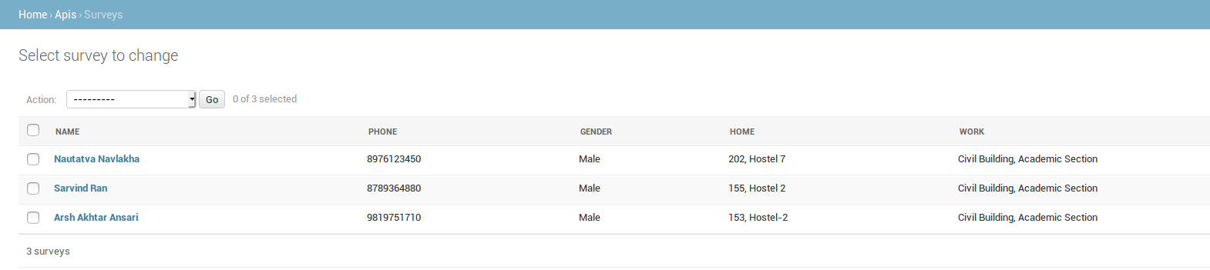
Backend Data Collection
Execution of a django database using different models for each field of database
Execution of APIs for connecting data collection from the app to server
Conversion of data into different file system like excel files for better data analysis

Slide 7
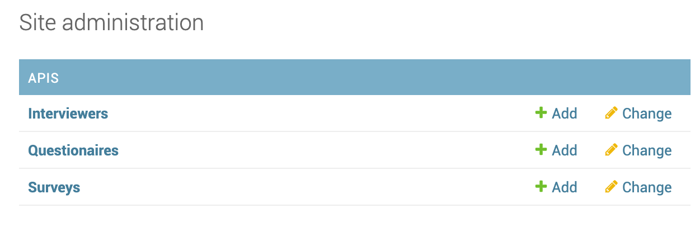
Admin interface
A admin interface where supervisor can add interviewers, set questions and view surveys taken.
User logs into his interviewer account to get the questions on the screen. He can then start taking interviews.
Extracting responses in form of excel sheet to view and share data offline.

Slide 8
Questionnaire Design
Choose a good questionnaire design to grab the purpose right from the start.
Household Get the socioeconomic info
Personal Get a detailed house structure in the area
Simple Provide a simple unifying message for what is to come

Slide 9
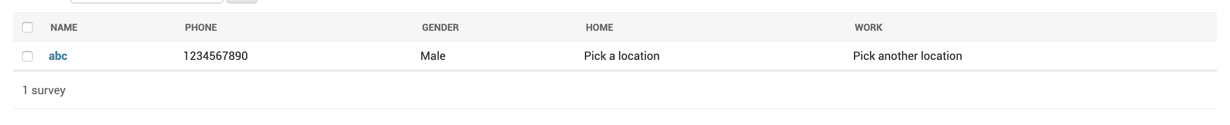
Take survey from inmates
The portals being ready, now can be used for practical purpose of taking survey on-field.
Will help in checking correctness of app.

Slide 10
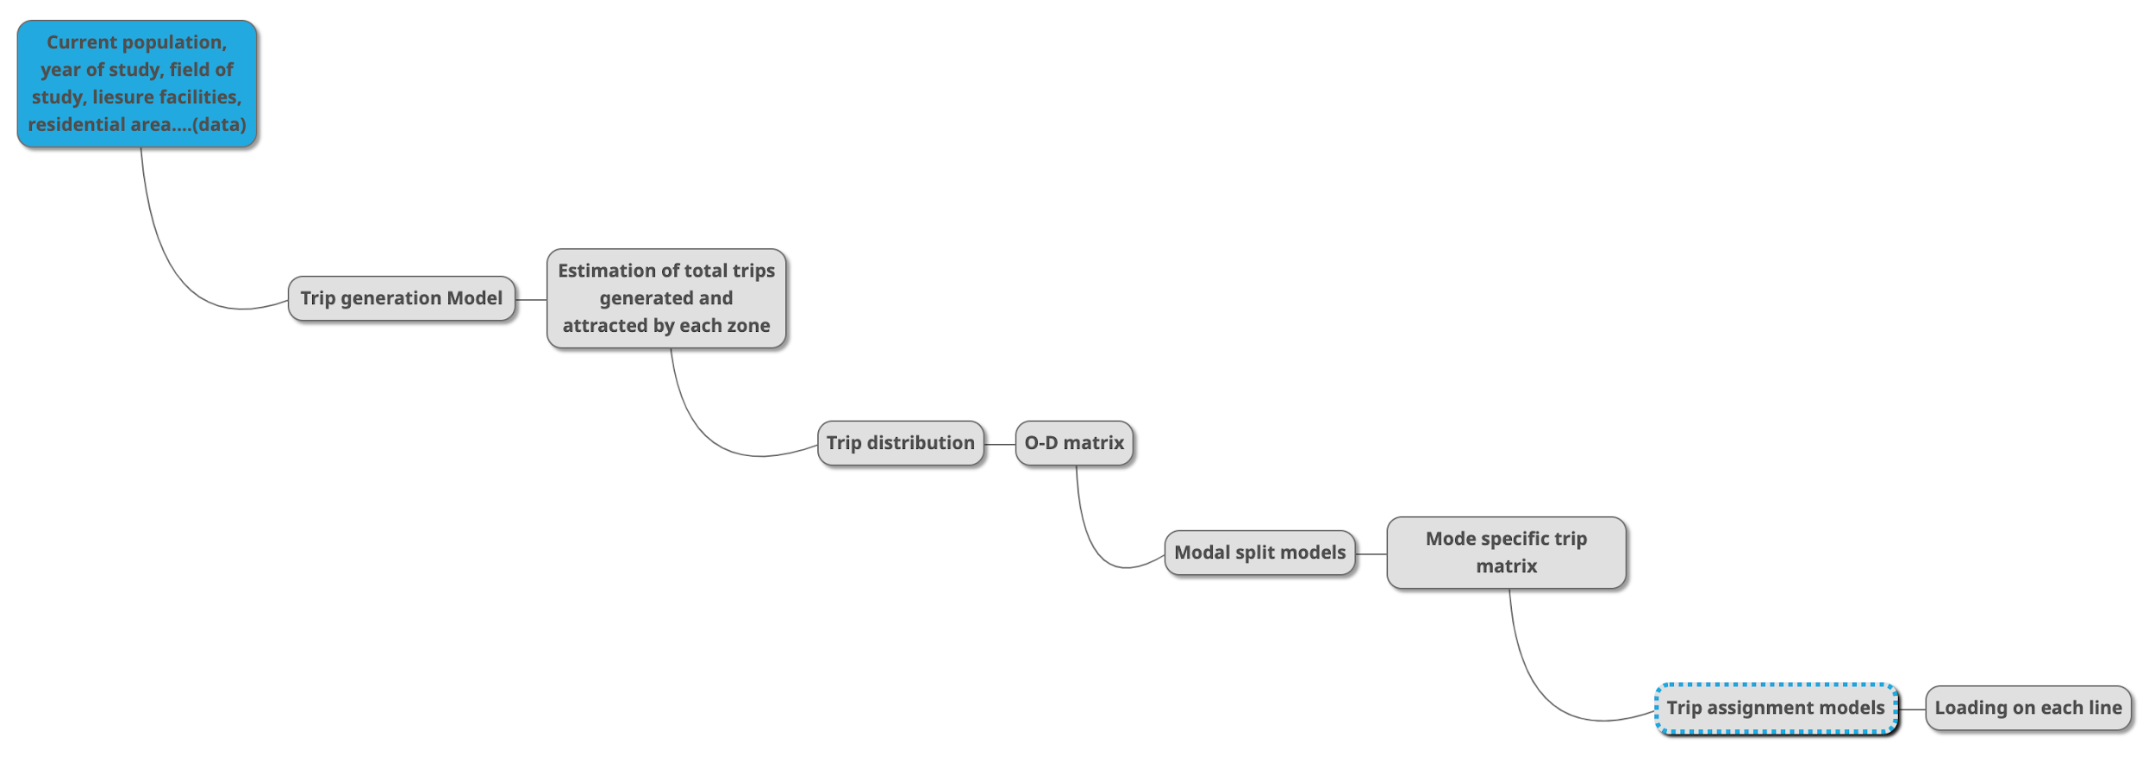
Analyze data
Analysis is important to know the current transportation situation
Our analysis will be making trip generation model

Slide 11
Why not conventional methods?
There are a number of online survey sites such as SurveyMonkey or as simple as google sheets, but….
Flexibility When you need to add custom validators to ensure the data provided is correct.
Hefty prices The external reports come to us with a hefty price which is way more that what maintaining a self-made app needs.

Slide 12
Summary Report
Expected delivery
April 15, 2019
For target
Analysis of trends of students going to various places like Academic Area, SAC, Main gate and Market gate.

Slide 13
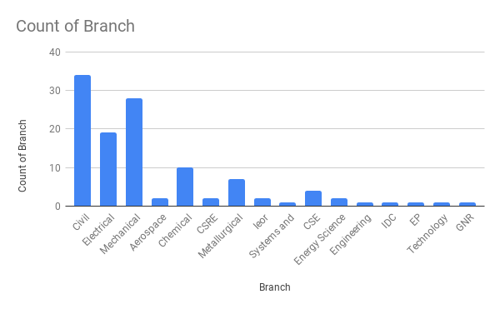
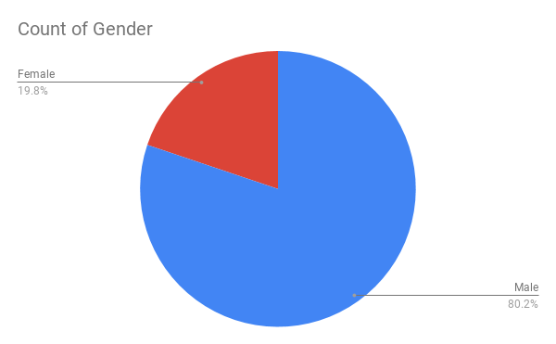
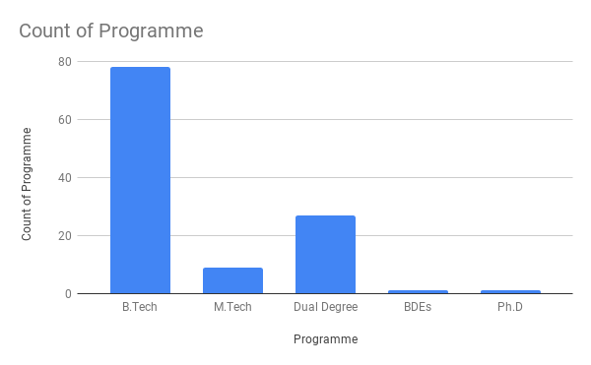

Knowing our audience

Slide 14
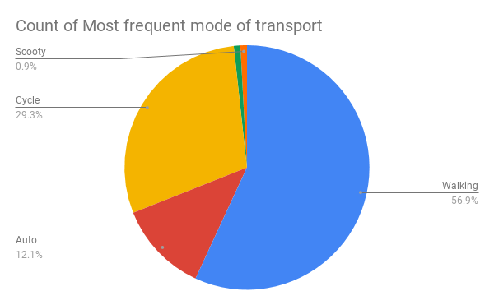
Most common mode of transport
Notes:
next

Slide 15
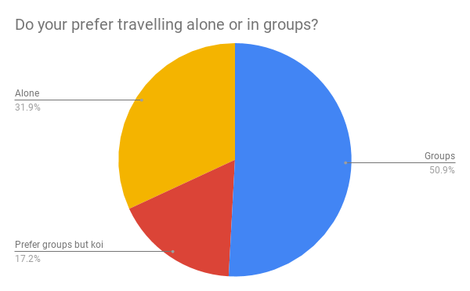
Travel in groups?

Slide 16
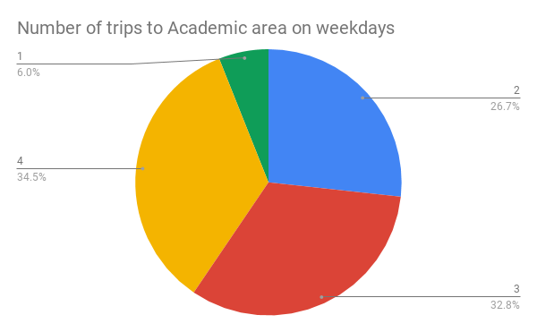
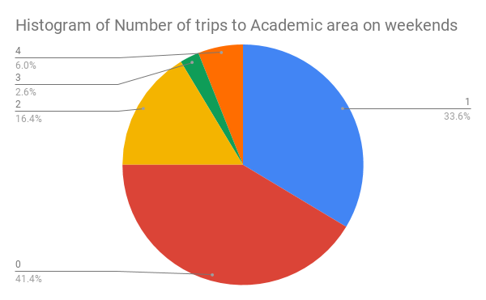
Travel to Academic Area

Slide 17
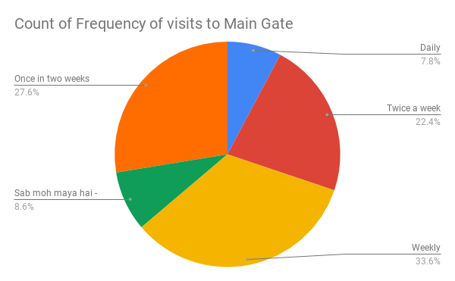
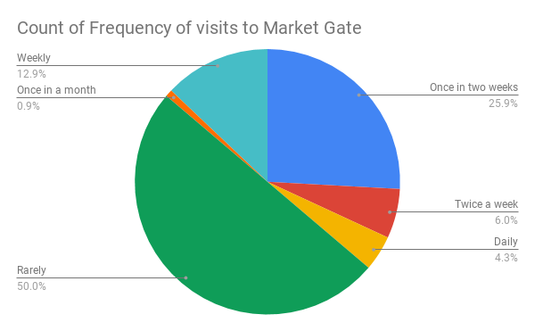
Interaction with the outside world

Slide 18
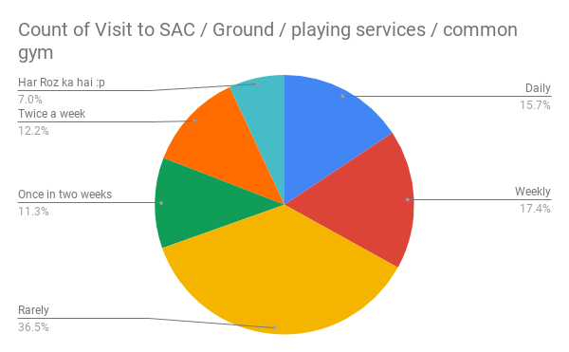
Activities other than academics...

Slide 19
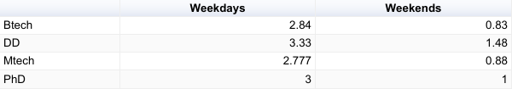
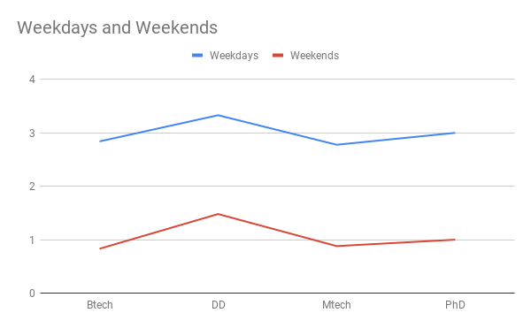
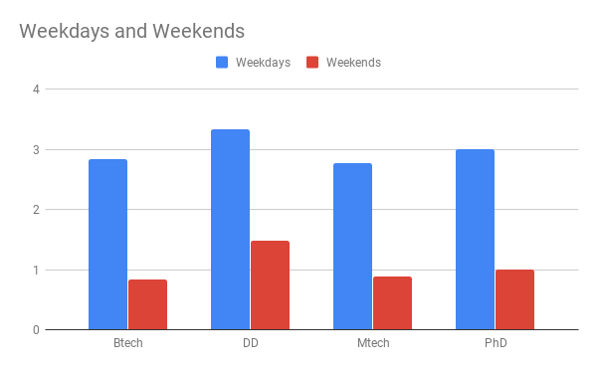
Interesting Observation

Slide 20
Results
The app has an edge in many aspects like flexibility in surveys. Some points in flexibility are as seen -
App Based Data Analytics Get graphs based on the data collected directly on the mobile app
Multi survey app Rather than using it once and resetting it we can have multiple use for different surveys

Slide 21
Thank You!

