Slide 1
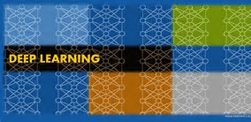
DL (Deep Learning) Workspace
Turn-Key Cluster for DL Training, Exploration, Inferencing, etc..
Hongzhi Li, Jin Li, Sanjeev Mehrotra

Slide 2
Private Cluster Deployment

Slide 3
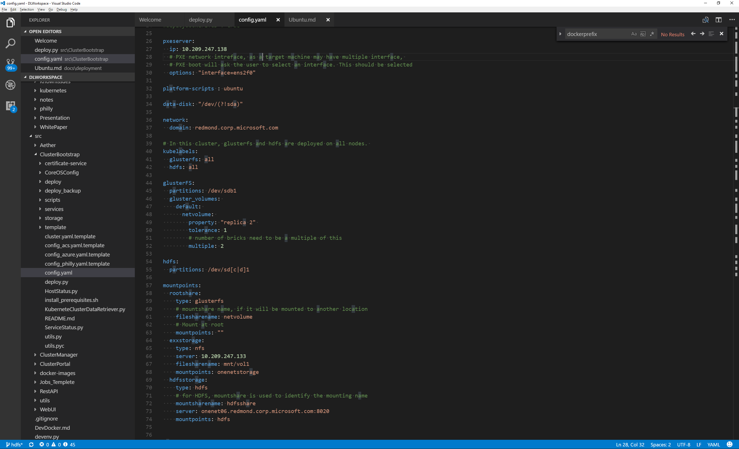
Configuraton

Slide 4
Build PXE Ubuntu Server
.\deploy.py –y build
.\deploy.py build pxe-ubuntu

Slide 5
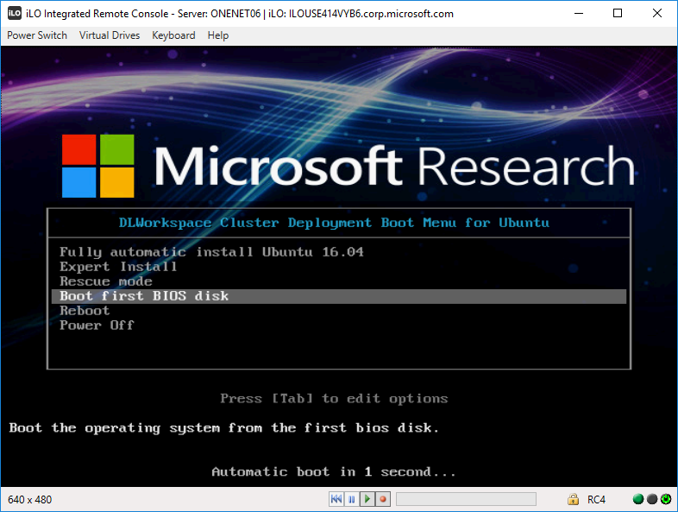
PXE Ubuntu

Slide 6
Partition Drive and Assign Drive to File system
Python regex description of
data drive,
glusterfs, hdfs drive

Slide 7
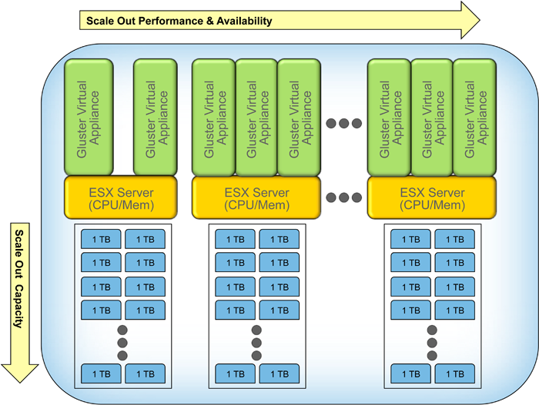
GlusterFS
General purpose scale-out distributed file system
Scalable – absence of a metadata server provides a faster file system
Affortable/Flexible/Open source:
Commodity hardware solution

Slide 8
GlusterFS Deployment on DLWorkspace
The procedure applies to deployment of any file system
Minimal additional code per file system deployment (about hundreds of lines of scripts)
1. Build GlusterFS docker (mostly reuse official gluster/gluster-centos docker)
+ configuration for the local machine
2. Partition drive (optional)
3. Create volume used by glusterfs
4. Start Glusterfs docker
5. Mount Glusterfs file system

