Slide 1

DL (Deep Learning) Workspace
Turn-Key Cluster for DL Training, Exploration, Inferencing, etc..
Hongzhi Li, Jin Li, Sanjeev Mehrotra

Slide 2

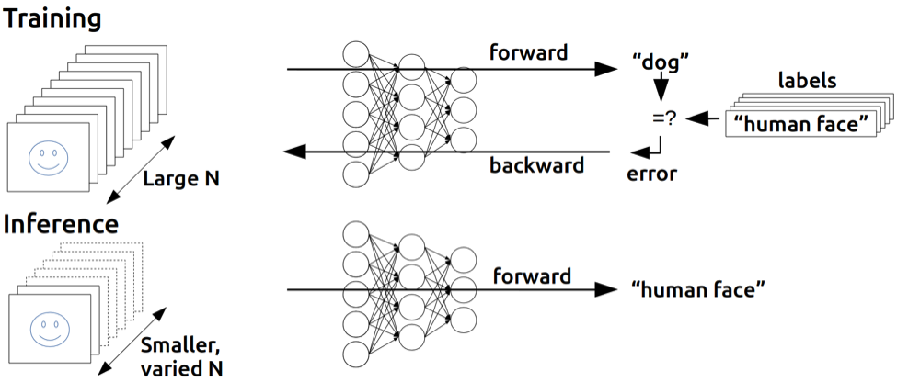
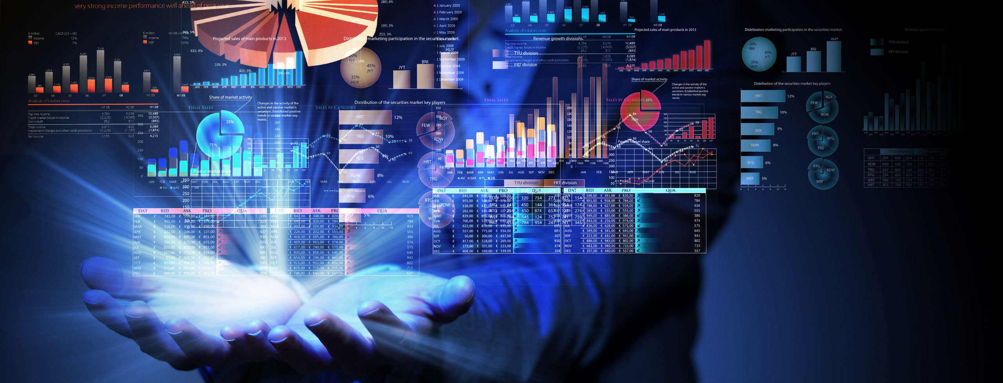
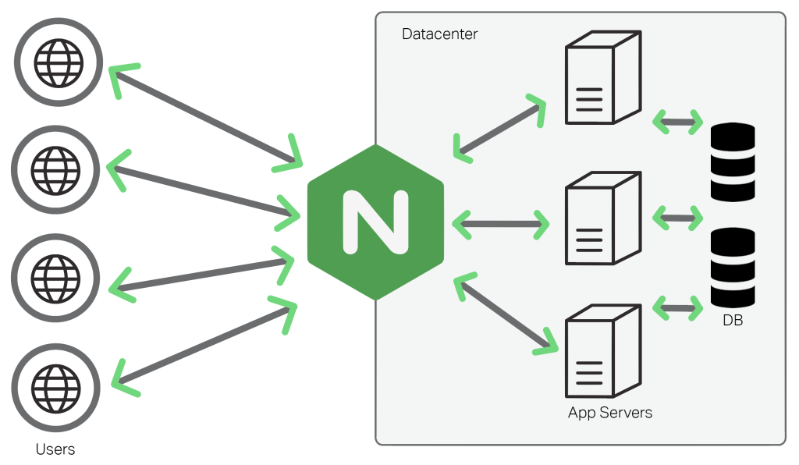
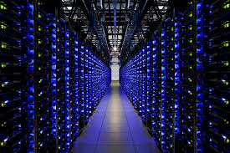
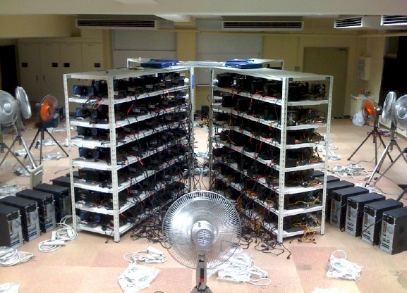
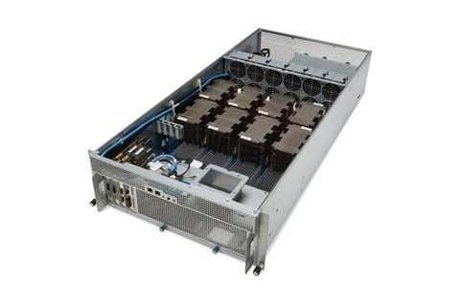
DL Workspace: Shared Computing Cluster
Interactive Exploration
Training
Data Analytics
WebUI/Restful API
Serving
DL Workspace
DL Workspace
DL Workspace
Group
Server
Individual
machine
Shared
Cluster

Slide 3
DL workspace
Turn-key cluster environment
No-installation required
Support Nvidia GPU/CPU
Support popular DL toolkit: Caffe, CNTK, TensorFlow, MxNet, etc..
Support single machine and/or multi machine training
Scenario
Dev box (interactive exploration) for the group members
Follow/repeat/extend DL experiments (ToDo)
DL training
Data analytics
Inferencing/serving

Slide 4
Key Building Blocks

Slide 5
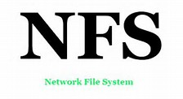
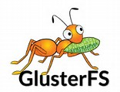
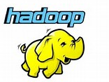
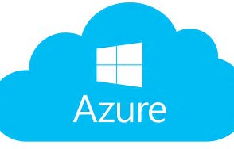
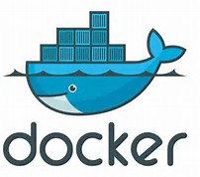
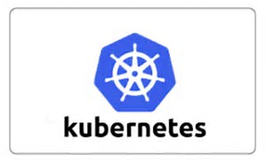


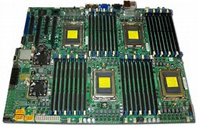
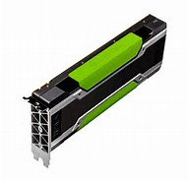
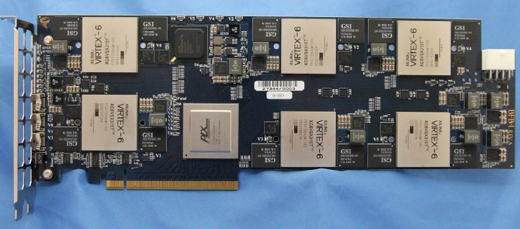
DL Workspace: Architecture (Modularly built)
Interactive
Workload
Training
Data Analytics
Inferencing/Serving
Filesystem
Plug-in
Container
Orchestration
+
Pluggable
Device Driver
Nvidia GPU/Infiniband (FPGA, other GPU, etc..)
Base OS
or
Hardware
CPU
FPGA
GPU

Slide 6
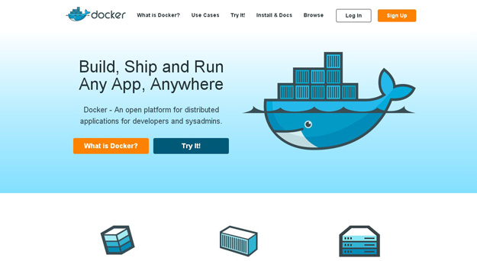
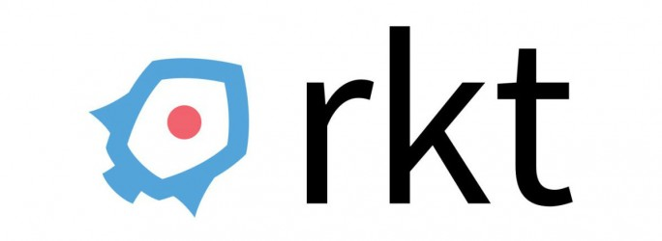
Docker: Containerized Microservice
Why docker
Run anywhere (laptop, desktop, Azure, etc..)
Streamline development & testing
Lightweight (only the necessary processor in docker)
Match well with Microservices Architecture
Alternative:

Slide 7
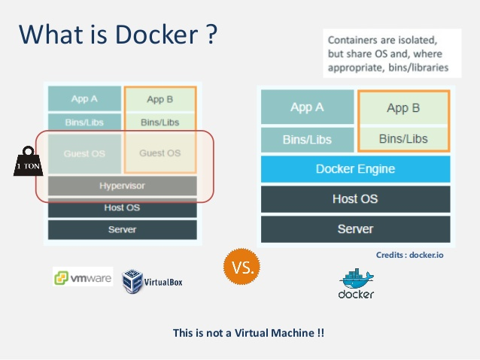

Slide 8
Why Docker in DL workspace
It contains everything you need to quickly start
E.g., tensorflow docker contains:
All binaries package used by tensorflow (e.g., curl, libpng, libzmq, zip, etc..)
Python (with pip, jypyer, numpy, scipy, sklean, etc..)
[ Optional, for –devel] Source code and build tools (bazel, etc..)
Proper cuda libraries
Different DL toolkit (of different version) may use different and conflict libraries (e.g., cudnn? Version)
Docker nicely encapsulate everything needed by a workload (avoid dll hell)

Slide 9
How to use docker in DL Workspace:
Public docker [quickest route]:
Most major DL toolkit today (e.g., TensorFlow, CNTK, Caffe, MxNet) has publicly released docker that is directly useable in DL workspace
Customized docker (e.g., TensorFlow with XLA support)
Most major DL toolkit today (e.g., TensorFlow, CNTK, Caffe, MxNet) has released source Dockerfile to build their docker
You can start with them, and to customize the build (e.g., to try out new/customized feature)

Slide 10
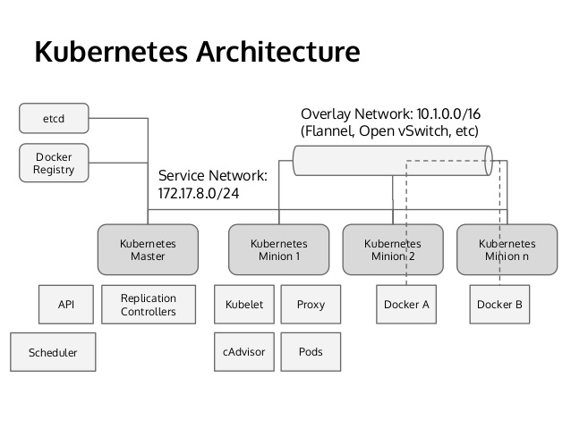
Kubernetes: Cluster Scheduling & Orchestration
Why
Top projects on github
Significant Slack and Stack Overflow community
[From our own experience] pretty stable platform, good code base quality, extensive unit test/stress test in code
Alternative: CoreOS fleet, Swarm, DC/OS

Slide 11
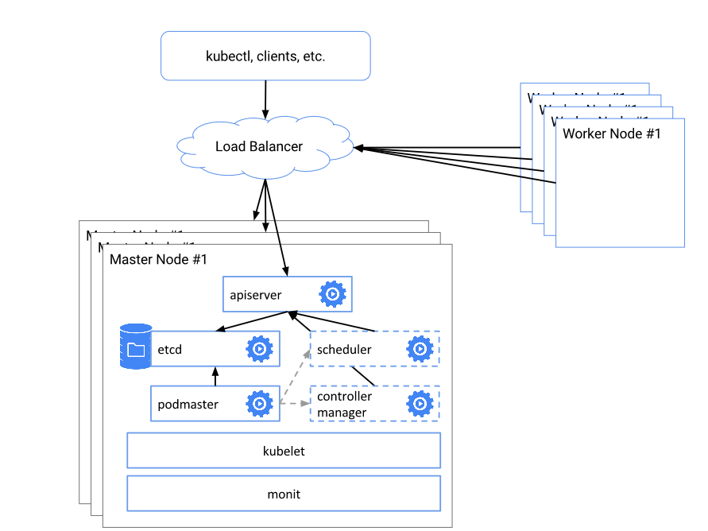
How Kubernete Works?

Slide 12
What is a Kubernete Pod?
A group of one or more containers and shared storage
E.g., a distributed training pod can contain:
A parameter server
Multiple workers

Slide 13
Demo & Q/A

Slide 14
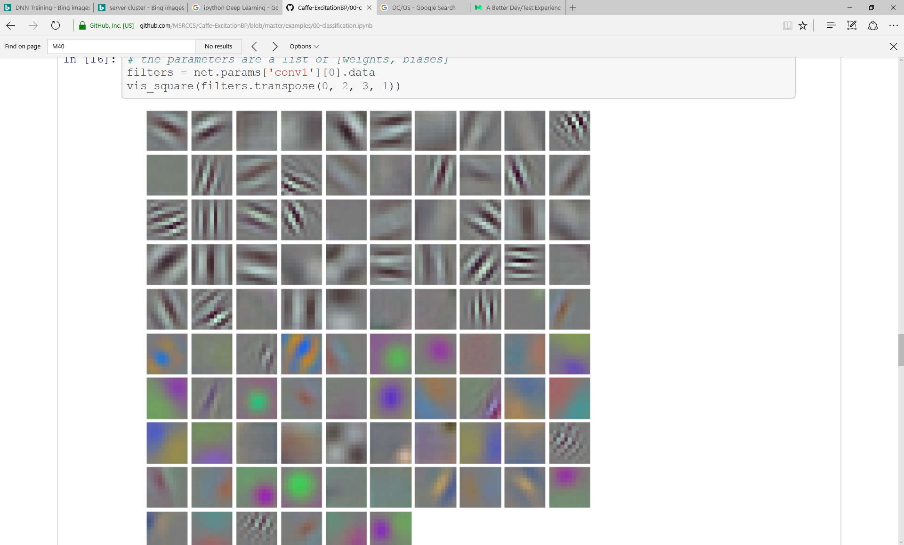
Sample User Case: Interactive Exploration

Slide 15
Backup

Slide 16
Targeted opportunity associated with potential AI use cases
IDC Cognitive / AI software and services forecast
Nov 2016, excludes Hardware and unclassified spend
Our approach
Include Software and Services spend as those seem relevant for a solutions approach
Filter by:
Overall forecasted opportunity size in 2020
Growth in opportunity size from 2016-2020 → looking for $1B+ growth
Include adjacent industries within total opportunity
Use Case | Sector / Industries | 2016 | 2020 | Growth, 2016-20 | CAGR, 2016-20
1. Diagnosis and Treatment Systems | Healthcare Providers | $0.7B | $6.2B | +$5.4B | +71%
2. Quality Management Investigation & Recommendation Systems | Manufacturing | $0.8B | $5.4B | +$4.6B | +64%
3. Automated Customer Service Agents | Retail | $0.8B | $4.3B | +$3.5B | +51%
4. Fraud Analysis & Investigation | Financial Services | $0.7B | $3.7B | +$2.9B | +49%
5. Program Advisors & Recommendation Systems | Financial Services | $0.4B | $2.9B | +$2.4B | +60%
6. Automated Threat Intelligence & Prevention Systems | Financial Services | $0.4B | $1.8B | +$1.4B | +42%
7. Merchandising for Omni Channel Operations | Retail | $0.3B | $1.4B | +$1.1B | +50%
8. Sales Process Recommendation & Automation | Cross-Industry | $0.2B | $1.2B | +$1.0B | +57%

Slide 17
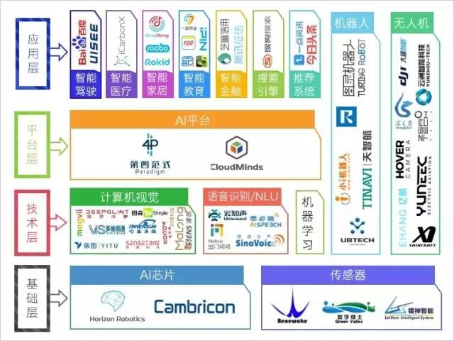
AI Startup (China)

