Slide 1
Interactive Job in DLWorkspace
Cloud Computing and Storage group
July 10th, 2017

Slide 2
Interactive Job Type
Training jobs are only a part of the researcher’s daily jobs. Most of their time is used on exploration, debugging the model.
The users would like to use the most familiar environment. We want to reduce the running environment gap between the cloud and their own machine.
Give user flexibility to run any type of interactive jobs
Make it convenient to use by providing the pre-defined job templates
Interactive jobs:
Ipython
SSH
(Tensorboard)
etc…

Slide 3
Networking
Container networking: flannel
Container ports in Kubernetes
Service IP and ports:
NodePort
NIC mapping

Slide 4
Networking
Flannel:
Flannel is a virtual network that gives a subnet to each host for use with container runtimes.
One virtual IP per container.
Support cross machine container communication.
PROs: easy to use; the cleanest way to handle ports allocation
CONs: performance (perf)

Slide 5
Kubernetes Networking Support
Service IP and ports:
flannel is used
In service spec, include the container selector and the container ports which are needed to be exposed.
Kubernetes will provide a cluster-only virtual IP and port which can be used to access the container at the designed port.
kind: Service
apiVersion: v1
metadata:
name: {{ svc["serviceId"] }}
labels:
run: {{ svc["jobId"] }}
spec:
selector:
run: {{ svc["jobId"] }}
ports:
- name: {{ svc["port-name"] }}
protocol: {{ svc["port-type"] }}
port: {{ svc["port"] }}

Slide 6
Kubernetes Networking Support
NodePort:
flannel is not required
In service spec, include the container selector and the container ports.
Kubernetes will automatically select an usable port on the host machine and map the host port to the container port.
kind: Service
apiVersion: v1
metadata:
name: {{ svc["serviceId"] }}
labels:
run: {{ svc["jobId"] }}
spec:
type: NodePort
selector:
run: {{ svc["jobId"] }}
ports:
- name: {{ svc["port-name"] }}
protocol: {{ svc["port-type"] }}
port: {{ svc["port"] }}

Slide 7
Kubernetes Networking Support
NIC mapping:
Best performance for distributed training jobs
Map NIC to container directly.
apiVersion: v1
kind: Pod
metadata:
name: {{ job["jobId"] }}-{{ job["distId"] }}
labels:
run: {{ job["jobId"] }}
jobName: {{ job["jobNameLabel"] }}
distRole: {{ job["distRole"] }}
distPort: "{{job["containerPort"]}}"
spec:
hostNetwork: true
{% if job["nodeSelector"]|length > 0 %}
nodeSelector:
{% for key, value in job["nodeSelector"].items() %}
{{key}}: {{value}}
{% endfor %}
{% endif %}
containers:
- name: {{ job["jobId"] }}
image: {{ job["image"] }}
command: {{ job["LaunchCMD"] }}
#container port and host port should be same.
ports:
- containerPort: {{job["containerPort"]}}
hostPort: {{job["containerPort"]}}
{% if job["distRole"] =="worker" %}
resources:
limits:
alpha.kubernetes.io/nvidia-gpu: {{ job["resourcegpu"] }}
{% endif %}
volumeMounts:
{% for mp in job["mountPoints"] %}
- mountPath: {{ mp.containerPath }}
name: {{ mp.name }}
{% endfor %}
restartPolicy: Never
volumes:
{% for mp in job["mountPoints"] %}
- name: {{ mp.name }}
hostPath:
path: {{ mp.hostPath }}
{% endfor %}

Slide 8
Networking – expose ports
Training Jobs:
Map NICs to container
Provide usable ports in commend line parameters and environment variables
How to force user to use the designed ports?
Interactive Jobs:
Expose ports for http access, ssh access, etc. (lightweight traffic)
Use Kubernetes NodePort ( == docker port mapping)

Slide 9
Launch the interactive jobs
Job templates:
Per-config job parameters (docker image, command line): e.g.
tensorflow ipython:
Docker image: tensorflow/tensorflow:latest
Command line: export HOME=/job && jupyter notebook --no-browser --port=8888 --ip=0.0.0.0 --notebook-dir=/
Tensorflow ssh:
Docker image: tensorflow/tensorflow:latest-gpu
Command line: apt-get update && apt-get install -y openssh-server sudo && addgroup --force-badname --gid 500000513 domainusers && adduser --force-badname --home /home/hongzl --shell /bin/bash --uid 522318884 -gecos '' hongzl --disabled-password --gid 500000513 && adduser hongzl sudo && echo '%sudo ALL=(ALL) NOPASSWD:ALL' >> /etc/sudoers && mkdir -p /root/.ssh && cat /work/.ssh/id_rsa.pub >> /root/.ssh/authorized_keys && mkdir -p /home/hongzl/.ssh && cat /work/.ssh/id_rsa.pub >> /home/hongzl/.ssh/authorized_keys && service ssh restart && sleep infinity

Slide 10
Policy (Open Discussion…)
Interactive job cloud be expensive. Need to design efficient policy.

Slide 11
Job Scheduling

Slide 12
Discussion
How to configure GPU resource quota for each team?
How to implement preemption?

Slide 13
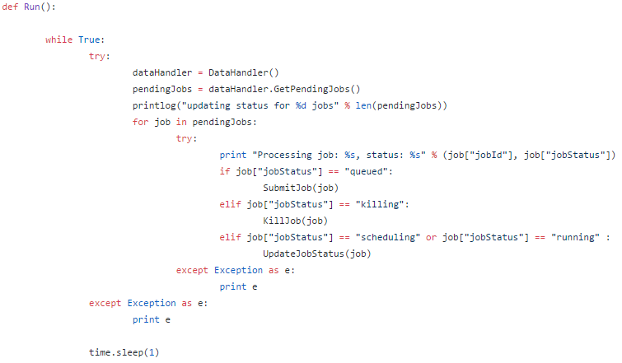
How to configure GPU resource quota for each team?
https://github.com/MSRCCS/DLWorkspace/blob/alpha.v1.0/src/ClusterManager/job_manager.py
if check_quota(job):
SubmitJob(job)

Slide 14
Support Job Priority?
https://github.com/MSRCCS/DLWorkspace/blob/alpha.v1.0/src/ClusterManager/job_manager.py
pendingJobs = get_job_priority(pendingJobs)

Slide 15
How to implement preemption?
Jobs are needed to be labeled as “allow preemption”:
Find the jobs can be preempted:
kubectl get pod -o yaml --show-all -l preemption=allow
Preempted job
Kill the jobs from k8s
Make the job status to “queued” to allow rescheduling.
apiVersion: v1
kind: Pod
metadata:
name: {{ job["jobId"] }}
labels:
run: {{ job["jobId"] }}
jobName: {{ job["jobNameLabel"] }}
userName: {{ job["userNameLabel"] }}
preemption : allow

