Slide 1
Job Scheduling and Runtime in DLWorkspace
Cloud Computing and Storage Group
July. 7th, 2017
Notes:
Contact: Hongzhi Li (hongzl@microsoft.com), Jin Li (jinl@microsoft.com)

Slide 2
System Diagram
SQL server
Cluster
Web Portal
RestfulAPI
Job Manager
K8s Master API

Slide 3
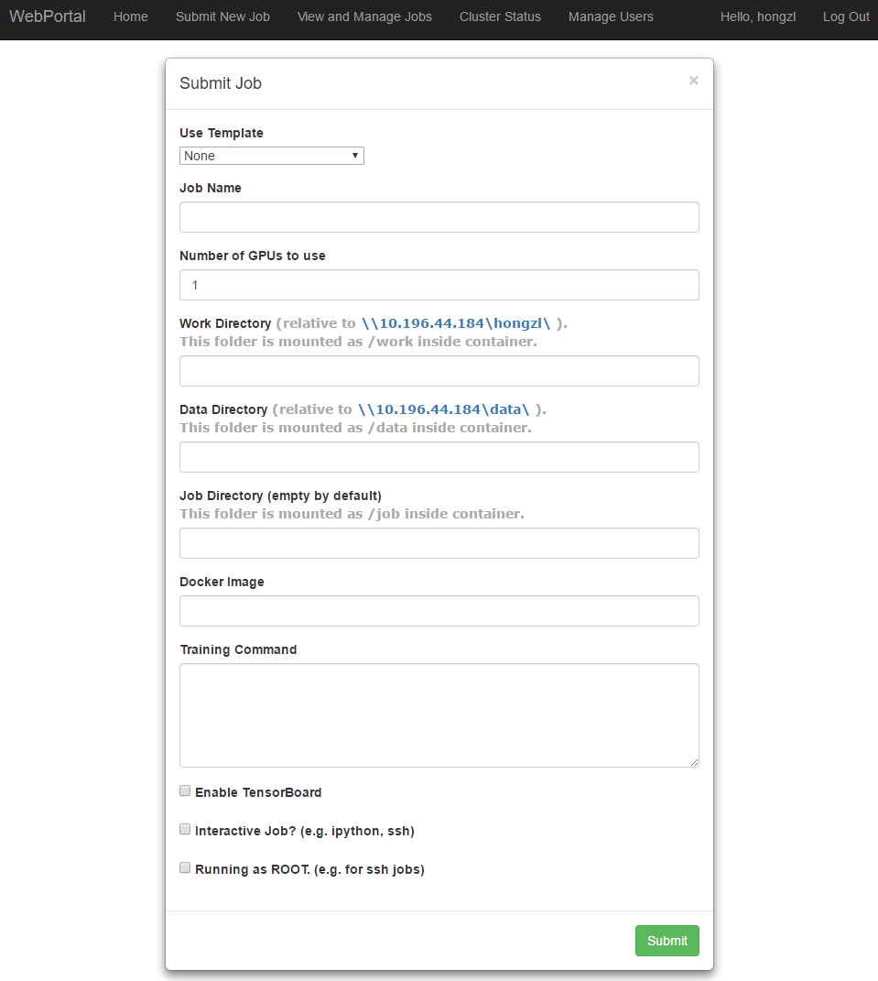
SQL server
Web Portal
RestfulAPI
Job Manager
K8s Master API
Cluster
Web Portal:
Authentication
Get job parameters from users and submit the request to RestfulAPI
Browse and manage the existing jobs
Monitor the cluster status
etc…

Slide 4
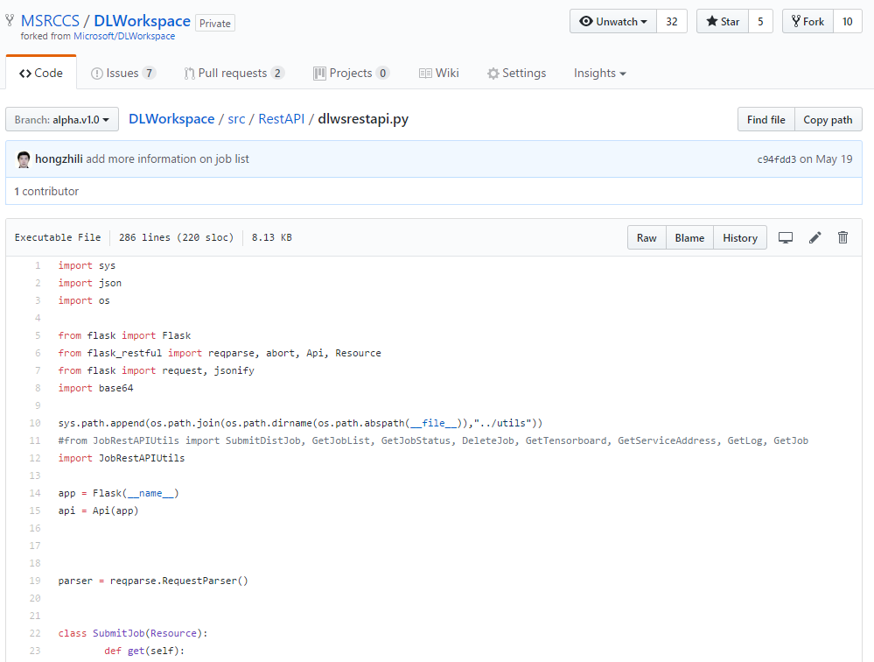
SQL server
Web Portal
RestfulAPI
Job Manager
K8s Master API
Cluster
RestfulAPI:
Process the request from web portal
SubmitJob
ListJobs
KillJob
GetJobDetail
GetClusterStatus
ApproveJob
etc…

Slide 5
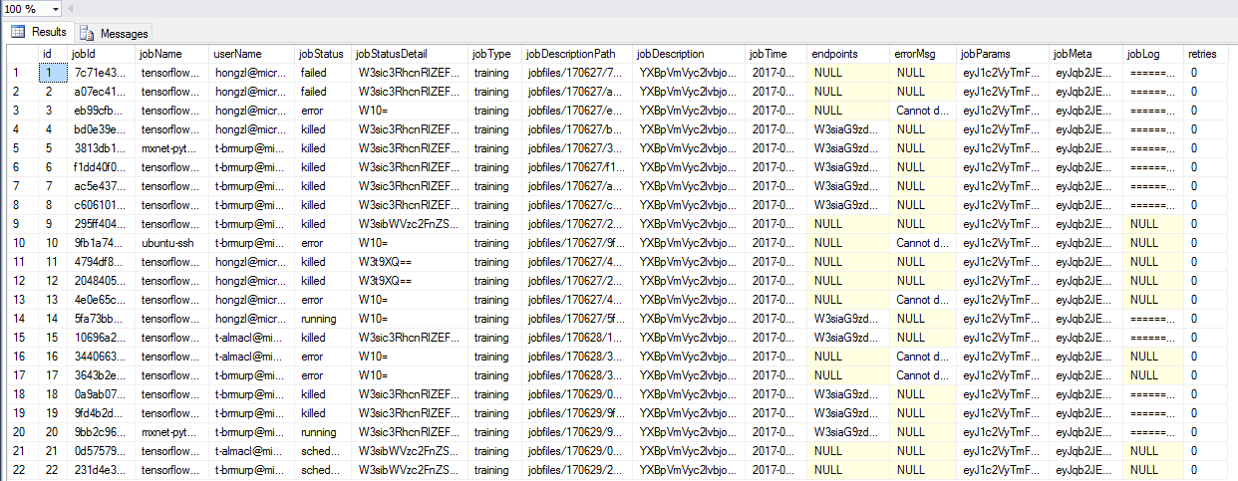
SQL server
Web Portal
RestfulAPI
Job Manager
K8s Master API
Cluster

Slide 6
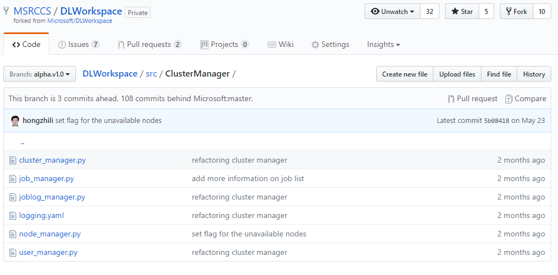
SQL server
Web Portal
RestfulAPI
Job Manager
K8s Master API
Cluster
Cluster Manager:
Job manager
Get new submitted jobs from SQL server, generate k8s pod description file and submitted to k8s master api.
The pod description file is generated from templates.
Query job status from k8s api and update the job status to SQL server
etc…
Log manager
Node manager
User manager
etc…

Slide 7
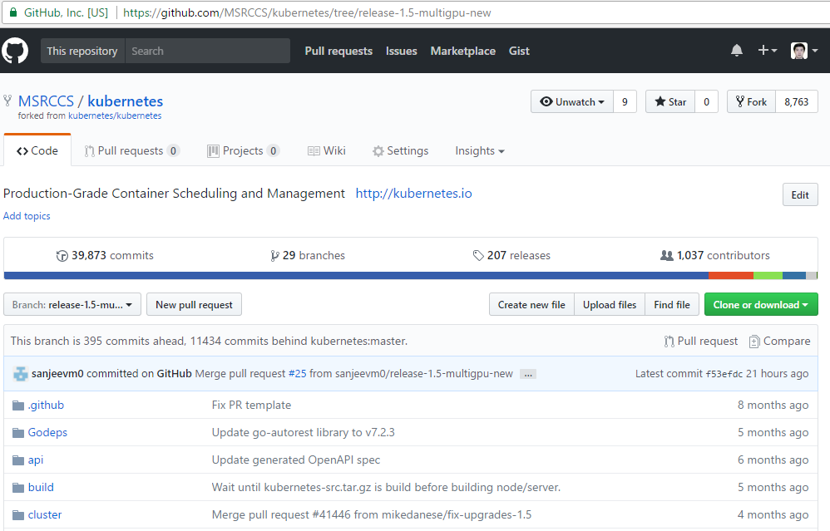
SQL server
Web Portal
RestfulAPI
Job Manager
K8s Master API
Cluster

Slide 8
DLWorkspace Job Runtime
Nvidia driver plugin
Shared storage
Special permission
Special device mapping

Slide 9
DLWorkspace Job Runtime - Nvidia driver plugin
Install nvidia driver on the host machine
CoreOS: use privileged Docker to insert kernel module
Ubuntu: apt-get install nvidia-***
Official Kubernetes:
Put driver libraries to a folder e.g. /opt/nvidia-driver/
Map the driver folder to container (the Docker image should be inherited from nvidia/cuda)
Our customized Kubernetes:
Call nvidia-docker-plugin to create a Docker volume for nvidia driver libraries
Mount the Docker volume to container

Slide 10
DLWorkspace Job Runtime - Shared Storage
All the shared storage are mounted on the host and then mapped to the container
Storage mount point
DLWorkspace system folder
storage, work, jobfiles
Soft link from storage mount point to system folder
Samba interface to allow users access their home folder (work folder) and data folder from windows machines (domain machines)

Slide 11
DLWorkspace Job Runtime - Special permission
E.g. run privileged Docker
Special approval work flow is supported (On going…)
If the cluster is configured to allow special permission, it may require additional approval from the system admin

