Slide 1


CODEBASICS SQL Project Challenge
Consumer Goods Ad-Hoc Insights
By – AYUSH NAUTIYAL
AtliQ Hardwares

Slide 2
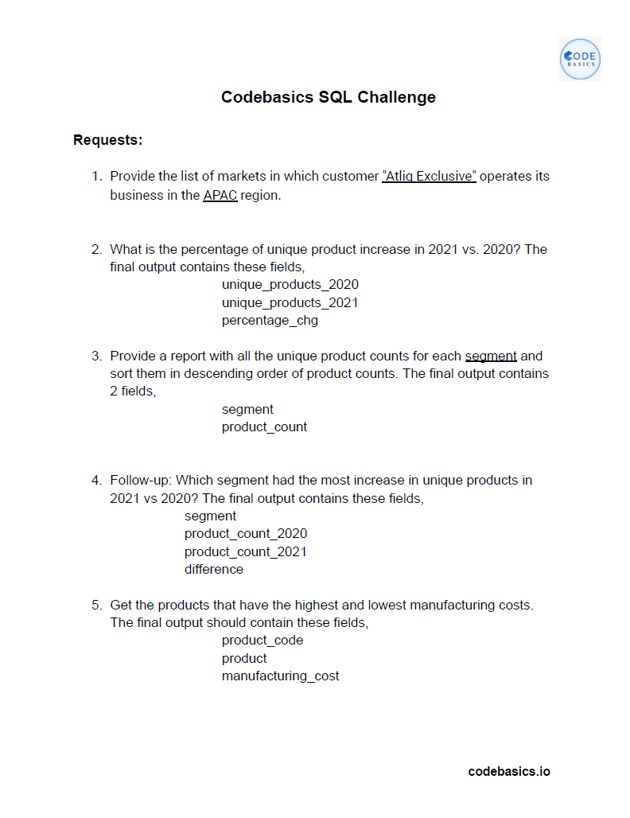
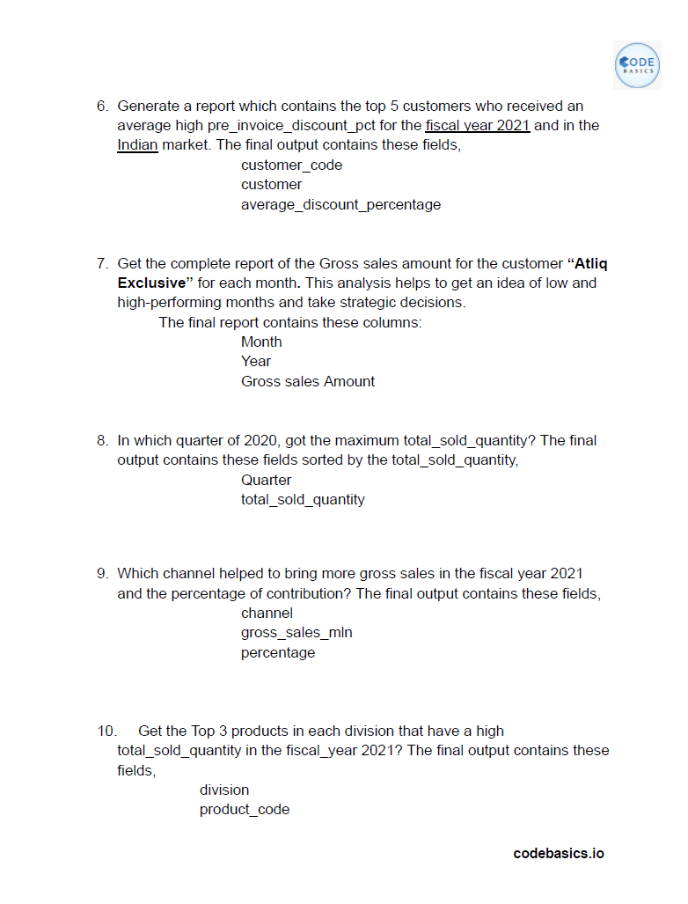
Ad – Hoc Requests

Slide 3
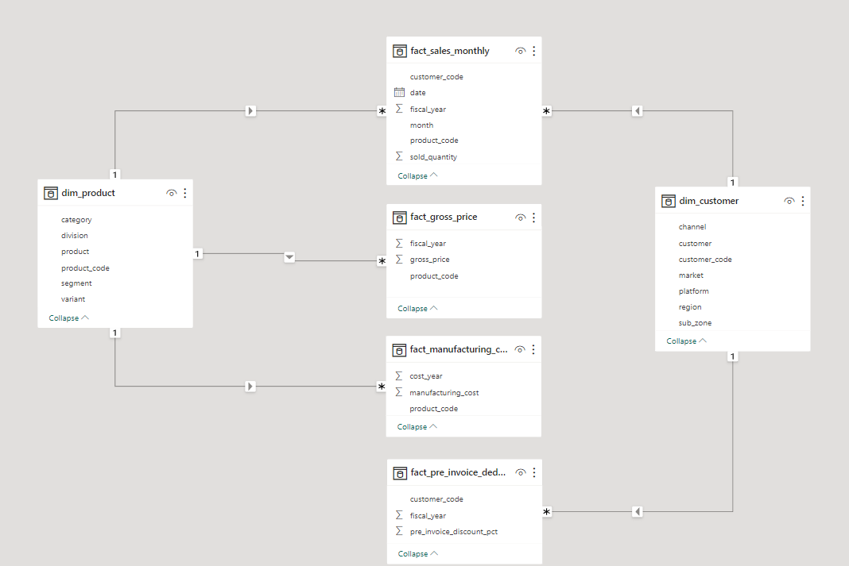
Getting familiar with the provided data.
Dimensions Tables :-
Product
Customer
Fact Tables :-
Sales Monthly
Gross Price
Manufacturing Cost
Pre Invoice Deductions
Schema :- Star
Tools Used :-
MySQL
Power BI

Slide 4
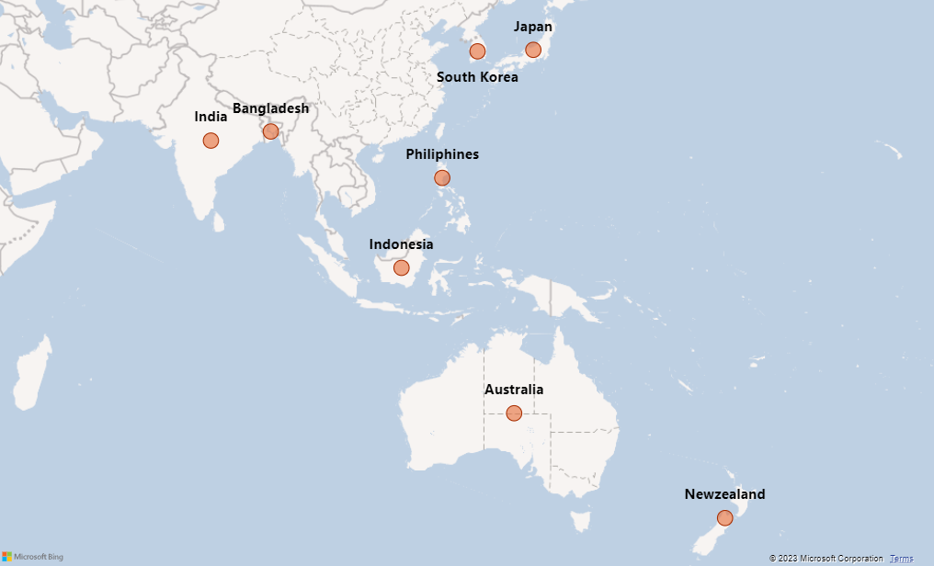
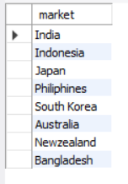
1. Provide the list of markets in which customer "Atliq Exclusive" operates its business in the APAC region.
Within the APAC region
the customer Atliq Exclusive operates in 8 different markets in total.

Slide 5
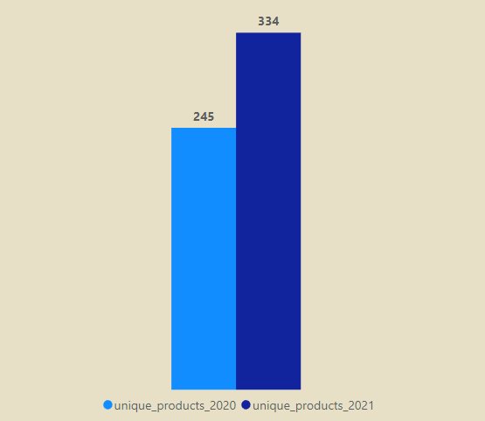

2. What is the percentage of unique product increase in 2021 vs. 2020?
36.33 %
In FY-2020 the number of unique products were 245 which increased to 334 in the FY-2021 showing a 36 % jump YoY.

Slide 6
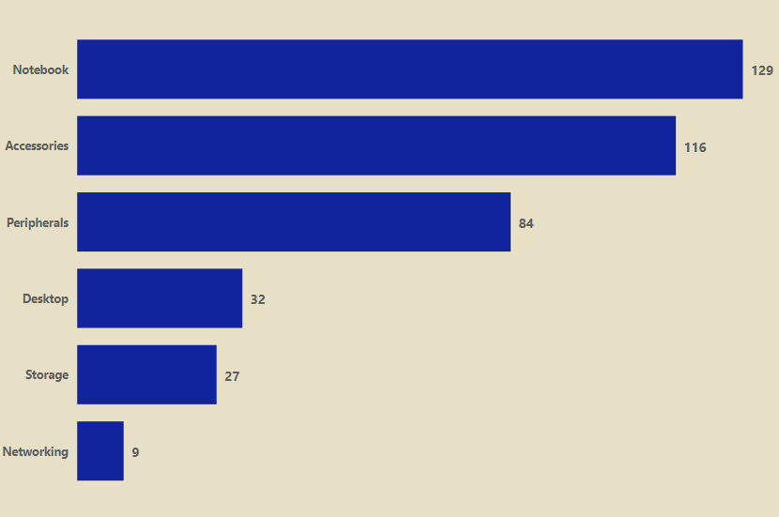
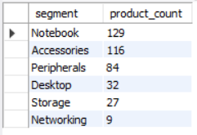
3. Provide a report with all the unique product counts for each segment and sort them in descending order of product counts.
Max
Notebook, Accessories & Peripherals are the top 3 segments in terms of unique product count. Combinedly they account for 83 % of the products portfolio of the company.
Desktop, Storage & Networking segments can be worked upon to bring new products. So growth potential is there if focused a bit more in these segments.
Segment to focus

Slide 7
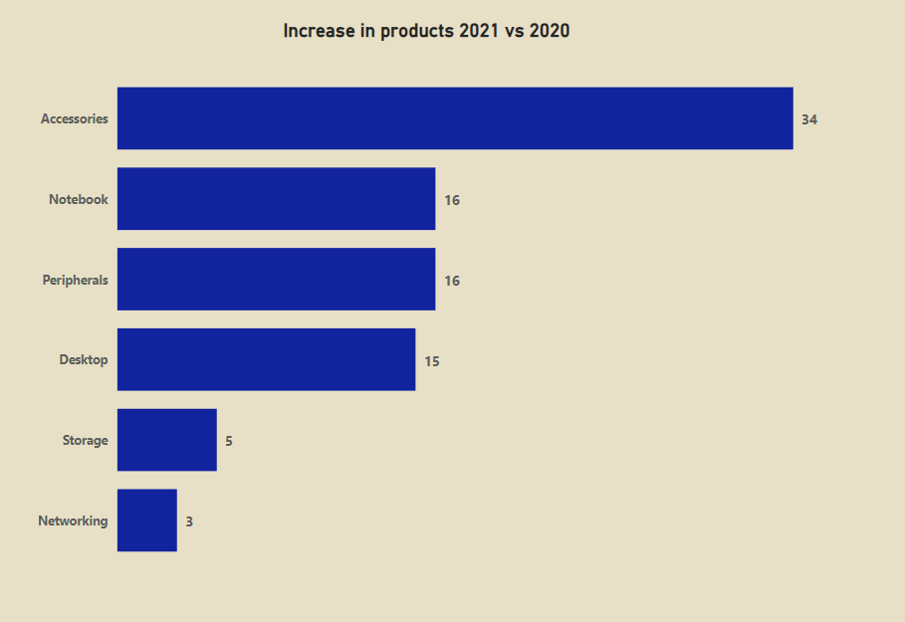
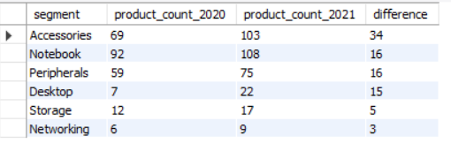
4. Which segment had the most increase in unique products in 2021 vs 2020?
Most increase
Accessories segment had the most increase in unique products YoY basis.
Storage and Networking segment can be focused more to introduce new products there. Thereby diversifying companies portfolio in every segment equally aggressively.
Segment to focus

Slide 8


5. Get the products that have the highest and lowest manufacturing costs.
Highest Manufacturing Cost –> AQ HOME Allin1 Gen 2 (Personal Computer) = 240.54 $
Lowest Manufacturing Cost –> AQ Master wired x1 Ms (Mouse) = 0.89 $
Personal Computer Mouse

Slide 9
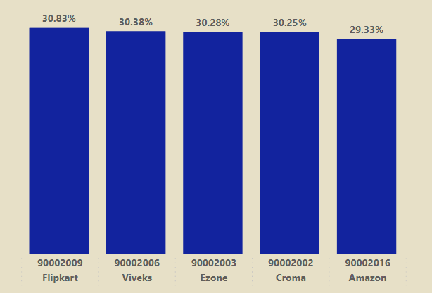
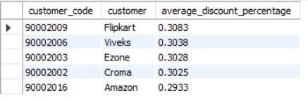
6. Generate a report which contains the top 5 customers who received an average high pre_invoice_discount_pct for the fiscal year 2021 and in the Indian market.
The max of average high pre invoice discount was given to Flipkart.
The min of average high pre invoice discount was given to Amazon.

Slide 10
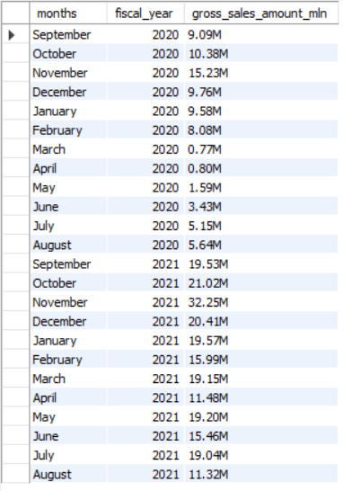
7. Get the complete report of the Gross sales amount for the customer “Atliq Exclusive” for each month . This analysis helps to get an idea of low and high-performing months and take strategic decisions.
FY - 2020
GROSS SALES - 79.50 M
MAX SALES - 15.23 M (NOVEMBER)
MIN SALES - 0.77 M (MARCH)
FY - 2021
GROSS SALES - 224.42 M
MAX SALES - 32.25 M (NOVEMBER)
MIN SALES - 11.32 M (AUGUST)
For FY-2020 the reason for the min sales month i.e., March can be attributed to COVID pandemic.
The reason for the max sales month i.e., November(Both FY) can be attributed to festive season of Diwali.

Slide 11
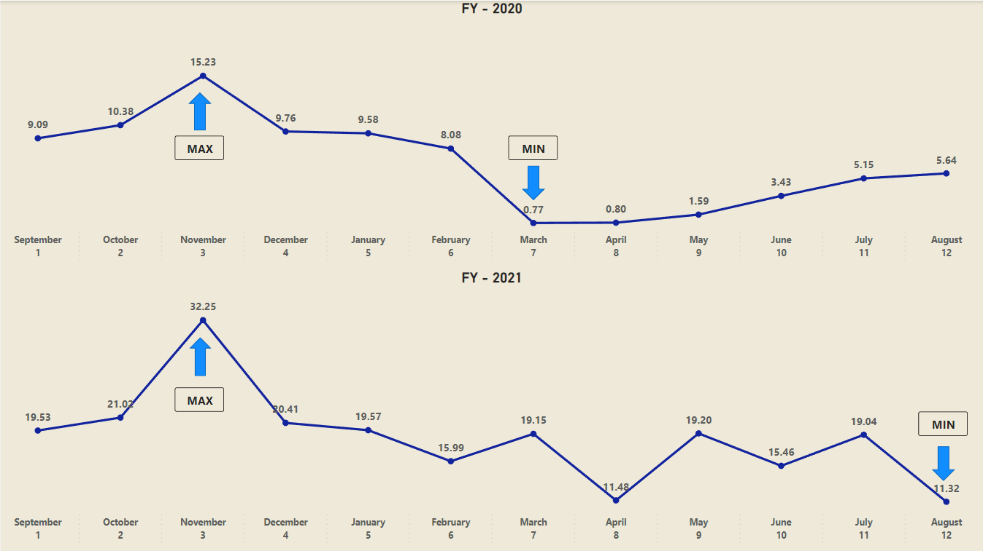

Slide 12
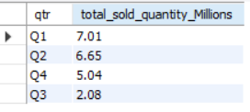
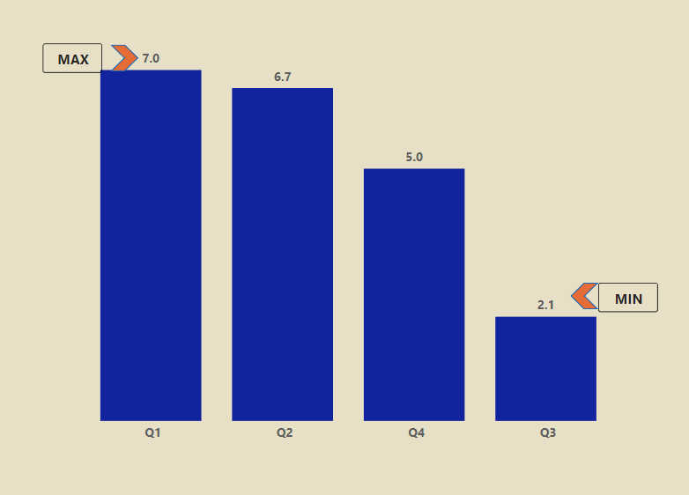
8. In which quarter of 2020, got the maximum total_sold_quantity?
The best performing quarter for fiscal year 2020
was "Quarter-1" with total of " 7 Million " quantity sold.
i.e. the month of September, October, November.
The worst performing was Quarter-3 with approximate of
2 Million quantities sold.
Q3 translates to - March, April, May.
So we must focus on how to improve the performance in these months.

Slide 13
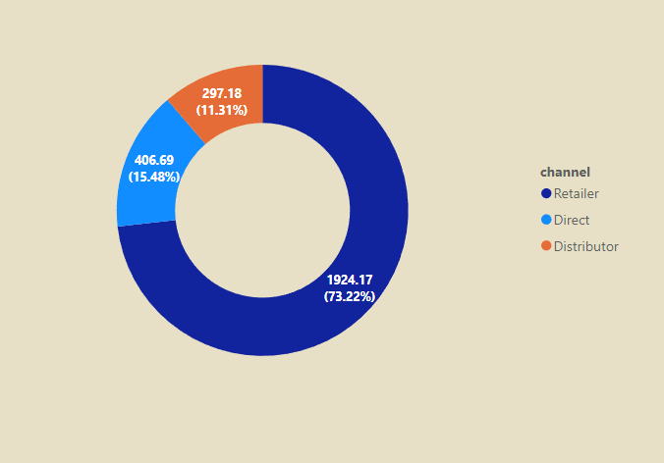
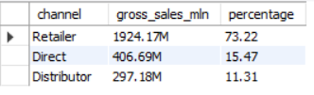
9. Which channel helped to bring more gross sales in the fiscal year 2021 and the percentage of contribution?
About 73% of the gross sales are from Retailer channel alone
which is the majority contributor for the company.
Where as Direct & Distributor channels comprises of
15%, 11% of gross sales respectively.
So we can focus on Direct channel as it is done by the company itself and will be more helpful in reducing total cogs and thereby increasing the overall profit margin of the company.

Slide 14
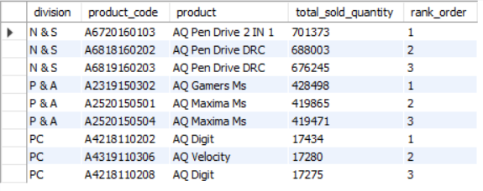
10. Get the Top 3 products in each division that have a high total_sold_quantity in the fiscal_year 2021?
In terms of sold quantity the order of performance of different division is as below :-
N & S
P & A
PC
Avg of top-3 quantities sold in each division :-
N & S with approx. 6.8 lakh units.
P & A with approx. 4.2 lakh units.
PC with approx. 17 thousand units.
We can also see that same product with different variants are in the top three within each division.

Slide 15
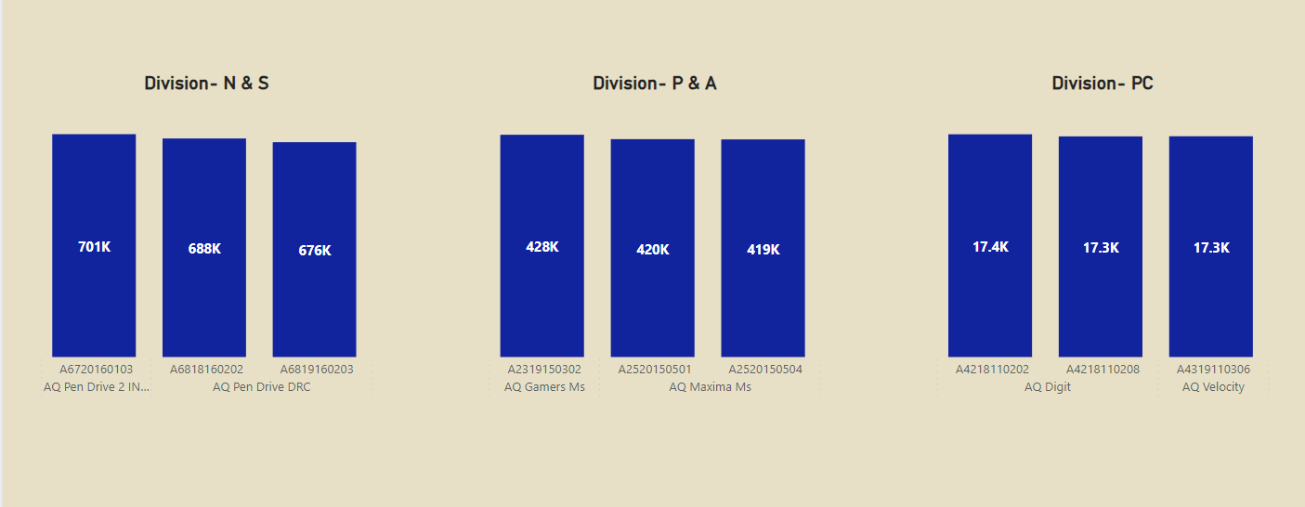
Top selling products in this division was Pen Drive with
around 7 lakh quantities sold.
Top selling products in this division was Mouse with around 4 lakh quantities sold.
Top selling products in this division was personal laptops
with around 17000 quantities sold.

Slide 16
END
THANK YOU…

