Slide 1
Oracle Assignment
Vivek Kumar

Slide 2
Introduction
Problem Statement
Algorithm description
Process Diagram
Class Diagram
Project Structure and Content
Junit Test
Performance
Questionnaires

Slide 3
Problem Statement
Write an application that takes score of a bowling game. It should take...
–the number of pins knocked down by each ball as input and
–gives the score for each frame as output

Slide 4
Algorithm description
The approach is to have 2 dimensional integer array which collect the score of each frame.
Length of the above array will 2x12 i.e 2 for row and 12 for column.
Length of 12 is taken because if last frame is strike then there would 2 more strikes
There is one score array which get calculated after all the frame or strikes are done.
Then Display of the result.
Note : Used System.out.println for fair display in the console, this can be replaced by logger or if there are any UI.

Slide 5
Process Diagram
Frame Start
Enter the input 1
Enter the input 2
No
No
Is input 0-10?
Yes
Is Strike?
Yes
Is last frame?
Calculate the results
No
End
4

Slide 6
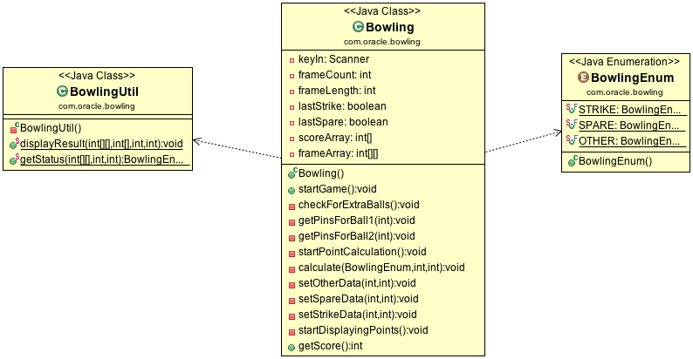
Class Diagram

Slide 7
Project Structure and Content
It’s a maven project on serve. Data file is stored in the class path.
Technology Stack
      Java-1.7/1.8
      Junit-4.2
src/main/java | Application/Library sources
src/main/resources | Application/Library resources
src/test/java | Test sources
src/test/resources | Test resources

Slide 8
Junit
All together 8 test scenario written which will run both valid and Invalid Input
The test case will be invoked once for each row of data. (Parameterized Test)
Test Methods:
            testGame

