Slide 1
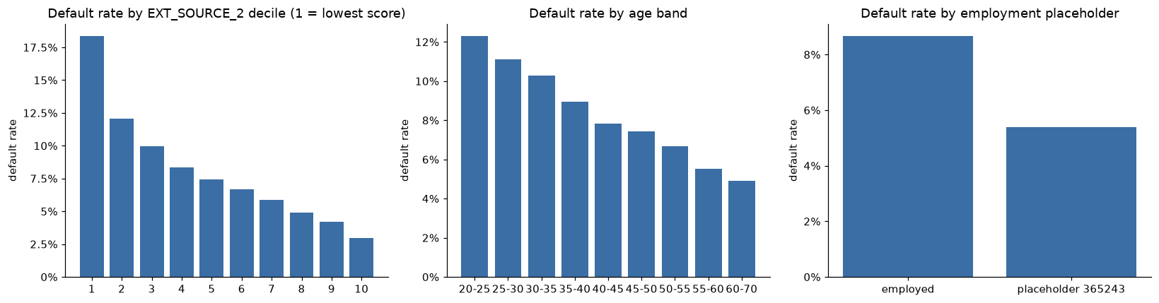
Predicting credit default, data and risk signals
• 307,507 past loans, 8.1% defaulted; 48,744 new applicants to score
• 7 linked tables (application, credit bureau (+monthly balance), previous Home Credit loans, instalments, POS & credit-card balances)
• Strongest signals are the external credit scores; for EXT_SOURCE_2 the default rate falls from 18.4% in the lowest decile to 3.0% in the highest
• Younger applicants default more, 12.3% at 20-25 vs 4.9% at 60-70
• Clients with the 'pensioner' placeholder (DAYS_EMPLOYED = 365243) default at 5.4% vs 8.7% for the employed, kept as a flag
• Imbalanced target → judged by AUC / Gini / KS, not accuracy
Home Credit Indonesia · Data Scientist assessment · Nauval Zulfikar · 1/5

Slide 2
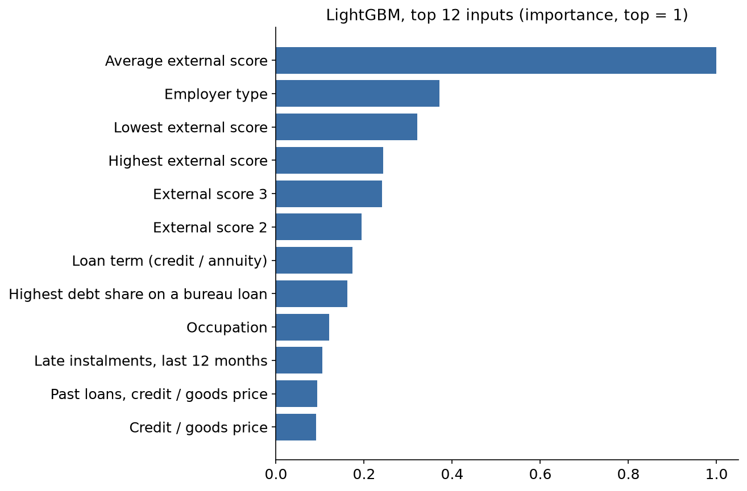
Workflow & business-logic features
• Raw CSVs → 4 feature scripts → 2 models → validation → scoring (one command, run_all.sh)
• Affordability, credit/income, annuity/income, loan term (credit/annuity)
• Stability, age, years employed, employment-to-age ratio
• Bureau, active loans, total debt ratio, worst days-past-due
• Past Home Credit behaviour, refusal rate, recent refusals, late-payment rate, under-payment, card utilisation
• 220 features for LightGBM; 29 for the scorecard (IV filter + correct risk direction only)
• Without the external scores LightGBM still reaches AUC 0.766, above the best simple rule (0.717), so the built features carry their own signal
• Gender excluded from both models (fair lending)
Home Credit Indonesia · Data Scientist assessment · Nauval Zulfikar · 2/5

Slide 3
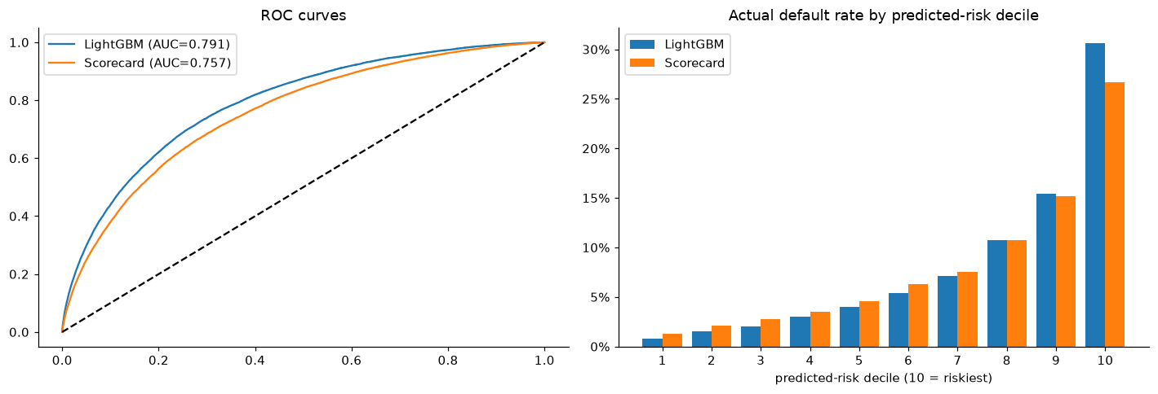
Two models, accuracy vs. explainability
Metric | LightGBM | Scorecard (LR)
OOF AUC | 0.791 | 0.757
Gini | 0.582 | 0.515
KS | 0.441 | 0.385
Fold AUC std | 0.0033 | 0.0034
AUC on own training data | 0.881 | 0.760
PSI train→test | 0.0041 | 0.0012
• Both beat the best simple rule (average of external scores, AUC 0.717); both stable across folds (std < 0.004); scores stable train→test (PSI < 0.01) but the loan-term input shifted
• LightGBM +0.033 AUC, but train 0.88 vs valid 0.79 → watch overfit
• Scorecard has no overfit, every coefficient has the expected sign, points 463 to 662
Home Credit Indonesia · Data Scientist assessment · Nauval Zulfikar · 3/5

Slide 4
Scorecard, every decision comes with a reason
Top variables (by IV) | Meaning | IV
APP_EXT_MEAN | average external credit score | 0.63
APP_EXT_MIN | worst external credit score | 0.48
APP_EXT_SOURCE_3 | external score 3 | 0.34
APP_EXT_SOURCE_2 | external score 2 | 0.33
APP_EXT_SOURCE_1 | external score 1 | 0.16
BUR_DAYS_CREDIT_MEAN | how recent bureau loans are | 0.13
APP_EMPLOYED_YEARS | years in current job | 0.12
BUR_TOTAL_DEBT_RATIO | outstanding / total bureau debt | 0.11
Example, INS_RECENT_LATE_RATE (late instalments, last 12 months)
Late share | Clients | Default rate | Points
< 2% | 50% | 6.7% | 21.6
2%-9% | 7% | 10.1% | 16.4
9%-36% | 10% | 12.0% | 14.2
≥ 36% | 4% | 14.7% | 11.5
none in last 12 months | 29% | 7.8% | 19.2
• 29 of 73 candidates kept, with information value ≥ 0.02, then only variables whose effect has the expected sign (APP_AGE_YEARS dropped)
• Score = sum of points per variable; 600 points = 50:1 good:bad odds, every 20 points doubles the odds
• Reason codes for a rejection = the variables where the applicant lost the most points vs. the best bin
• Missing values form their own bin, scored by their own default rate (no instalments in the last 12 months, 29% of clients, 7.8% default, 19.2 points)
Home Credit Indonesia · Data Scientist assessment · Nauval Zulfikar · 4/5

Slide 5
Business use & next steps
Reject riskiest | Default rate of approved | Defaults avoided | Break-even ratio
5% | 6.5% | 23% | 1.66
10% | 5.6% | 38% | 2.29
15% | 4.9% | 49% | 2.88
20% | 4.3% | 57% | 3.42
30% | 3.4% | 70% | 4.41
• LightGBM for ranking; the scorecard where reason codes are needed (adverse-action letters, OJK audit); recalibrate on recent loans before pricing
• Grey zone, auto-approve low risk, auto-reject top risk, manual review in the middle
• Monthly, PSI of the score and top-10 inputs (watch > 0.1, act > 0.25) and early default; quarterly, Gini, calibration and refusal rate by gender and age
• Limits, no application dates so no time-based test; test set is 99% cash loans (cash-loan AUC 0.790); heavy reliance on external scores
• Loan terms are shorter in test (PSI 1.6) though the score stays stable; under-30s are refused far more than their risk explains
• Next, shadow run, go live once the shift is explained, agree the cut-off with the business, validate on dated data
• Today 8.1% of loans default
• Refusing the riskiest 10% pays off only if a default loses more than 2.3x what a good loan earns, per unit of credit
• Break-even ratio = credit of good clients refused ÷ credit of defaulters refused; the bank plugs in its own margin
• Past refusals have no outcome → confirm with a small live test
Home Credit Indonesia · Data Scientist assessment · Nauval Zulfikar · 5/5

