Slide 1
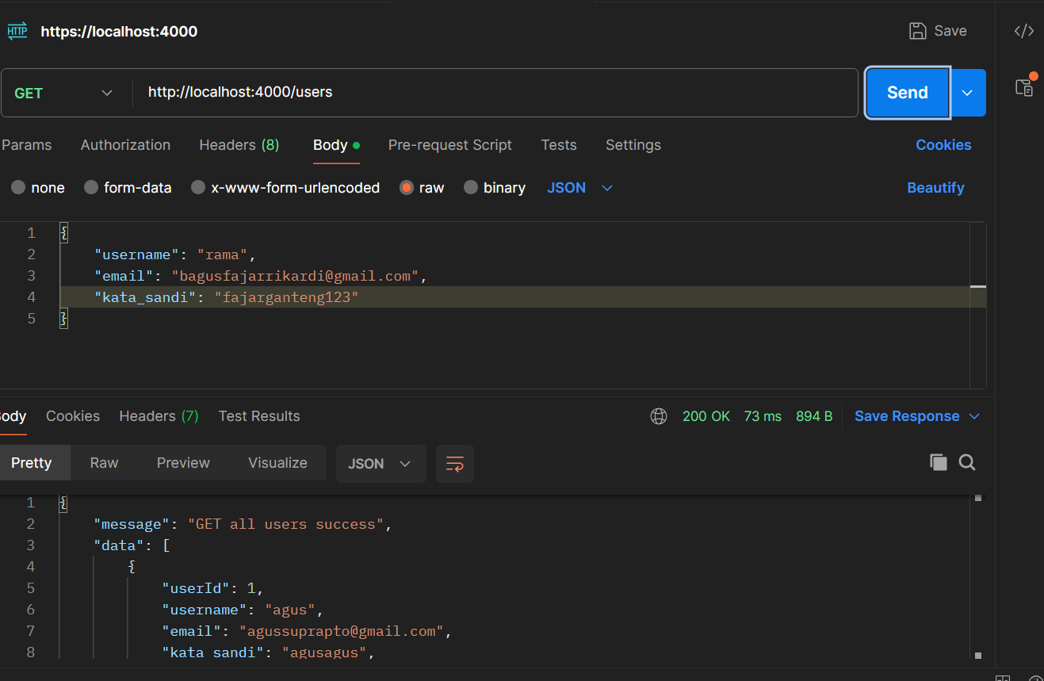
GET ALL USER

Slide 2
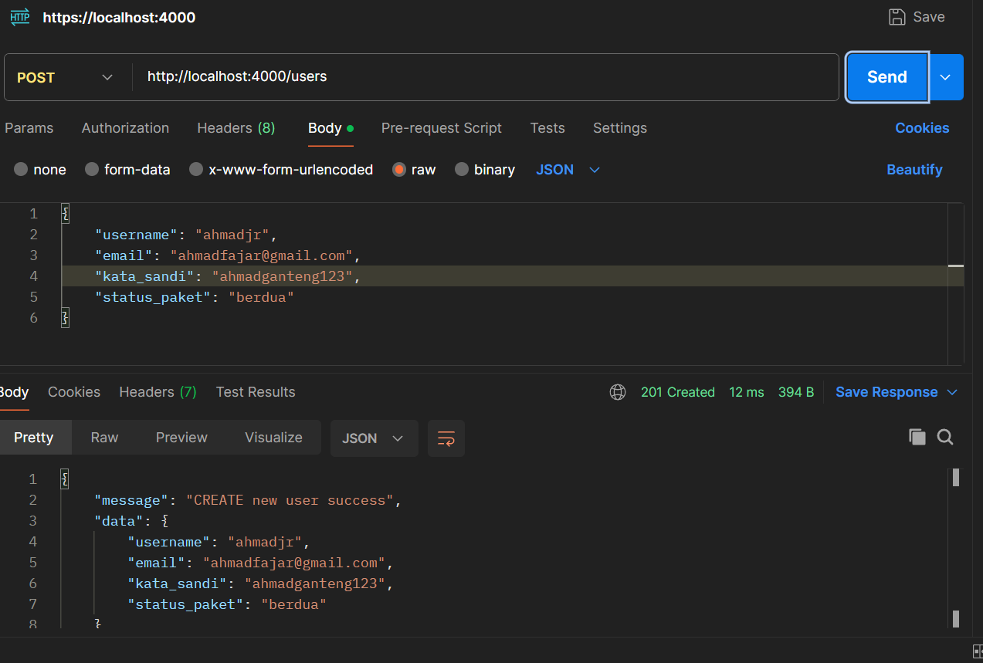
CREATE USER

Slide 3
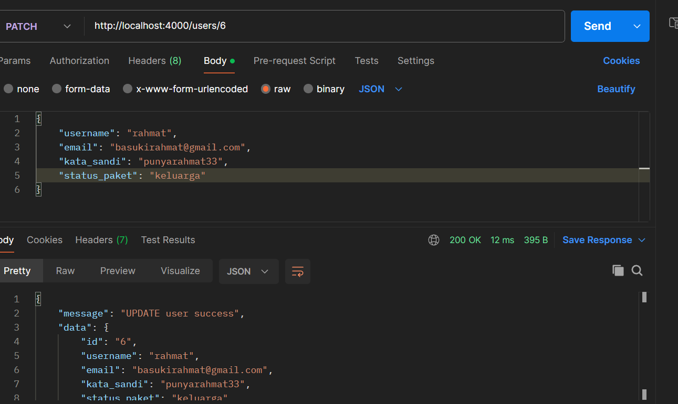
UPDATE USER

Slide 4
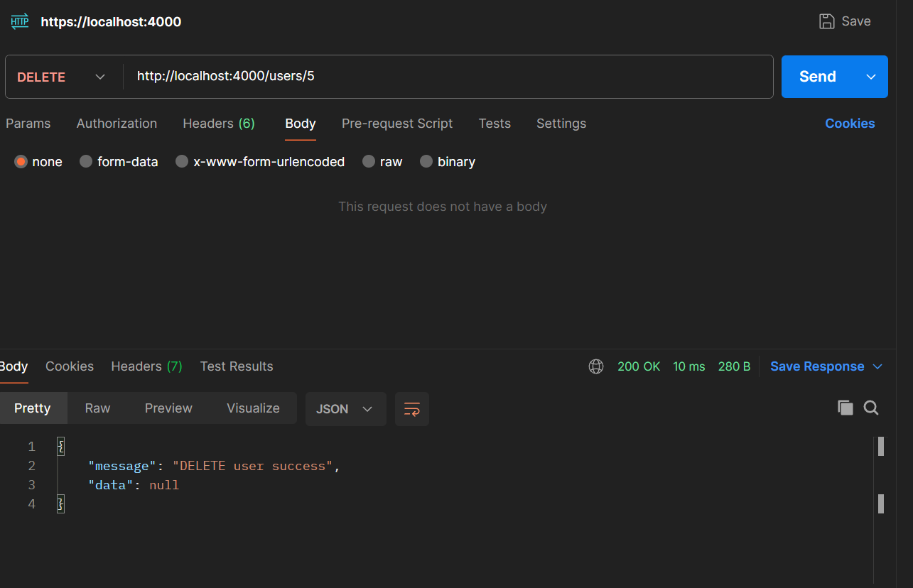
DELETE USER

Slide 5
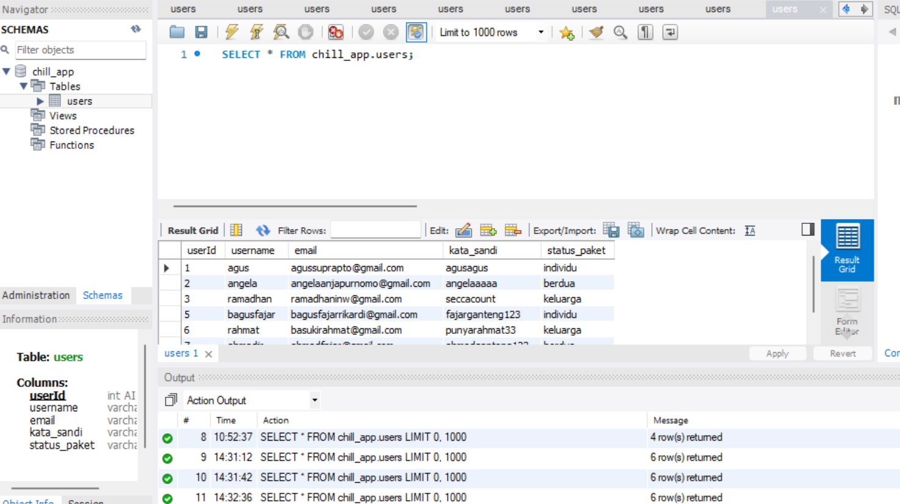
Chill_app Tabel in Mysql

