Slide 1
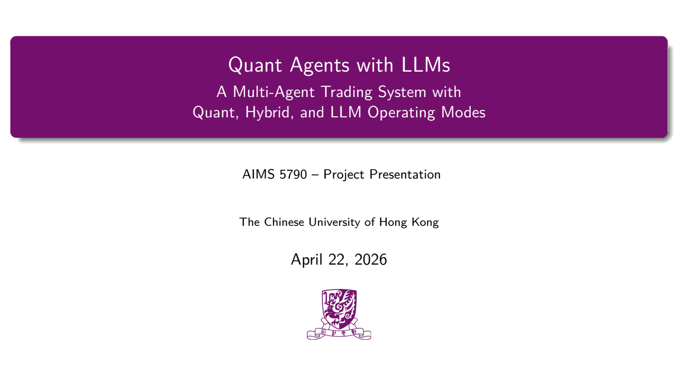
Notes:
Good morning/afternoon everyone. Thank you for being here. Today we'll be presenting our AIMS 5790 project: **Quant Agents with LLMs** — a multi-agent trading system that supports quant, hybrid, and LLM operating modes.
Our team built a full research platform from the ground up to answer one core question: what happens when you put rule-based quantitative agents and large language models side by side in the same trading infrastructure?

Slide 2

Notes:
Here's a quick roadmap for today. We'll start with our motivation and research problem, then review related work. The core of the talk is the system design section, followed by our research methodology. After that, we'll walk through experimental results across three different market windows. Finally, we'll discuss strengths, limitations, and future directions.

Slide 3
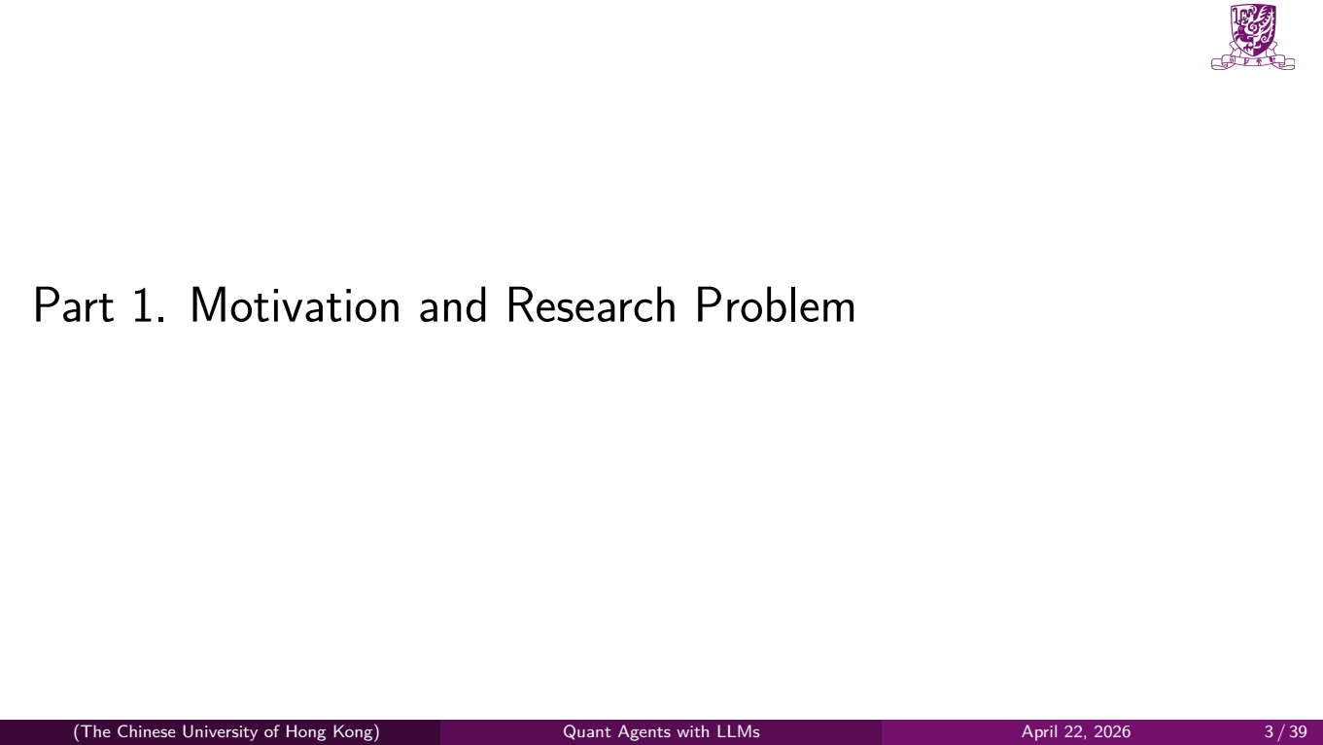
Notes:
Let's begin with the motivation.

Slide 4
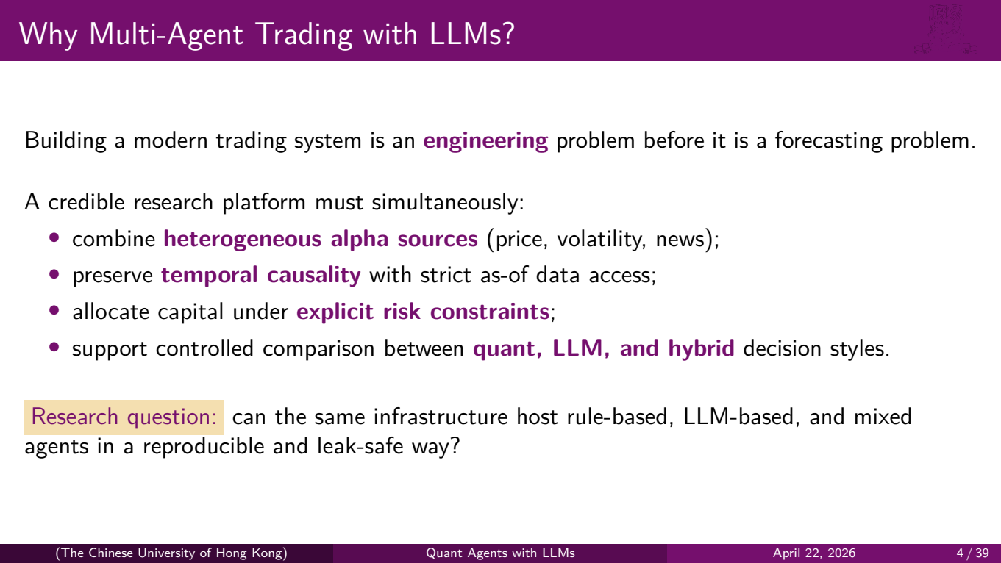
Notes:
Building a modern trading system is, first and foremost, an **engineering** problem — before it is a forecasting problem. There's a lot of academic work on "can an LLM predict stock prices?" But that's actually the easy part to test once you have the infrastructure right.
A credible research platform has to do four things simultaneously:
First, it must combine **heterogeneous alpha sources** — price-based momentum, volatility-based mean reversion, and textual news sentiment — all of which have different scales and reliabilities.
Second, it must preserve **temporal causality**. This means strict as-of data access — you can only see data that was actually available at time *t* when making a decision at time *t*. This sounds obvious, but getting it wrong is the single most common source of inflated backtest performance in both academia and industry.
Third, it needs to allocate capital under **explicit risk constraints** — not just generate signals, but actually turn those signals into a portfolio that respects exposure limits, concentration limits, and drawdown limits.
And fourth, it must support **controlled comparison** between quant, LLM, and hybrid decision styles. You need to swap components in and out while keeping everything else fixed.
Our core research question is shown at the bottom: can the same infrastructure host rule-based, LLM-based, and mixed agents in a reproducible and leak-safe way?

Slide 5
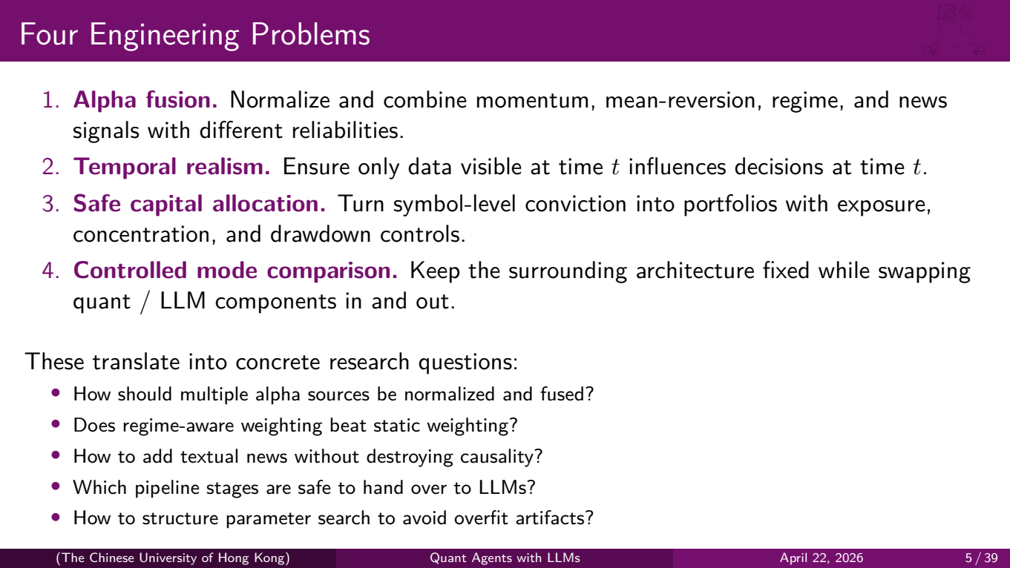
Notes:
These requirements translate into four concrete engineering problems.
**Number one: alpha fusion.** When you have a momentum signal that says "buy" and a mean-reversion signal that says "sell" and a news signal that says "neutral," how do you normalize and combine them? They have different scales, different reliabilities, and different update frequencies.
**Number two: temporal realism.** We need a guarantee, enforced at the infrastructure level, that only data visible at time *t* influences decisions at time *t*. We actually write tests for this — a news article published tomorrow must be invisible today, even if it's already in our cache.
**Number three: safe capital allocation.** It's not enough to say "we are bullish on SPY." The system needs to decide *how much* to buy, subject to gross exposure limits, per-position concentration caps, and drawdown-based scaling.
**Number four: controlled mode comparison.** We want to keep the surrounding architecture — the data pipeline, the portfolio construction, the risk layer, the execution — completely fixed, and only swap the decision-making agents between quant and LLM versions.
These engineering problems map directly to the five research questions at the bottom, which we'll revisit in the results section.

Slide 6

Notes:
Now let's look at how our approach compares to related work.

Slide 7
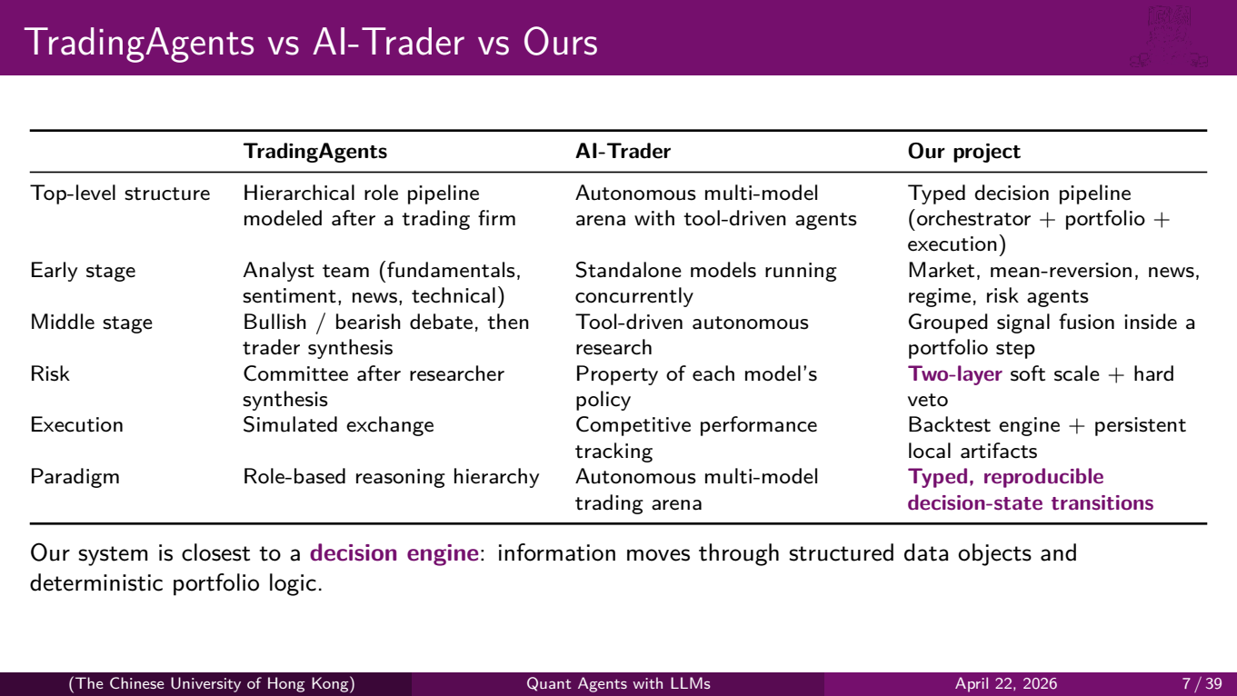
Notes:
This table compares two prominent multi-agent trading systems with our project.
**TradingAgents**, from Tauric Research, models a trading firm. It has analyst teams, a bullish-bearish debate mechanism, a trader synthesis step, and a risk committee. The key idea is a hierarchical role pipeline — analysts argue, then a trader makes the call, then a committee reviews.
**AI-Trader**, from HKU, takes a different approach. It's an autonomous multi-model arena where different AI models trade competitively. Each model runs independently with its own tool-driven research process, and performance is tracked competitively.
**Our project** is closest to what we call a **decision engine**. Instead of long-form reasoning traces or competitive arenas, information moves through typed data objects and deterministic portfolio logic.
Let's highlight two key differences. In the risk row, TradingAgents uses a committee after researcher synthesis, and AI-Trader treats risk as a property of each model's policy. We use a **two-layer** system: soft scaling during signal fusion and hard vetoes after portfolio construction. Risk is not an afterthought — it's embedded at two points in the pipeline.
And in the paradigm row, our system is about **typed, reproducible decision-state transitions**. Every intermediate result — every signal, every order intent, every fill — is a typed Python object with a defined schema. This makes debugging, testing, and comparison much easier than parsing natural language reasoning traces.

Slide 8
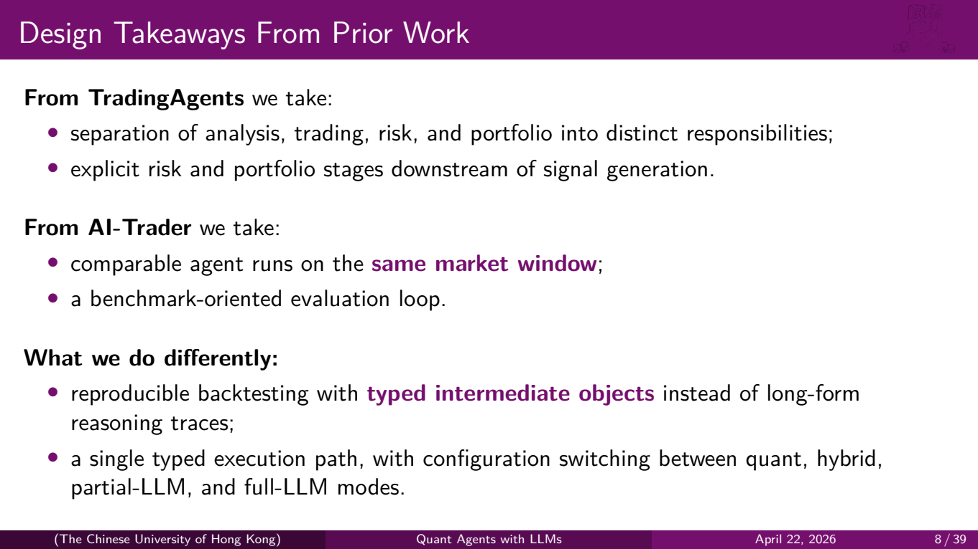
Notes:
So what do we take from each system?
From **TradingAgents**, we take the idea of clear separation of responsibilities — analysis, trading, risk, and portfolio as distinct stages — and the principle that risk and portfolio stages should sit downstream of signal generation, not mixed in.
From **AI-Trader**, we take the idea of running comparable agents on the **same market window** with the same data and the same time period, and evaluating them with a benchmark-oriented loop.
What we do **differently** is use **typed intermediate objects** instead of long-form reasoning traces. Every step produces a structured output — a Signal object, an OrderIntent object — not a paragraph of text. And we use a single execution path with configuration switching, not separate codebases for quant versus LLM.

Slide 9
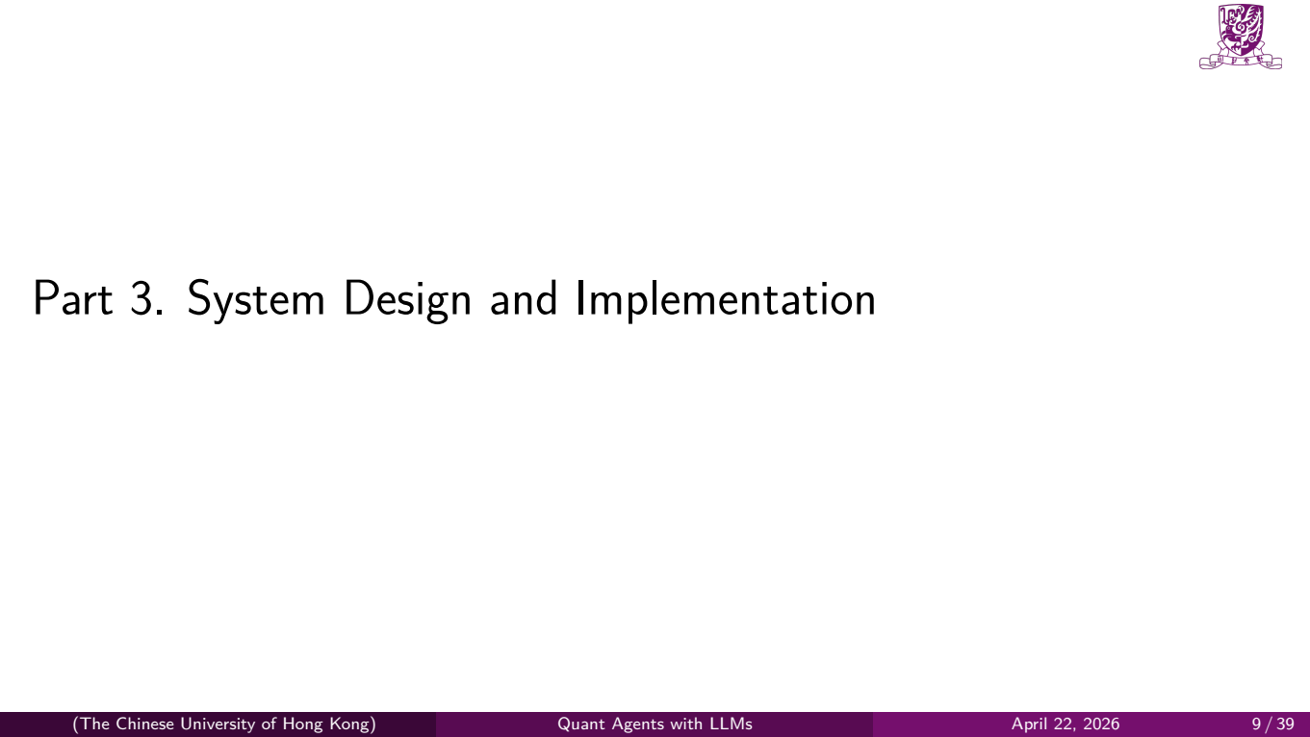
Notes:
Now let's dive into the system architecture.

Slide 10
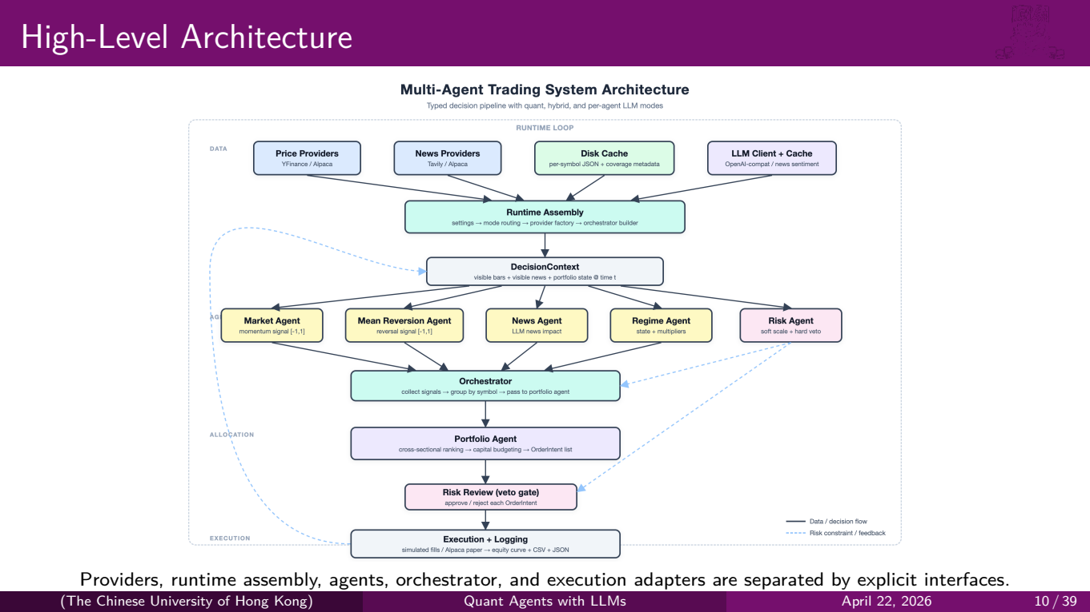
Notes:
This is our full system architecture. Let's walk through it top to bottom.
At the top, in the **DATA** layer, we have four provider categories: price providers from Yahoo Finance or Alpaca, news providers from Tavily or Alpaca, a disk cache for per-symbol data with range-coverage metadata, and an LLM client with its own cache for news sentiment queries.
Everything flows into the **Runtime Assembly**, which handles settings, mode routing, and provider factory construction. The mode routing is critical — this is where we decide, based on configuration, whether each agent should run in quant mode or LLM mode.
Below that, we build a **DecisionContext** — this is the snapshot of all visible bars, visible news, and the current portfolio state at time *t*. This object is what agents actually receive.
In the **AGENTS** layer, we have five agents: Market, Mean Reversion, News, Regime, and Risk. Each produces typed signals. These flow into the **Orchestrator**, which collects and groups signals by symbol, then passes them to the **Portfolio Agent** for cross-sectional ranking and capital allocation.
After portfolio construction, orders go through a **Risk Review** veto gate — this is the hard layer. Finally, approved orders reach the **Execution and Logging** layer at the bottom, which handles simulated fills or Alpaca paper trading, and produces equity curves and trade logs.
Notice the dashed blue lines — those represent risk constraint and feedback loops flowing back up through the system.

Slide 11
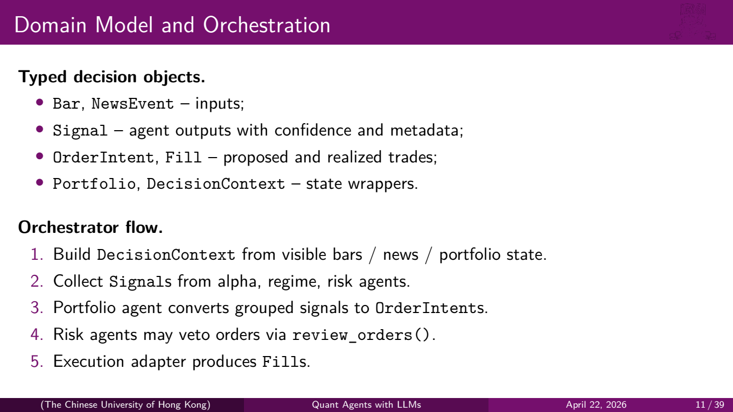
Notes:
Let's talk about the typed decision objects that flow through this architecture.
We have **input types**: Bar and NewsEvent. These are the raw data.
**Signal** is the output of each agent — it carries a direction, a confidence score, and metadata about which agent produced it.
**OrderIntent** and **Fill** represent proposed trades and realized trades, respectively.
And **Portfolio** and **DecisionContext** are state wrappers that capture the full state at any point in time.
The orchestrator flow is straightforward: build the DecisionContext, collect Signals from all agents, have the portfolio agent convert grouped signals into OrderIntents, let risk agents veto orders, and finally produce Fills through the execution adapter. This is a fixed, deterministic sequence — no dynamic agent-to-agent communication, no unpredictable message passing.

Slide 12
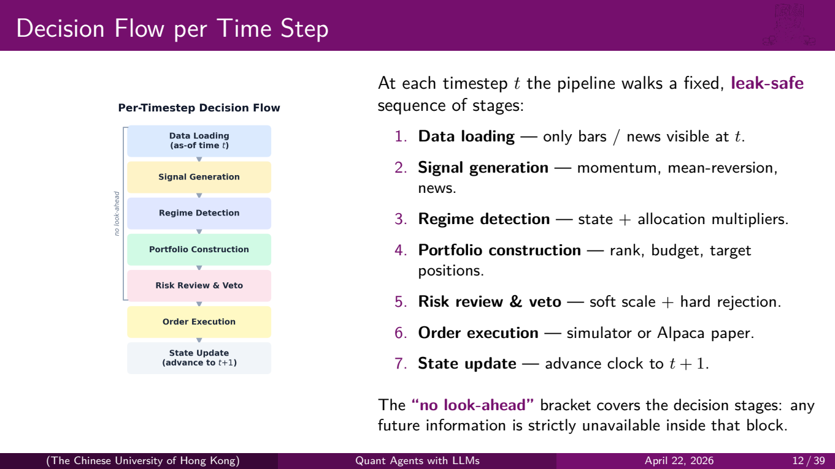
Notes:
This diagram on the left shows the per-timestep decision flow, and we should draw attention to the "no look-ahead" bracket on the left side.
At each timestep *t*, the pipeline walks through seven stages in a fixed order:
1. **Data loading** — only bars and news visible at time *t* are loaded.
2. **Signal generation** — momentum, mean-reversion, and news agents produce their scores.
3. **Regime detection** — the regime agent classifies the current market state and emits allocation multipliers.
4. **Portfolio construction** — signals are ranked, budgeted, and converted into target positions.
5. **Risk review and veto** — soft scaling has already been applied; now the hard layer can reject individual orders.
6. **Order execution** — either through the simulator or Alpaca paper trading.
7. **State update** — advance the clock to *t+1*.
The critical point is that the "no look-ahead" bracket covers all the decision stages. Any information from the future is structurally unavailable inside that block. This isn't just a convention — it's enforced by the backtest engine's data access API.

Slide 13
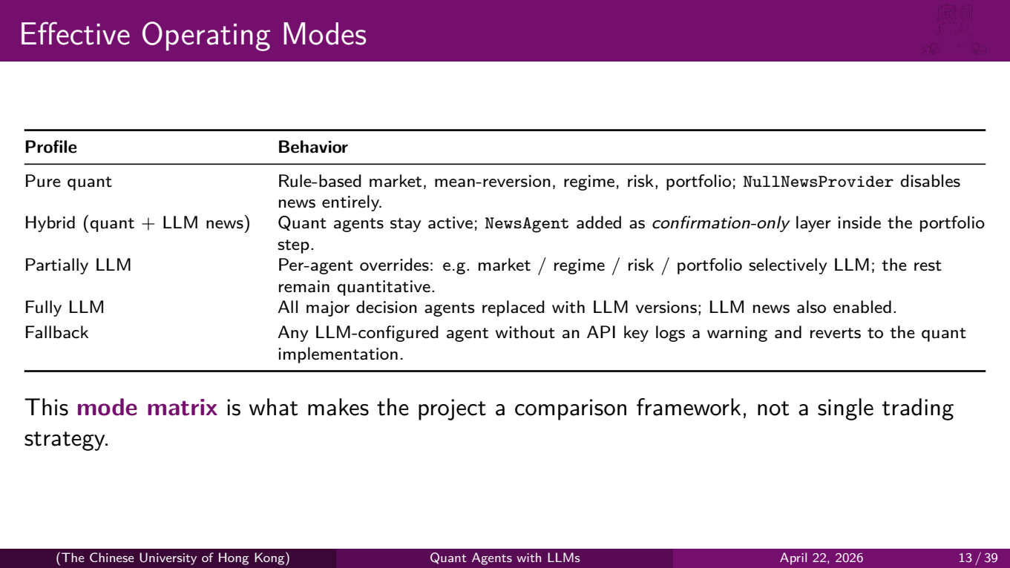
Notes:
One of the key contributions of our project is this **mode matrix**. It's what makes the system a comparison framework, not a single trading strategy.
We support five operating profiles:
**Pure quant**: all agents are rule-based. The NullNewsProvider is injected, so there's no news at all. This is our baseline.
**Hybrid**: quant agents stay active, and we add a NewsAgent as a confirmation-only layer. The news agent can scale down or veto a quantitative trade, but it cannot initiate trades on its own.
**Partially LLM**: you can override individual agents — for example, use an LLM for the regime agent but keep everything else quantitative. This is useful for ablation studies.
**Fully LLM**: all major decision agents are replaced with their LLM versions. This gives us the "what if we let GPT do everything?" baseline.
**Fallback**: if any LLM-configured agent doesn't have an API key, it logs a warning and silently reverts to the quant implementation. This makes the system robust to configuration errors.

Slide 14
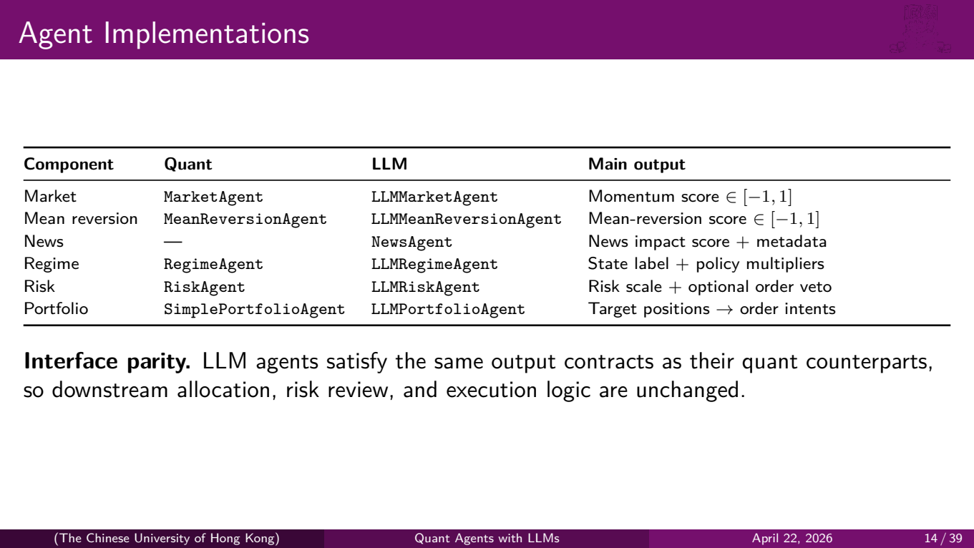
Notes:
This table shows every agent component and its quant and LLM variants.
For Market, Mean Reversion, Regime, Risk, and Portfolio, we have both a quant implementation and an LLM implementation. News is LLM-only — there's no quant version because news analysis is inherently a language task.
The key design principle is **interface parity**. Every LLM agent satisfies the exact same output contract as its quant counterpart. The LLMMarketAgent produces a momentum score in [-1, 1], just like MarketAgent. The LLMRiskAgent produces a risk scale and optional veto, just like RiskAgent.
This means downstream logic — portfolio construction, risk review, execution — is completely unchanged regardless of which agent variant is running. You can swap agents without touching any other code.

Slide 15
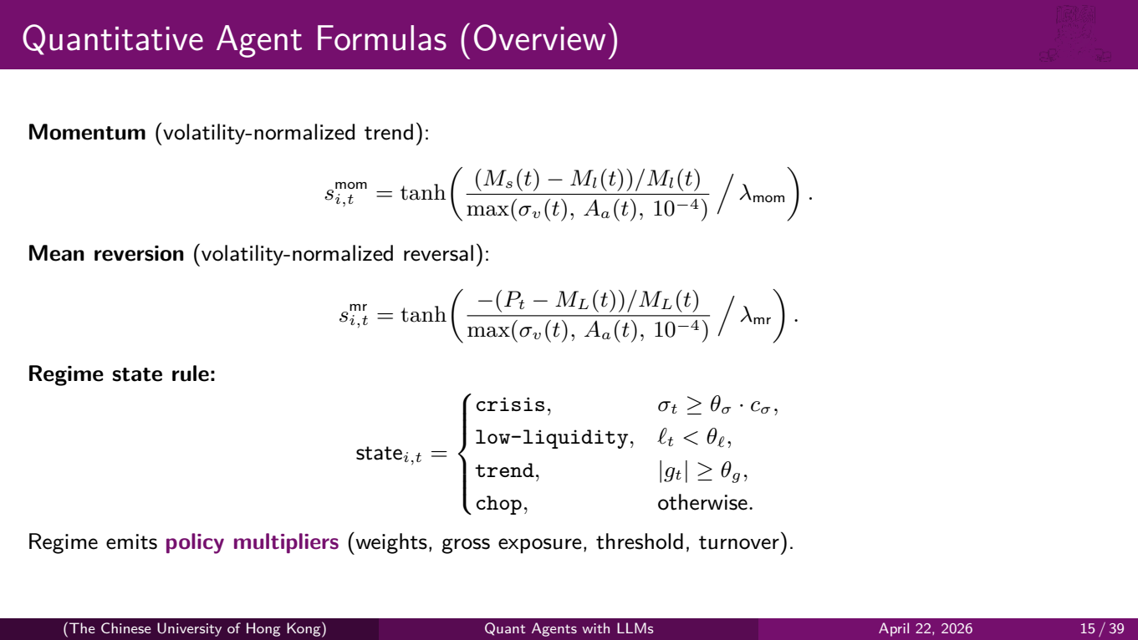
Notes:
Let's briefly walk through the core formulas.
The **momentum signal** computes the difference between a short and long moving average, normalizes it by the maximum of recent volatility and average true range, and passes it through a tanh activation with a sensitivity parameter lambda. The tanh ensures the output is bounded in [-1, 1].
The **mean reversion signal** is similar but inverted — it measures how far the current price has deviated from a long-term mean, again normalized by volatility.
The **regime classification** uses a cascading rule: if volatility exceeds a crisis threshold, we're in crisis mode. If liquidity is below a threshold, we're in low-liquidity mode. If there's a strong directional trend, we're in trend mode. Otherwise, it's chop — a sideways, range-bound market.
The important output of the regime agent is not just the state label but the **policy multipliers** — these adjust the weights of different signal sources, the gross exposure cap, the minimum conviction threshold, and the maximum turnover. So in a crisis, for example, the system automatically reduces exposure and raises the bar for new positions.

Slide 16
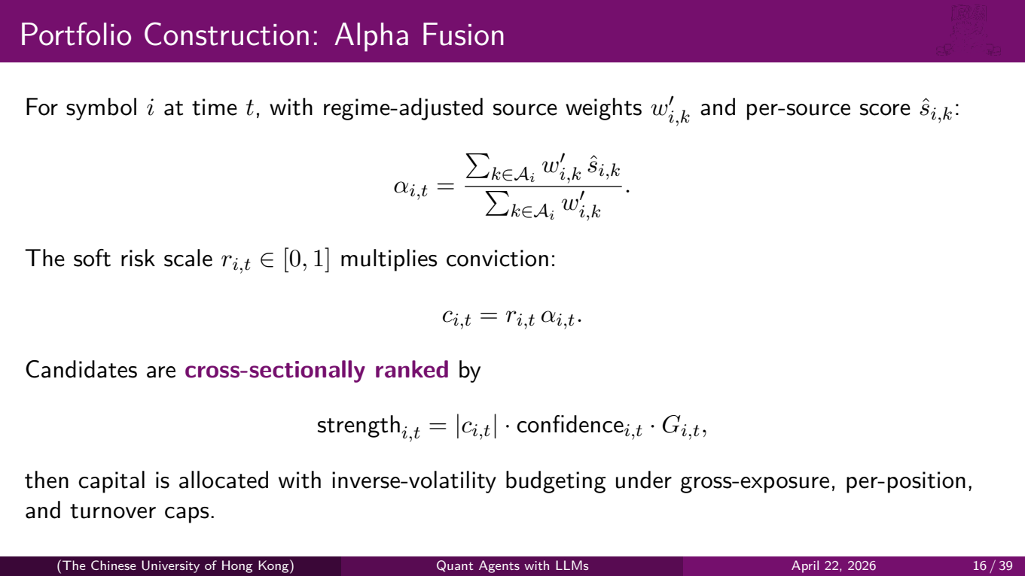
Notes:
Here's how we fuse signals into portfolio decisions.
For each symbol *i* at time *t*, we compute a blended alpha score as a weighted average of all available signal sources, where the weights are adjusted by the regime agent. This is the regime-adaptive alpha fusion step.
Then we multiply by the soft risk scale *r*, which gives us the risk-adjusted conviction *c*. Symbols are then **cross-sectionally ranked** by a strength score that combines the absolute conviction, the confidence of the signals, and a regime-dependent gain factor.
Finally, capital is allocated using inverse-volatility budgeting — less volatile symbols get larger positions — subject to three hard caps: total gross exposure, per-position concentration, and single-step turnover. This prevents the portfolio from making dramatic changes in a single timestep.

Slide 17
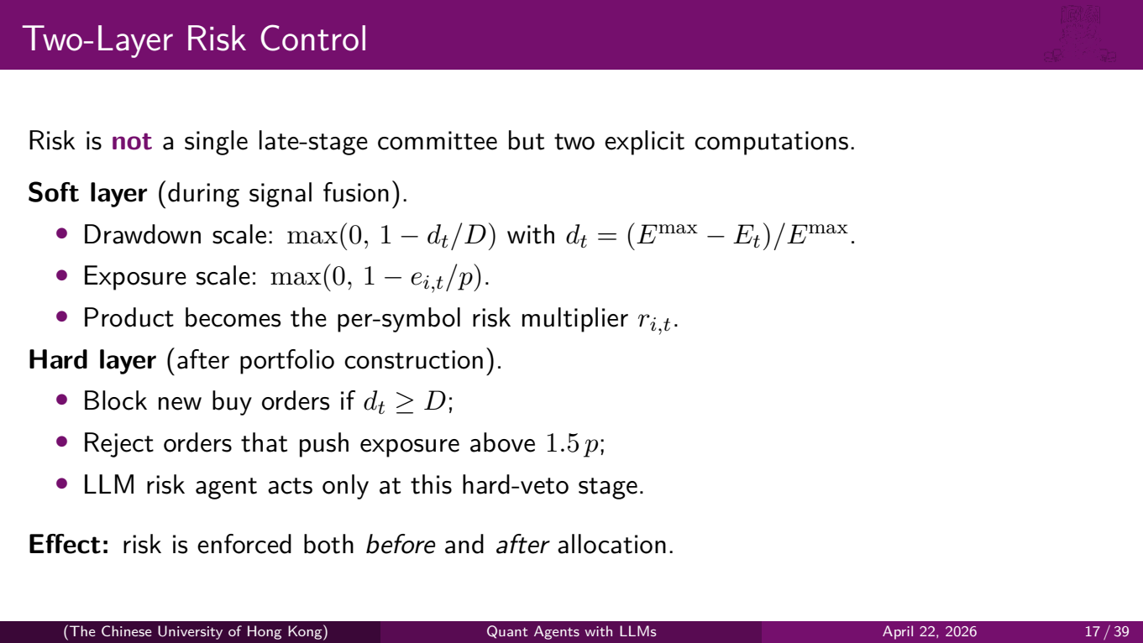
Notes:
Risk control is a critical design choice. In our system, risk is **not** a single late-stage committee — it's two explicit computations at different points in the pipeline.
The **soft layer** operates during signal fusion. It computes a drawdown scale — the further you are from your equity peak, the more it scales down new positions. It also computes an exposure scale — the closer a symbol is to its position limit, the more it's scaled down. The product of these becomes the per-symbol risk multiplier.
The **hard layer** operates after portfolio construction. It has three rules: block all new buy orders if the drawdown exceeds a threshold, reject any individual order that would push exposure above 1.5 times the per-position limit, and the LLM risk agent — if configured — acts only at this hard-veto stage.
The key insight is that risk is enforced both **before** and **after** allocation. The soft layer prevents over-concentration during signal fusion, and the hard layer catches anything that slipped through.

Slide 18
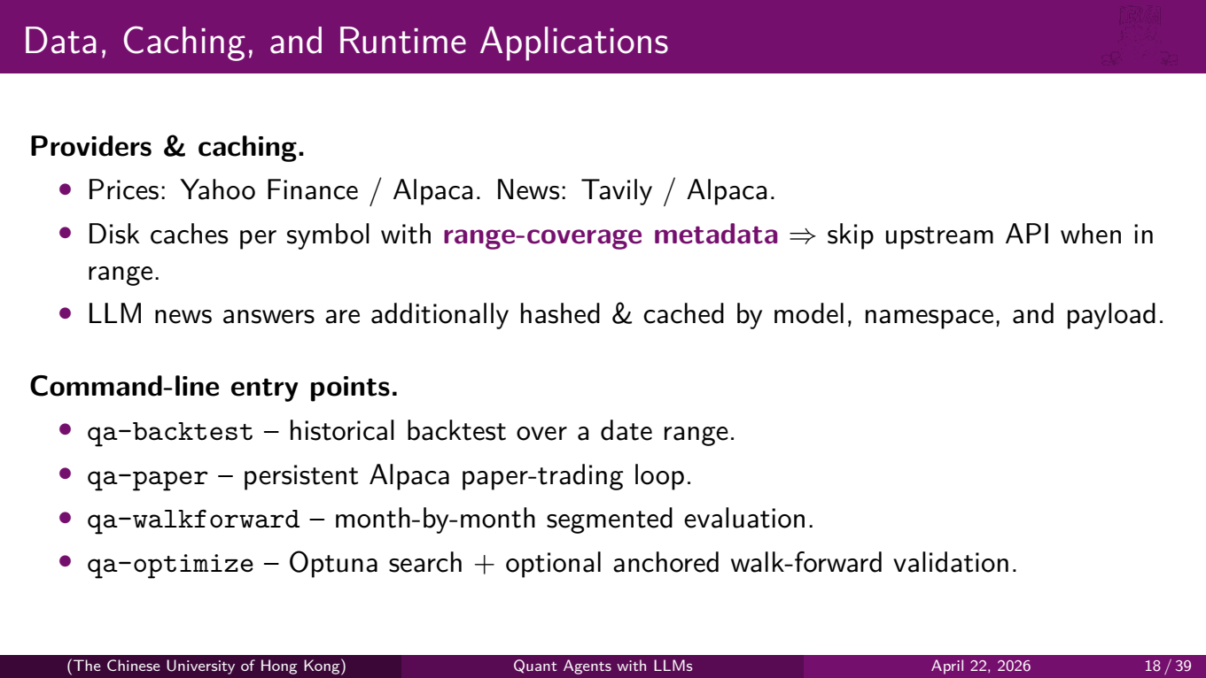
Notes:
Briefly on the infrastructure side: we support multiple data providers — Yahoo Finance and Alpaca for prices, Tavily and Alpaca for news.
Each symbol has its own disk cache with **range-coverage metadata**. Before making an API call, the system checks whether the requested date range is already covered in the cache. This dramatically reduces API calls during development and optimization.
LLM news answers are additionally cached by a hash of the model, namespace, and payload, so identical queries are never sent to the API twice.
We expose four command-line entry points: `qa-backtest` for historical simulation, `qa-paper` for live Alpaca paper trading, `qa-walkforward` for segmented evaluation, and `qa-optimize` for Optuna parameter search.

Slide 19

Notes:
Now let's discuss how we ensure our results are trustworthy.

Slide 20
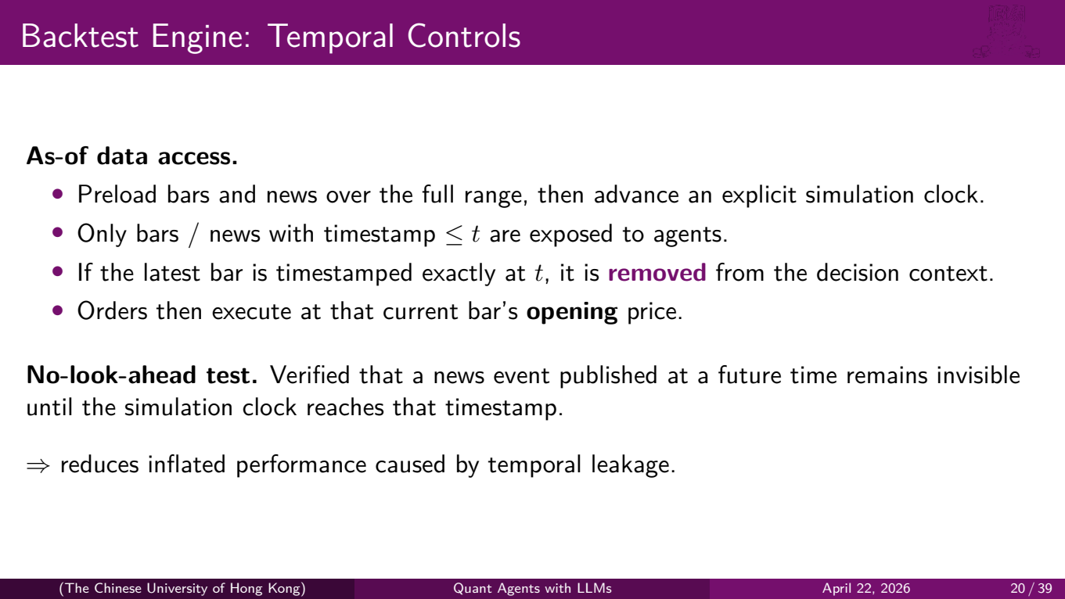
Notes:
The backtest engine is the foundation of our evaluation methodology, and temporal controls are its most important feature.
We preload all bars and news over the full date range, then advance an explicit simulation clock step by step. At each step, only data with a timestamp less than or equal to *t* is exposed to agents.
There's a subtle but important detail: if the latest bar is timestamped exactly at *t*, it is **removed** from the decision context. Why? Because the bar's close price at time *t* includes information that wasn't available when the decision was made. Orders then execute at that bar's **opening** price, which was known at the start of the period.
We also wrote a **no-look-ahead test** — it's part of our regression suite. It verifies that a news event published at a future timestamp remains invisible to agents until the simulation clock actually reaches that timestamp.
This matters because temporal leakage is the number one reason backtest results fail to replicate in live trading.

Slide 21
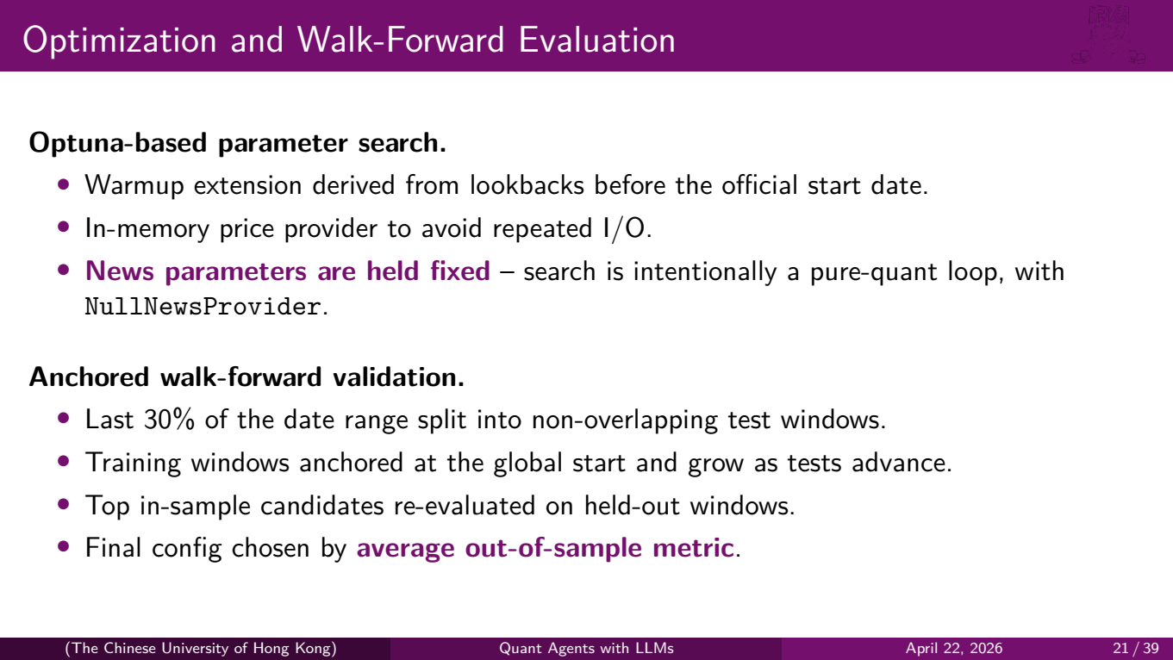
Notes:
For parameter optimization, we use **Optuna** — a Bayesian hyperparameter search framework. A few important design choices:
We derive a warmup extension from the lookback windows of our indicators, so the optimizer sees enough historical data before the official start date.
We use an in-memory price provider during optimization to avoid thousands of redundant disk reads.
And critically, **news parameters are held fixed** during optimization. The search is intentionally a pure-quant loop using the NullNewsProvider. We don't want the optimizer to overfit to the specific phrasing of cached LLM news answers.
For validation, we use **anchored walk-forward**. The last 30% of the date range is split into non-overlapping test windows. Training windows are anchored at the global start and grow as tests advance. Top in-sample candidates are re-evaluated on held-out windows, and the final configuration is chosen by average out-of-sample performance — not in-sample performance.

Slide 22
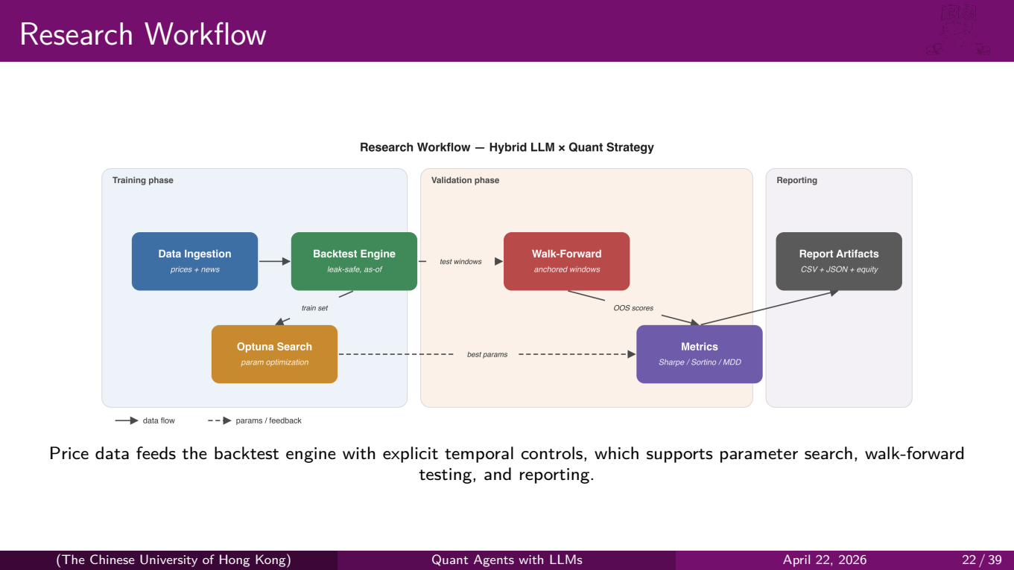
Notes:
This diagram summarizes our research workflow. Raw price and news data flows into the leak-safe backtest engine. From there, the Optuna parameter search optimizes in-sample, the walk-forward validation tests out-of-sample, and both feed into performance metrics — Sharpe ratio, Sortino ratio, maximum drawdown — which produce the final report artifacts.

Slide 23
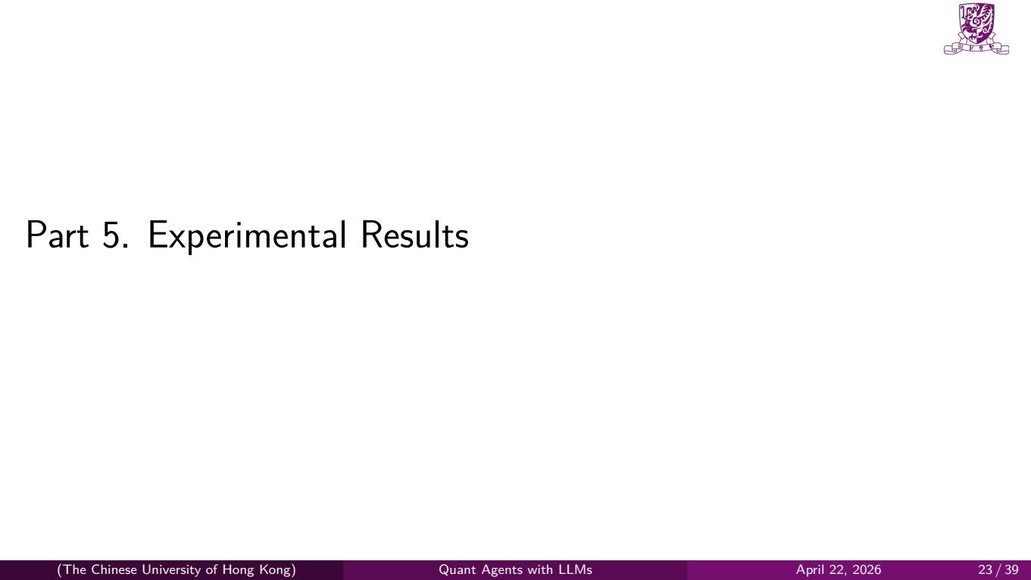
Notes:
Now let's look at the results.

Slide 24
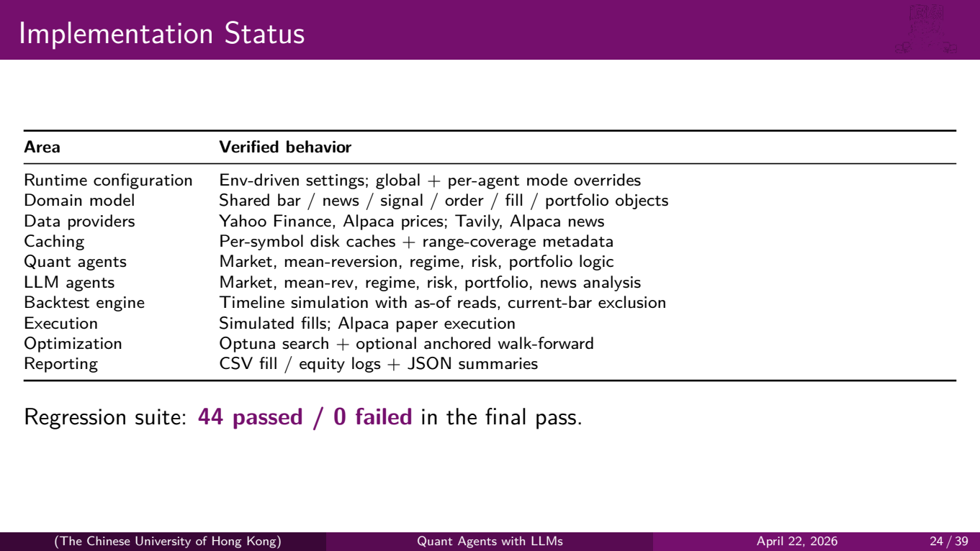
Notes:
Before diving into financial results, let's confirm the implementation status. This table shows every major subsystem and its verified behavior — runtime configuration, domain model, data providers, caching, quant agents, LLM agents, backtest engine, execution, optimization, and reporting.
Everything listed here is implemented, tested, and verified. Our regression suite shows **44 tests passed, 0 failed** in the final run. This gives us confidence that the results we're about to show are produced by correct, leak-safe code.

Slide 25
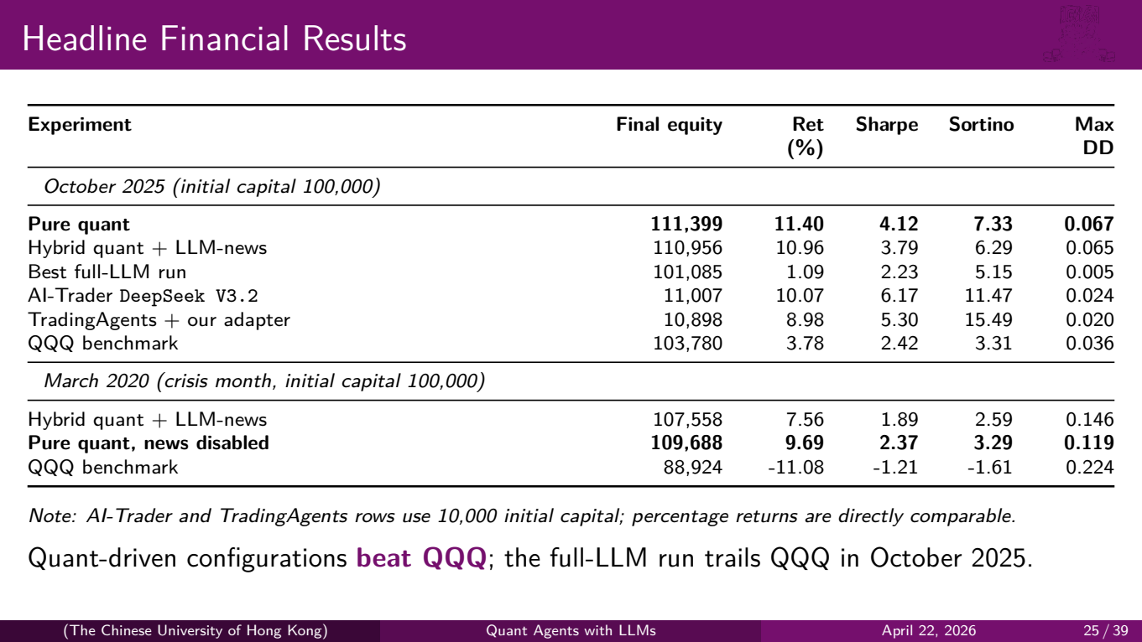
Notes:
This is the main results table. Let's walk through the key numbers.
**October 2025**, our own system runs start with 100,000 dollars:
Our **pure quant** configuration achieved an 11.40% return with a Sharpe ratio of 4.12 — this is our best result.
The **hybrid** configuration — quant plus LLM news — came close at 10.96% with a Sharpe of 3.79. Very competitive, but the news overlay slightly reduced returns in this particular month.
The **best full-LLM run** returned only 1.09%. LLMs alone, without quantitative structure, essentially produce a flat equity curve.
Now the external benchmarks: **AI-Trader with DeepSeek V3.2** returned 10.07%, and **TradingAgents with our adapter** returned 8.98%. Note that both external benchmarks start from 10,000 dollars, so the equity levels use a different capital scale, but the percentage returns are directly comparable. Our quant-driven configurations outperform both.
The **QQQ benchmark** returned 3.78%. Our quant-driven configurations beat the market, while the full-LLM run trails QQQ in this month.
**March 2020** — the COVID crisis month:
Both our configurations stay profitable while QQQ drops 11%. Pure quant returns 9.69% with a max drawdown of 11.85%, and hybrid returns 7.56% with a larger drawdown of 14.57%. The news overlay actually **hurt** during the crisis — we'll explain why shortly.

Slide 26
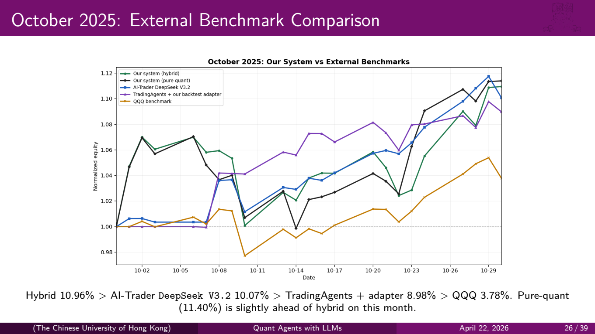
Notes:
This equity curve shows all five strategies over October 2025. You can see our hybrid system — the green line — and our pure quant — the black line — consistently at or near the top.
AI-Trader DeepSeek V3.2, in blue, tracks closely but ends slightly lower. TradingAgents with our adapter, in purple, is competitive but more volatile. And the QQQ benchmark, in orange at the bottom, clearly underperforms all agent-based approaches.
The key takeaway is that our system is not just competitive — it outperforms both TradingAgents and AI-Trader while operating on a fundamentally different paradigm.

Slide 27
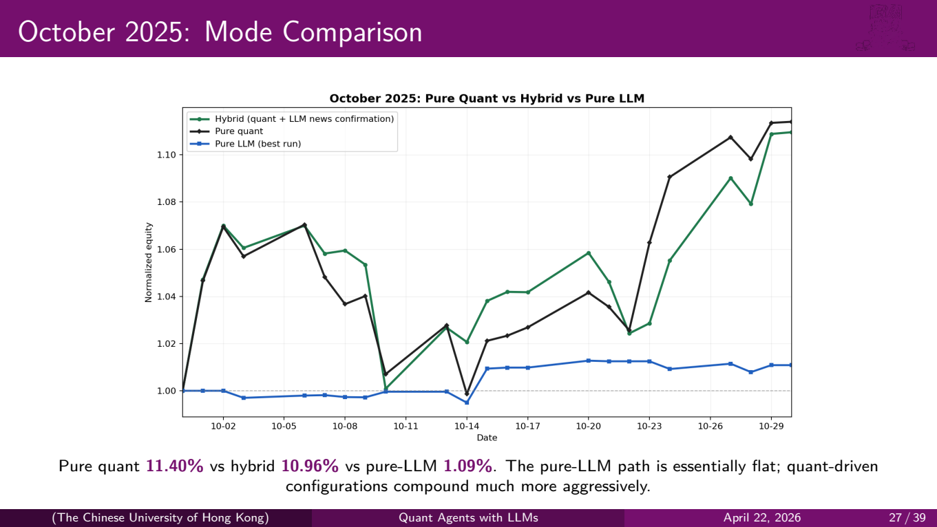
Notes:
This chart compares our three internal operating modes on the same data.
The black line — pure quant at 11.40% — and the green line — hybrid at 10.96% — track each other closely. They both compound aggressively throughout the month.
The blue line — the best pure-LLM run at 1.09% — is essentially flat. The LLM-only configuration barely trades, and when it does, the positions are small and inconsistent.
This is a strong result: **quant-driven configurations dominate**. LLMs alone do not produce actionable, consistently profitable trading signals in our framework.

Slide 28
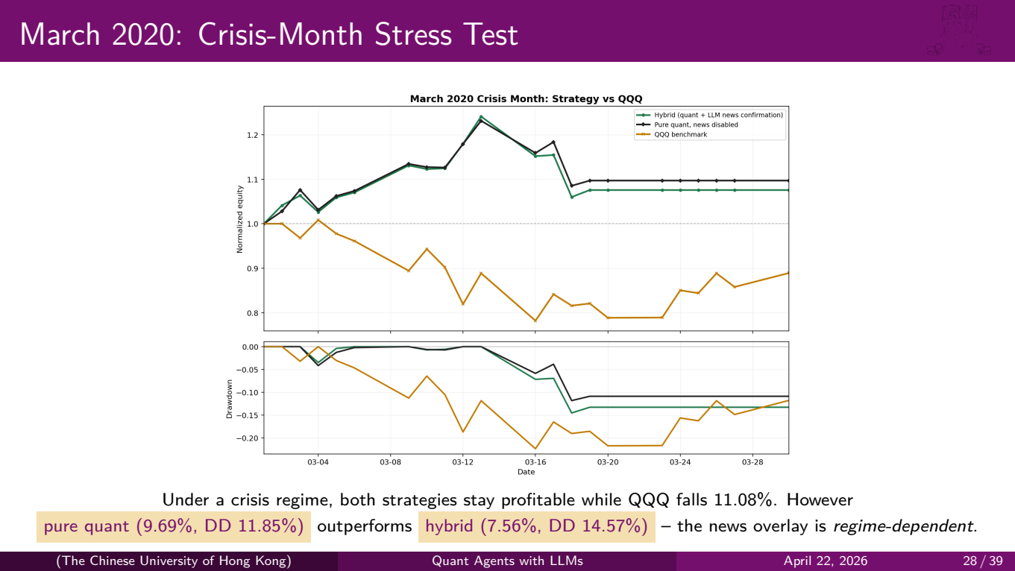
Notes:
This is perhaps our most interesting experiment. March 2020 was the COVID crash — one of the most violent market drawdowns in history. QQQ dropped over 11% that month.
Both our strategies remain **profitable**. Pure quant returns 9.69% and hybrid returns 7.56%. That's remarkable during a crisis.
But notice something important: the pure quant configuration — without any news — **outperforms** the hybrid configuration that includes LLM news. The max drawdown is also smaller: 11.85% versus 14.57%.
Why? During a crisis, macro forces dominate everything. Individual company news becomes noise — every stock is being driven by the same macro fear. The news agent, in confirmation-only mode, actually delays or shrinks trades that the quantitative signals correctly identified. The bottom panel shows the drawdown trajectories, confirming that the pure quant approach recovers faster.
This tells us that the value of the news layer is **regime-dependent**.

Slide 29
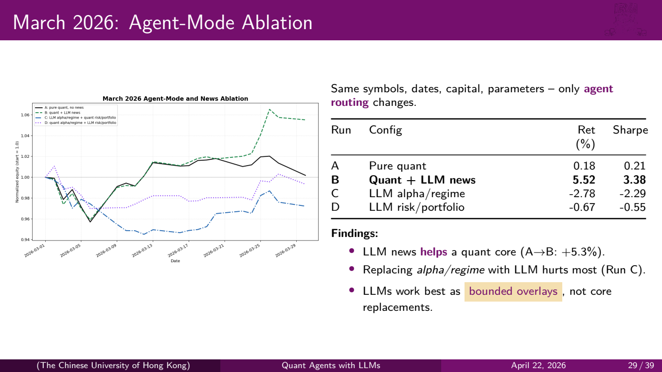
Notes:
This is our ablation study from March 2026. The key insight is that we hold **everything constant** — same symbols, same dates, same capital, same parameters — and only change which agents are in quant mode versus LLM mode.
Run A is pure quant: 0.18% return, Sharpe 0.21. Modest.
Run B adds LLM news to the quant core: return jumps to 5.52%, Sharpe to 3.38. A dramatic improvement.
Run C replaces the alpha and regime agents with LLMs: return drops to -2.78%. The LLM-generated momentum and regime signals are worse than the quantitative versions.
Run D replaces risk and portfolio agents with LLMs: return is -0.67%. Also worse.
Three findings:
First, LLM news **can help** when added to a working quant core. In this March 2026 window, the jump from A to B is +5.3%.
Second, replacing **alpha and regime logic** with LLMs hurts the most. These are the stages where quantitative precision matters most.
Third, LLMs work best as **bounded overlays** — confirmation layers, not core replacements. They add value when they filter and contextualize, not when they're asked to generate the primary trading signals.

Slide 30
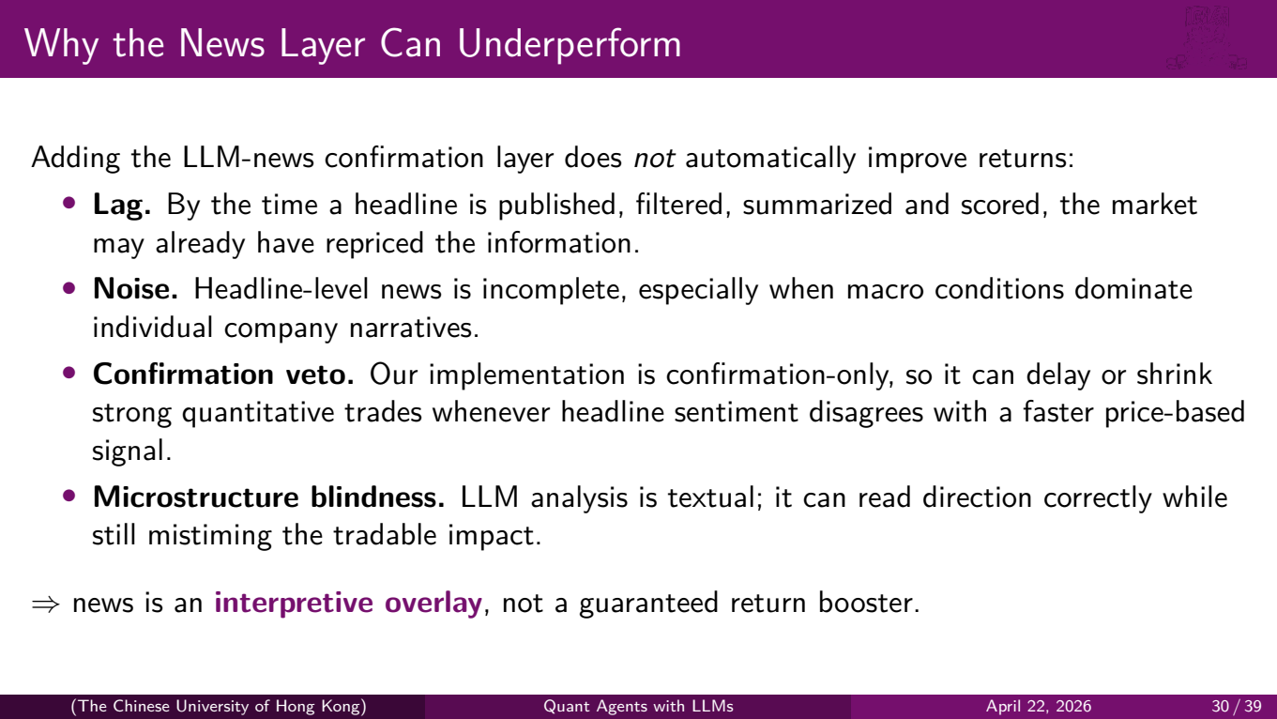
Notes:
This slide addresses a natural question: if LLM news can help in some regimes, as in the March 2026 ablation, why did it hurt in March 2020 and barely help in October 2025?
Four reasons:
**Lag.** By the time a headline is published, filtered by our news provider, summarized and scored by the LLM, the market may have already repriced that information. Price-based signals are faster.
**Noise.** Headline-level news is incomplete. During macro-driven markets, individual company news becomes irrelevant noise that can mislead the agent.
**Confirmation veto.** Our implementation is confirmation-only — the news agent can reduce or block a quantitative trade, but it can't initiate one. When headline sentiment disagrees with a strong price signal, the system ends up with a smaller position than the quant-only version.
**Microstructure blindness.** LLM analysis is textual. It can correctly identify the direction of an event but completely misjudge the timing or magnitude of the tradable impact.
The bottom line: news is an **interpretive overlay**, not a guaranteed return booster. Its value depends on the market regime.

Slide 31
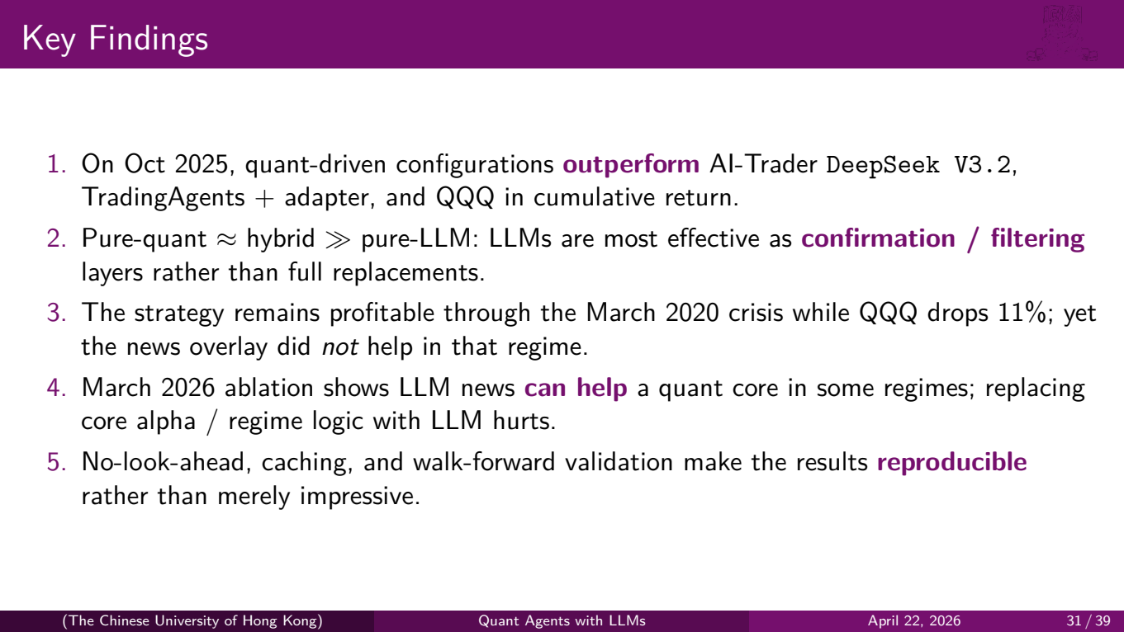
Notes:
Let's summarize our five key findings:
**One**: in October 2025, our quant-driven configurations outperform both AI-Trader and TradingAgents in cumulative return, and both beat QQQ.
**Two**: pure quant is roughly equal to hybrid, and both are far ahead of pure LLM. LLMs are most effective as confirmation and filtering layers, not full replacements.
**Three**: the strategy remains profitable through the March 2020 crisis while QQQ drops 11%. But the news overlay did not help in that regime.
**Four**: the March 2026 ablation shows that LLM news can help a quant core in some regimes; replacing core alpha or regime logic with LLMs hurts.
**Five**: our no-look-ahead guarantees, caching infrastructure, and walk-forward validation make these results **reproducible** — not just impressive on paper, but verifiable and repeatable.

Slide 32

Notes:
Let's discuss the broader implications.

Slide 33
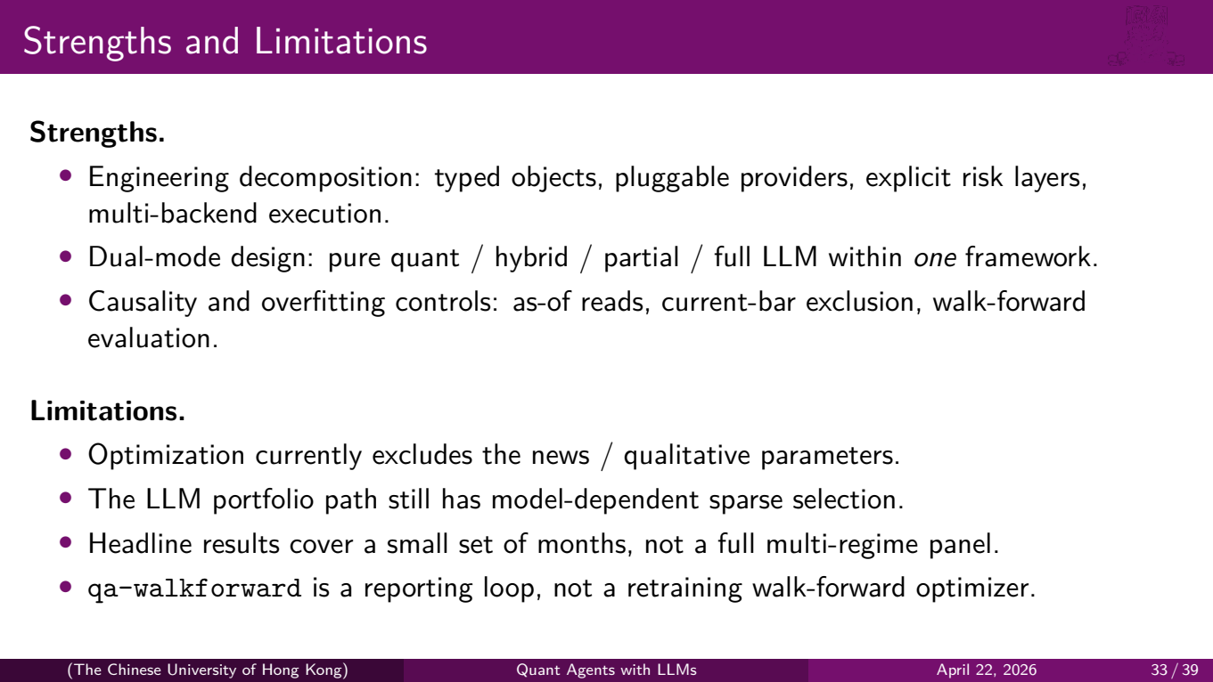
Notes:
**Strengths.** Our engineering decomposition — typed objects, pluggable providers, explicit risk layers, multi-backend execution — makes the system maintainable and testable. The dual-mode design lets us run pure quant, hybrid, partial LLM, and full LLM within one framework. And our causality controls — as-of reads, current-bar exclusion, walk-forward evaluation — prevent the most common sources of backtest overfitting.
**Limitations.** Our optimization currently excludes news and qualitative parameters — we only tune the quant side. The LLM portfolio path still exhibits model-dependent sparse selection — different LLMs produce very different trading behavior. Our headline results cover a small number of months, not a comprehensive multi-year, multi-regime panel. And our walk-forward implementation is a reporting loop — it evaluates fixed parameter sets on successive windows, but it doesn't retrain or re-optimize within each window.

Slide 34
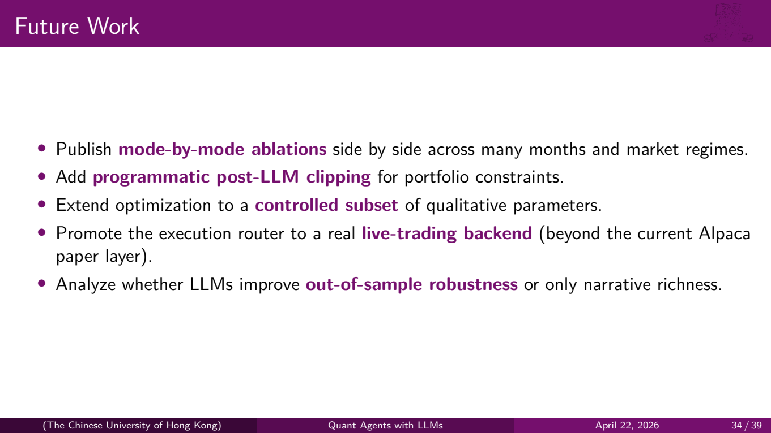
Notes:
Looking ahead, we see five directions:
First, publish **mode-by-mode ablations** across many months and market regimes — not just the three windows we tested.
Second, add **programmatic post-LLM clipping** for portfolio constraints — right now LLM agents can suggest positions that are somewhat unconstrained.
Third, extend the optimizer to cover a **controlled subset** of qualitative parameters — carefully, to avoid overfitting to cached LLM outputs.
Fourth, promote the execution router to a real **live-trading backend** — beyond Alpaca paper trading.
And fifth, rigorously analyze whether LLMs improve **out-of-sample robustness** or just add narrative richness to the decision process.

Slide 35

Notes:
Let's wrap up.

Slide 36
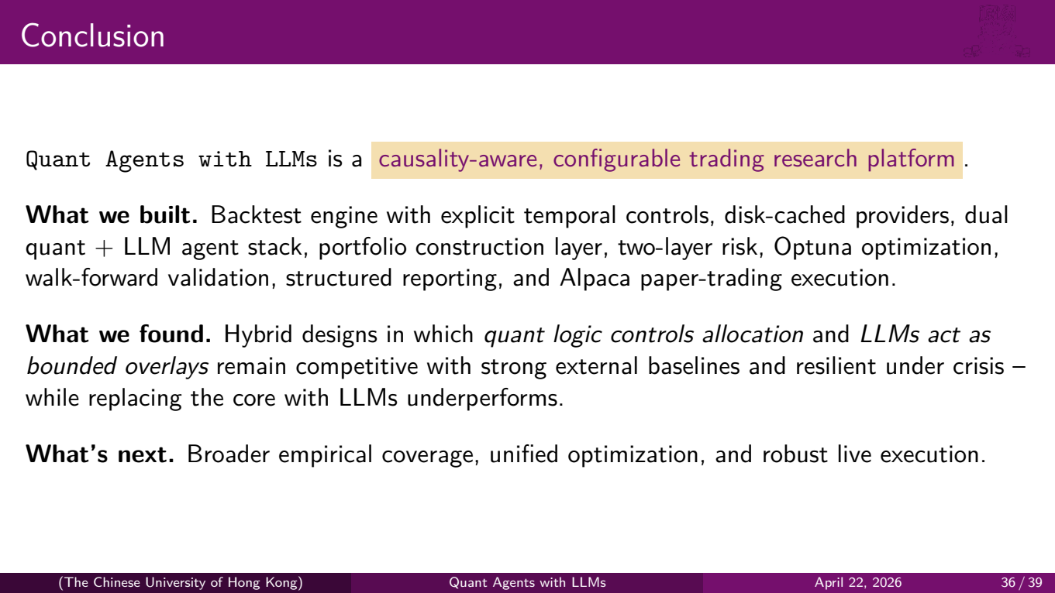
Notes:
Quant Agents with LLMs is a **causality-aware, configurable trading research platform**.
**What we built**: a backtest engine with explicit temporal controls, disk-cached providers, a dual quant-plus-LLM agent stack, a portfolio construction layer with alpha fusion, two-layer risk control, Optuna-based optimization, anchored walk-forward validation, structured reporting, and Alpaca paper-trading execution. This is a complete, end-to-end system.
**What we found**: hybrid designs — where quant logic controls allocation and LLMs act as bounded overlays — remain competitive with strong external baselines and resilient under crisis. Replacing the quantitative core with LLMs underperforms. LLMs are best used for interpretation and confirmation, not for primary signal generation.
**What's next**: broader empirical coverage across more market regimes, unified optimization that includes qualitative parameters, and robust live execution.

Slide 37

Notes:
Our references are listed here.

Slide 38
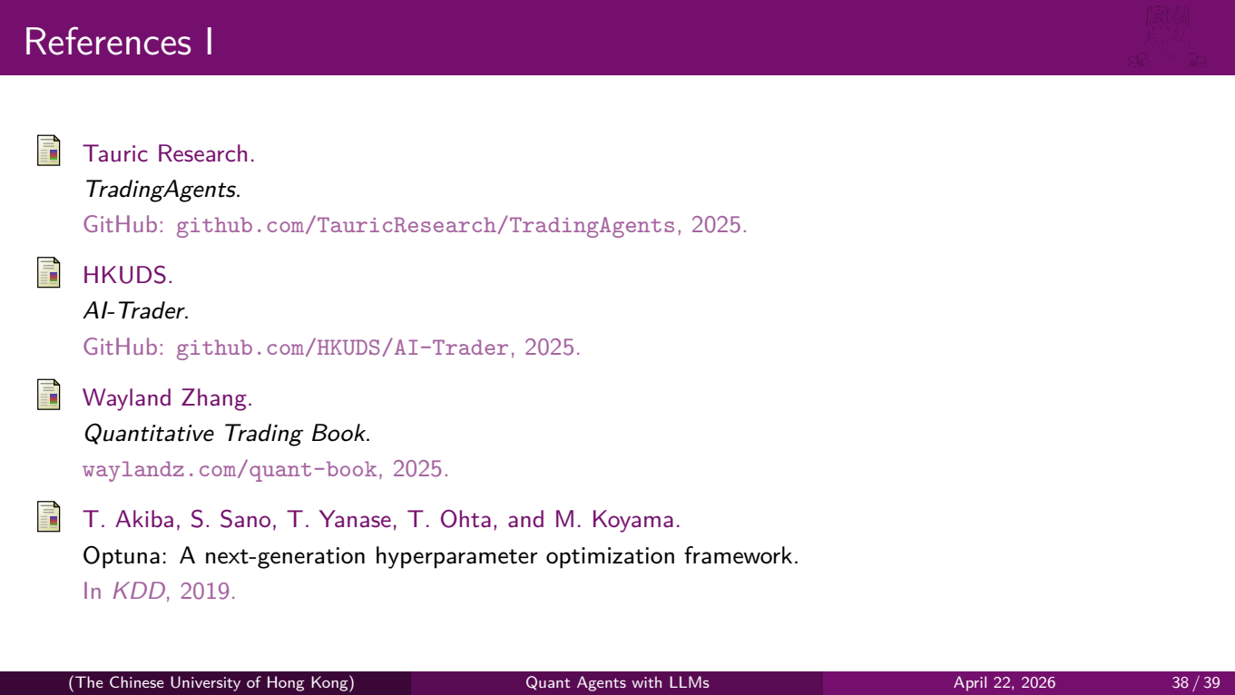
Notes:
We primarily reference the TradingAgents and AI-Trader repositories that we benchmarked against, Professor Wayland Zhang's Quantitative Trading Book which informed our system design, and the Optuna framework that powers our parameter search.

Slide 39
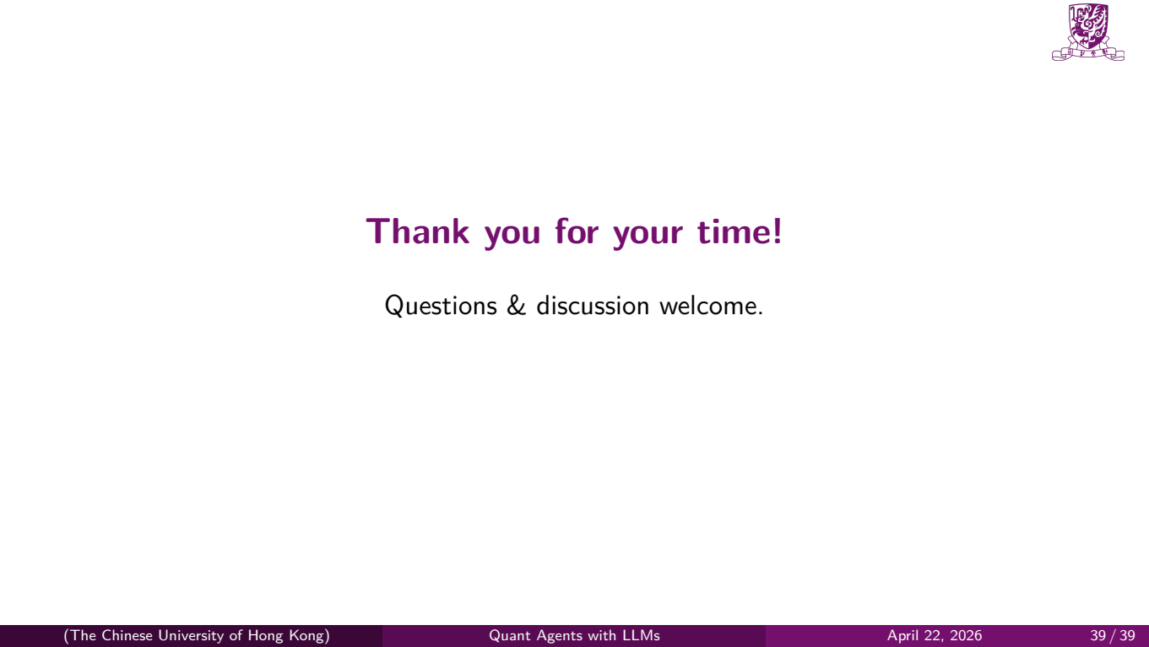
Notes:
Thank you for your time. We're happy to take any questions or discuss any aspect of the system in more detail.
*End of script. Estimated total: ~28–30 minutes.*

