Slide 1

Reskewl

Slide 2
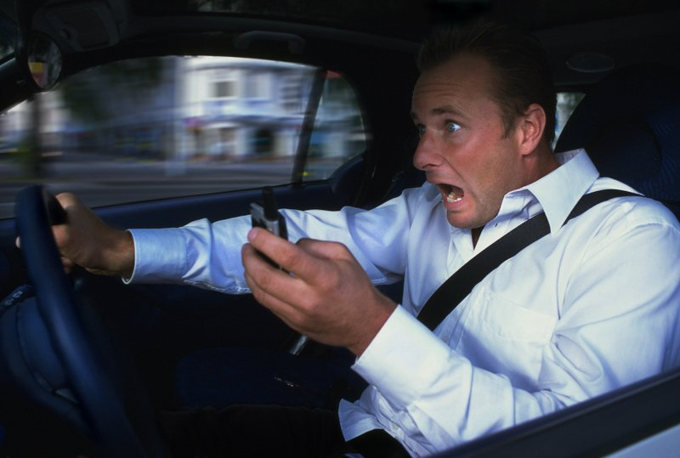
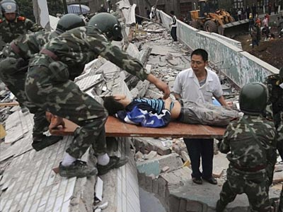


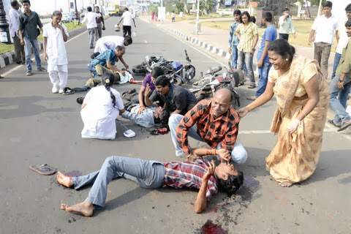
Emergency situation could be anywhere, anytime

Slide 3


How to help without knowing identity ?
RESKEWL builds the bridge, enhances chances of rescue

Slide 4
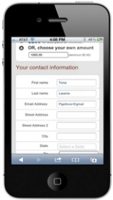


Solution Workflow
1. Registration
2.Incident handling
Service Subscriber
Stores emergency profile
Details Collected
Aadhar details
Blood group
Emergency contacts
Medical history
OTP driven
Subscriber pays a monthly/annual fee
Reskewl DB

Slide 5

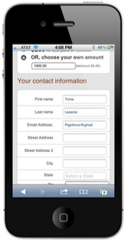


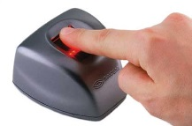
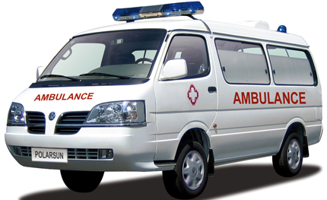
Solution Workflow – Contd.
1. Registration
2.Incident handling
Rescuer at site
Reskewl
Calls Reskewl emergency care from phone’s emergency screen & shares location
Detects nearest possible aid
and prepares for treatment
RESKEWL intimates Family
Patient promptly treated
Dispatches ambulance from nearest
hospital
Ambulance verifies Biometric at incident site to confirm identity

Slide 6
Initial Assumptions
Future Roadmap
Android platform
User has an AndroidOne-based phone and data connection
Passer-by wants to help
I want to help but don’t know how
Network hospitals understand the service requirements
Ambulance staff are trained to offer service
Ambulance staff use Biometric device for at-site identity verification
SMS & phone network-based solution
DigitalLocker integration
Facial or Biometric based identity retrieval , based on Aadhaar API
National level scaling and offer international travelers
Can constantly enhance service based on Aadhaar’s roadmap

