Slide 1
E-Learning Platform
Naveen V-2260401
Devika K p-2260359
Sumeet Bafna-2260450
Nischay Chhetri-2260404
Theja Sajeesh-2260121

Slide 2
Agenda
Introduction to application
Visualization of your application
Class Diagram
10 Requirements
How have we applied SRP
What are Decorators that we have used
Where have we Open the code for extension
Where have we closed code for modification
Conclusion

Slide 3
Introduction to application The E-Learning Platform is a dynamic and scalable solution designed to provide seamless online education experiences. It incorporates a modular architecture adhering to the Open/Closed Principle (OCP), ensuring the system is open for extension while maintaining the stability of existing functionalities. Key features include user management with distinct roles, course creation and tracking, quizzes with evaluation mechanisms, certification generation, and interactive discussion forums. By leveraging abstraction, interfaces, and inheritance, the platform enables easy integration of new features without altering core functionality. This design ensures scalability, maintainability, and a user-centric approach, making it adaptable to diverse learning needs.

Slide 4
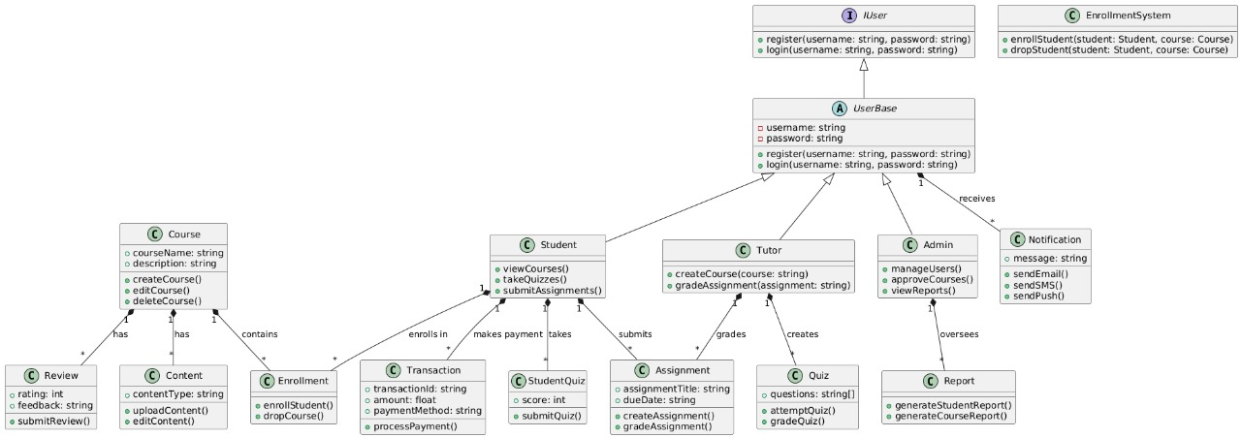
Class Diagram

Slide 5
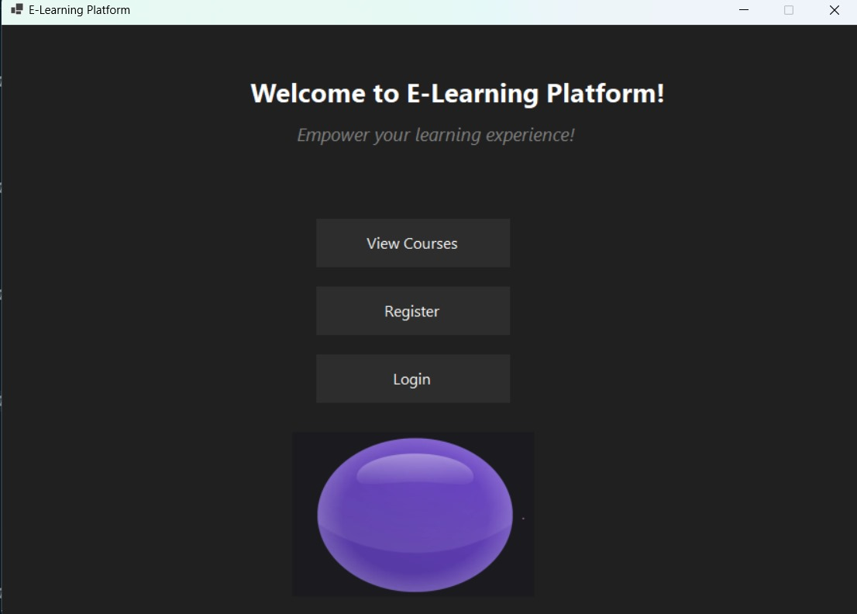
Visualization of your application

Slide 6
10 Requirements
1.User Management
2.Role Management
3.Course Management
4.Learning Progress Tracking
5.Quiz Functionality
6.Certificate Generation
7.Notifications
8.Discussion Forums
9.Seamless Media Playback
10.Search and Filters

Slide 7
How have we applied SRP
User Management:
Separate classes for UserRegistration, UserLogin, and RoleManager ensure that user-related
Operations (registration, login, and role assignments) are handled independently.
Course Management:
CourseManager handles adding, updating, and removing courses.
CourseViewer manages fetching and displaying course information.
Learning Progress Tracking:
ProgressTracker is solely responsible for tracking user progress in lessons and quizzes.
Quiz Functionality:
QuizCreator is responsible for creating quizzes.
QuizEvaluator handles evaluating quiz results.
Certificate Generation:
CertificateGenerator generates course completion certificates, focusing only on this task.

Slide 8
How have we applied SRP
Notifications:
NotificationSender manages the sending of notifications, isolating notification logic.
Discussion Forums:
ForumManager handles thread creation and replies, ensuring discussions are managed
independently.
Media Playback:
MediaPlayer is used to play course-related videos, focusing only on playback functionality.
Search and Filters:
CourseSearch allows searching for courses.
Filtering logic is encapsulated in the same or a separate class to keep it modular.
Secure Access:
AccessManager ensures course access control for enrolled users.

Slide 9
What are Decorators that we have used
Abstract (abstract)
Used in UserBase to enforce essential methods like Register.
Ensures a common structure for all user types.
Virtual (virtual)
Applied to the Login method in UserBase for providing a default implementation.
Allows derived classes (RegularUser, AdminUser) to customize behavior.
Override (override)
Redefines methods (Register, Login) in derived classes for role-specific functionality.
Interface (interface)
IUser: Defines Register and Login for user management.
ICourseManagement: Specifies AddCourse and ListCourses for course operations.
Sealed (sealed)
AdminUser: Prevents further inheritance, ensuring the integrity of admin functionality.

Slide 10
Where have we Open the code for extension
User Management
Base Class: UserBase (Abstract class for shared functionality).
Extensions: Add new user types like GuestUser or PremiumUser without modifying
RegularUser or AdminUser.
Course Management
Interface: ICourseManagement enables creation of custom course managers like
AdvancedCourseManagement.
New functionality like additional metadata for courses can be added
without altering CourseManagement.
Quiz Functionality
Base Class: QuizCreator.
Extensions: Add advanced quiz types, like adaptive or timed quizzes,
using new derived classes.

Slide 11
Where have we Open the code for extension
4.Certificate Generation
Class: CertificateGenerator.
Extensions: Add digital certificates or QR-code-based verification by
creating new generator classes.
Notifications
Class: NotificationSender.
Extensions: Support new notification types (e.g., push notifications, WhatsApp)
with additional derived classes.
Search & Filters
Class: CourseSearch.
Extensions: Add advanced filtering options like difficulty level or
duration search without altering existing code.

Slide 12
Where have we closed code for modification
User Management
The UserBase abstract class and IUser interface encapsulate existing user operations
(e.g., registration, login).
Existing logic for RegularUser and AdminUser is not altered when
adding new user types like GuestUser.
Course Management
The ICourseManagement interface ensures that the base course operations
(e.g., add, list) remain intact.
Existing CourseManagement logic is not modified when adding advanced
course features.
Quiz Functionality
The base quiz creation and evaluation logic in QuizCreator and QuizEvaluator
is stable and not changed,even when extending to new quiz types.

Slide 13
Where have we closed code for modification
Certificate Generation
The CertificateGenerator class ensures that existing certificate generation
logic is preserved when extending to new formats like digital
certificates or QR codes.
Notifications
The NotificationSender class encapsulates the logic for sending notifications.
Existing notification mechanisms (e.g., email, SMS) remain unchanged
when introducing new channels like push notifications.
Search & Filters
The CourseSearch class keeps the basic search functionality stable while allowing
new filter types to be added externally.

Slide 14
Conclusion
The E-Learning Platform is a testament to the effective implementation of the Open/Closed Principle (OCP), ensuring the system is both extendable and stable. By designing the code to be open for extension, new functionalities can be integrated seamlessly, such as adding advanced user roles, course features, or notification methods. At the same time, the platform remains closed for modification, preserving the integrity of existing functionalities. This modular approach ensures scalability and maintainability, allowing the system to adapt to evolving requirements without disrupting its core structure. With a focus on flexibility and future-proofing, the platform provides a robust and user-centric solution for modern learning environments

Slide 15
THANK YOU

