Slide 1
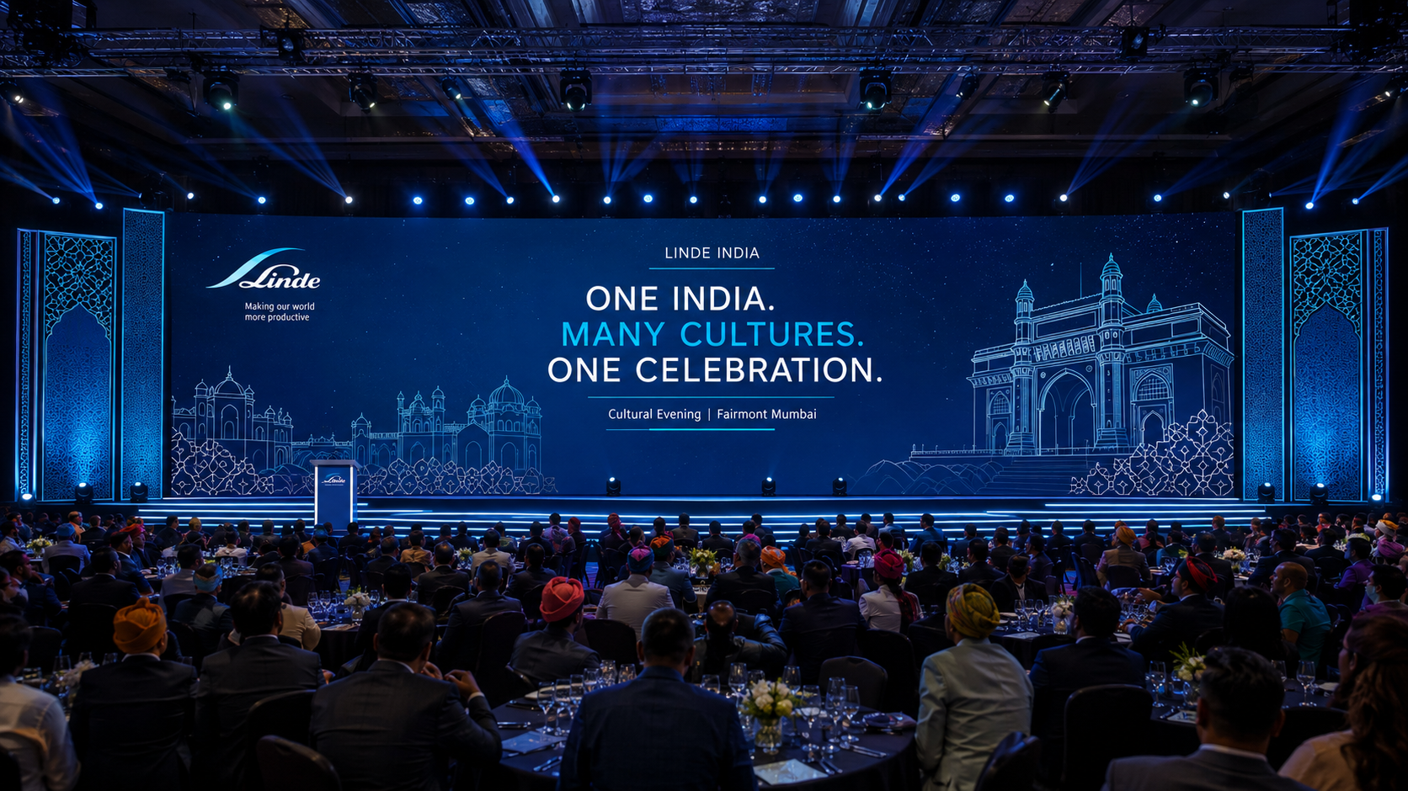
LINDE INDIA
ONE INDIA
Many Cultures. One Celebration.
Cultural Evening | Fairmont Mumbai
Presented by MIKE Events

Slide 2
LINDE INDIA • CULTURAL EVENING
THE CREATIVE THOUGHT
A contemporary celebration of India through architecture, rhythm, performance, light and people.
Corporate Linde
ONE INDIA.
MANY CULTURES.
ONE CELEBRATION.
+ Contemporary India
+ Premium Entertainment
Less décor. More impact.

Slide 3
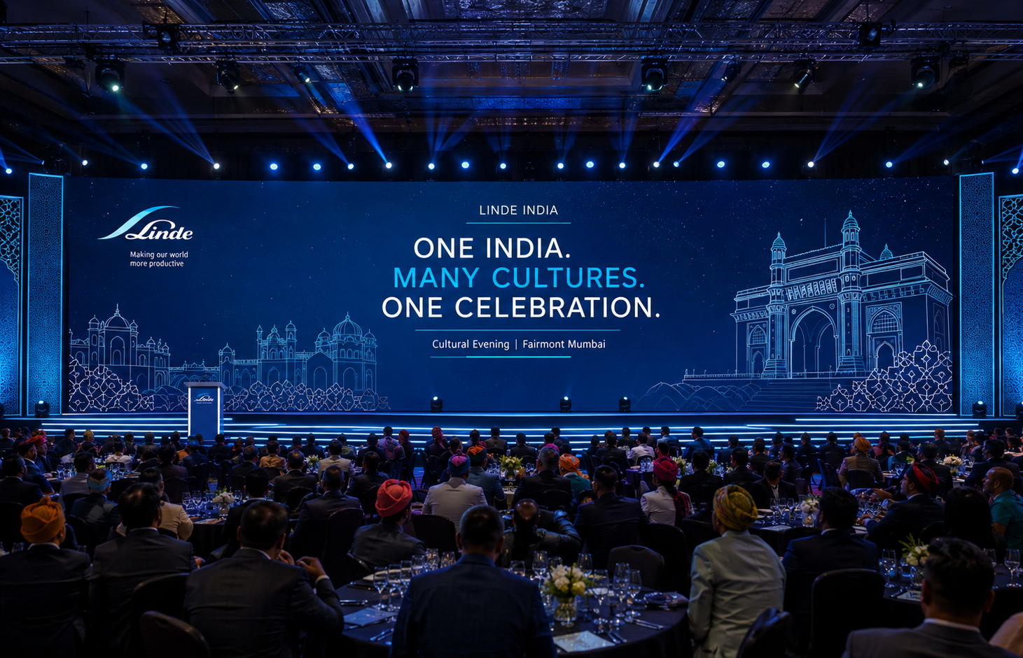
LINDE INDIA • CULTURAL EVENING
FAIRMONT MUMBAI — BUILT FOR SCALE
Use the ballroom as a high-production canvas, not a heavily decorated environment.
PLANNING SCALE
≈ 15,000 sq. ft.
Pre-function welcome
Grand ballroom reveal
60 ft hero stage
Immersive LED storytelling
Performance + DJ transformation

Slide 4
LINDE INDIA • CULTURAL EVENING
FROM WELCOME TO CELEBRATION
One continuous guest journey with energy building at every transition.
01
02
03
04
05
ARRIVAL
→
INDIAN WELCOME
→
PRE-FUNCTION
→
BALLROOM REVEAL
→
EMCEE
06
07
08
09
10
DRUM CIRCLE
→
CULTURAL SHOW
→
DINNER
→
CELEBRATION
→
DJ NIGHT

Slide 5
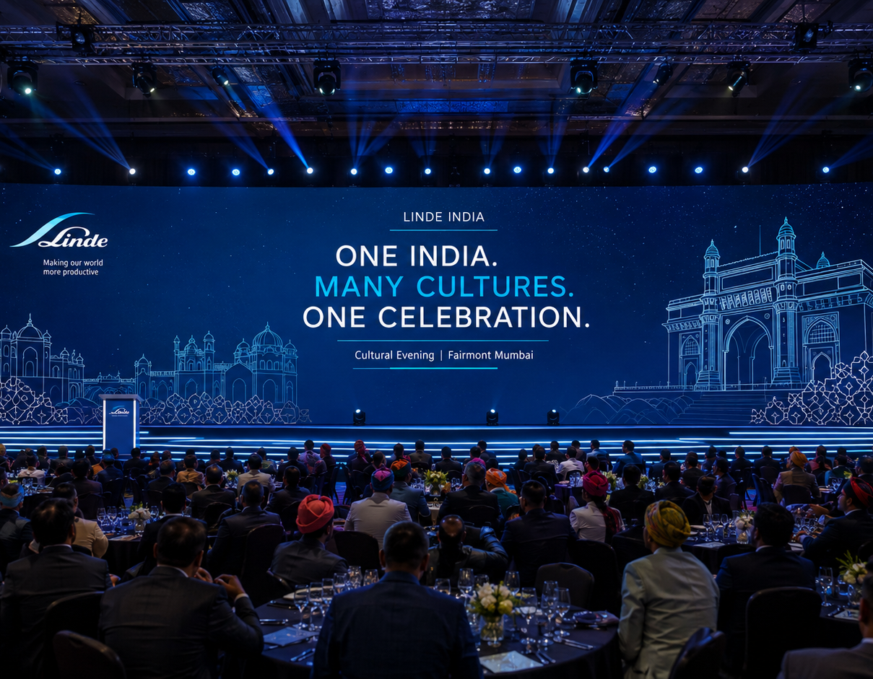
LINDE INDIA • CULTURAL EVENING
WEAR A COLOUR OF INDIA
A curated Safa / Pagdi welcome — colourful, elegant and distinctly corporate.
ARRIVAL EXPERIENCE
Safa / Pagdi
Welcome
Professional tying team
Linde welcome signage
Warm ambient lighting
Contemporary Indian instrumental music

Slide 6
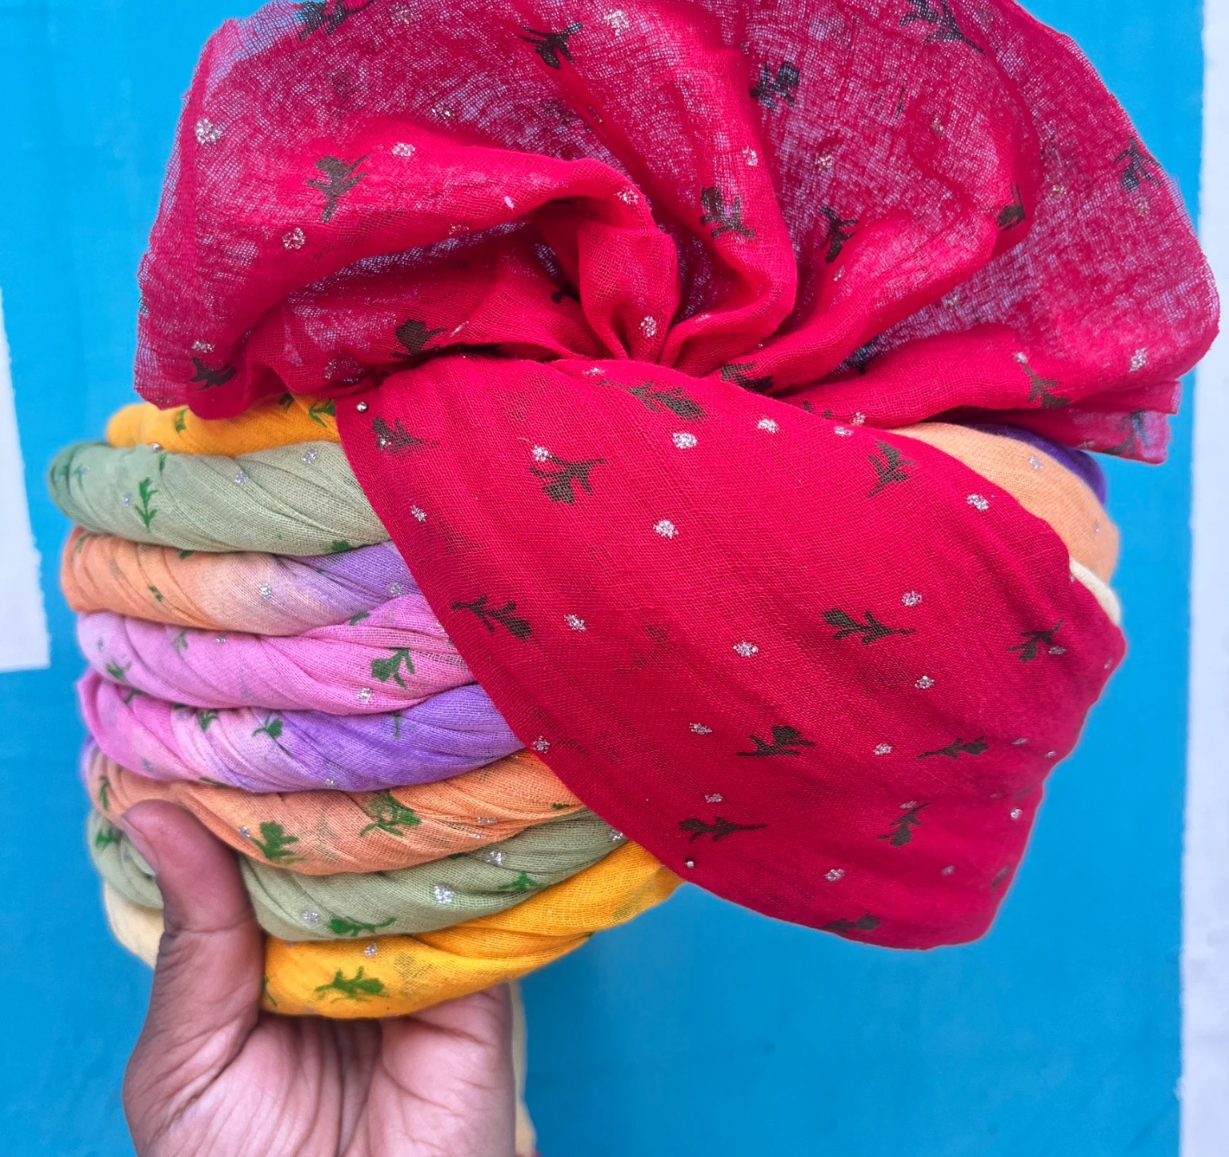
LINDE INDIA • CULTURAL EVENING
LIVE SAFA TYING — WEAR A COLOUR OF INDIA
An interactive pre-function welcome that instantly brings colour, participation and Indian culture into the guest journey.
LIVE SAFA / PAGDI TYING
Guests choose from colourful Safas and have them tied live by professional artists in the pre-function area.
WELCOME
Creates an immediate cultural arrival moment.
INTERACTION
A simple activity that naturally starts conversations.
PHOTO MOMENT
Guests can carry the Safa into the ballroom for vibrant photographs.
PRE-FUNCTION ACTIVITY
Premium • Participative • Colourful • Corporate

Slide 7
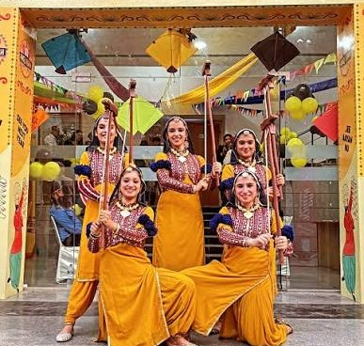
LINDE INDIA • CULTURAL EVENING
BHANGRA WELCOME — ENERGY AT ARRIVAL
A vibrant Punjabi welcome performance to greet guests as they arrive and set an energetic tone for the evening.
LIVE BHANGRA WELCOME
A colourful group of Punjabi performers welcomes guests in the pre-function area with upbeat music, movement and traditional props.
ARRIVAL IMPACT
Creates instant energy at the entrance.
CULTURAL WELCOME
Adds a joyful North Indian flavour without heavy décor.
PHOTO MOMENT
Performers can interact with guests for lively arrival photographs.
WELCOME PERFORMANCE
Suggested duration: 10–15 minutes during guest arrival

Slide 8
LINDE INDIA • CULTURAL EVENING
PRE-FUNCTION — CONNECTION BEFORE THE SHOW
Elegant touchpoints that make Linde’s nationwide presence visible.
01
02
INDIA PHOTO MOMENT
INDIA CONNECTION WALL WITH WORD
A clean Linde × India installation with modern architectural line art.
Guests mark the city or state and country they represent on a premium World map.
“Where in World are you joining us from?”

Slide 9
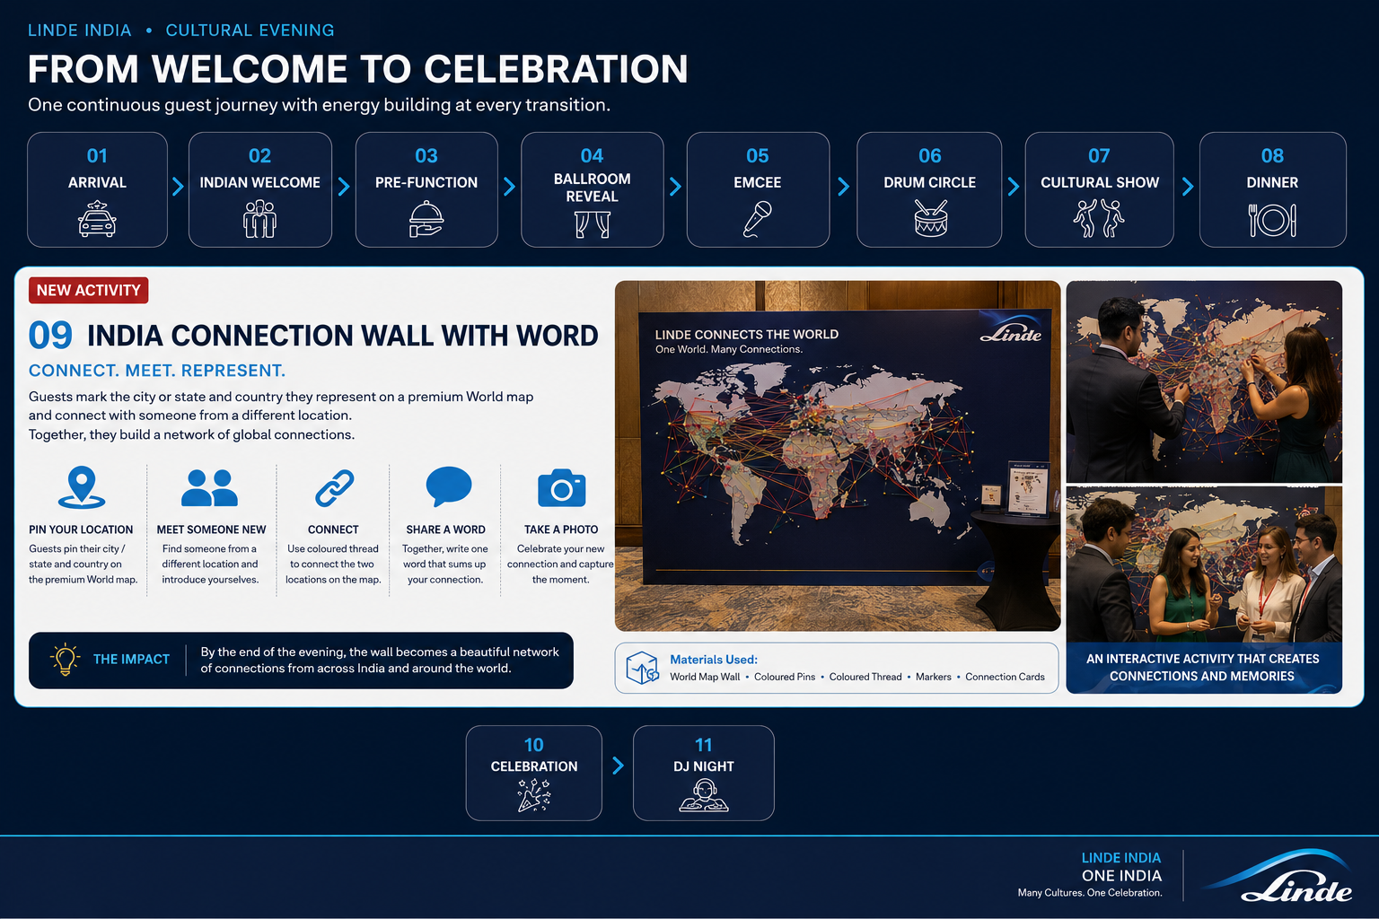
LINDE INDIA • CULTURAL EVENING
02
GLOBAL CONNECTION WALL
An interactive networking activity for guests arriving from around the world.
1
PIN YOUR HOME
Mark your city and country on the world map.
2
MEET SOMEONE NEW
Find a guest from a different country and introduce yourselves.
3
CONNECT
Use coloured thread to link your two locations on the map.
4
SHARE A WORD
Write one word that represents your new connection.
5
CAPTURE THE MOMENT
Take a photograph together at the completed wall.
ONE WORLD. MANY CONNECTIONS.

Slide 10
LINDE INDIA • CULTURAL EVENING
HOW TO PLAN & EXECUTE IT
Simple to operate • Highly visual • Designed for continuous participation
SET-UP
GUEST KIT
ON-GROUND TEAM
16–20 ft wide × 8 ft high world map
Dark navy premium finish
Magnetic / pin-friendly surface
Country & major-city labels
Small counter for markers + cards
1 location pin / marker
1 connection card
Coloured thread / ribbon
Fine-tip marker
Optional name + country sticker
1 activity host
1 assistant at the wall
Emcee announcement at arrival
Photographer for interactions
Team resets thread / markers as required
RECOMMENDED FLOW
REGISTRATION → PIN HOME COUNTRY → MEET A NEW GUEST → CONNECT COUNTRIES → SHARE A WORD → PHOTO
Keep the wall active throughout cocktails/networking. The completed network becomes the visual finale and a group photo backdrop.

Slide 11
THE GRAND BALLROOM REVEAL
Monumental stage • Immersive LED • Intelligent lighting • Contemporary India
INDIA SHOULD BE EXPERIENCED — NOT OVER-DECORATED.

Slide 12
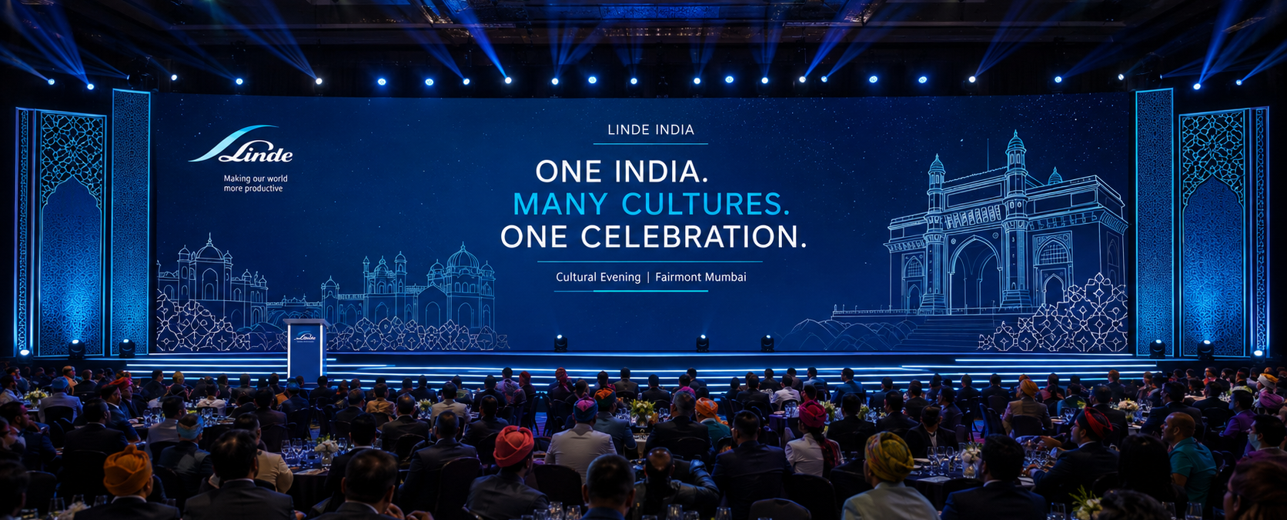
LINDE INDIA • CULTURAL EVENING
HERO STAGE — CONTEMPORARY INDIA
Gateway geometry and jali-inspired layers frame a dominant LED canvas.
60 ft W × 20 ft D × 2.5 ft H

Slide 13
LINDE INDIA • CULTURAL EVENING
STAGE — TECHNICAL DESIGN INTENT
Performance-first planning with clean sightlines and generous open floor.
Large-format central LED
Architectural side wings
60′
E-podium
Steps both sides
STAGE WIDTH
Performer entry / exit
Box truss + moving heads
20′ DEPTH • 2.5′ HEIGHT
Profiles + stage wash
Audience wash + haze
OPEN PERFORMANCE ZONE

Slide 14
LINDE INDIA • CULTURAL EVENING
ONE STAGE. FOUR WORLDS.
LED content and lighting transform the environment without changing the physical stage.
01
02
03
04
WELCOME
DRUM CIRCLE
CULTURAL INDIA
DJ NIGHT
One India. Many Cultures.
Rhythm graphics + pulses
Landscapes + regional colour
Linde blue + kinetic energy

Slide 15
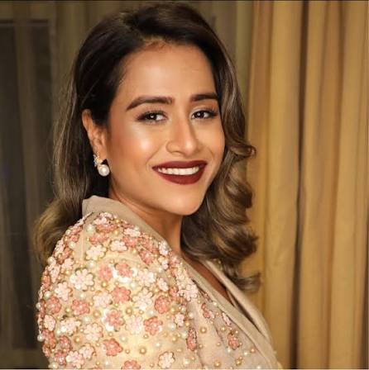
LINDE INDIA • CULTURAL EVENING
YOUR EMCEE — ANGELA REBELLO
Warm. Engaging. Energetic. The voice connecting every moment of the evening.
ANGELA REBELLO
EMCEE
Angela will anchor the cultural journey from the opening welcome through audience interactions, performance transitions and the seamless handover into the DJ celebration.
ROLE THROUGH THE EVENING
Welcome • Leadership moments • Interactive fillers • Cultural transitions • DJ handover
Video Link
Video

Slide 16
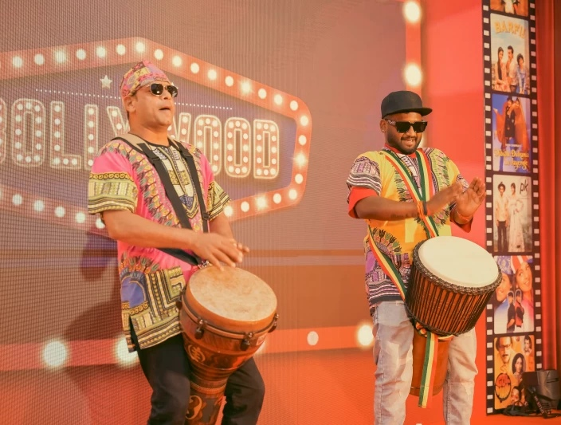
LINDE INDIA • CULTURAL EVENING
OPEN WITH PEOPLE. THEN BUILD THE BEAT.
ONE RHYTHM.
ONE TEAM.
INTERACTIVE DRUM CIRCLE
A professional facilitator builds a simple rhythm.
Different sections join one by one until the entire
ballroom plays together.
Different rhythms → Different people → One collective beat
THE RHYTHM OF ONE LINDE

Slide 17
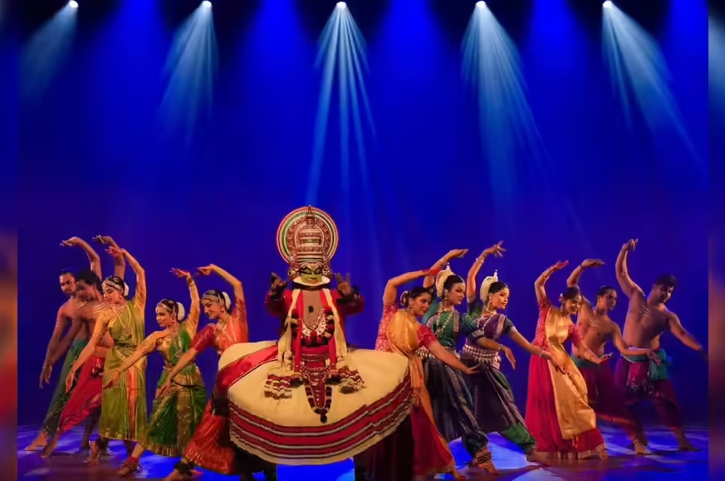
LINDE INDIA • CULTURAL EVENING
THE RHYTHMS OF INDIA
One theatrical production –
not disconnected folk acts.
NORTH — Punjabi / Bhangra
WEST — Rajasthan / Gujarat
MAHARASHTRA — High energy
SOUTH — Tamil Nadu / Kerala / Karnataka
EAST + NORTH-EAST — Regional fusion
A CONTEMPORARY JOURNEY ACROSS INDIA
MANY CULTURES. ONE INDIA. ONE LINDE.

Slide 18
LINDE INDIA • CULTURAL EVENING
DANCES OF INDIA — THE VISUAL LANGUAGE
Colour comes alive through costume, choreography, music and lighting — while the ballroom remains clean and corporate.
CINEMATIC MUSIC • COORDINATED COSTUMES • REGIONAL COLOUR • CONTEMPORARY TRANSITIONS

Slide 19
LINDE INDIA • CULTURAL EVENING
EMCEE FILLERS — KEEP THE ENERGY MOVING
Short 3–5 minute interactions connect the entertainment segments without breaking momentum.
Guess the Indian song
Guess the state
Complete a Bollywood dialogue
Regional language greetings
Linde employee shout-outs
Leadership interactions
Quick audience interactions
Fun table challenges

Slide 20
LINDE INDIA • CULTURAL EVENING
OPTIONAL WOW MOMENT
Add one unexpected high-production act between cultural segments.
LED DHOL PERFORMANCE
INDIA FUSION PERCUSSION
CONTEMPORARY VISUAL / AERIAL ACT
LIVE PERCUSSION + ELECTRONIC FUSION
Recommended: INDIA FUSION PERCUSSION — modern, inclusive and easy to integrate into the stage language.

Slide 21
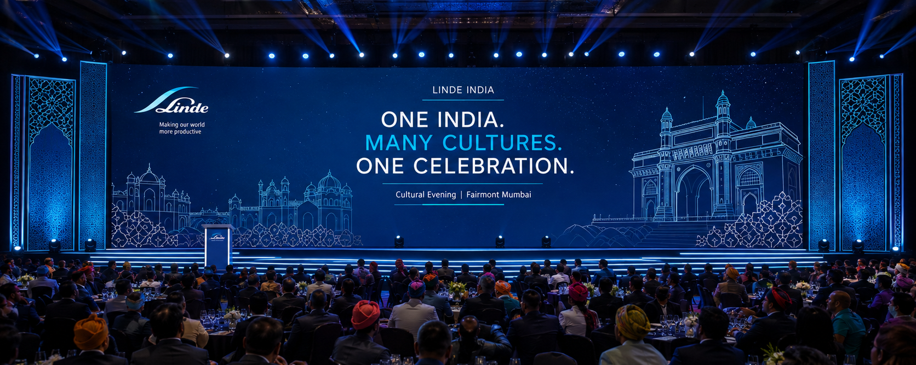
LINDE INDIA • CULTURAL EVENING
GRAND CULTURAL FINALE
The emotional high point: regional groups converge into one contemporary India visual.
ONE INDIA • ONE LINDE

Slide 22
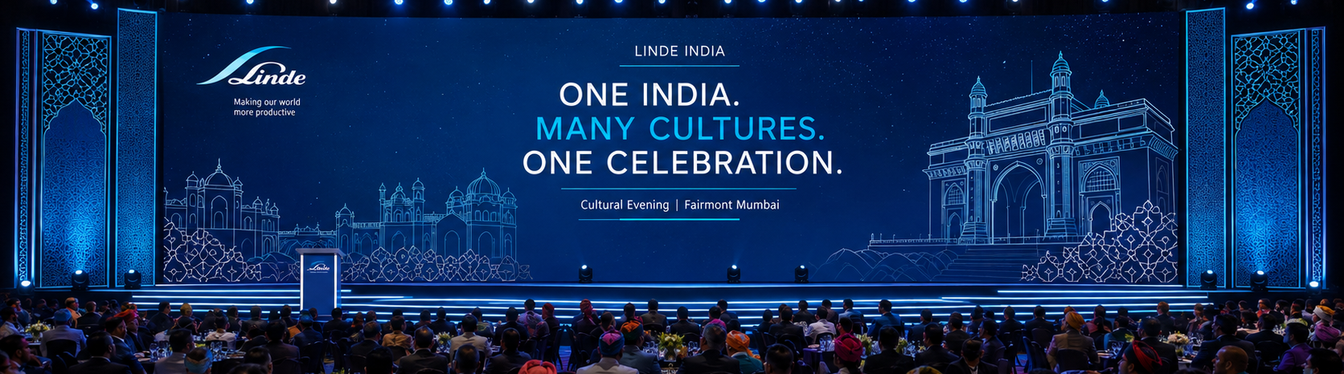
LINDE INDIA • CULTURAL EVENING
FROM CULTURE TO CELEBRATION
No hard stop — the finale music evolves into a contemporary Bollywood / commercial track and the DJ takes over.
CULTURAL FINALE
→
DANCE FLOOR OPENS
→
DJ NIGHT

Slide 23
LINDE INDIA • CULTURAL EVENING
DJ NIGHT — SAME STAGE. NEW ENERGY.
A sophisticated corporate party atmosphere in Linde blue.
BOLLYWOOD → COMMERCIAL → RETRO → PUNJABI → INTERNATIONAL

Slide 24
LINDE INDIA • CULTURAL EVENING
SUGGESTED PROGRAM FLOW
Indicative evening sequence — designed to keep energy continuous.
7:00–7:45
Arrival + Safa/Pagdi + Networking
7:45–7:50
Ballroom Opening / Seating
7:50–8:00
Emcee Welcome
8:00–8:20
Interactive Drum Circle
8:20–8:30
Leadership / Emcee Interaction
8:30–8:45
Dances of India — Act I
8:45–8:55
Audience Filler
8:55–9:10
Dances of India — Act II
9:10–9:20
Fusion / WOW Performance
9:20–9:30
Grand India Finale
9:30 onwards
Dinner + DJ + Celebration

Slide 25
LINDE INDIA • CULTURAL EVENING
PRODUCTION & LIGHTING
Lighting evolves with the show — warm welcome to cinematic culture to high-energy celebration.
Large-format LED
Professional sound
Box trussing
Moving-head beams
Moving-head washes
Profiles
Audience wash
Stage wash
Atmospheric haze
Wireless microphones
Time-coded show lighting
DJ setup
WELCOME → WARM DRUM CIRCLE → ENERGETIC CULTURE → CINEMATIC FINALE → SPECTACULAR DJ → HIGH ENERGY

Slide 26
LINDE INDIA • CULTURAL EVENING
VISUAL STORYTELLING PRINCIPLE
Keep physical fabrication selective. Let the show itself carry India.
Entertainment
LED content
INDIA SHOULD BE
EXPERIENCED -
NOT OVER-DECORATED.
Costumes
Music
Lighting
Guest interaction
This keeps the environment sophisticated, contemporary and appropriate for Linde.

Slide 27
LINDE INDIA • CULTURAL EVENING
THE COMPLETE EXPERIENCE
A premium Indian cultural evening built around participation, performance and transformation.
WELCOME
→
CONNECT
→
RHYTHM
→
CULTURE
→
CELEBRATE
ONE INDIA. MANY CULTURES. ONE CELEBRATION.

Slide 28
ONE INDIA.
ONE ENERGY.
ONE LINDE.
THANK YOU
LET'S CELEBRATE TOGETHER
Presented by MIKE Events

