Slide 1
Team - 4

Slide 2
Problem Statement
In this project we aim to determine the type of network congestion occurring in a network in the context of the telecommunication industry.
We are required to train machine learning models that use cell tower statistics and information pertaining to both tower level activity and user-level activity in order to perform a multiclass classification to predict the type of network congestion that might occur in a network as No Congestion, 4G RAN congestion, 4G Backhaul Congestion or 3G Backhaul Congestion.
Evaluation of the output is based on the Matthews correlation coefficient also abbreviated as MCC.

Slide 3
Evaluation Metrics
In general, the Matthews correlation coefficient is used as a measure of the quality of binary classifications. It takes into account true and false positives and negatives. It returns a value between −1 and +1. A coefficient of +1 represents a perfect prediction and −1 indicates total disagreement between prediction and observation.
It is regarded as a balanced measure which can be used even if the data has class imbalance, which can very well be the case if we are doing the network congestion type prediction on a complete industrial dataset and not on a handpicked subset of that data.
As in our Problem statement, we are doing multiclass classification, therefore we use the generalized form of MCC score for multiclass classification.

Slide 4
Variables:
Original Dataset is consisted of 78560 rows and 39 columns.
There are 2 types of statical data available in problem,
Numerical
Categorical
First 37 columns are of Numerical Type.
Last two columns are of categorical Type.
Target Variable Name is “Congestion_Types” and it is of Categorical type.

Slide 5
There are 4 unique categories of target variable
NC(Non-Congestion)
3G_Backhaul_Congestion
4G_Backhaul_Congestion
4G_Ran_Congestion
First 8 columns gives information about cell tower number, tower type, year, month, day, hour, minute, subscriber count.
Next 26 columns gives information about usage of data for different tasks like web browsing, file sharing, social networking, etc.
Further next 4 columns gives information about tilt, beam direction , range of tower and the service provider(‘categorical feature’).

Slide 6
Additional Variables
•We divided the hours into time zones of 5 intervals ( 1:00 am -7:00 am, 7:00 am - 11:00 am, 11:00 am - 4:00 pm, 4:00 pm - 8:00 pm, 8:00 pm - 1:00 am ) and label encoded each time-zone.
•We took the sum of all bytes consumed through the tower and created a new feature for sum_total_bytes consumed.
•We divided the ‘par_days’ feature by 7 and created a new feature of days_of_week, that is if it is Monday then we gave a value 1, 2 for Tuesday,3 for Wednesday and so on. We expected more congestions on Sundays or holidays.
•Due to high variance in data of Bytes consumption we took log of each feature to reduce variance and made its data distribution normal.
•We created new features by squaring values to capture any hidden pattern.

Slide 7
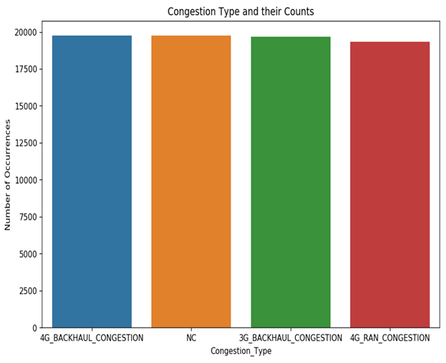
Visual Interpretation
From this basic plot, we can conclude that class distribution between the 4 congestion types is almost similar in the training set.

Slide 8
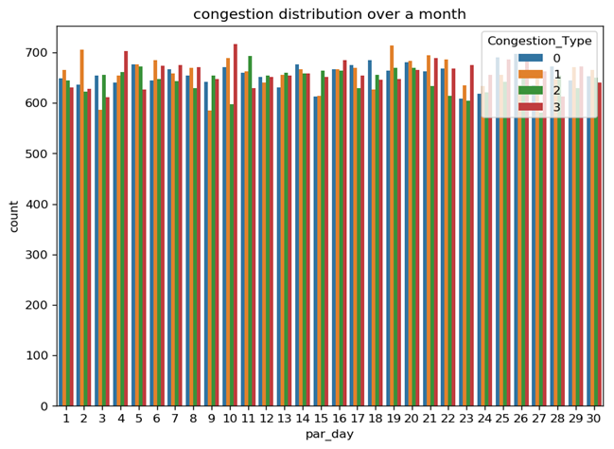
This plot represents the count of each type of congestion during a day. From this, we can conclude that a specific pattern is not generated but the count of each congestion type is randomly distributed throughout the month. Each type being maximum some day and minimum on some other day.

Slide 9
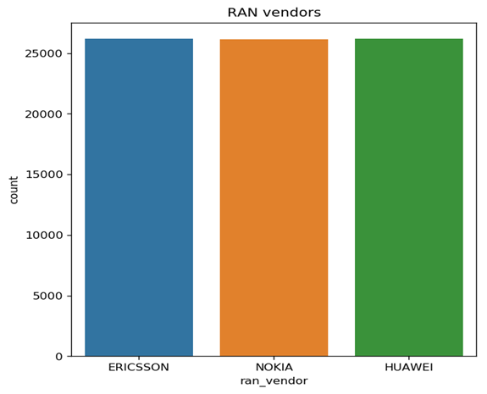
Plot showing the count of each ran_vendor. From this, we can infer that there is no preference given to any specific vendor and this feature may give us detailed hindsight in this data.

Slide 10
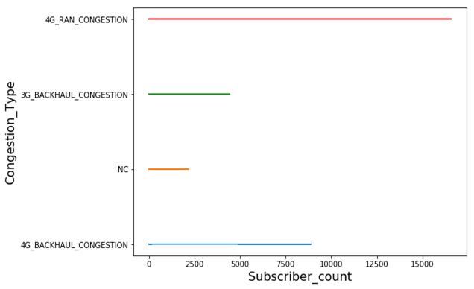
This plot represents the type of congestion and the maximum value of subscriber_count each type has. This clearly indicates that there is always congestion existing beyond 2177 subscribers and after 8890 subscribers, the only type of congestion that exists is 4G_Ran_Congestion.

Slide 11
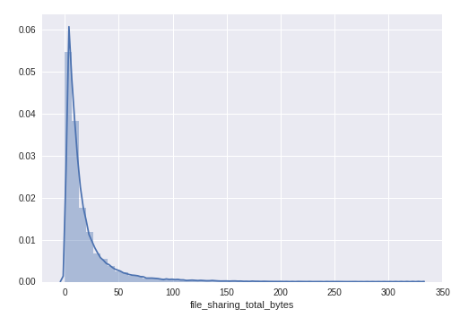
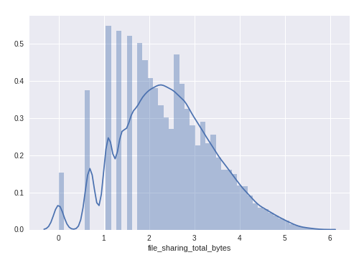
As observed from the left plot, the data for ‘file_sharing_total_bytes’ feature is skewed to a considerable extent. The same is the case with all other types of bytes features.
We hence will apply a log transform to obtain a Gaussian-like distribution as shown on the right.

Slide 12
Data Preprocessing :
Removed “Cell_name” column
Removed “Par_Year” and “Par_Month” column also because both are fixed and their variance is zero
Divided the day into 5 intervals according to general usage pattern
1:00 AM - 7:00 AM
7:00 AM- 11:00 AM
11:00 AM - 4:00 PM
4:00 PM - 8:00 PM
8:00 PM - 1:00 AM

Slide 13
There are 2 type of data (Numerical and categorical).
Target Variable is also of Categorical type.
Label Encode Categorical variables into numerical because models for training takes only numerical data.
Initially values of data usage(bytes) is skewed.
To remove skewness in data , we used several methods,like
Take logarithm of data
Squaring of each feature
Also added all the types of data usage and made new feature “Total_bytes”

Slide 14
Approach for model
Various different models are used such as :
Random Forest Classifier, AdaBoost Classifier, Extra Trees Classifier, Logistic Regression, Decision Tree Classifier, MLP Classifier , XGBoost Classifier, Gradient Boosting Classifier
Grid search is applied to find the optimum hyper parameter for the mentioned classifiers which were computationally less expensive.
Logistic Regression, Random Forest Classifier, MLP classifier

Slide 15
Approach for model
We arranged all the classifiers in descending order according to their MCC score and the chose the top 4 models whose MCC score was greater than 0.7
We used Voting classifier to ensemble our model with these 4 models:
MLP Classifier
XGBoost Classifier
Gradient Boosting Classifier.
Logistic Regression

Slide 16
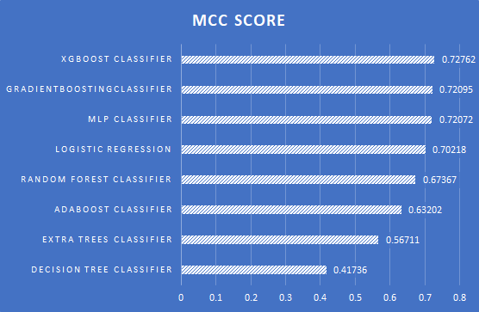
Results

Slide 17
OUTPUT INTERPRETATION
Final MCC after ensembling: 0.732
Hurdles we faced:
Reducing the false positives and true negatives between `4G_BACKHAUL_CONGESTION` and `4G_RAN_CONGESTION`.
Constructing features that were closely correlated to the congestion classes.
Finding a relation between the various time patterns

Slide 18
Estimation of uncertainty in prediction
For better determination of our model CONFIDENCE INTERVALS are used.
A 90% CONFIDENCE INTERVAL is used which gives the error around 0.14638 this will be our bound for our prediction , hence our final MCC is 0.732 ± 0.14638.
It defines that 0.9 is the probability of the variable to lie in our predicted region.
Here we have used value of K=15 in k-fold cross validation as it was producing best results.

Slide 19
Problems faced:
There were an irregular number of data rows for a particular 5 minute time bin. ->> explain this to me in meeting
Cell tower names were unique so we couldn’t make clusters of data values of a particular cell tower and thereafter construction of a Time Series was impractical

Slide 20
IMPROVEMENTS
Improvements we could apply:
Using Grid search for tuning hyperparameters of various models such as XGBoost, AdaBoost etc.
Using Deep Learning models with efficient number of layers, nodes, and hyper-parameters.

