Slide 1

SMART HELPDESK FOR IT SERVICES
PRESENTED BY :
MITHUN B - 714024104127 MOHAMED DHARIK S - 714024104129 NAVANEETH P - 714024104137 SANJAIBALA S - 714024104188 MANOJ K C - 714024104502
IInd YEAR CSE – ‘C’
SIET
SUPERVISED BY:
MRS.NANDHINI G S
AP/CSE, SIET

Slide 2
AGENDA
OBJECTIVE
ABSTRACT
INTRODUCTION
LITERATURE SURVEY
EXISTING SYSTEM AND ITS DRAWBACKS
PROPOSED SYSTEM
TECH STACK
REFERENCE
CONCLUSION

Slide 3
OBJECTIVE
To automate IT service request handling using AI for faster ticket classification and it’s resolution.
To provide a centralized platform with chatbot support for easy ticket creation and tracking.
To improve service efficiency and user satisfaction through real-time alerts and smart analytics.

Slide 4
ABSTRACT
The Smart Helpdesk Ticketing System is an AI-based platform that automates IT service request handling through web, mobile, and chatbot interfaces.
The system improves response time, service efficiency, and user satisfaction with real-time updates and performance analytics.
The system is scalable and user-friendly. Overall, it ensures faster, smarter, and more efficient IT service management.

Slide 5
INTRODUCTION
Modern organizations face challenges in managing large volumes of IT service requests efficiently.
A helpdesk system acts as a centralized support platform that helps organizations manage IT issues, service requests, and user communication efficiently.
An AI-based smart helpdesk system can automate support processes and improve service quality.

Slide 6
LITERATURE SURVEY
YEAR | AUTHOR | TITLE | TECHNOLOGY USED | LIMITATION
2023 | Yashraj Chanchad, Suraj Kanade, Ranjana Singh | Web-Based Helpdesk Ticketing System | Web Development, Database Systems | No AI automation; manual classification

Slide 7
LITERATURE SURVEY
YEAR | AUTHOR | TITLE | TECHNOLOGY USED | LIMITATION
2024 | Dr. S. Parvathi, P. Ajith, J. Daniel Tharmaraj, T. R. Dharaneeshl | Multilingual Chatbot Ticketing System | NLP, AI Chatbot, Analytics Dashboard | High development complexity

Slide 8
LITERATURE SURVEY
YEAR | AUTHOR | TITLE | TECHNOLOGY USED | LIMITATION
2025 | S. Manonmani, V. Deepa, N. Dhivyabharathi, P. Harshini, M. Akalya | AI Chatbot-Based Ticketing System | NLP, Machine Learning, Chatbot Systems | Limited real-time scalability; depends on training data

Slide 9
EXISTING SYSTEM AND ITS DRAWBACKS
IT service requests are mostly handled manually through emails, calls or basic ticketing tools.
Support staff manually categorize and assign tickets to respective departments.
Delays in issue resolution due to manual processing.
Higher workload on IT staff and chances of human errors.

Slide 10
PROPOSED SYSTEM
An AI-based smart helpdesk platform that automates ticket creation, classification and assignment.
Integration of an intelligent chatbot to assist users and provide instant solutions.
A centralized dashboard for real-time ticket tracking and performance monitoring.
Smart knowledge base that learns from past issues and resolutions.

Slide 11
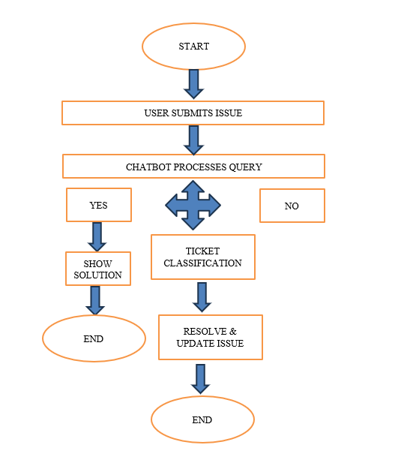
FLOW CHART

Slide 12
TECH STACK
💻 Frontend:
HTML, CSS, JavaScript – for user interface design
React.js – for dynamic and responsive UI
Tailwind CSS – for clean styling
⚙️ Backend:
Node.js – server-side logic
Express.js – API handling
MongoDB – database for storing tickets and user data
🤖 AI:
Gemini Flash 2.0 API – chatbot & ML services
NLP libraries – for ticket classification

Slide 13
HELPDESK & AI INTEGRATION
Automated Escalation System – Escalates unresolved tickets based on SLA time limits.
Role-Based Access Control (RBAC) – Secure access for Admin, Support Staff, and Users.
AI-Based Ticket Classification using NLP – Automatic issue understanding and smart categorization.
Chatbot Integration with Context Awareness – Intelligent bot that understands user queries and provides instant solutions

Slide 14
REFERENCE
[1] Y. Chanchad, S. Kanade, and R. Singh, “Helpdesk Ticketing System,” International Journal of Innovative Research in Technology (IJIRT), vol. 9, no. 3, pp. 120–125, 2023.
[2] S. Parvathi, P. Ajith, J. D. Tharmaraj, and T. R. Dharaneeshl, “Online Chatbot-Based Ticketing System,” International Journal of Scientific Research and Engineering Trends (IJSRET), vol. 10, no. 6, pp. 508–512, 2024.
[3] S. Manonmani, V. Deepa, N. Dhivyabharathi, P. Harshini, and M. Akalya, “AI Chatbot-Based Ticketing System,” International Journal of Scientific Research in Engineering and Management (IJSREM), vol. 9, no. 2, pp. 1–6, 2025.
[4] A. M. Lakshmi, C. S. Deepika, A. Arshad, and J. K. B, “Online Chatbot-Based Ticketing System,” IRE Journals, vol. 8, no. 5, pp. 45–50, 2025.
[5] R. Kumar and S. Patel, “AI-Based Customer Support Automation,” International Journal of Scientific Engineering and Technology (IJSET), vol. 12, no. 5, pp. 822–828, 2024.

Slide 15
CONCLUSION
The proposed system improves IT support by using AI-based automation and smart ticket management.
The integration of chatbot, NLP, and machine learning enhances user experience and efficiency.
Overall, the system provides a scalable, fast, and intelligent helpdesk solution for modern organizations.

Slide 16
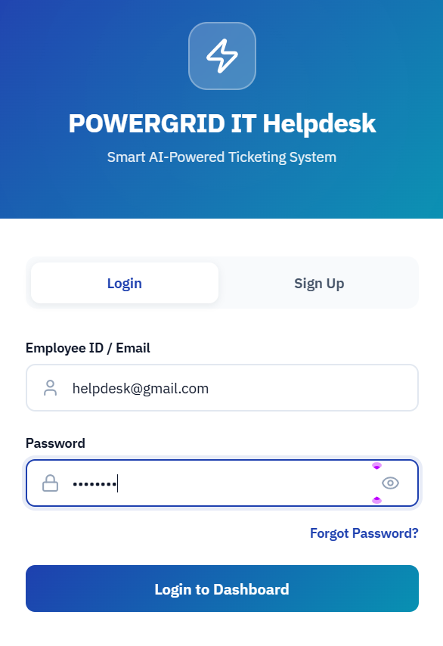
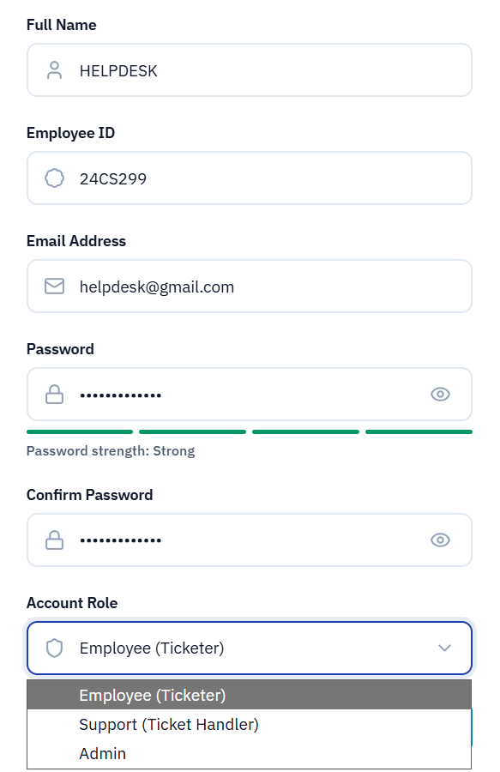
SIGN UP AND LOGIN PAGE

Slide 17
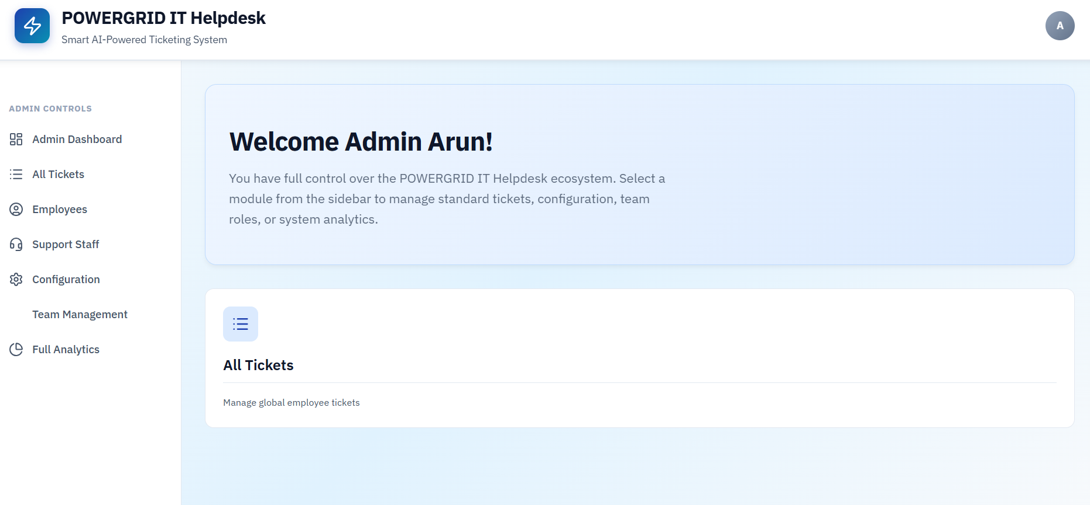
ADMIN DASHBOARD

Slide 18
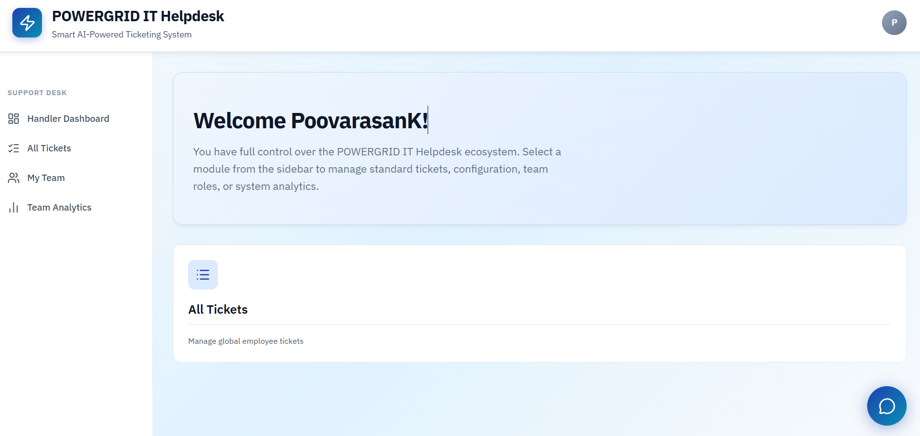
HANDILER DASHBOARD

Slide 19
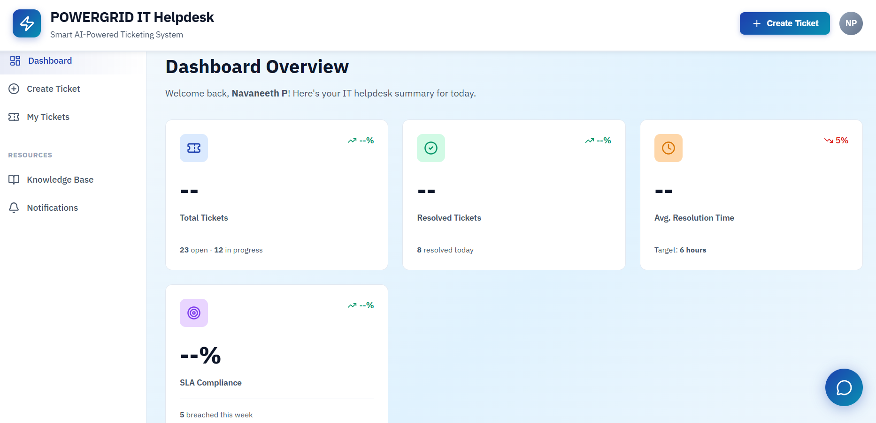
EMPLOYEE DASHBOARD

Slide 20
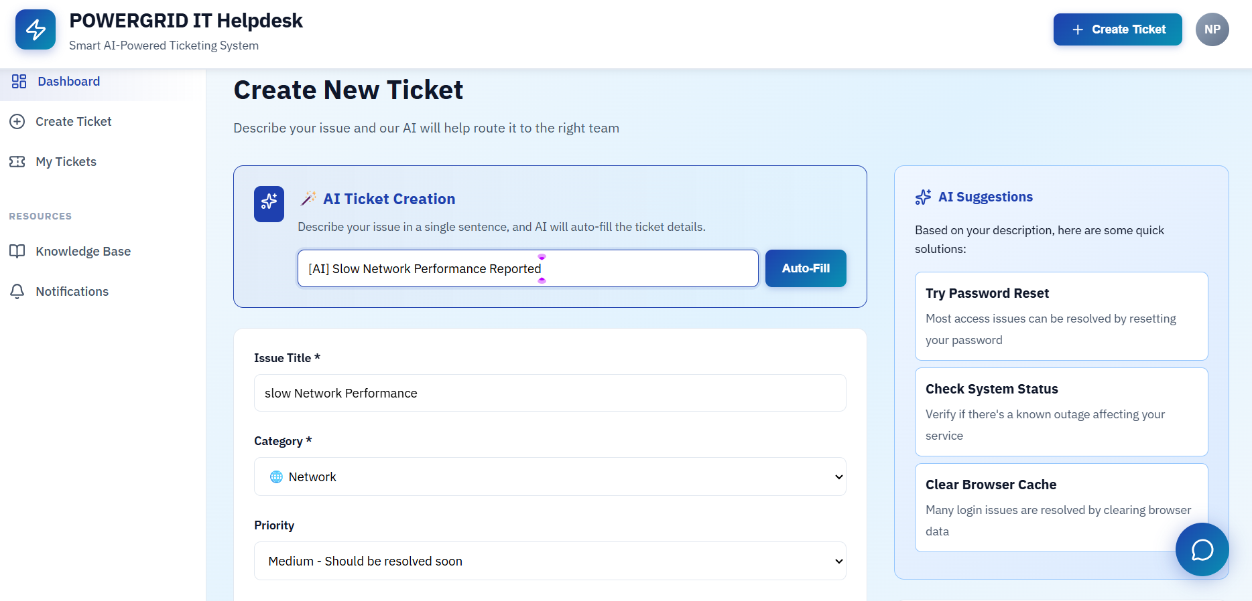
TICKET CREATION PAGE

Slide 21
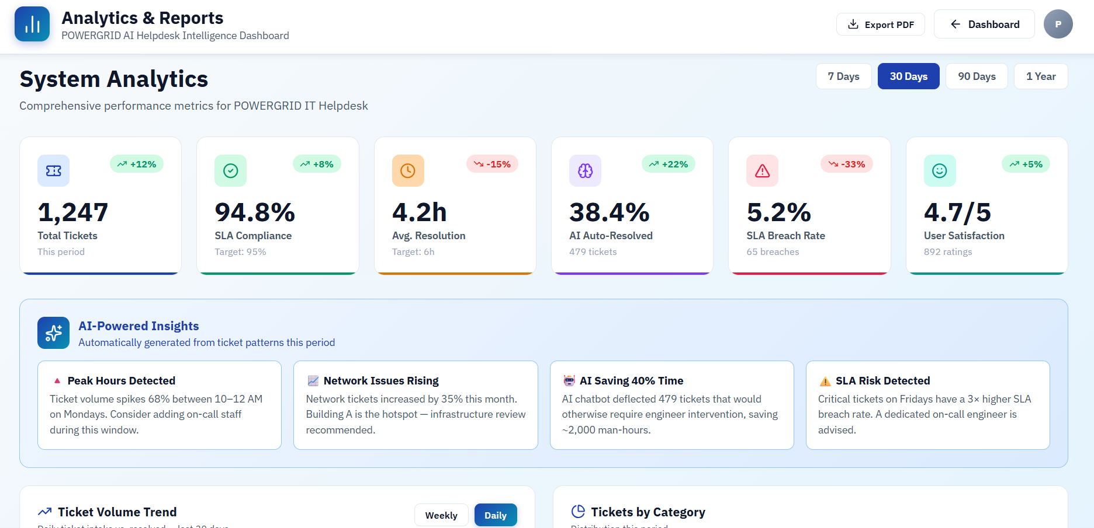
ANALYTICS PAGE

Slide 22
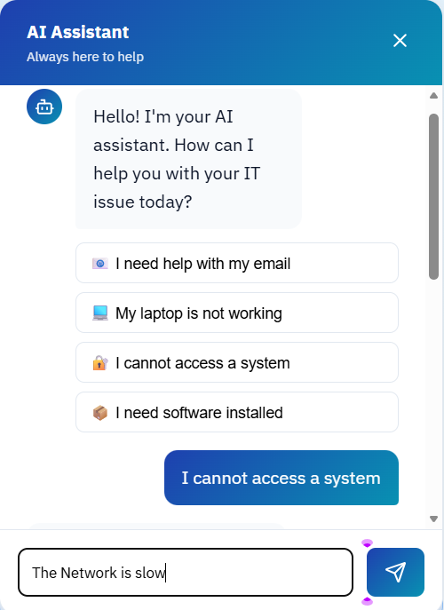
AI CHATBOT ASSISTANT

Slide 23
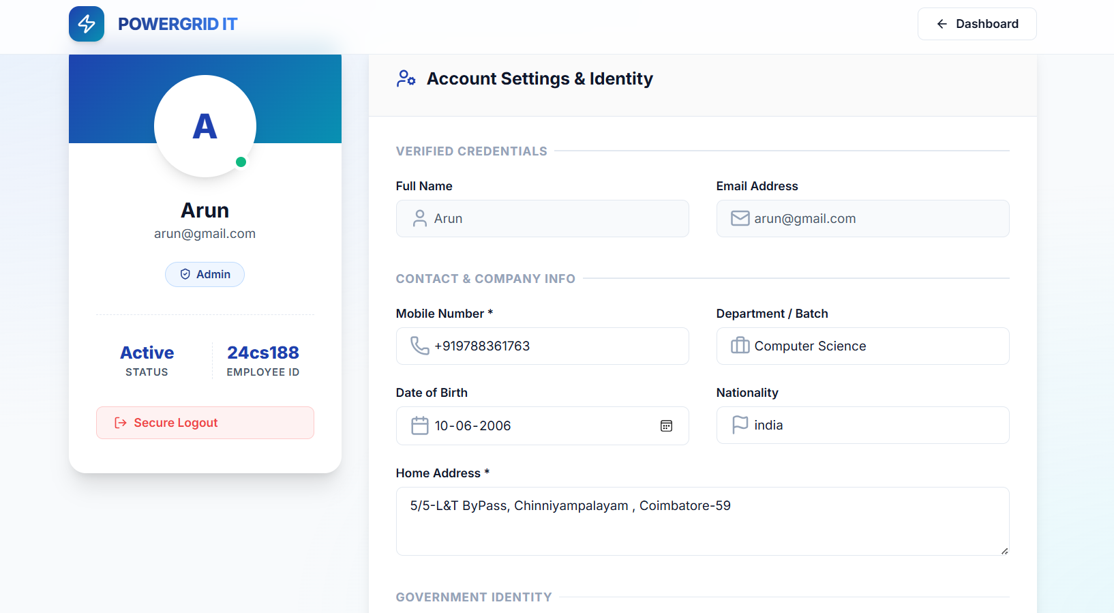
PROFILE

Slide 24
THANK YOU!!!

