Slide 1
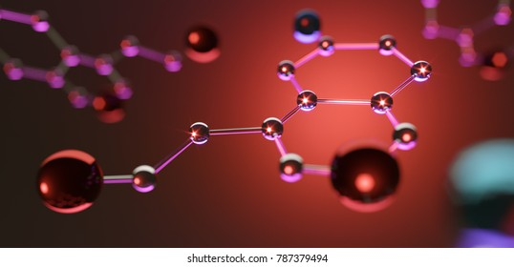
Local hormones
MOULIKA S

Slide 2
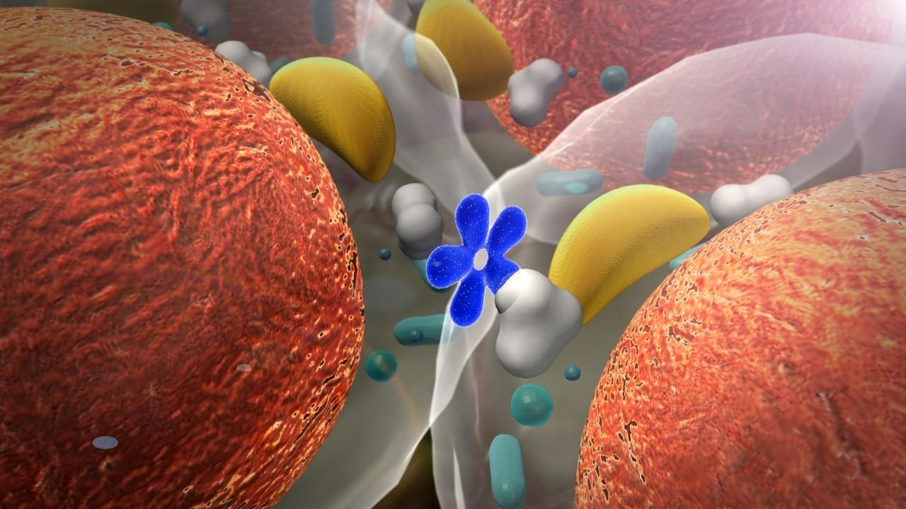
LOCAL HORMONES
Chemicals that are secreted locally from endocrine tissue & involved in control of local tissue.
Major Local Hormones-histamine, serotoin, prostaglandin

Slide 3
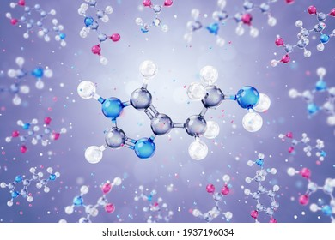
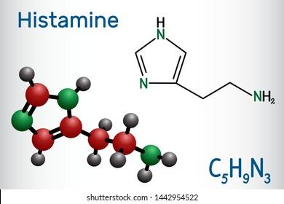
HISTAMINE, serotoin, prostaglandin
Source, Synthesis& Metabolim.
Receptors.
Physiological actions.
Clinical correlation.

Slide 4
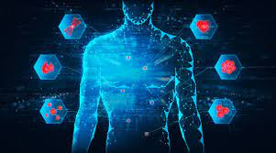
SOURCE, SYNTHESIS & METABOLISM
Secreted from mast cells and basophil.
Widely in mammalian tissue.
Present in high concentration in skin, gastric mucosa.
Pituitary and lungs.

Slide 5
receptors
3 types namely-H1,H2,H3 receptors.
Found in brain&peripheral tissues
H1 receptors: attached to phospholipids C.it mediate inflammation &allergy.
H2 receptors:acts by increasing intracellular cAMP.found in gastric mucosa&mediate gastric acid secretion.
H3 receptors:found in CNS,in presynaptic membrane. Inhibit release of histamine &other NT from presynaptic nerve terminals.

Slide 6
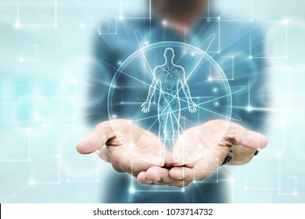
PHYSIOLOGICAL ACTIONS
Acts mainly on CVS, smoothmuscle, exocrine secretion. It mediate inflammation &allergy.
On CVS-potent vasodilator, decreases BP(hypotension)&cardiac output.
On smooth muscle-increases tone of muscle& intestinal motility, cause bronchoconstriction.
On exocrine secretion-it is a powerful stimulator of HCL secretion from parietal cells stomach. Also potentials salivary, pancreatic &intestinal secretions.

Slide 7
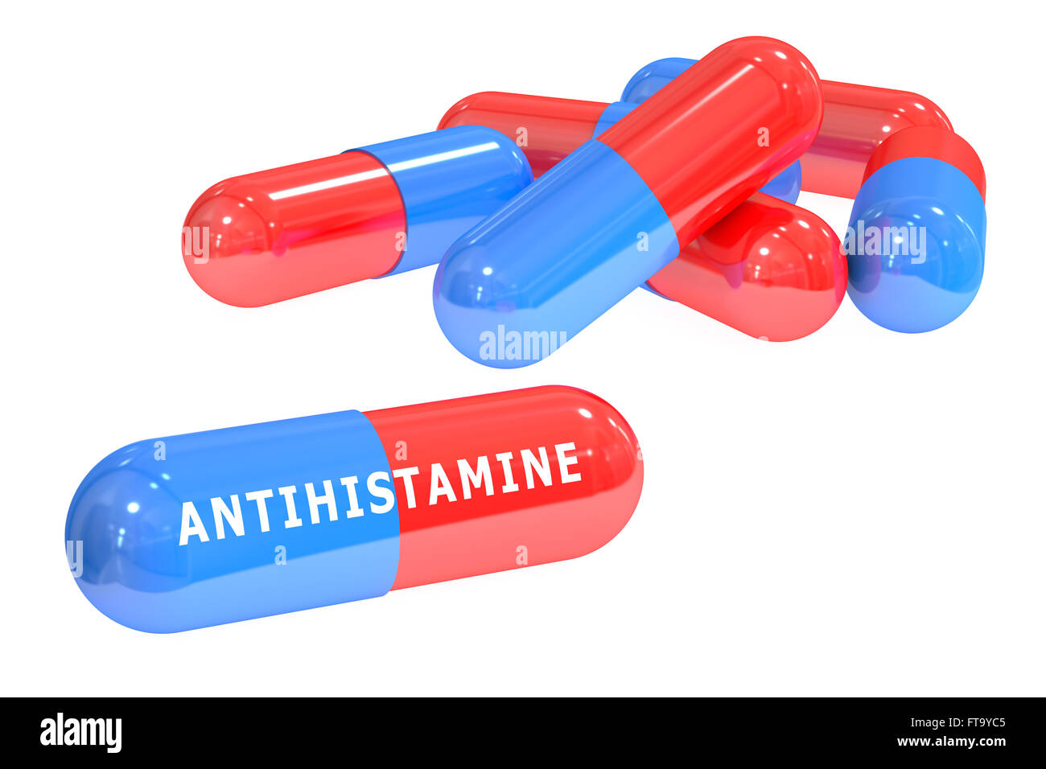
ANTIHSTAMINE DRUGS
Used for treatment.
H1 Receptor Antagonists-like mepyramine & promethazine are used to prevent histamine induced contractions of smooth muscle of intestine & bronchi.
Frequently in treatment of allergies.
H2 Receptor Antagonists-like crimetidine, ranitidine & famotidine are used to inhibit histamine induced HCl secrtion in stomach.
Frequently in treatment of peptic ulcer.

Slide 8
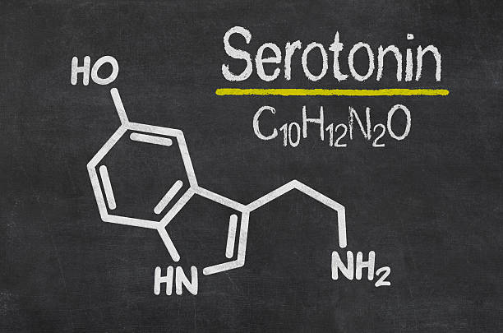
SEROTONIN
5 Hydroxytryptamine.
Various tissue.
Present in high conc. in GIT, GNS especially in hypothalamus & brainstem, skin.
Due to higher conc in Instestine (enteramine).
Also in platelets & basophils

Slide 9
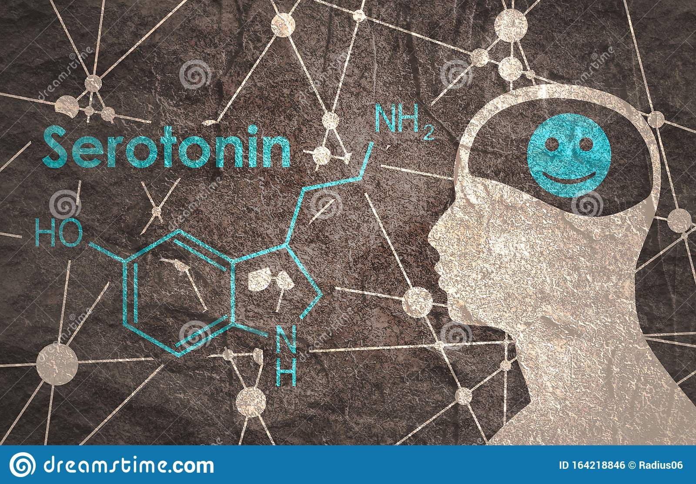
RECEPTORS:
-7 types (5-HT1, 5-HT2, 5-HT3, 5-HT4, 5-HT5, 5-HT6, 5-HT7).
PHYSIOLOGICAL ACTIONS:
-Mainly on CVS, RS, Kidney, Smooth muscle & NS.
CVS:
→Acting locally produces vasocentriction.
→Facilities platelet aggregation.
→Esstial for temporary hemestasis.
→Produce tachtcardia.
RS:
→Increase bronchial tone (causes bronchonstrition).
→Includes acute attack of asthma (asthmatic patients).
→Stimulates rate of respiration.

Slide 10
KIDNEY:
# Has mild antidiuretic effect.
# Prevents diuresis by decearsing GER.
# Cause-uretric sparm and temporarily steps urination.
GIT:
# Stimulates GI secretion and motility.
# Promotes peristalsis and produce diarrha.
CNS:
# Resphespinal system (on stimulation produces analgesia).
# 5-HT3 receptors includes vomiting, 5-HT6 & 5-HT7 are distributed throught limbic system, neocortex and spinal cord.
CENTRAL FUNCTIONS:
# Inhibits transmission of pain impulses.
# Stimulate prolactin secretion.
# Regulates circadian rhythm.
# Strong antidepressant.
# Suppresses sleep.

Slide 11
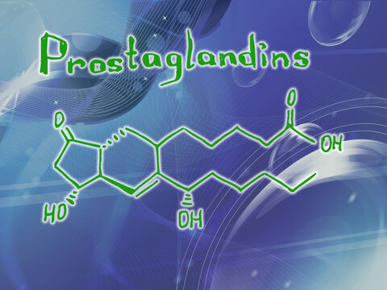
PROSTAGLANDINS
By von euler.
Found in various tissue of body.
They are 20-carbon unsaturated fatty acids containing cyclopentane ring.
TYPES:
PGE, PGF, PGI, PFH and PGA (common).

Slide 12
PHYSIOLOGICAL ACTIONS:
All tissue of body.
Mainly involved in control of functions of various organ systems, hemostasis and metabolism and inflammation.
CVS:
PGA & PGA2 cause peripheral artiolar dilation.
Facilitate Lutealysis (decreases secrtion of progesterone). Increase in uterine fluid.
Increase secrtion of GnRH from hyphalamus.
RS: Prostagladin E causes bronchodilation whereas.
PGF2:
Produces bronchoconstriction.
HEMOSTASIS

Slide 13
GI:
Inhibit absorption of sodium and water.
Watery diarrea produced in cholera is by prostaglandins.
Stimulates intestinal mortility.
CNS:
Intibits release of norepinephrine from nerve ending(PGE).
INFLAMTION:
PGE & A increase capillary permeability.
Sensitize nerve ending to bradykinin and produces pain.
METABOLISM:
PGE, inhibits lipolysis, induced by ACTH, GH, glucagons and epinephrine.
CLINICAL CORRELATION:
Steroidal anti-inflammatory drugs.
Non-steroidal anti-inflammatory drugs.

Slide 14
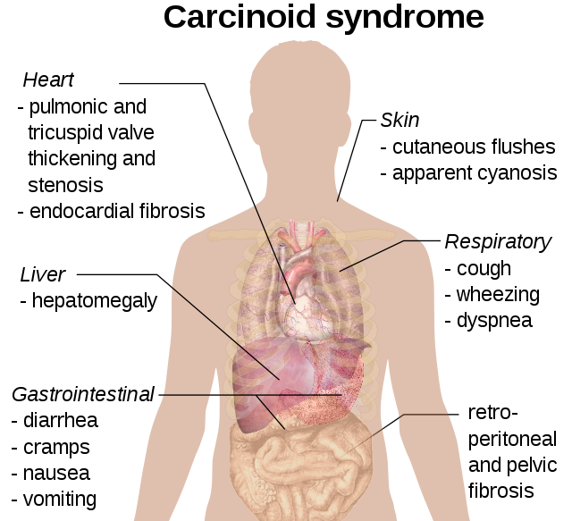
CARCINOID SYNDROME
Tumors of enterochromaffin cells of GIT or bronchus or pancreas.
Episodic flushing of skin, with hypertension, abdominal pain, diarrea and bronchosteriction.
Episodic attack due to secrtion of various from tumer enterochromaffin cells.
Secrete excess of serotonin and histamine.
Diagnosed by excretion of increased amount of 5—HIAA in urine.

Slide 15


