Slide 1

HR-Analytics Dashboard
Created by : T. Nava Jeevan Paul

Slide 2

Project Overview
This project analyzes employee attrition, workforce demographics, and job satisfaction using Power BI.

Slide 3
Tools Used
Power BI
Excel / CSV
SQL
Data Visualization

Slide 4
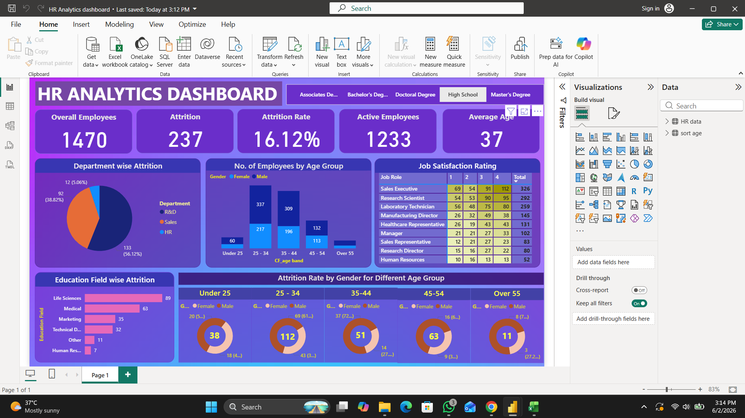
Dashboard Preview

Slide 5
Key Insights
Attrition Rate: 16.12%
Total Employees: 1470
Active Employees: 1233
Department-wise attrition analysis
Job satisfaction analysis

Slide 6




Conclusion
The dashboard helps HR teams identify employee trends and make better workforce decisions.

Slide 7

THANK YOU

