Slide 1
Solving Laplace Equation using Conformal Mapping
Dulyawat Boonvut
Undergraduate, 6205110
Department of Physics, Faculty of Science
Mahidol University

Slide 2
Overview
Conformal mapping
Laplace Equation and its solution
Example problem
Setting
Conformal mapping
Solution

Slide 3
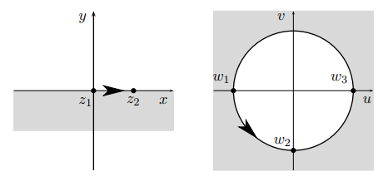

Conformal Mapping
A transformation of a complex function in complex plane that the function remains mutually orthogonal (preserve local angle).
Example:
Transforming a half plane $(z)$ onto a disc $(w)$: $w=\frac{z−i}{z+i}$
From “Complex Analysis for Physicist” Lecture Note

Slide 4
Laplace Equation: Piecewise condition
2D Laplace equation of $V$ reads
$$V_{xx}+V_{yy}=0$$
the simplest form of Elliptic PDE
use in fluid dynamics

Slide 5












Laplace Equation: Piecewise condition
Considering piecewise $V\left(x,0\right)$
$$V=V_{0}$$
…
…
$$V=V_{n}$$
$$V=V_{1}$$
$$V=V_{i−1 }$$
$$V=V_{i}$$
$$x=x_{1}$$
$$x=x_{2}$$
$$x=x_{i−1}$$
$$x=x_{i}$$
$$x=x_{i+1}$$
$$x=x_{n−1}$$
The solution for the following condition reads
$$V\left(x,y\right)=V_{n}+\sum_{i=1}^{n}{\left(V_{i−1}−V_{i}\right)Arg(z\left(x,y\right)−x_{i})}$$

Slide 6
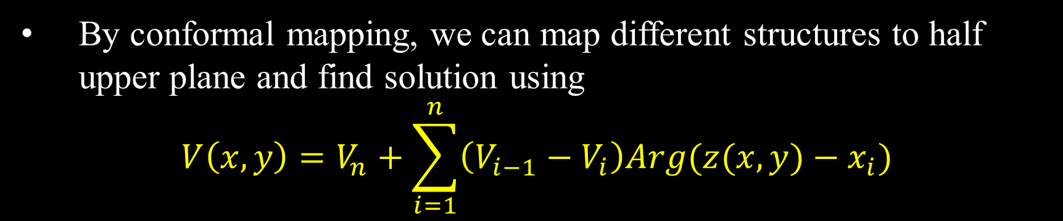
Laplace Equation in Fluid Dynamics
In 2D irrotational flow, the equation for velocity potential $V$ reads
$$V_{xx}+V_{yy}=0$$
By conformal mapping, we can map different structures to half upper plane and find solution using
$$V\left(x,y\right)=V_{n}+\sum_{i=1}^{n}{\left(V_{i−1}−V_{i}\right)Arg(z(x,y)−x_{i})}$$

Slide 7




Example Problem: Setting
infinitely long semicircular pipe with radius $a$
stream function with boundary condition:
$V=0$ at the flat surface
$V=V_{0}$ at the curved surface
Observe an inviscid flow in this problem (Laplace equation)
$$V=V_{0}$$
$$a$$
$$V=0$$

Slide 8





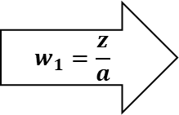








Example Problem: Conformal Mapping
$$y=a$$
$$y=1$$
$$w_{1}=\frac{z}{a}$$
$$x=−1$$
$$x=1$$
$$x=−a$$
$$x=a$$
$$w_{2}={\left(\frac{1+w_{1}}{1−w_{1}}\right)}^{2}={\left(\frac{1+z/a}{1−z/a}\right)}^{2}$$
$$V=V_{0}$$
$$V=0$$
(Curved surface maps to negative $x$)
$$x=1$$
$$x=∞$$
$$x=0$$

Slide 9



Example Problem: Solution
$$V=V_{0}$$
$$V=0$$
$$x=0$$
$$V\left(x,y\right)=0+\frac{1}{π}\left(V_{0}−0\right)Arg\left(w−0\right)=\frac{2V_{0}}{π}Arg\left(\frac{a+x+iy}{a−x−iy}\right)$$

Slide 10
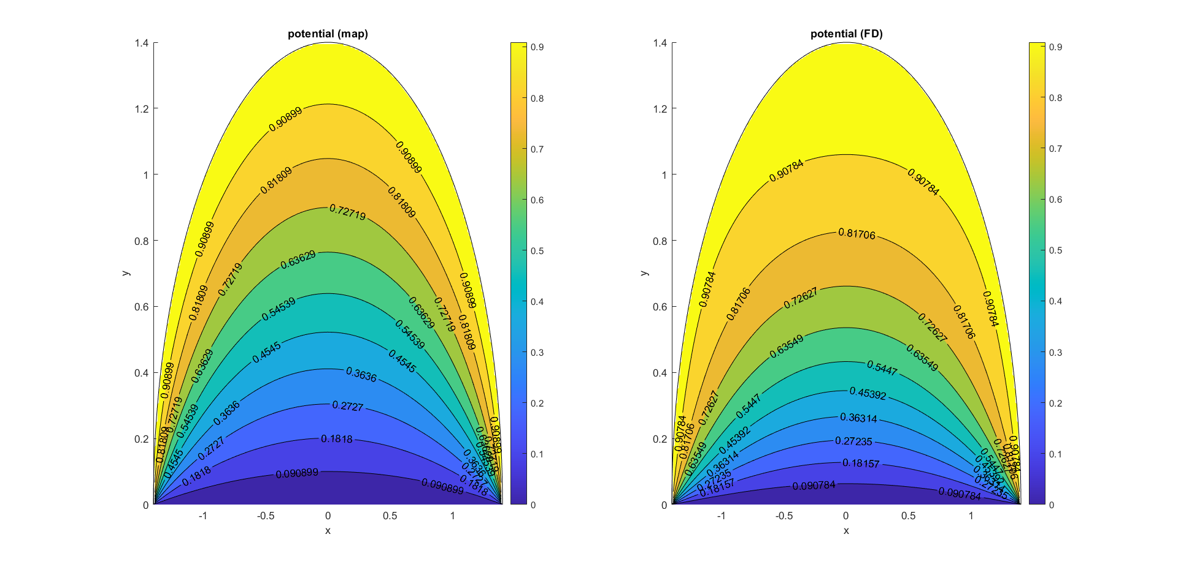
Example Problem: Graph of Solution

Slide 11
Summary
Conformal mapping
Laplace equation in case of piecewise condition can be solved by conformal mapping
map from any shape to half upper plane
Example Problem: flow in infinite semicircular tube

Slide 12
References
https://en.wikipedia.org/wiki/Conformal_map
“Complex Analysis for Physicist” Lecture Note
“Computational Fluid Dynamics” Lecture Note

