Slide 1


GLOBAL ACADEMY OF TECHNOLOGY
Approved by AICTE, New Delhi | Recognized by Govt. of Karnataka | Autonomous Institute under VTU, Belagavi
Rajarajeshwari Nagar, Bengaluru - 98 | Department of Artificial Intelligence & Data Science
MAJOR PROJECT | FINAL PRESENTATION
ADS23706
Agentic AI-Driven Honeypot for Autonomous
Scam Detection and Threat Intelligence Extraction
Team Members
Under the Guidance of
Name | USN
Chaitanya A M | 1GA23AD011
Emmanuel Lara | 1GA23AD015
Naval C N | 1GA23AD034
Dr. Ugranada Channabasava
Associate Professor, Dept. of AI & DS

Slide 2
GLOBAL ACADEMY OF TECHNOLOGY
Department of Artificial Intelligence & Data Science
MAJOR PROJECT FINAL
Presentation Contents
1
Introduction
6
Methodology
2
Literature Survey
7
Implementation
3
Problem Statement
8
Results & Testing
4
Objectives
9
Conclusion & Future Work
5
Design – System Architecture
10
References
Agentic AI-Driven Honeypot for Autonomous Scam Detection and Threat Intelligence Extraction
2

Slide 3
GLOBAL ACADEMY OF TECHNOLOGY
Department of Artificial Intelligence & Data Science
Introduction
According to CERT-In, India reported over 1.5 million cybersecurity incidents in 2023, with UPI fraud alone crossing ₹1,000 crore in losses. The attackers behind these aren't using malware — they're using WhatsApp and Telegram.
Attacker
⚠
Modern cyber attackers exploit human psychology rather than system vulnerabilities — using phishing, impersonation, and UPI-based financial fraud that relies on real-time interaction, urgency, and manipulation.
Honeypot
⛶
A honeypot mimics vulnerable systems to attract and monitor malicious activity. Traditional honeypots are passive — they log attacker behaviour but never engage, which limits their use against interactive scams.
◉
Agent
An intelligent agent perceives, decides, and acts autonomously. Here, the agent is a conversational entity that engages the scammer, adapts its replies dynamically, and strategically extracts financial details and phishing links.
Agentic AI-Driven Honeypot for Autonomous Scam Detection and Threat Intelligence Extraction
3

Slide 4
GLOBAL ACADEMY OF TECHNOLOGY
Department of Artificial Intelligence & Data Science
Literature Survey
Title, Author & Year | Overview | Drawbacks
Detecting Phishing Attacks Using Machine Learning Mohammad et al., 2022 | Uses ML models to classify phishing URLs and messages based on features. | No interaction with the attacker; purely detection-based.
Conversational AI for Social Engineering Detection Chen et al., 2023 | Uses NLP to identify scam conversations inside chat systems. | Cannot continue the conversation or extract intelligence.
Intelligent Honeypots for Cyber Defense Fan & Fernandez, 2021 | Enhances honeypots with adaptive behaviour. | Focuses on network attacks, not social engineering scams.
UPI Fraud Detection Using Data Mining Sharma et al., 2023 | Detects fraudulent transactions using behavioural patterns. | Works only after fraud occurs; no prevention or interaction.
LLM-Based Chatbots for Cybersecurity Applications Zhang et al., 2024 | Uses large language models for cybersecurity automation. | Lacks structured extraction and controlled agent behaviour.
Research gap: no existing work combines scam detection, active multi-persona engagement, intelligence extraction and automatic blocking in one system.
Agentic AI-Driven Honeypot for Autonomous Scam Detection and Threat Intelligence Extraction
4

Slide 5
GLOBAL ACADEMY OF TECHNOLOGY
Department of Artificial Intelligence & Data Science
Problem Statement
Online scammers now use apps like Telegram and WhatsApp to cheat people through phishing links, fake UPI requests, fake jobs and impersonation. Existing tools have two gaps: scam detectors only block or flag a message and never collect any evidence, and normal honeypots only sit and watch without talking to the attacker. Because of this, important details such as UPI IDs, bank accounts, QR codes and phishing links are lost, and the same scammer can attack again. So the problem is to build a system that can detect a scam message, talk to the scammer on its own using a believable victim persona that does not look like a bot, and automatically collect evidence and block the attacker.
Agentic AI-Driven Honeypot for Autonomous Scam Detection and Threat Intelligence Extraction
5

Slide 6
GLOBAL ACADEMY OF TECHNOLOGY
Department of Artificial Intelligence & Data Science
Objectives
1
Scam Detection & Classification
2
Persona-Driven Interaction
Detect scam messages in real time and find the scam type (bill threat, KYC, job/task, crypto) using NLP, so only suspicious chats are engaged.
Reply like a real victim using 3 personas (Kamla Devi, Rohan Sharma, Rajesh Uncle) picked by scam type, and act human with typing delay and typos.
3
Intelligence Extraction
4
Structured Output & Auto-Block
Use smart stalling questions so the scammer shares UPI IDs, bank details, phone numbers, QR codes and links; check links with URLhaus.
Save the evidence as clean JSON, block confirmed scammers automatically and show everything on the SOC dashboard.
Agentic AI-Driven Honeypot for Autonomous Scam Detection and Threat Intelligence Extraction
6

Slide 7
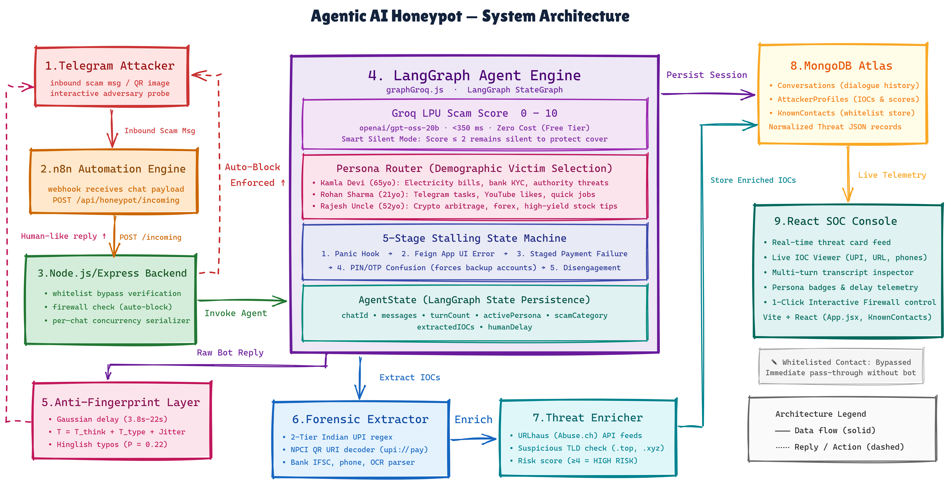
Agentic AI-Driven Honeypot for Autonomous Scam Detection and Threat Intelligence Extraction
7

Slide 8
GLOBAL ACADEMY OF TECHNOLOGY
Department of Artificial Intelligence & Data Science
Methodology
Ingest & Screen
Human-Like Replies
1
Every Telegram message goes through n8n to the backend, which checks the known-contact whitelist and the firewall of already-flagged scammers.
4
The anti-fingerprint layer adds a Gaussian typing delay and Hinglish typos, so the scammer believes a real person is typing.
2
Real-Time Scam Scoring
5
Deep Threat-Intel Extraction
For new senders, a Groq LPU (gpt-oss-20b) gives a scam score of 0–10 and the scam type in one fast call. Low scores stay silent to protect cover.
2-tier UPI regex, bank / IFSC, phone numbers, and UPI QR codes decoded from images. Links are checked with URLhaus and a risky-domain score.
3
Persona Routing & Engagement
Classify, Persist & Block
Scam type picks the persona: Kamla Devi (bill / KYC threats), Rohan Sharma (job / task scams), Rajesh Uncle (crypto). A 5-stage state machine stalls the scammer.
6
The full chat is re-checked and saved in MongoDB as one JSON record. Confirmed scammers are auto-blocked and shown on the SOC dashboard.
Agentic AI-Driven Honeypot for Autonomous Scam Detection and Threat Intelligence Extraction
8

Slide 9
GLOBAL ACADEMY OF TECHNOLOGY
Department of Artificial Intelligence & Data Science
Implementation
Completed Modules
Implemented API Endpoints
backend/ Express + Mongoose REST API; Conversations, AttackerProfiles, KnownContacts; threatEnricher.js (URLhaus + risky-domain score); whitelist and firewall.
Method | Endpoint
POST | /api/honeypot/incoming — ingest, score, engage, extract
GET | /api/honeypot/alerts — flagged scammer feed
GET | /api/honeypot/conversations/:chatId — full transcript
POST | /api/honeypot/block-toggle — manual SOC block / unblock
POST | /api/honeypot/whitelist — bypass known senders
agent/ LangGraph state machine (graphGroq.js), 3 personas (persona.js), antiFingerprint.js, multimodalExtractor.js (UPI QR + OCR), extractor.js.
dashboard/ React + Vite SOC console: live alerts, IOC viewer, transcript inspector, persona badges, one-click block / unblock.
n8n/ Exported Telegram-routing workflow (telegram_honeypot_workflow.json).
docs/ Normalized threat-intelligence JSON schema (schema.md) with extraction & merge logic.
Tech Stack
Node.js / Express • MongoDB Atlas • LangGraph • Groq LPU (openai/gpt-oss-20b) • React + Vite • n8n • Tests: verify_upgrades.mjs, evaluate_ieee_benchmark.mjs
Agentic AI-Driven Honeypot for Autonomous Scam Detection and Threat Intelligence Extraction
9

Slide 10
GLOBAL ACADEMY OF TECHNOLOGY
Department of Artificial Intelligence & Data Science
Results & Testing (1/2)
Verification tests (verify_upgrades.mjs)
12-message scenario check
Test | What was checked | Result
Personas | 3 personas loaded: Kamla Devi, Rohan Sharma, Rajesh Uncle | Pass
Anti-fingerprint | Human typing delay (about 3.8–22 s) and typo noise applied | Pass
QR decoding | UPI QR decoded to UPI ID, payee name and amount | Pass
Image OCR | UPI ID found from text inside an image | Pass
Domain check | Suspicious .top domain with deep subdomains: risk score 6 | Pass
8 / 8
scam messages flagged
4 / 4
normal messages stayed silent
8 / 8
persona routing correct
4 / 8
IOCs extracted on the mixed text + image test set (to improve)
All upgrade tests passed
Note: this check uses keyword rules to test the routing logic. It is not a measure of LLM accuracy.
Human-delay test on 50 sampled turns: mean 14.1 s, std ±3.6 s, range 7.2–20.3 s (different every time, so bots cannot spot a pattern).
Agentic AI-Driven Honeypot for Autonomous Scam Detection and Threat Intelligence Extraction
10

Slide 11
GLOBAL ACADEMY OF TECHNOLOGY
Department of Artificial Intelligence & Data Science
Results & Testing (2/2)
Simulated attack sessions
Intelligence collected
6
sessions recorded on the running system
6 fraudulent UPI IDs
5 phishing URLs and links
2 unique attacker phone numbers
5 attacker profiles auto-blocked by the firewall
5 (83%)
sessions confirmed as scams
4.2
average turns kept engaged per session
Example sessions
Electricity-bill threat: Kamla Devi faked an app error and the scammer shared a backup account (electricity.emergency@hdfcbank).
YouTube task scam: Rohan Sharma played along and the scammer shared a recruiter handle and a mule UPI ID.
QR scam: UPI QR codes were decoded directly from the image.
4 + 2
Kamla Devi and Rohan Sharma sessions
Scripted attacker messages were sent through Telegram → n8n → backend → MongoDB. These are test sessions, not real scammers.
Agentic AI-Driven Honeypot for Autonomous Scam Detection and Threat Intelligence Extraction
11

Slide 12
GLOBAL ACADEMY OF TECHNOLOGY
Department of Artificial Intelligence & Data Science
Conclusion and Future Work
Conclusion
Future Work
We built an AI honeypot that does not just watch the scammer, it talks to them like a real victim.
It picks a persona by scam type, behaves like a human, and extracts UPI IDs, bank details, QR data and links.
The evidence is saved as structured JSON, confirmed scammers are blocked automatically, and everything is shown on a SOC dashboard.
WhatsApp and SMS support
Hindi and Kannada scammers
Voice-call scams
Better OCR and link extraction to raise the IOC yield
LLM-based accuracy benchmark on a larger dataset
Report extracted evidence to cybercrime portals
Test on real scam chats with permission
Linking systems to NIC databases
Agentic AI-Driven Honeypot for Autonomous Scam Detection and Threat Intelligence Extraction
12

Slide 13
GLOBAL ACADEMY OF TECHNOLOGY
Department of Artificial Intelligence & Data Science
References
1
Mohammad, R., et al. (2022). Detecting Phishing Attacks Using Machine Learning.
2
Chen, L., et al. (2023). Conversational AI for Social Engineering Detection.
3
Fan, Y., & Fernandez, E. (2021). Intelligent Honeypots for Cyber Defense.
4
Sharma, A., et al. (2023). UPI Fraud Detection Using Data Mining.
5
Gupta, S., et al. (2024). Detection-Without-Extraction Approaches in Scam Analytics
6
Zhang, H., et al. (2024). LLM-Based Chatbots for Cybersecurity Applications.
7
LangChain / LangGraph Documentation — https://langchain-ai.github.io/langgraph/
8
Groq Developer Documentation — https://console.groq.com/docs
Agentic AI-Driven Honeypot for Autonomous Scam Detection and Threat Intelligence Extraction
13

Slide 14
Thank You
Questions & Discussion
Global Academy of Technology • Department of Artificial Intelligence & Data Science

