Slide 1
CRYPTOCURRENCY TRADING APPLICATION
BY
MANSI GANDHI
JUHI NAVALEKAR
POOJA HIREMATH

Slide 2
PROBLEM STATEMENT
Cryptocurrency Trading Application provides a simpler way to trade in cryptocurriences across any network via enterprises.

Slide 3
OBJECT MODEL

Slide 4

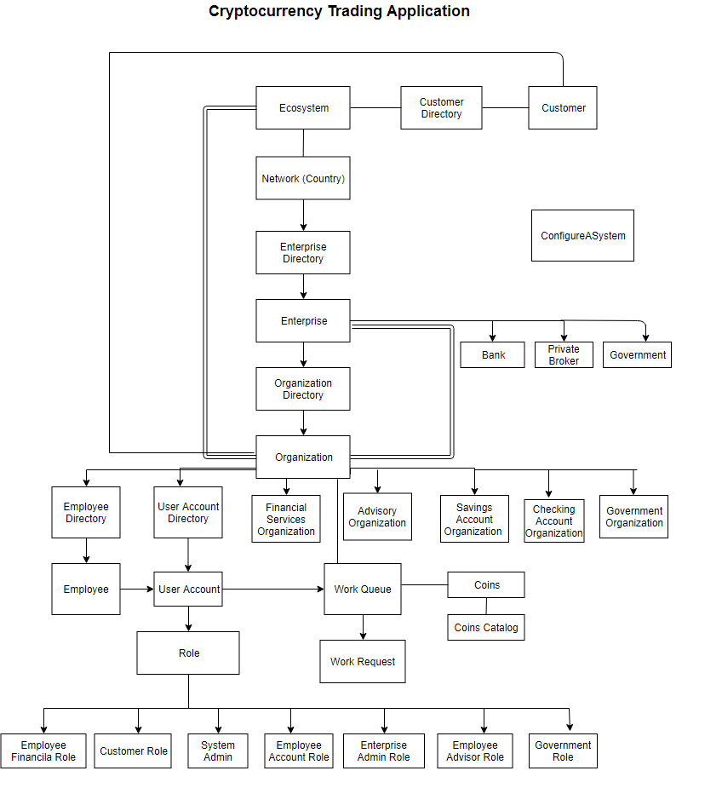

Slide 5
Use Cases

Slide 7
System Administrator

Slide 8
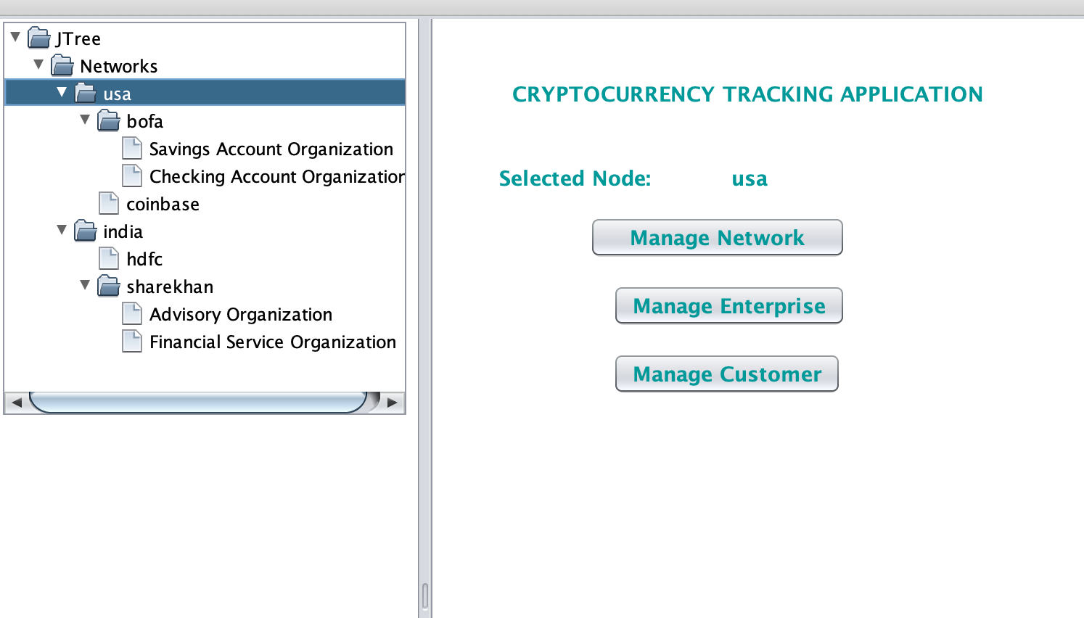
System Admin has access to entire system
He can add, delete/disable, view update Customer details, Network information as well as the Enterprise along with its admin.
System Admin Work Area

Slide 9

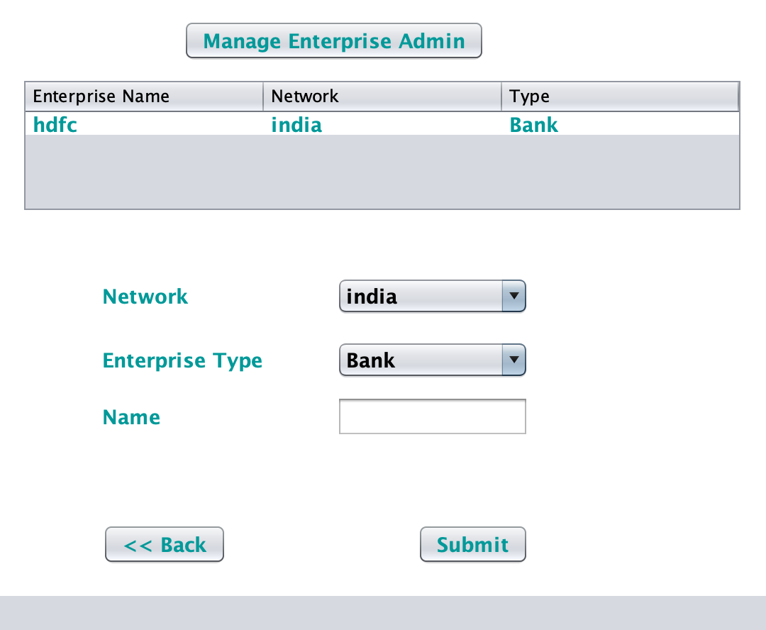
System Admin can create enterprises and manage enterprises

Slide 10

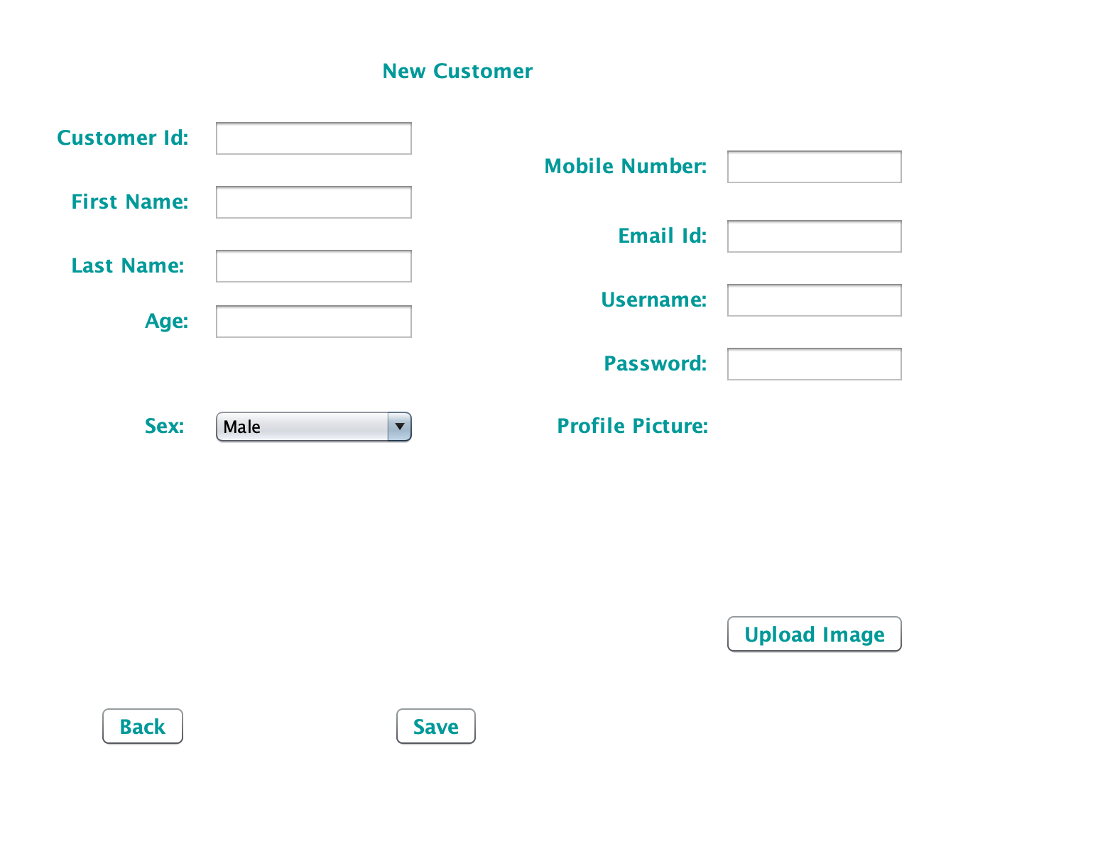
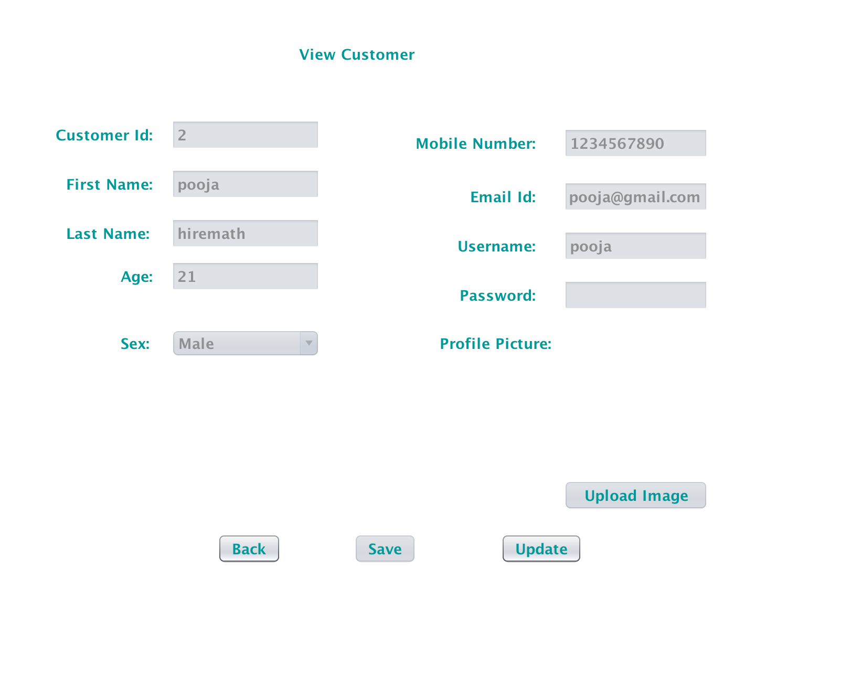
He can create and view customers

Slide 11
Enterprise Administrator

Slide 12
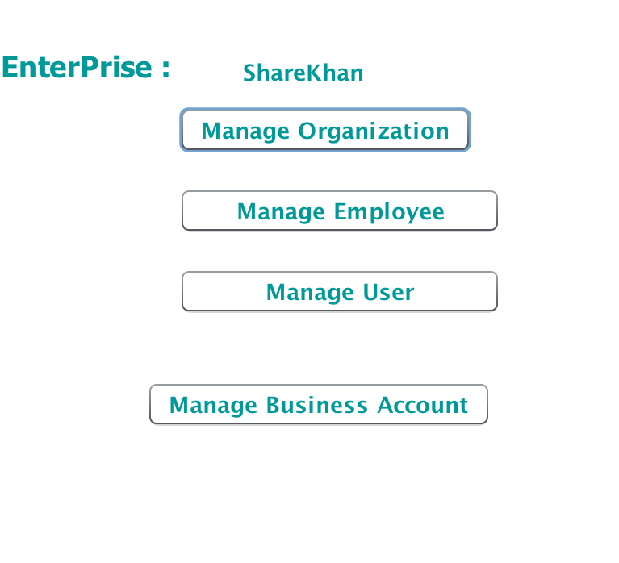
Admin -WorkArea Enterprise admin can add organizations, manage employees and create user accounts for the employees. He can also create a Bank account for the enterprises of type Private Broker for Business

Slide 13
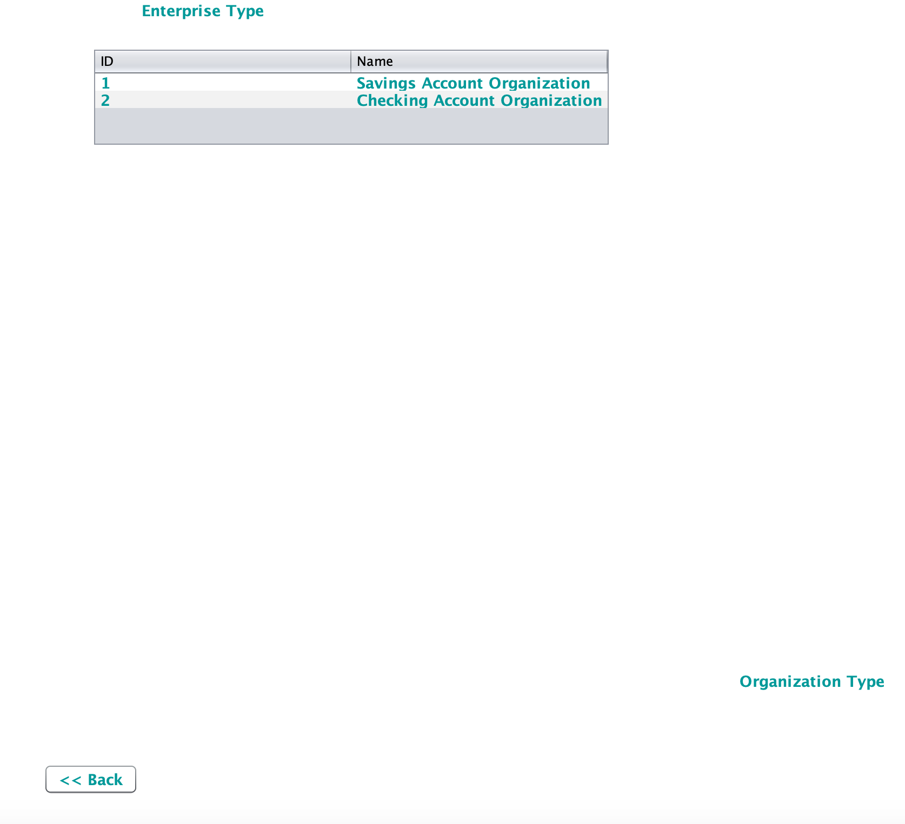
Enterprise admin can create organizations

Slide 14
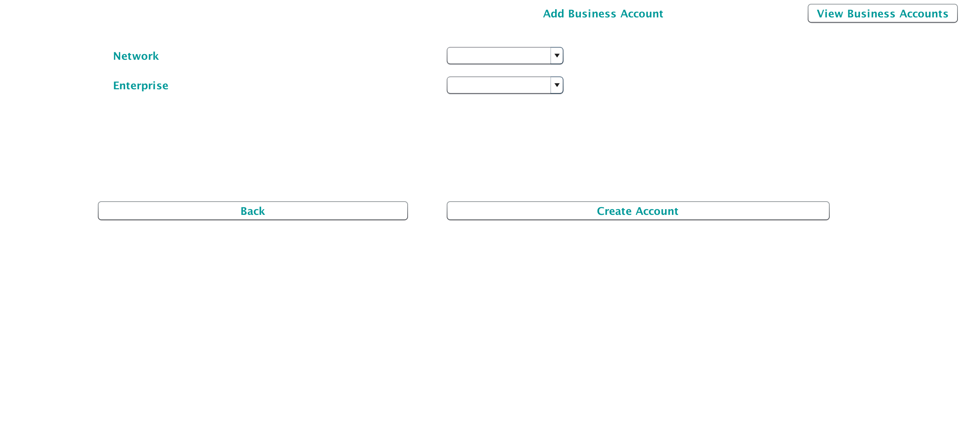
Enterprise Admin can create Bank account for the enterprise

Slide 15
Customer

Slide 16
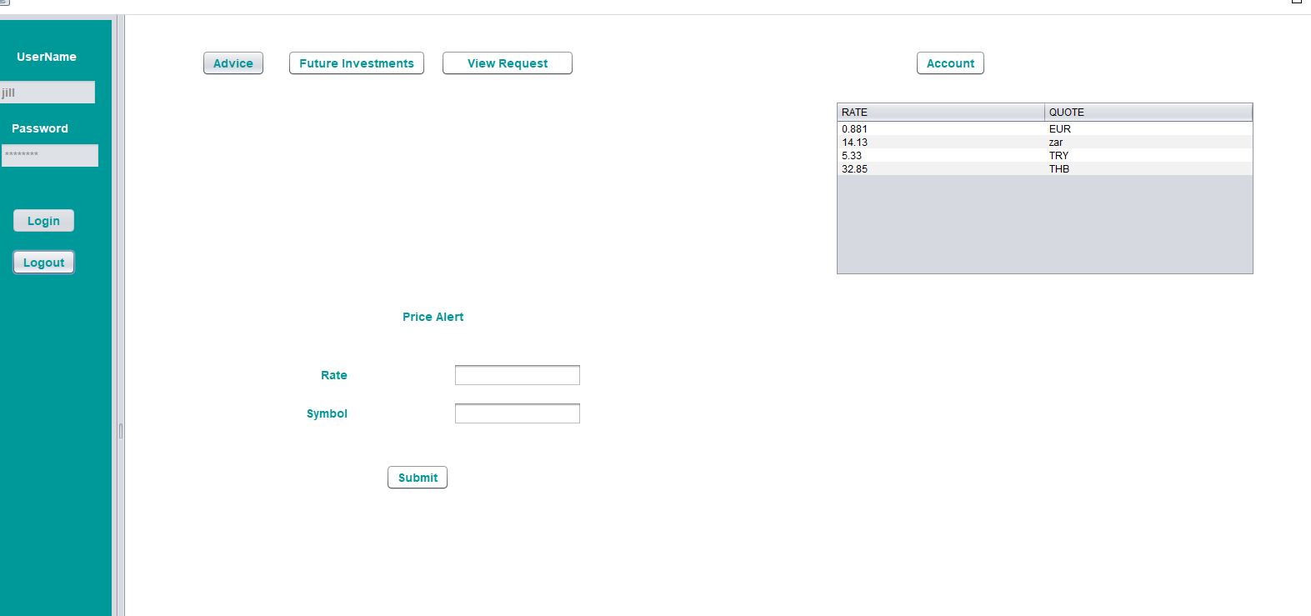
Customer WorkArea Customer can create bank accounts, can seek advice, invest in cryptocurrency, view all the investments

Slide 17
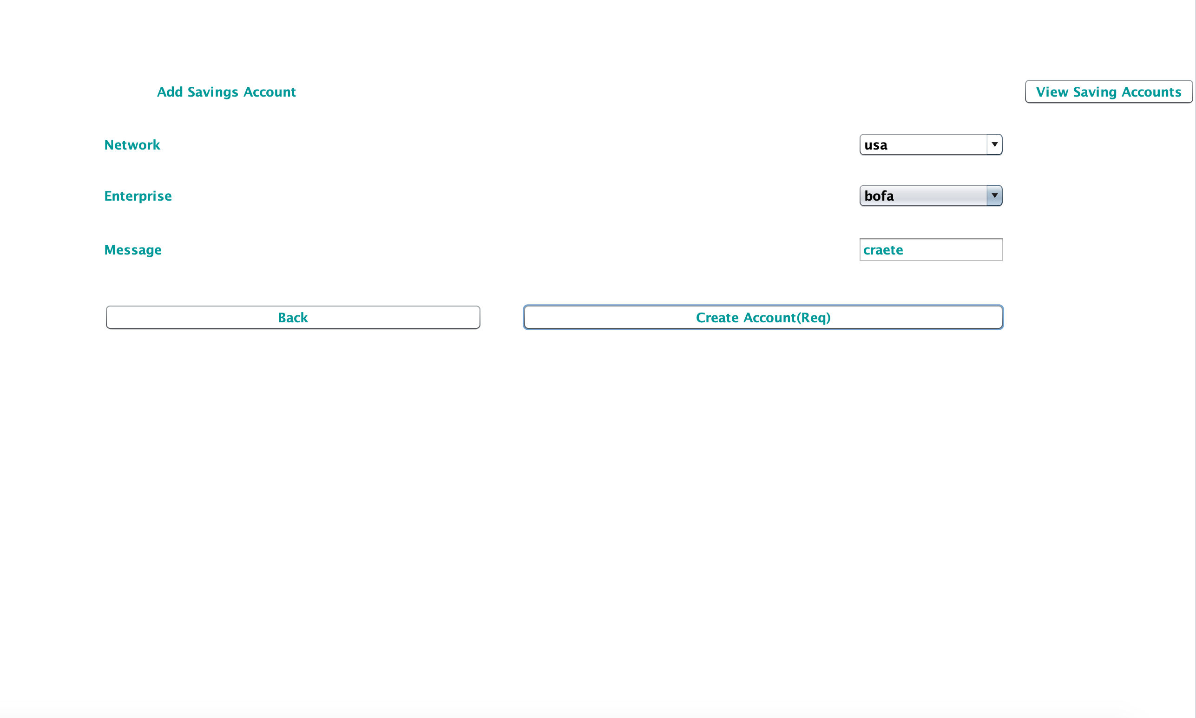
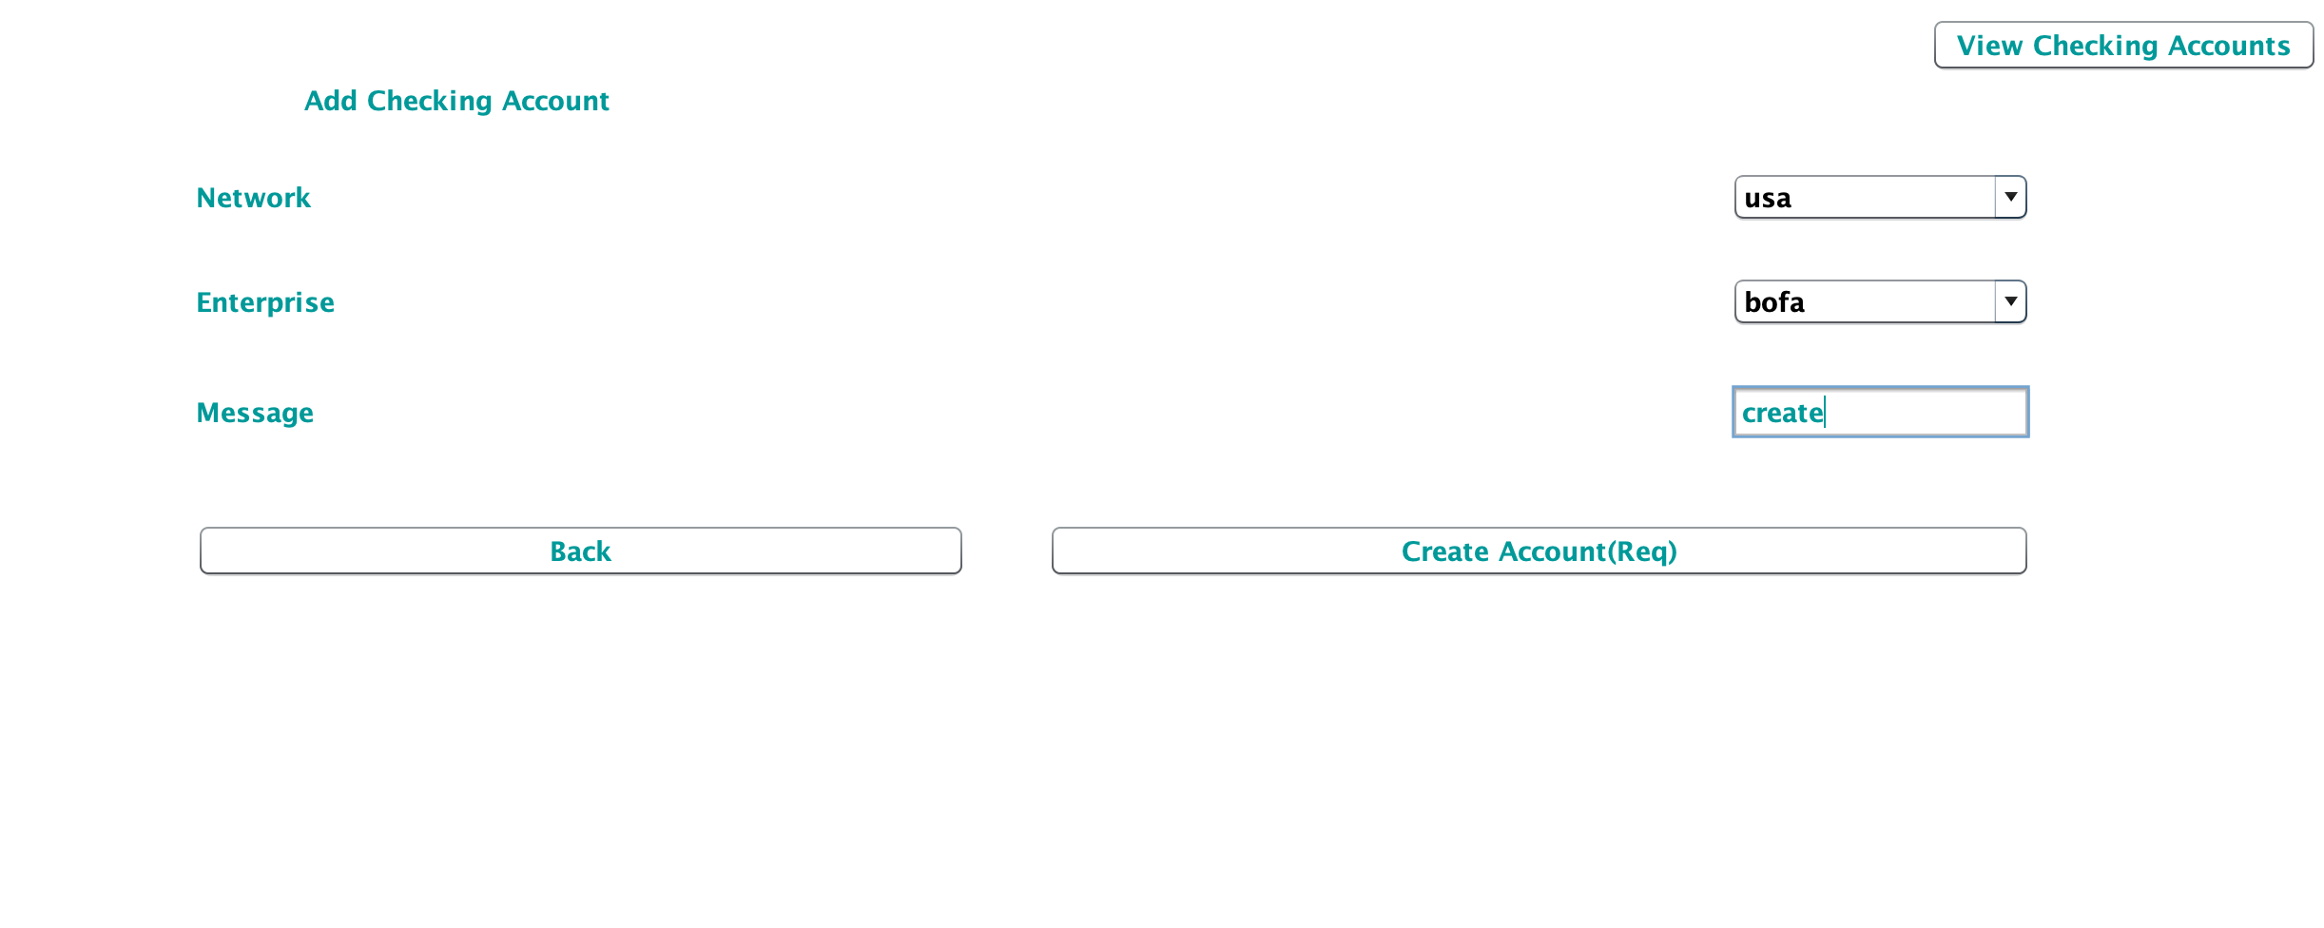
Customer can create savings or checking account in banks. This is required to trade in cryptocurrencies.

Slide 18
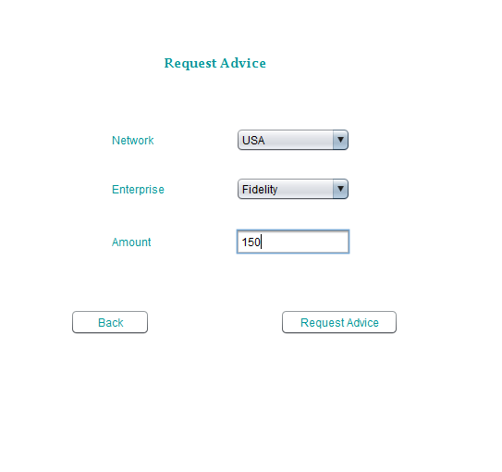
Customer can reach out to advisory organization of private broker to seek advise on Cryptocurrency investments. Customer WorkArea- Employee Investment

Slide 19
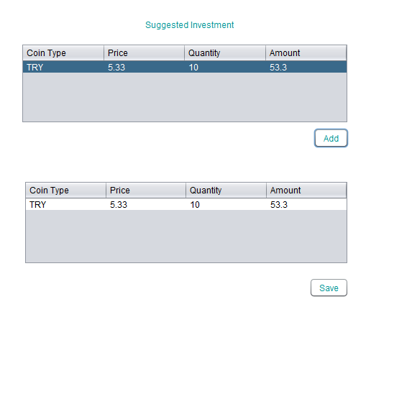
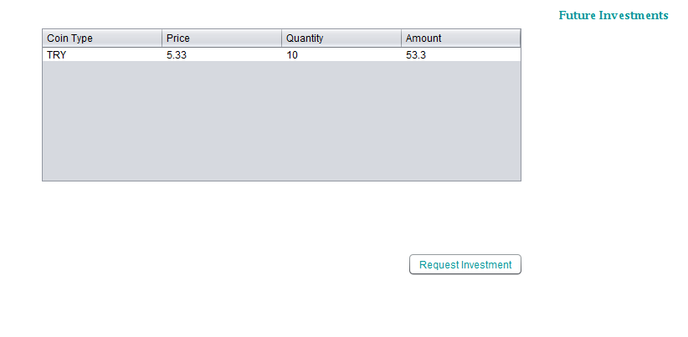
Customer maintains a list of coins to buy after advise from the advisory organization. Customer WorkArea- Future Investments

Slide 20
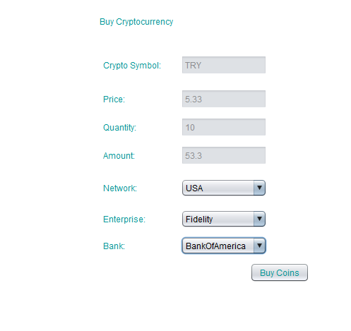
Customer can buy the coins by sending the requests to the financial service organization.

Slide 21
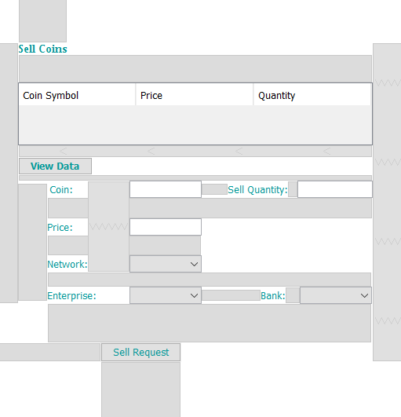
Customer has the ability to request Investment Employee to sell his Cryptocoins. Customer WorkArea- Sell coins

Slide 22
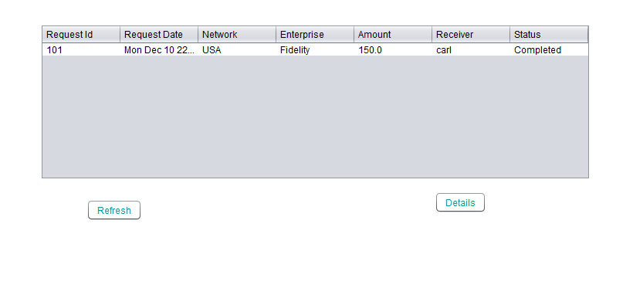
Customer can view both advice as well as investment requests made to Advisory Employee. Customer WorkArea- View Requests

Slide 23
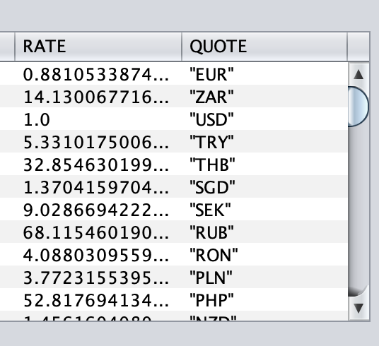
Live cryptocurrency data is available to the customer using coin.api The coin.api is implemented by multi threading.

Slide 24
Bank

Slide 25
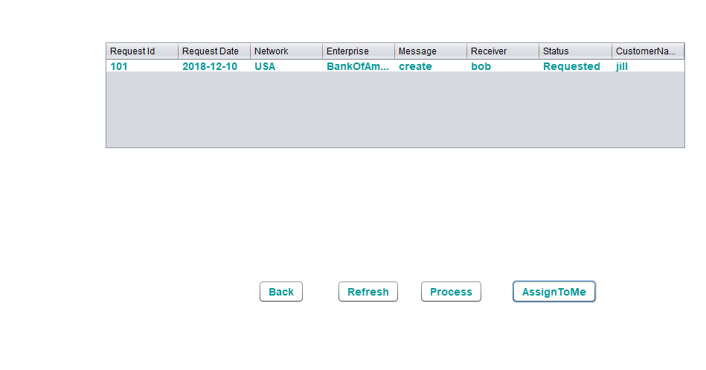
Bank employee can approve requests of customer to create checking and saving accounts

Slide 26
Private Broker

Slide 27
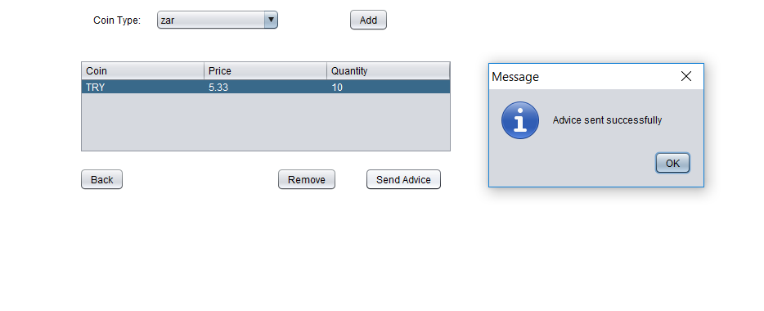
Advisory employee can advise customers for investment in cryptocurrency. Investment Employee WorkArea- Advice Customer a

Slide 28
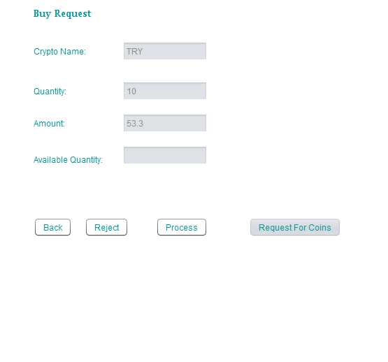
Financial service employee will serve customer requests for investing for buying and selling coins. Investment Employee WorkArea- Serve Customer

Slide 29
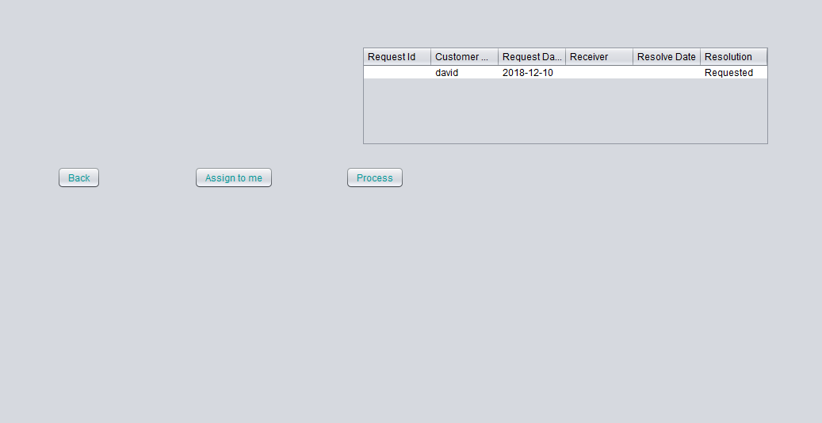
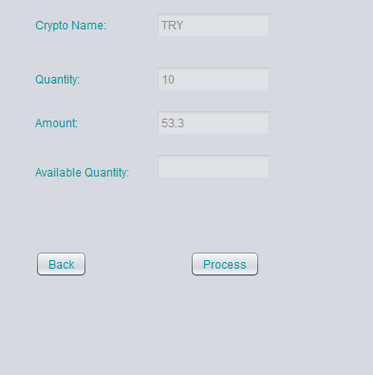
Financial organization can send a request and borrow coins from another organization to satisfy the request. Financial WorkArea- Borrow coins

Slide 30
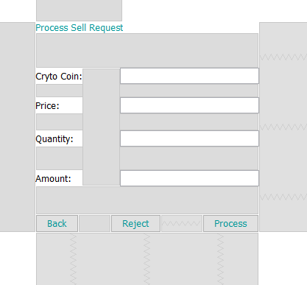
Financial organization can sell coins on behalf of customer Financial WorkArea- Sell coins

Slide 31
Highlighting Features

Slide 32
The coin prices for coins are read by using Live Crypto APIs.
Customers has the ability to sell some and/or few stock quantity.
If any financial organization doesn’t have enough coins, he can raise a request and borrow it from another organization.
Customer can get an invoice for his transactions.
Customer can receive price alerts.

Slide 33
Live Cryptocoin APIs
The Cryptocoin Prices are fetched dynamically using Live Cryptocoin APIs.
Multithreading is implemented to fetch data in every 10 seconds

Slide 34
PDF Reports
Customer will have access to his processed investment Invoice Receipt.

Slide 35
Social Cause
Customer without knowledge of cryptocurrency can also invest in cryptocoins with the help of advisory.

