Slide 1
Lead Score Case Study
Submitted by :
Naval Kishore
Mukul Pant
Muthukumar Natarajan

Slide 2
Lead Score Case Study
Problem Statement :
X Education sells online courses to industry professionals. The company markets its courses on several websites and search engines like Google.
Once these people land on the website, they might browse the courses or fill up a form for the course or watch some videos. When these people fill up a form providing their email address or phone number, they are classified to be a lead. Moreover, the company also gets leads through past referrals.
Once these leads are acquired, employees from the sales team start making calls, writing emails, etc. Through this process, some of the leads get converted while most do not. The typical lead conversion rate at X education is around 30%.
Business Goal:
X Education needs help in selecting the most promising leads, i.e. the leads that are most likely to convert into paying customers.
The company needs a model wherein you a lead score is assigned to each of the leads such that the customers with higher lead score have a higher conversion chance and the customers with lower lead score have a lower conversion chance.
The CEO, in particular, has given a ballpark of the target lead conversion rate to be around 80%.

Slide 3
Analysing Approach
Importing the data for analysis
Sanity Check.
Exploratory Data Analysis.
Feature Scaling.
Splitting the data into Test and Train dataset.
Logistic Regression model and calculate Lead Score.
Evaluating the model by using different metrics.
Applying the best model in Test data based on the Sensitivity and Specificity Metrics.

Slide 4
Data Cleaning
"Select" level represents null values for some categorical variables, as customers did not choose any option from the list.
Columns with over 40% null values were dropped.
Missing values in categorical columns were handled based on value counts and certain considerations.
Drop columns that don't add any insight or value to the study objective (tags, country)
Additional categories were created for some variables.
Columns with no use for modeling (Prospect ID, Lead Number) or only one category of response were dropped.
Numerical data was imputed with mode after checking distribution.
Outliers in TotalVisits and Page Views Per Visit were treated and capped.

Slide 5
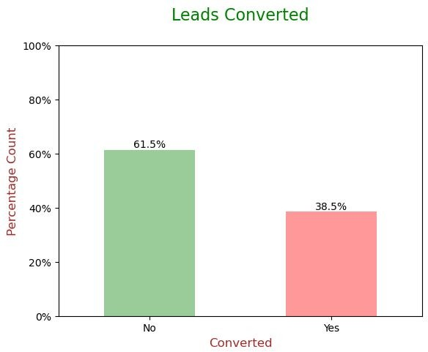
Exploratory Data Analysis
Conversion rate is of 38.5%, meaning only 38.5% of the people have converted to leads.(Minority)
While 61.5% of the people didn't convert to leads. (Majority)

Slide 6
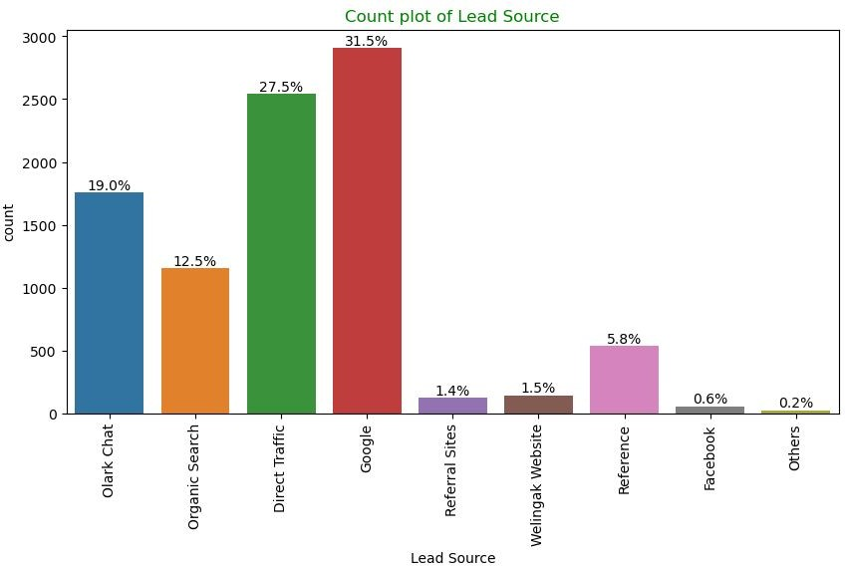
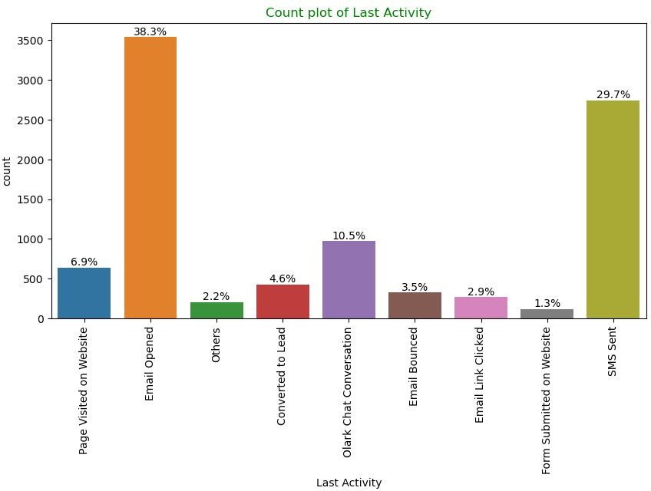
Univariate Analysis – Categorical Variables
Lead Source: 58% Lead source is from Google & Direct Trafﬁc combined.
Last Activity: 68% of customers contribution in SMS Sent & Email Opened activities.

Slide 7
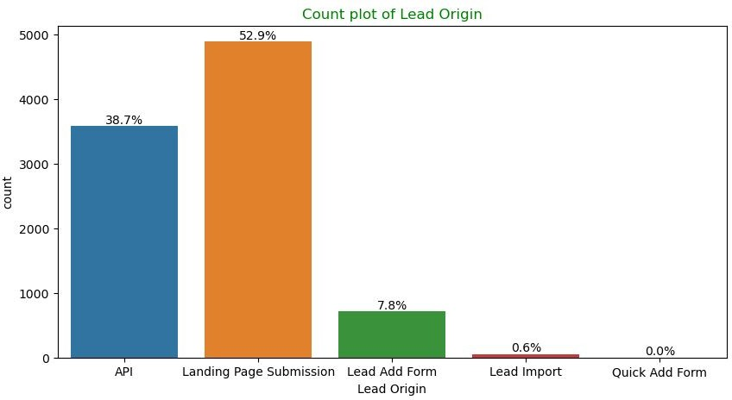
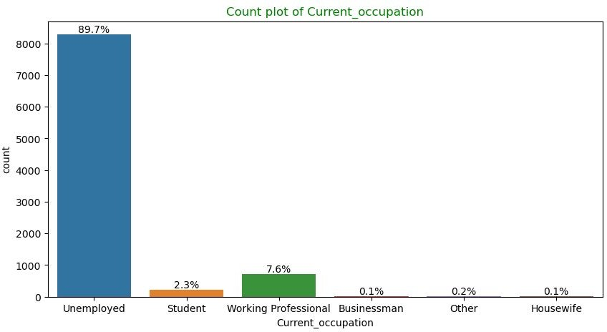
Univariate Analysis – Categorical Variables
Lead Origin: "Landing Page Submission" identiﬁes 53% of customers, "API" identiﬁes 39%.
Current_occupation: It has 90% of the customers as Unemployed.

Slide 8
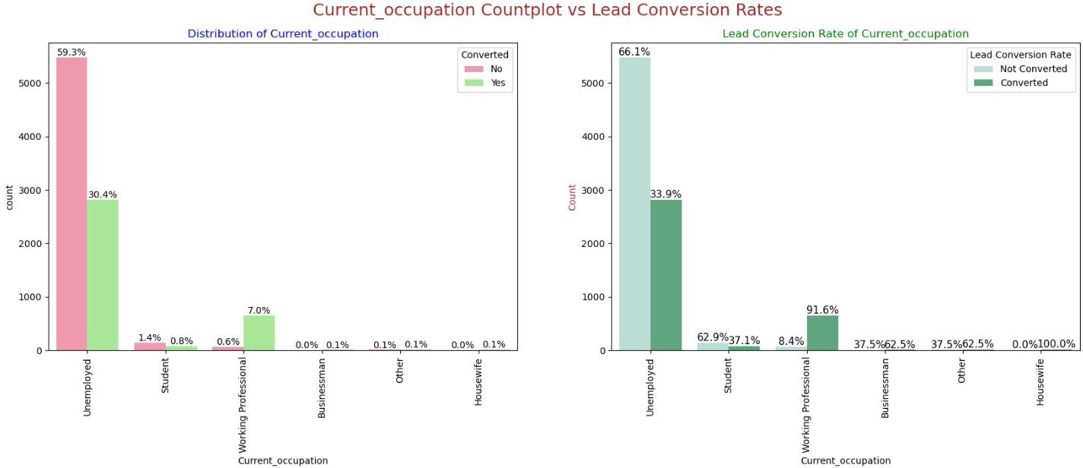
Bivariate Analysis for Categorical Variables
Current_occupation:
Around 90% of the customers are Unemployed, with lead conversion rate of 34%.
While Working Professional contribute only 7.6% of total customers with almost 92% Lead conversion rate.

Slide 9
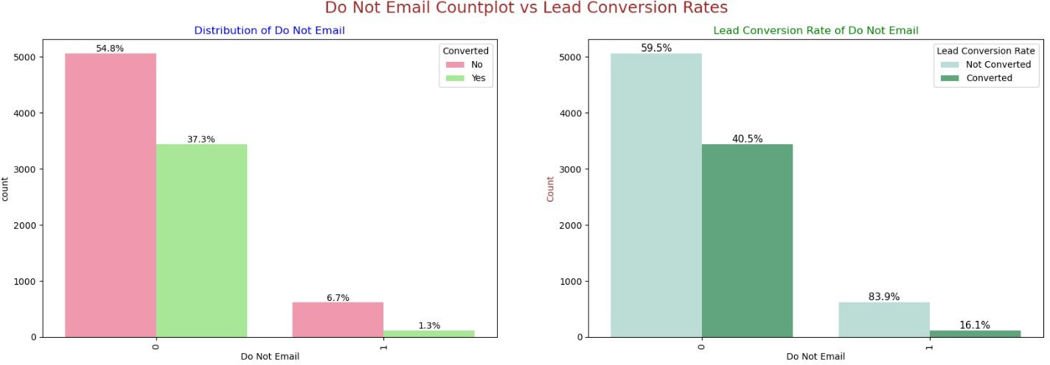
Bivariate Analysis for Categorical Variables
Do Not Email:
92% of the people has opted that they don't want to be emailed about the course & 40% of them are converted to leads.

Slide 10
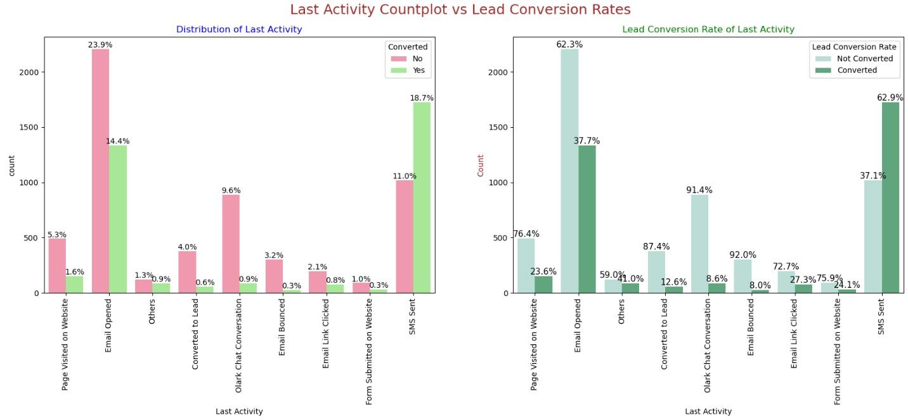
Bivariate Analysis for Categorical Variables
Last Activity:
'
SMS Sent'
has high lead conversion rate of 63% with 30% contribution from last activities,
'
Email Opened'
activity contributed 38% of last activities performed by the customers, with 37% lead
conversion rate.

Slide 11
Data Preparation
Binary level categorical columns were already mapped to 1 / 0 in previous steps
Created dummy features (one-hot encoded) for categorical variables – Lead Origin, Lead Source, Last Activity, Specialization, Current_occupation
Splitting Train & Test Sets
70:30 % ratio was chosen for the split
Feature scaling
Standardization method was used to scale the features
Checking the correlations
Predictor variables which were highly correlated with each other were dropped (Lead Origin_Lead Import and Lead Origin_Lead Add Form).

Slide 12
Model Building
Feature Selection
The data set has lots of dimension and large number of features.
This will reduce model performance and might take high computation time.
Hence it is important to perform Recursive Feature Elimination (RFE) and to select only the important columns.
Then we can manually ﬁne tune the model.
RFE outcome
Pre RFE – 48 columns & Post RFE – 15 columns

Slide 13
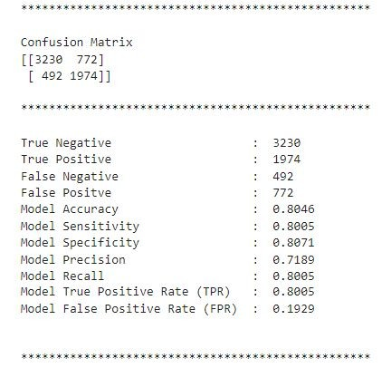
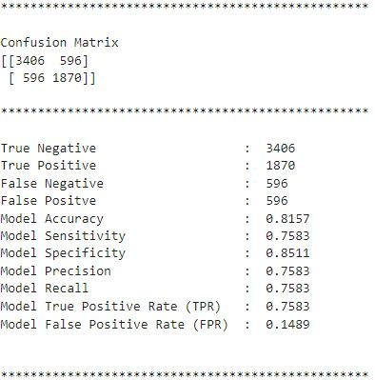
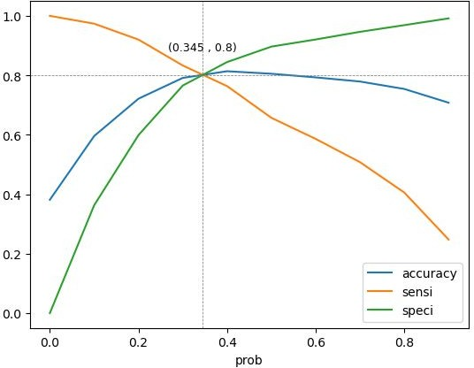
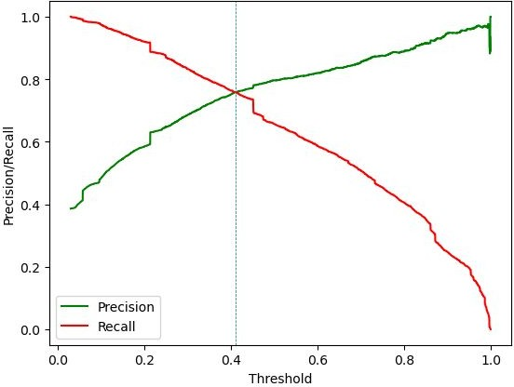
Model Evaluation
Train Data Set
Confusion Matrix & Evaluation Metrics with 0.345 as cutoff
Confusion Matrix & Evaluation Metrics with 0.41 as cutoff

Slide 14
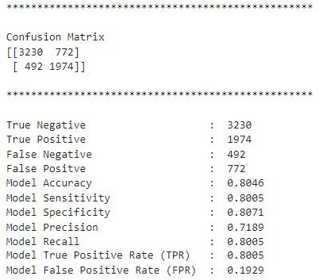
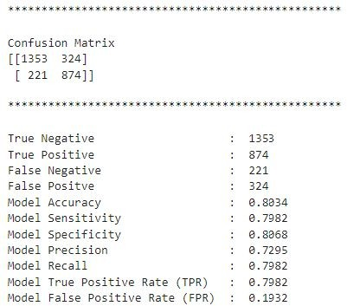
Model Evaluation
Confusion Matrix & Metrics
Train Data Set
Test Data Set
Using a cut-off value of 0.345, the model achieved a sensitivity of 80.05% in the train set and 79.82% in the test set.
Sensitivity in this case indicates how many leads the model identify correctly out of all potential leads which are converting
The CEO of X Education had set a target sensitivity of around 80%.
The model also achieved an accuracy of 80.46%, which is in line with the study's objectives.

Slide 15
Recommendation based on Final Model
As per the problem statement, increasing lead conversion is crucial for the growth and success of X Education. To achieve this, we have developed a regression model that can help us identify the most signiﬁcant factors that impact lead conversion.
Accuracy, Sensitivity and Specificity values of test set are around 81%, 79% and 82% which are approximately closer to the respective values calculated using trained set.
The top 3 variables that contribute for lead getting converted in the model are
Total time spent on website
Lead Add Form from Lead Origin
Had a Phone Conversation from Last Notable Activity
Engage working professionals with tailored messaging.
Working professionals to be aggressively targeted as they have high conversion rate and will have better ﬁnancial situation to pay higher fees too.
Analysing negative coefﬁcients in specialization offerings.
Review landing page submission process for areas of improvement.

