Slide 1
Capstone Project
EDA On zomato-Data by- Naval Kumar

Slide 2
Approach
Defining problem statement
Data Summary and variables understating
EDA
Graphical representation of finding
Conclusion

Slide 3
Problem Statement
I am using the Zomato dataset for this project.
The aim is to identify the insight that maximum transactions from which country .
I will find the region and countries where online delivery has or not.

Slide 4
Data Summary The dataset has a shape of (9551,21) which means that it contains approximately 9551 rows and 21 Variables. List of variables that used for further analysis:
Aggregate Rating
Rating Color
Online Delivery
Country
state
Uses In City

Slide 5
EDA(Exploratory Data Analysis)
Exploratory Data Analysis (EDA) is an approach to analyzing the data sets to summarize their main characteristics, often using statistical graphics and other Data Visualization Methods

Slide 6
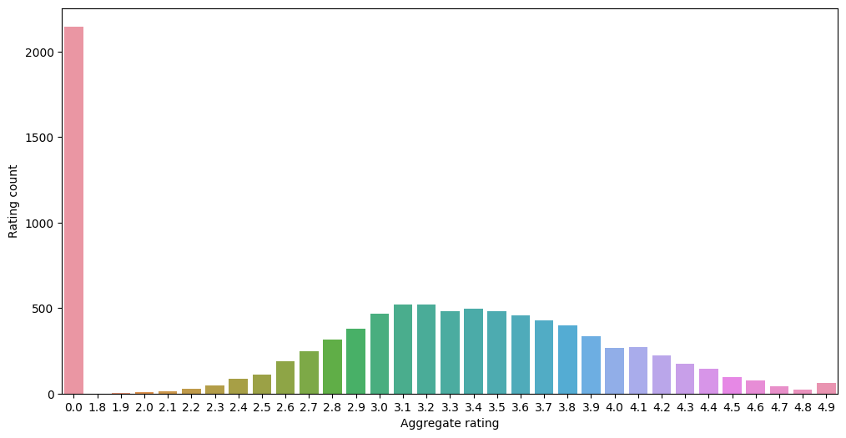
Graphical Representation of Findings
I have drawn the Bar plot to draw Aggregate Rating vs Rating count of customers
According to the graph, most number of Aggregate Rating happen is “0” in India

Slide 7
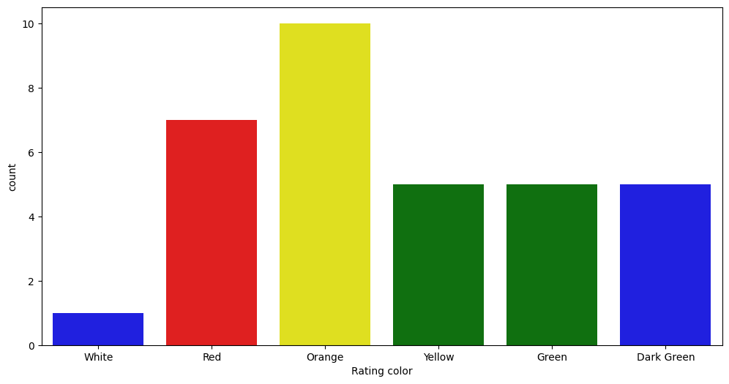
Count plot to show relation between Rating color vs count

Slide 8
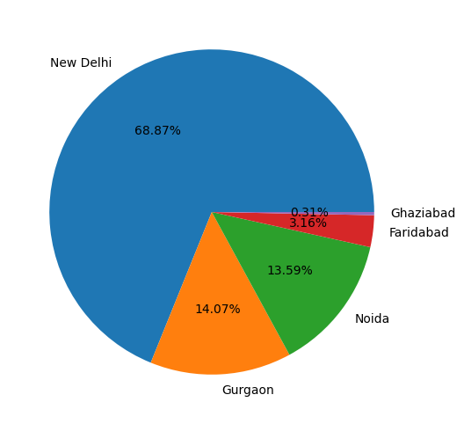
Success rate of zomato city wise

Slide 9
Which city has most number of uses ?

Slide 10
Conclusions
Zomato maximum number of transaction that may be probably happening is in India.
Zomato minimum number of transaction that may be probably in Canada.
India, United Kingdom, United States top-3 countries that is basically using Zomato.
Showing in percentage(%) maximum no. of transaction or record .
INDIA—->>> 94.39%
United States—-->> 4.73%
United Kingdom —--->>> 0.87%
Maximum number of customer is not ratings anything.
1.8 TO 2.4 is a range of Poor ratings.
2.5 TO 3.4 is a range of Average ratings.

Slide 11
Conclusions (continued)
3.5 to 3.9 is a range of good ratings & 4.0 to 4.7 is a range of very good ratings.
4.8 & 4.9 is range of Excellent ratings.
Maximum no. of ratings are b/w 2.5 to 3.4 that is average ratings.
Maximum no. of “0” ratings are from Indian customers.
Online delivery is only available in INDIA & UAE.
New Delhi has the maximum no. of transactions then Gurgaon, Noida & others.
Showing in percentage(%) maximum no. of transaction or record on City basis
New Delhi—-->>>66.87%
Gurgaon—--->>>14.077%
Noida—------>>>13.55%

Slide 12
THANK YOU

