Slide 1
The Agile Scheduling Process: Kanban
A Lean Approach to Workflow Optimization
SE 4003
December 2, 2024
MAJ Steve Loman
Notes:
Today we will be discussing the Kanban methodology within the Agile Process.

Slide 2
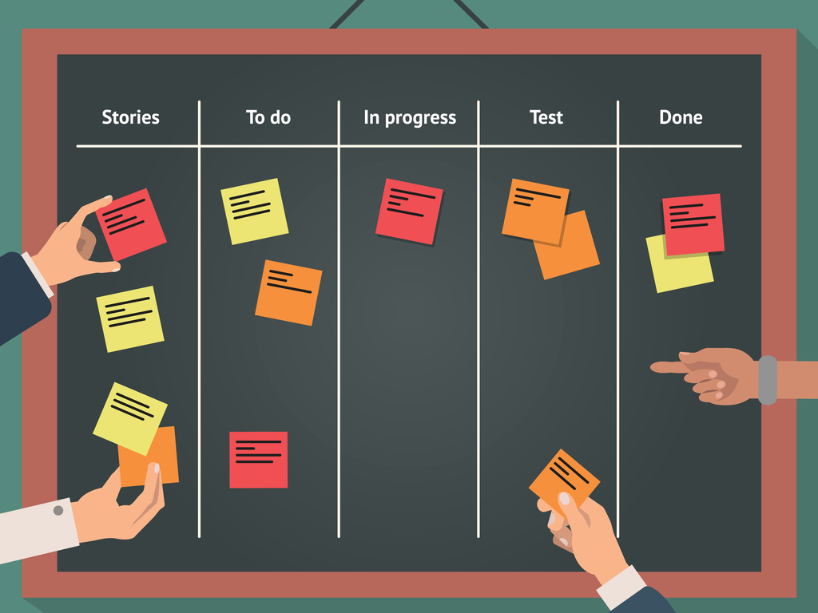
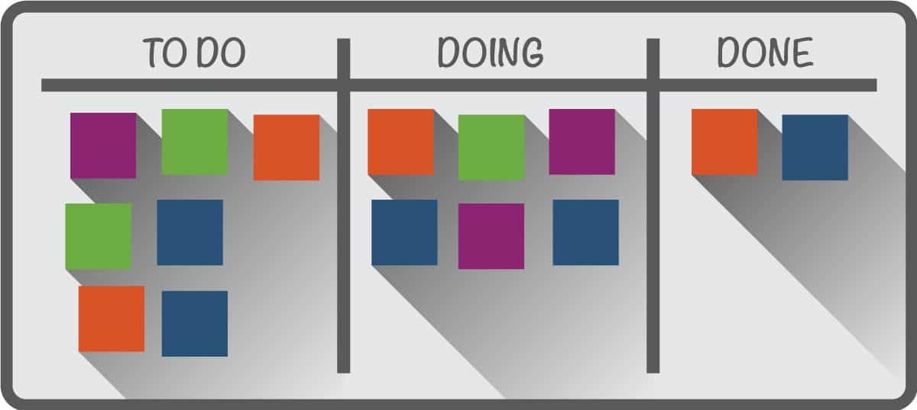

Agenda
Background and Motivation
Overview
Kanban in Defense Applications
References
Notes:
Today’s agenda…

Slide 3
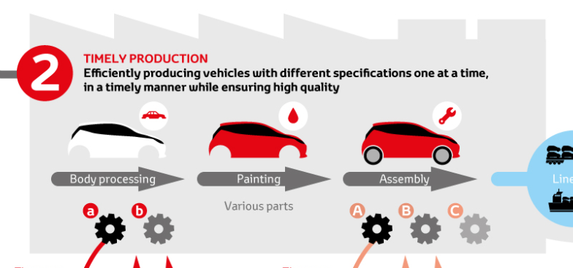

Background and Motivation
What is Kanban?
Kanban means “signal” in Japanese
Originates from the Toyota Production
System (TPS) (Sugimori et al., 1977)
Kanban was designed as the scheduling
system for Toyota’s lean manufacturing system
Enables pull production through visual workflow
management – facilitates transparency to achieve
a quality deliverable through a continuous flow
Motivation:
Addresses inefficiencies like overproduction and poor workflow transparency (Braglia et al., 2020)​
Key Question:
How is Kanban different from traditional Scrum?..
The TPS: Principle and Lean Manufacturing (2022)
Notes:
Kanban was created by the Japanese-based Toyota Motor Corporation as part of their famous Toyota Production System which has made the automotive brand’s Lean processes synonymous with quality and reliability.
Let’s start off with a Steve Jobs quote: “The group of people that do not use quality in their marketing are the Japanese. You never see them using ‘quality’ in their marketing. It’s only the American companies that do. And yet, if you ask people on the street which products have the best reputation for quality, they will tell you, it’s the Japanese products,”
Kanban is Japanese for the word “signal” – which will make more sense when we delve into the Kanban process…
Kanban is all about the pull. Work is pulled through the process to ensure continual workflow that is transparent to the production team and management.
The goal of Kanban is to reduce inefficiencies (waste – think “Lean”) and create a process that is easy to manage/oversee
Key Question…. Answer: There is an overall product backlog (no sprint backlog), therefore there are no sprints – Kanban is a continuous process

Slide 4
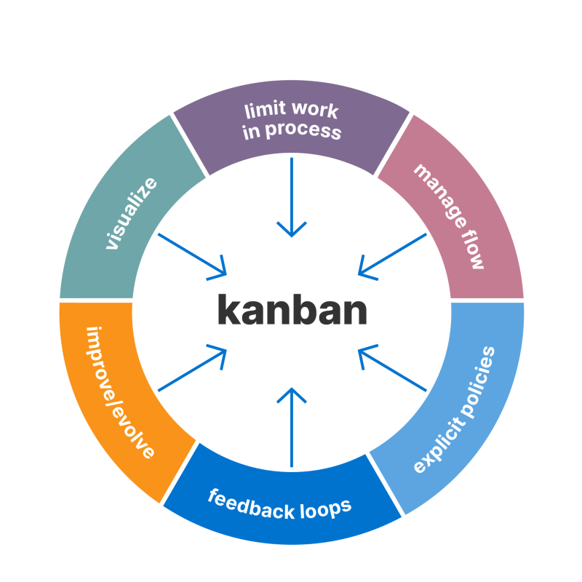
Overview
Six general practices of Kanban:
Visualize the Workflow
Limit Work in Progress (WIP)
Manage the flow of work
Make the process/policies explicit
Implement feedback loops
Improve collaboratively and evolve experimentally
Core Principles
Visualize tasks, limit work-in-progress, reduce context switching, and optimize flow (Monden, 2011)
Continuous improvement through iterative processes (Reddy et al., 2023)
Components:
Kanban boards (typically made of cards/sticky notes within columns) are utilized to manage workflows effectively
Boards can be physical, digital, or both; boards must be located in a public venue
Notes:
Kanban has 6 general practices:
Visualize the Workflow Explain that visualizing tasks using Kanban boards ensures everyone understands the work process.
Limit Work in Progress (WIP) Emphasize controlling WIP to avoid bottlenecks and enhance focus. WIP refers to the number of stories addressed at any one time within a Kanban column (more on that in later slides)
Manage the Flow of Work Discuss ensuring work moves smoothly from start to finish.
Make the Process/Policies Explicit Point out the need to document and standardize processes for clarity.
Implement Feedback Loops Highlight that feedback loops enable continuous improvements and alignment.
Improve Collaboratively and Evolve Experimentally Stress the importance of teamwork and iterative improvements.
Again, Kanban is about efficiency and visualization of work. This visualization affords the team/management the ability to monitor the process and remove impediments
The Kanban Board is the tool to this end – it is a scheduling method for Agile
How it fits into Agile SW Engineering and Development:
Continuous Delivery and Flow: Kanban’s pull-based workflow aligns with Agile’s emphasis on delivering value incrementally. It allows teams to respond dynamically to changes without disrupting ongoing processes (Sugimori et al., 1977)
Focus on Efficiency and Visualization: Kanban boards enhance transparency in Agile development by visually tracking progress and bottlenecks, enabling teams to optimize workflows and meet evolving software requirements (Reddy et al., 2023)

Slide 5
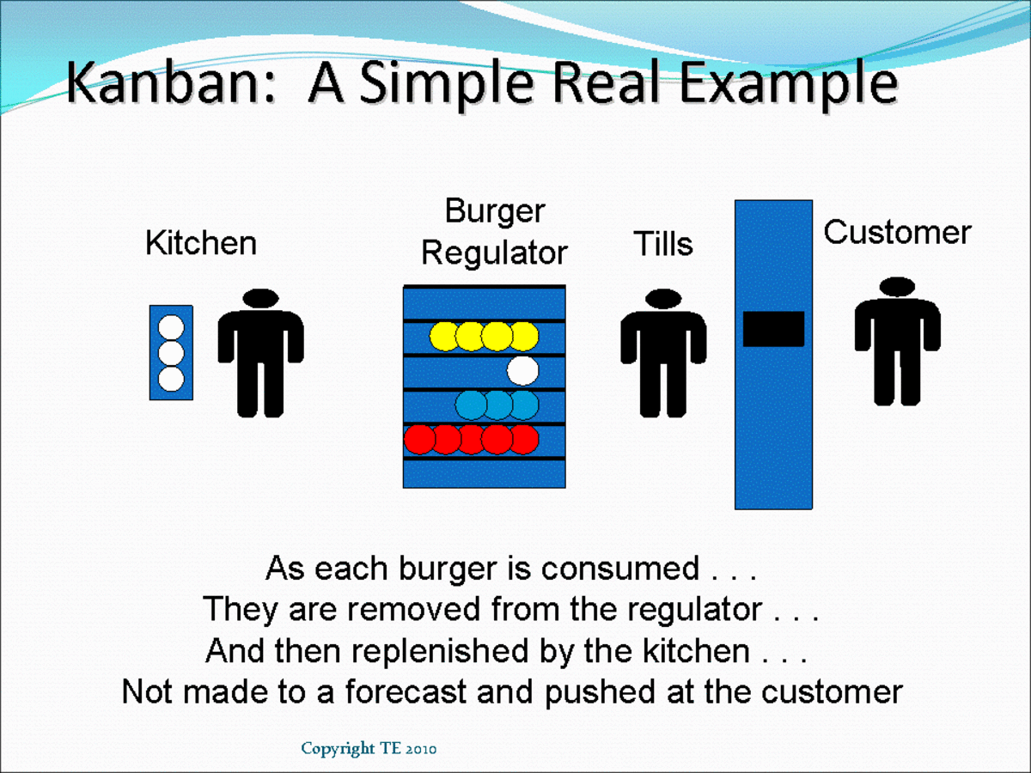
Overview (cont.)
Kanban – Manufacturing Pull System (Petrullo, 2015)
Notes:
Here is a simple, and relatable, visual of a Kanban process we are all familiar with.
You’ll never look at a McDonalds or Chick-Fil-A restaurant the same way again…
Note – this is a graphic from Britain, Tills is synonymous with cashier or cash register in England.

Slide 6
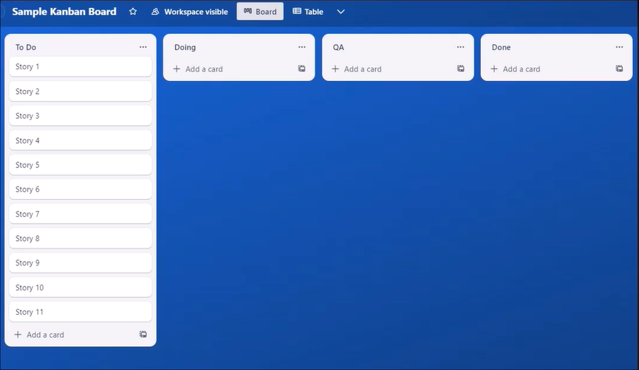
Overview (Kanban Board)
Sample Kanban Board (Payne, 2023)
Notes:
Here is a sample Kanban board that one could expect to see in an Agile software development environment to schedule and manage work.
Work is always pulled to the right (animation) by the Development (Dev) Team
The far left, To Do, column contains Stories that are ready for work
These stories are pulled right into the Doing column where they are completed
The stories are then pulled into the Quality Assurance (QA) column for validation
Finally, stories are pulled into the Done column once they are validated and complete
Note, the number of stories in each column (Doing and QA) constitute the Work in Progress (WIP)

Slide 7
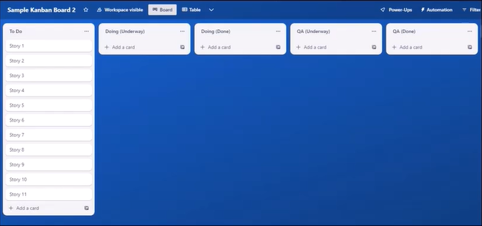

Overview (Kanban Board, cont.)
Sample Kanban Board (Payne, 2023)
Both the Doing and the Quality Assurance (QA) columns are further subdivided into two columns each; an Underway and a Done column
Notes:
Here is a more detailed view of the sample Agile Software Kanban Board.
Both the Doing and the Quality Assurance (QA) columns are further subdivided into two columns each; an Underway and a Done column
Animation – follow Story 1 through the Kanban process…

Slide 8
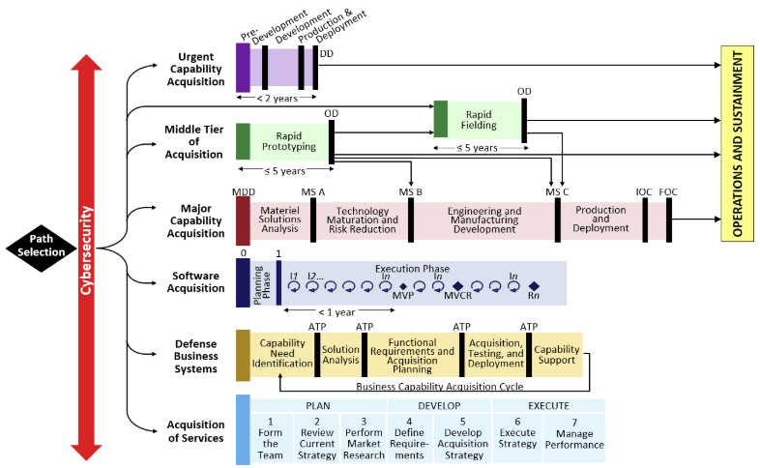
Defense Applications
How is Kanban Relevant to Military/Defense Applications?
The ability to visualize tasks, limit work-in-progress, and flow/process optimization
can be applied to a myriad of military tasks: maintenance, training/readiness, etc.
However, Kanban is particularly useful in the management of DoD software programs or programs that rely heavily on integrated software to meet their given requirement.
Adaptive Acquisition Pathways (DAU, 2020)
Notes:
Now that we have looked at the mechanics of the Kanban process, let’s consider its application in Defense
The Kanban process isn’t relegated to just software, it could be utilized in the management of maintenance tasks or spare parts issuing, or in the advancement of a unit’s readiness
Software: Kanban has particular utility in the management of DoD software intensive programs
In 2020, the US military’s acquisition process was diversified with the Adaptive Acquisition Pathways
One of these pathways is the Software Acquisition pathway (animation) – this pathway can benefit considerably from the Kanban process

Slide 9
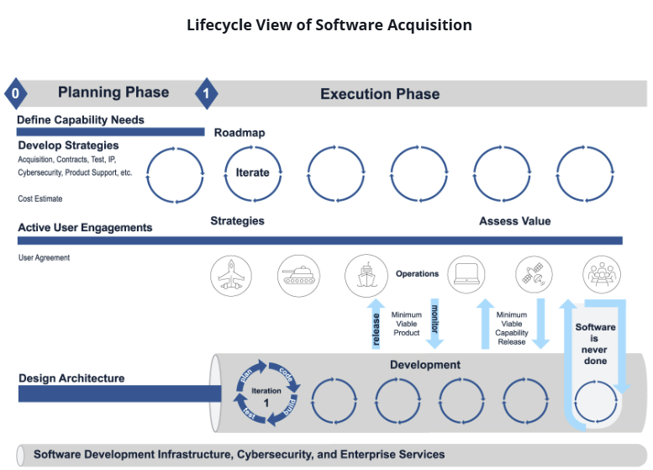
Defense Applications (cont.)
Software Acquisition Lifecycle (DAU, 2020)
Notes:
Here is a blown-up view of the Software Acquisition pathway – you can see how much it differs from the more traditional Major Capability (predictive / waterfall) pathway
The constant iterations (depicted as circles in the graphic) present opportunities for Kanban process management to quickly turn iterations of a product in response to Warfighter requirements
Anecdotally, I have a friend who is an Asst. Product Manager (APM) within the US Army’s PEO Enterprise Information Systems (EIS) –the Army’s PEO that manages our software-intensive programs. He noted that PEO EIS uses the Software Acquisition pathway almost exclusively and that the Agile Kanban process manages the iterative process of each SW program.

Slide 10
References
Braglia, M., Gabbrielli, R., & Marrazzini, L. (2020). Rolling Kanban: A new visual tool to schedule family batch manufacturing processes with Kanban. International Journal of Production Research, 58(13), 3998–4014. https://doi.org/10.1080/00207543.2019.1639224
Defense Acquisition University. (2024). Adaptive acquisition framework pathways. Retrieved from https://aaf.dau.edu/aaf/aaf-pathways/
Defense Acquisition University. (2024). Lifecycle view of software acquisition. Retrieved from https://aaf.dau.edu/aaf/software/
Krieg, G. N. (2005). Kanban-controlled manufacturing systems. Lecture Notes in Economics and Mathematical Systems, 549. Springer.
Lage, M., & Filho, M. G. (2010). Variations of the Kanban system: Literature review and classification. International Journal of Production Economics, 125(1), 13–21. https://doi.org/10.1016/j.ijpe.2010.01.009
Monden, Y. (2011). Toyota production system: An integrated approach to just-in-time. CRC Press.
Payne, S. (2023). Kanban overview. All-In PMP Prep.
Petrullo, T. (2015, January 21). Kanban - Manufacturing pull system - Bin systems and CONWIP. Retrieved from https://discover.hubpages.com/technology/Kanban
Reddy, J. M. K., Rao, N. A., & Lanka, K. (2023). System dynamics modelling of fixed and dynamic Kanban-controlled production systems. Journal of Modelling in Management, 18(1), 17–35. https://doi.org/10.1108/JM2-06-2020-0168
Thürer, M., Fernandes, N. O., & Stevenson, M. (2022). Production planning and control in multi-stage assembly systems. International Journal of Production Research, 60(3), 1036–1050. https://doi.org/10.1080/00207543.2020.1849847

