Slide 1
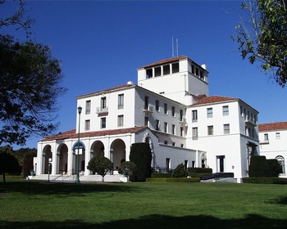
Constructive Product Line Investment Model
An Overview of its Application in Software Development
Joe Bahleda
December 01, 2024

Slide 2
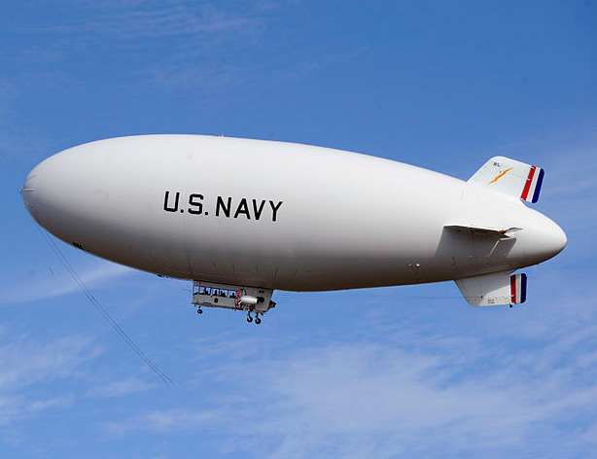
Agenda
Background/Motivation
Overview
DoD Application

Slide 3
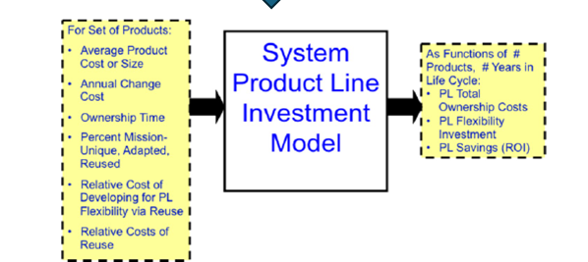
Background/Motivation
In progress of developing an ASW Combat Suite for airships. Current acquisition practice is to procure the ASW combat system separately from different sources thus there is little reuse (Madachy & Green, 2019).
My research will dive into system variability modeling to highlight an analysis of alternatives of the individual systems that could potentially comprise the airship

Slide 4
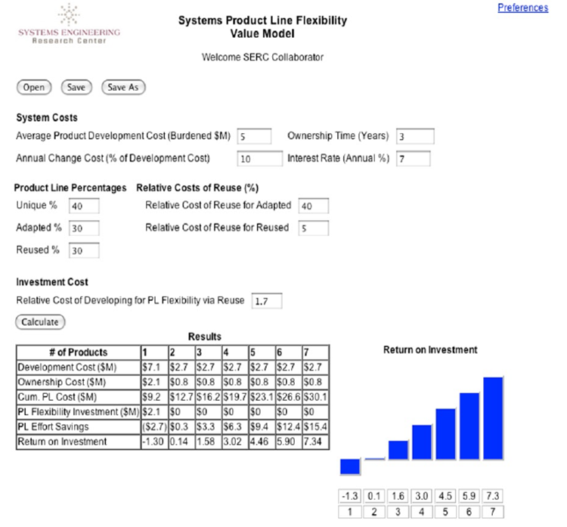
COPLIMO Overview
COPLIMO utilizes parametric inputs related to engineering product lines across various system types. Its outputs provide insights into lifecycle savings from product reuse and return on investment (Boehm et al 2004).
Originally, COPLIMO was developed as a comprehensive model for software product lines to quantify the benefits of reusing source code.
Key Inputs for the System COPLIMO Include:
- System Costs: Average product development cost, ownership time, annual change cost, and annual interest rate.
- Product Line Percentage
- Relative Cost of Reuse Percentages
- Investment Cost

Slide 5
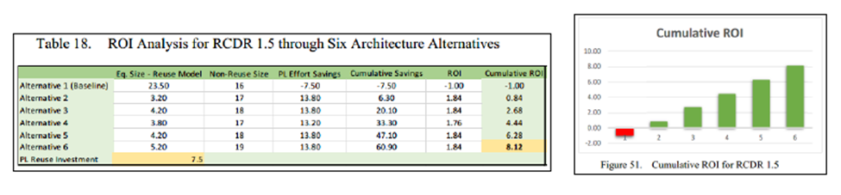
DoD Application
For his research, Alves demonstrated how shows how using product line economics to develop UUVs have a high ROI by using COPLIMO (Alves, 2022).
Virtually all case studies have demonstrated high ROI of product line practices on defined DoD missions (Madachy & Green, 2019).
This result corroborates previous product line economic analyses, demonstrating that many DoD systems and other types of system families would benefit from a product line strategy.

Slide 6
References
Hall, R. (2018). Utilizing a model-based systems engineering approach to develop a combat system product line [Master’s thesis, Naval Postgraduate School]. NPS Archive: Calhoun. https://calhoun.nps.edu/handle/10945/59675
COPLIMO product line investment model. (n.d.). Retrieved August 8, 2022, from http://coplimo.org/
Boehm, B., Brown, A. W., Madachy, R., & Ye Yang. (2004). A software product line life cycle cost estimation model. Proceedings. 2004 International Symposium on Empirical Software Engineering, 2004. ISESE ‘04., 156–164. https://doi.org/10.1109/ISESE.2004.1334903
Chance, K. A. (2019). Naval combat systems product line economics: Extending the constructive product line investment model for the aegis combat system [Master’s thesis, Naval Postgraduate School]. NPS Archive: Calhoun https://calhoun.nps.edu/handle/10945/62854
Madachy, R., & Green, J. (Mike). (2019). Naval combat system product line architecture economics [Report]. Monterey, California. Naval Postgraduate School. https://calhoun.nps.edu/handle/10945/62913
Haller, K., Kolber, D. S., Storms, T. R., Weeks, J. B., & Weers, W. (2022). Unmanned underwater vehicle mission systems engineering product reuse return on investment [Systems Engineering Capstone Report, Naval Postgraduate School]. NPS Archive: Calhoun. https://calhoun.nps.edu/handle/10945/69650

Slide 7

Questions

