Slide 1

Lord BoBbi presentation Bank of Baroda Hackathon 2024
Your Team Name : Lord BoBbi
Your team bio : Naval Singh
Date : 29/06/2024

Slide 2

Problem Statement?
Why did you decide to solve this Problem statement?
A BoB customer has a query about their account balance or recent transactions but cannot reach the bank's customer service representative due to high call volumes.
A BoB customer is unsure about the best savings or investment options available and needs personalized guidance.
A BoB customer notices unauthorized transactions on their account but cannot get immediate assistance from the bank.
A BoB customer finds the loan application process cumbersome and slow, with multiple forms and documents to submit.
BoB Customers feel their complaints and feedback are not being addressed adequately by the bank

Slide 3

Pre-Requisite
What are the alternatives/competitive products for the problem you are solving?

Slide 4
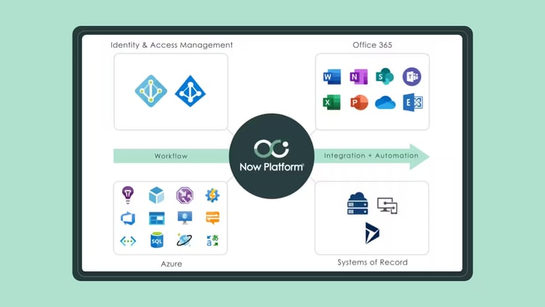
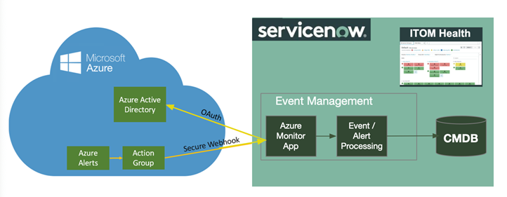
Tools or resources
Azure tools or resources which are likely to be used by you for the prototype, if your idea gets selected

Slide 5
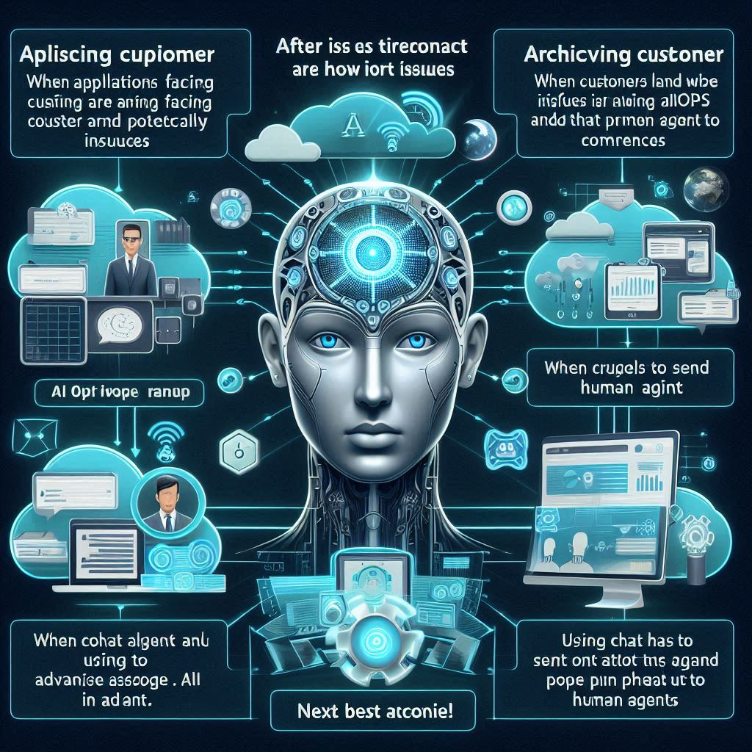
Any Supporting Functional Documents
Present your solution, talk about methodology, architecture & scalability
Customer facing apps
Architecture
Issue detected ⚠️
VA+
AI learning
Propose resolution
Triage+ Human
Next best action

Slide 6
Key Differentiators & Adoption Plan
How is your solution better than alternatives and how do you plan to build adoption?
When applications facing customer are running on cloud infra and that infra may potentially have issues (ServiceOps or AIOps), predicting and correcting issues.
After issues have occurred, when customers land on support page, using Virtual Agent to answer queries.
When chat has to be sent to human agent, choosing which agent to send it to using Advanced Work Assignment.
When chat transfers to human agent, using AI to pop up relevant next best actions like recommendations for remedial actions, offers, coupons.
After customer is served, using AI to predict the staffing schedule based on the trends of requests coming in.
Also, using AI to analyse which requests can be shifted to Virtual Agent or Service Catalog for self serve instead of Human Agent.
Using AI to mine the processes (P-SP-A-T) (process-sub process-activity-task) and identify business process re-engineering opportunities to simplify and remove bottlenecks and redundant steps.
Using AI to document all the above in a KB to ensure no knowledge is lost.

Slide 7
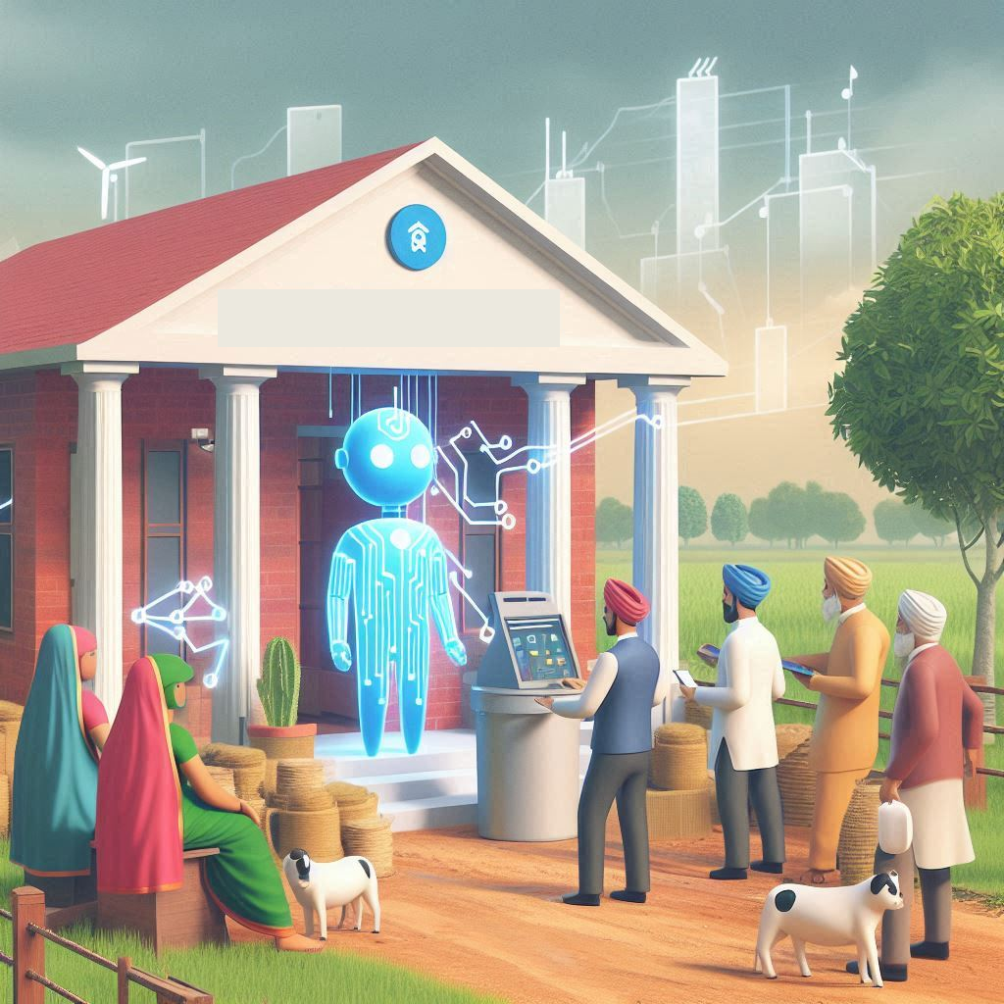
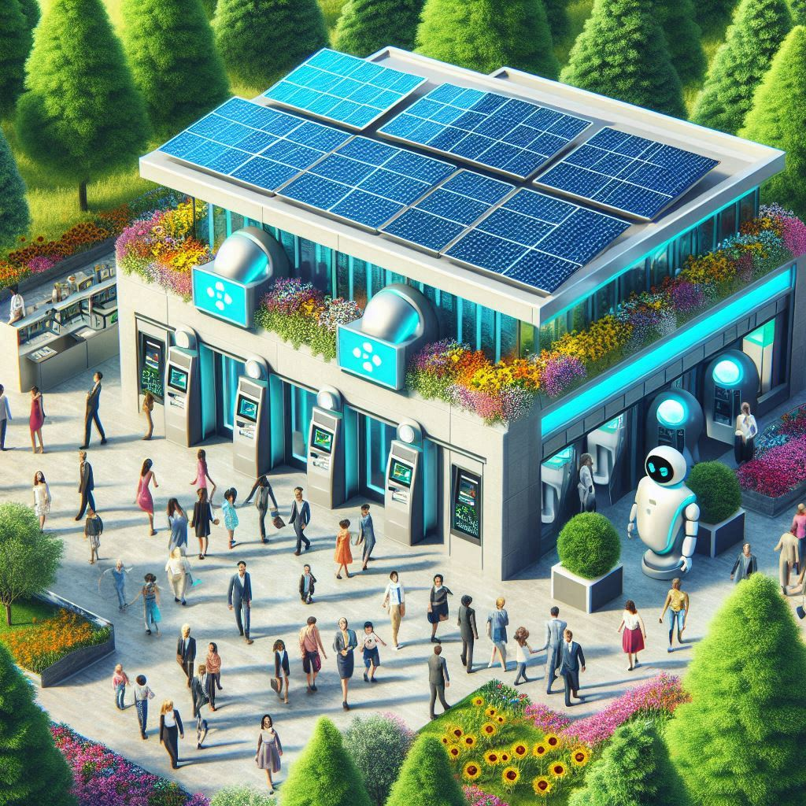
GitHub Repository Link & supporting diagrams, screenshots, if any
How far it can go?
Generative AI to help human and virtual agent to summarise and add detail and verbosity to support requests and improve grammar and understandability of action/ task summaries.
Using Generative AI to create Training Need Analysis (TNA) for human agents and their managers; and hyper parametric tuning of weight of neural networks/ transformers attention computation for AI managers.

Slide 8
Business Potential and Relevance
What are the business applications of the problem you are solving?
A BoB customer has a query about their account balance or recent transactions but cannot reach the bank's customer service representative due to high call volumes.
A BoB customer is unsure about the best savings or investment options available and needs personalized guidance.
A BoB customer finds the loan application process cumbersome and slow, with multiple forms and documents to submit.
BoB Customers feel their complaints and feedback are not being addressed adequately by the bank
A BoB customer notices unauthorized transactions on their account but cannot get immediate assistance from the bank.
INR 11cr
Rationalize Systems (Redirect Current Spend)
INR 10cr
Increase Escalated Support & Field Service Efficiency
INR 1cr
Increase Customer Service Efficiency
Use solution to reduce the number of solutions your organization currently uses so you can redirect the savings to more strategic priorities.
Help staff resolve escalated cases more quickly, reduce cases by guiding customers to self-service, and shift more cases to a lower service tier.
Reduce the number of cases agents need to triage and escalate and the time it takes for agents to resolve cases.

Slide 9
Uniqueness of Approach and Solution
What is the unique aspects of the proposed idea?
a flexible data model that is capable of being changed without code change or customization
one user interface, one code base, and one data model for all out-of-box and custom applications
in-platform reporting and analytics capabilities not require third-party reporting tools
multiple configuration options – including no code, low code, and pro code – to help us implement a solution to meet our unique business needs

Slide 10
User Experience
How will your idea enhance the user experience?
device agnostic (provide full application access from any device type, including laptop/desktop, smart phone/tablet, and through native apps for iOS and Android)
survey function that leverages a modern, responsive, and mobile-friendly design similar to other commonly available survey tools
a Kanban-style board for managing tasks
display the presence of users for collaboration and workload management

Slide 11
Scalability
How effectively can your solution be scaled to accommodate growth without compromising performance?
high availability with warm standby
automated failover capability
automated horizontal scalability
MEiTY certified cloud service provider

Slide 12
Ease of Deployment and Maintenance
allow planned maintenance with zero to minimal downtime
allow feature release upgrades with zero to minimal downtime
Upgrades and updates must be included in the cost of the solution
self-service options for automated instance management
How simple is your solution to implement and maintain on an ongoing basis?

Slide 13
Security Considerations
own and operate the private cloud
must not require VPN or special firewall holes required to access the service
solution must be able to encrypt data in transit using TLS 1.2 and able to encrypt text fields and attachments
must have ISO 27001 certification and SSAE 16 SOC 2 Type 2 attestation
What measures are incorporated to ensure the security and integrity of your solution?

Slide 14
Thank You
Naval Singh

