Slide 1

mongodb.org

Slide 2
Content
Part 1: Introduction & Basics
2: CRUD
3: Schema Design
4: Indexes
5: Aggregation
6: Replication & Sharding

Slide 3
History
mongoDB = “Humongous DB”
Open-source
Document-based
“High performance, high availability”
Automatic scaling
C-P on CAP
Notes:
Too much text.
Open Source
High Performance
CA bullets

Slide 4
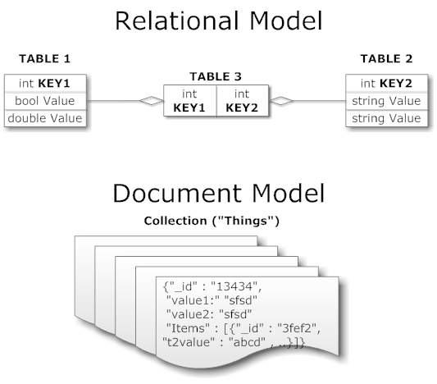
Other NoSQL Types
Key/value (Dynamo)
Columnar/tabular (HBase)
Document (mongoDB)
Notes:
Images for key / value
Pictures of document schema

Slide 5
Motivations
Problems with SQL
Rigid schema
Not easily scalable (designed for 90’s technology or worse)
Requires unintuitive joins
Perks of mongoDB
Easy interface with common languages (Java, Javascript, PHP, etc.)
DB tech should run anywhere (VM’s, cloud, etc.)
Keeps essential features of RDBMS’s while learning from key-value noSQL systems
http://www.slideshare.net/spf13/mongodb-9794741?v=qf1&b=&from_search=13
Notes:
Quotes from a person

Slide 6

Company Using mongoDB
“MongoDB powers Under Armour’s online store, and was chosen for its dynamic schema, ability to scale horizontally and perform multi-data center replication.”

Slide 7
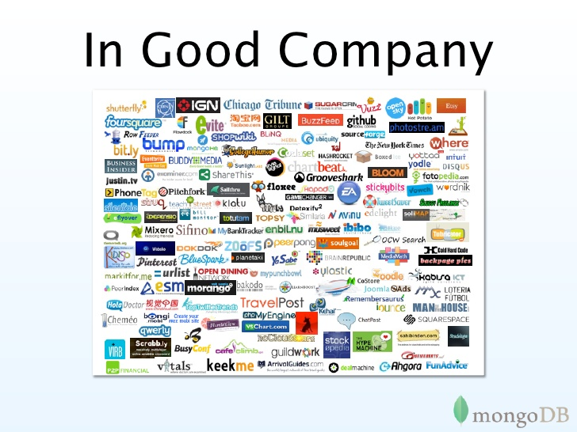

Slide 8
Data Model
Document-Based (max 16 MB)
Documents are in BSON format, consisting of field-value pairs
Each document stored in a collection
Collections
Have index set in common
Like tables of relational db’s.
Documents do not have to have uniform structure
-docs.mongodb.org/manual/

Slide 9
JSON
“JavaScript Object Notation”
Easy for humans to write/read, easy for computers to parse/generate
Objects can be nested
Built on
name/value pairs
Ordered list of values
http://json.org/

Slide 10
BSON
“Binary JSON”
Binary-encoded serialization of JSON-like docs
Also allows “referencing”
Embedded structure reduces need for joins
Goals
Lightweight
Traversable
Efficient (decoding and encoding)
http://bsonspec.org/

Slide 11
BSON Example
{
"_id" : "37010"
"city" : "ADAMS",
"pop" : 2660,
"state" : "TN",
“councilman” : {
name: “John Smith”
address: “13 Scenic Way”
}
}

Slide 12
BSON Types
Type | Number
Double | 1
String | 2
Object | 3
Array | 4
Binary data | 5
Object id | 7
Boolean | 8
Date | 9
Null | 10
Regular Expression | 11
JavaScript | 13
Symbol | 14
JavaScript (with scope) | 15
32-bit integer | 16
Timestamp | 17
64-bit integer | 18
Min key | 255
Max key | 127
The number can be used with the $type operator to query by type!
http://docs.mongodb.org/manual/reference/bson-types/

Slide 13
The _id Field
By default, each document contains an _id field. This field has a number of special characteristics:
Value serves as primary key for collection.
Value is unique, immutable, and may be any non-array type.
Default data type is ObjectId, which is “small, likely unique, fast to generate, and ordered.” Sorting on an ObjectId value is roughly equivalent to sorting on creation time.
http://docs.mongodb.org/manual/reference/bson-types/

Slide 14
mongoDB vs. SQL
mongoDB | SQL
Document | Tuple
Collection | Table/View
PK: _id Field | PK: Any Attribute(s)
Uniformity not Required | Uniform Relation Schema
Index | Index
Embedded Structure | Joins
Shard | Partition

Slide 15
CRUD Create, Read, Update, Delete

Slide 16
Getting Started with mongoDB
To install mongoDB, go to this link and click on the appropriate OS and architecture: http://www.mongodb.org/downloads
First, extract the files (preferrably to the C drive).
Finally, create a data directory on C:\ for mongoDB to use
i.e. “md data” followed by “md data\db”
http://docs.mongodb.org/manual/tutorial/install-mongodb-on-windows/

Slide 17
Getting Started with mongoDB
Open your mongodb/bin directory and run mongod.exe to start the database server.
To establish a connection to the server, open another command prompt window and go to the same directory, entering in mongo.exe. This engages the mongodb shell—it’s that easy!

Slide 18
CRUD: Using the Shell
To check which db you’re using db
Show all databases show dbs
Switch db’s/make a new one use <name>
See what collections exist show collections
Note: db’s are not actually created until you insert data!

Slide 19
CRUD: Using the Shell (cont.)
To insert documents into a collection/make a new collection:
db.<collection>.insert(<document>)
<=>
INSERT INTO <table>
VALUES(<attributevalues>);

Slide 20
CRUD: Inserting Data
Insert one document
db.<collection>.insert({<field>:<value>})
Inserting a document with a field name new to the collection is inherently supported by the BSON model.
To insert multiple documents, use an array.

Slide 21
CRUD: Querying
Done on collections.
Get all docs: db.<collection>.find()
Returns a cursor, which is iterated over shell to display first 20 results.
Add .limit(<number>) to limit results
SELECT * FROM <table>;
Get one doc: db.<collection>.findOne()

Slide 22
a sample document representing an article on a social news site
author: 'msmith',
vote_count: 20,
tags: ['databases', 'mongodb', 'indexing'],
image: {
url: 'http://example.com/db.jpg',
caption: '',
type: 'jpg',
size: 75381,
data: "Binary"
},
comments: [
{ user: 'bjones',
text: 'Interesting article!'
},
{ user: 'blogger',
text: 'Another related article is at http://example.com/db/db.txt'
}
]

Slide 23
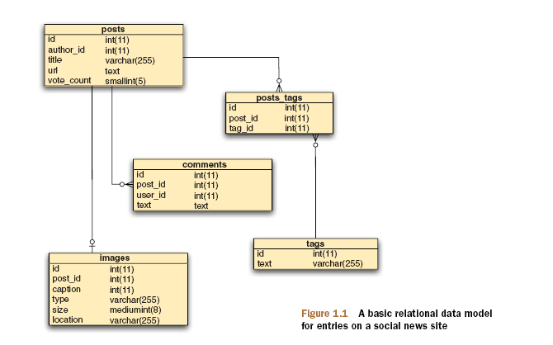

Slide 24


Slide 25
CRUD: Querying
To match a specific value:
db.<collection>.find({<field>:<value>})
“AND”
db.<collection>.find({<field1>:<value1>,
<field2>:<value2>
})
SELECT *
FROM <table>
WHERE <field1> = <value1> AND <field2> = <value2>;

Slide 26
CRUD: Querying
OR
db.<collection>.find({ $or: [
<field>:<value1>
<field>:<value2> ]
})
SELECT *
FROM <table> WHERE <field> = <value1> OR <field> = <value2>;
Checking for multiple values of same field
db.<collection>.find({<field>: {$in [<value>, <value>]}})

Slide 27
CRUD: Querying
Including/excluding document fields
db.<collection>.find({<field1>:<value>}, {<field2>: 0})
SELECT field1
FROM <table>;
db.<collection>.find({<field>:<value>}, {<field2>: 1})
Find documents with or w/o field
db.<collection>.find({<field>: { $exists: true}})

Slide 28
CRUD: Updating
db.<collection>.update(
{<field1>:<value1>}, //all docs in which field = value
{$set: {<field2>:<value2>}}, //set field to value
{multi:true} ) //update multiple docs
upsert: if true, creates a new doc when none matches search criteria.
UPDATE <table> SET <field2> = <value2>
WHERE <field1> = <value1>;

Slide 29
CRUD: Updating
To remove a field
db.<collection>.update({<field>:<value>},
{ $unset: { <field>: 1}})
Replace all field-value pairs
db.<collection>.update({<field>:<value>},
{ <field>:<value>, <field>:<value>})
*NOTE: This overwrites ALL the contents of a document, even removing fields.

Slide 30
CRUD: Removal
Remove all records where field = value
db.<collection>.remove({<field>:<value>})
DELETE FROM <table>
WHERE <field> = <value>;
As above, but only remove first document
db.<collection>.remove({<field>:<value>}, true)

Slide 31
CRUD: Isolation
By default, all writes are atomic only on the level of a single document.
This means that, by default, all writes can be interleaved with other operations.
You can isolate writes on an unsharded collection by adding $isolated:1 in the query area:
db.<collection>.remove({<field>:<value>, $isolated: 1})

Slide 32
Schema Design

Slide 33
RDBMS |  | MongoDB
Database | ➜ | Database
Table | ➜ | Collection
Row | ➜ | Document
Index | ➜ | Index
Join | ➜ | Embedded Document
Foreign Key | ➜ | Reference

Slide 34
Intuition – why database exist in the first place?
Why can’t we just write programs that operate on objects?
Memory limit
We cannot swap back from disk merely by OS for the page based memory management mechanism
Why can’t we have the database operating on the same data structure as in program?
That is where mongoDB comes in

Slide 35
Mongo is basically schema-free
The purpose of schema in SQL is for meeting the requirements of tables and quirky SQL implementation
Every “row” in a database “table” is a data structure, much like a “struct” in C, or a “class” in Java. A table is then an array (or list) of such data structures
So we what we design in mongoDB is basically same way how we design a compound data type binding in JSON

Slide 36
There are some patterns
Embedding
Linking

Slide 37
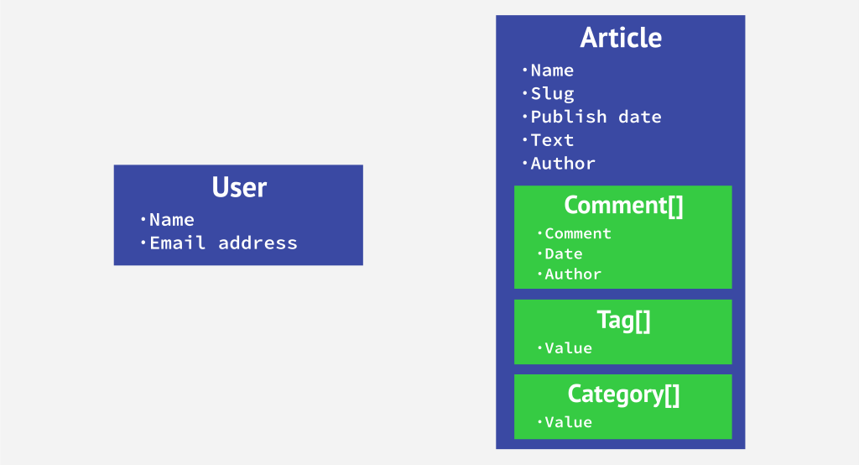
Embedding & Linking

Slide 38
One to One relationship
zip = {
_id: 35004,
city: “ACMAR”,
loc: [-86, 33],
pop: 6065,
State: “AL”
}
Council_person = {
zip_id = 35004,
name: “John Doe",
address: “123 Fake St.”,
Phone: 123456
}
zip = {
_id: 35004 ,
city: “ACMAR”
loc: [-86, 33],
pop: 6065,
State: “AL”,
council_person: {
name: “John Doe",
address: “123 Fake St.”,
Phone: 123456
}
}

Slide 39
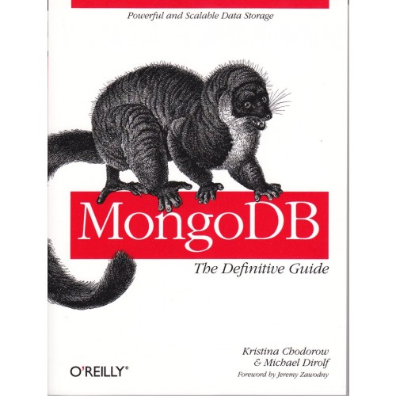
Example 2
MongoDB: The Definitive Guide,
By Kristina Chodorow and Mike Dirolf
Published: 9/24/2010
Pages: 216
Language: English
Publisher: O’Reilly Media, CA

Slide 40
One to many relationship - Embedding
book = {
title: "MongoDB: The Definitive Guide",
authors: [ "Kristina Chodorow", "Mike Dirolf" ]
published_date: ISODate("2010-09-24"),
pages: 216,
language: "English",
publisher: {
name: "O’Reilly Media",
founded: "1980",
location: "CA"
}
}

Slide 41
One to many relationship – Linking
publisher = {
_id: "oreilly",
name: "O’Reilly Media",
founded: "1980",
location: "CA"
}
book = {
title: "MongoDB: The Definitive Guide",
authors: [ "Kristina Chodorow", "Mike Dirolf" ]
published_date: ISODate("2010-09-24"),
pages: 216,
language: "English",
publisher_id: "oreilly"
}

Slide 42
Linking vs. Embedding
Embedding is a bit like pre-joining data
Document level operations are easy for the server to handle
Embed when the “many” objects always appear with (viewed in the context of) their parents.
Linking when you need more flexibility

Slide 43
Many to many relationship
Can put relation in either one of the documents (embedding in one of the documents)
Focus how data is accessed queried

Slide 44
Example
book = {
title: "MongoDB: The Definitive Guide",
authors : [
{ _id: "kchodorow", name: "Kristina Chodorow” },
{ _id: "mdirolf", name: "Mike Dirolf” }
]
published_date: ISODate("2010-09-24"),
pages: 216,
language: "English"
}
author = {
_id: "kchodorow",
name: "Kristina Chodorow",
hometown: "New York"
}
db.books.find( { authors.name : "Kristina Chodorow" } )

Slide 45
What is bad about SQL ( semantically )
“Primary keys” of a database table are in essence persistent memory addresses for the object. The address may not be the same when the object is reloaded into memory. This is why we need primary keys.
Foreign key functions just like a pointer in C, persistently point to the primary key.
Whenever we need to deference a pointer, we do JOIN
It is not intuitive for programming and also JOIN is time consuming

Slide 46
Example 3
Book can be checked out by one student at a time
Student can check out many books

Slide 47
Modeling Checkouts
student = {
_id: "joe"
name: "Joe Bookreader",
join_date: ISODate("2011-10-15"),
address: { ... }
}
book = {
_id: "123456789"
title: "MongoDB: The Definitive Guide",
authors: [ "Kristina Chodorow", "Mike Dirolf" ],
...
}

Slide 48
Modeling Checkouts
student = {
_id: "joe"
name: "Joe Bookreader",
join_date: ISODate("2011-10-15"),
address: { ... },
checked_out: [
{ _id: "123456789", checked_out: "2012-10-15" },
{ _id: "987654321", checked_out: "2012-09-12" },
...
]
}

Slide 49
What is good about mongoDB?
find() is more semantically clear for programming
De-normalization provides Data locality, and Data locality provides speed
(map (lambda (b) b.title)
(filter (lambda (p) (> p 100)) Book)

Slide 50
Part 4: Index in MongoDB

Slide 51
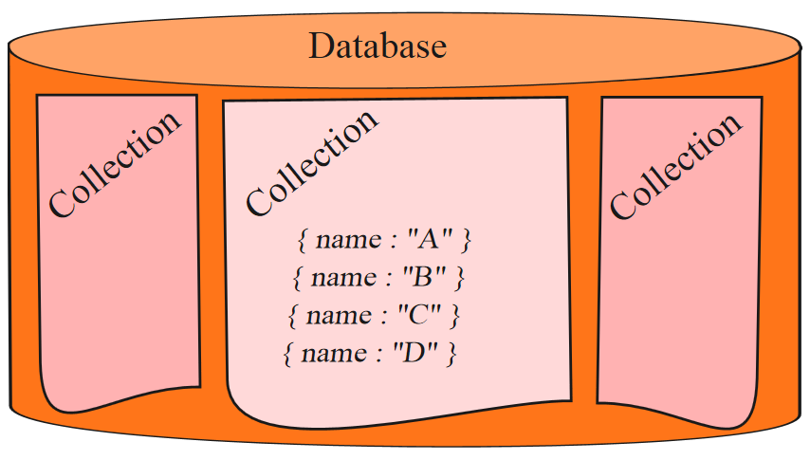

Before Index
What does database normally do when we query?
MongoDB must scan every document.
Inefficient because process large volume of data
db.users.find( { score: { “$lt” : 30} } )

Slide 52
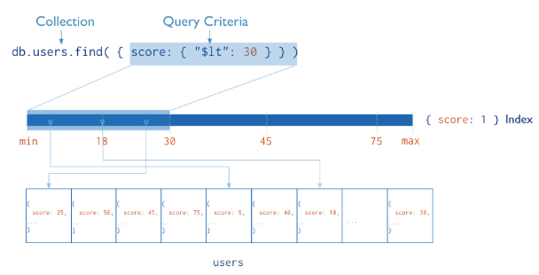
Definition of Index
Definition
Indexes are special data structures that store a small portion of the collection’s data set in an easy to traverse form.
Index
Diagram of a query that uses an index to select

Slide 53
Index in MongoDB
Operations
Creation index
db.users.ensureIndex( { score: 1 } )
Show existing indexes
db.users.getIndexes()
Drop index
db.users.dropIndex( {score: 1} )
Explain—Explain
db.users.find().explain()
Returns a document that describes the process and indexes
Hint
db.users.find().hint({score: 1})
Overide MongoDB’s default index selection

Slide 54
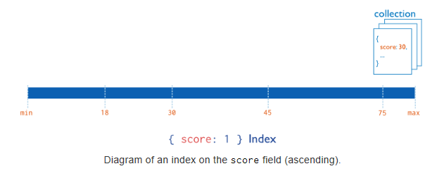
Index in MongoDB
Types
Single Field Indexes
Compound Field Indexes
Multikey Indexes
Single Field Indexes
db.users.ensureIndex( { score: 1 } )

Slide 55
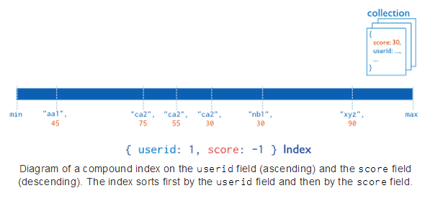
Index in MongoDB
Types
Single Field Indexes
Compound Field Indexes
Multikey Indexes
Compound Field Indexes
db.users.ensureIndex( { userid:1, score: -1 } )

Slide 56
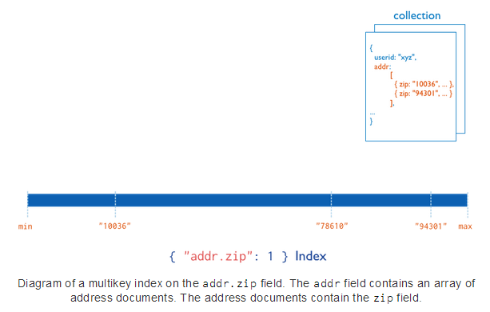
Index in MongoDB
Types
Single Field Indexes
Compound Field Indexes
Multikey Indexes
Multikey Indexes
db.users.ensureIndex( { addr.zip:1} )

Slide 57
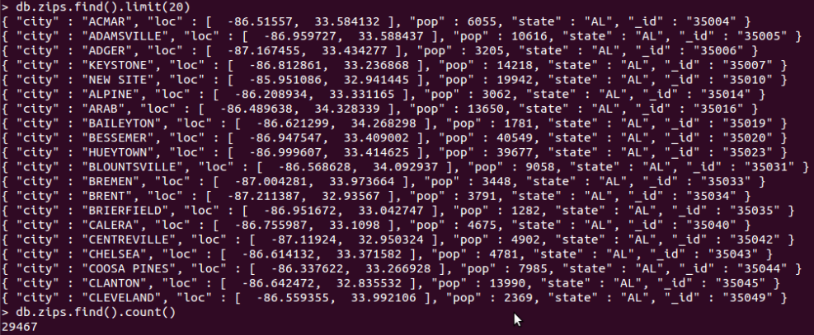
Demo of indexes in MongoDB
Import Data
Create Index
Single Field Index
Compound Field Indexes
Multikey Indexes
Show Existing Index
Hint
Single Field Index
Compound Field Indexes
Multikey Indexes
Explain
Compare with data without indexes

Slide 58

Demo of indexes in MongoDB
Import Data
Create Index
Single Field Index
Compound Field Indexes
Multikey Indexes
Show Existing Index
Hint
Single Field Index
Compound Field Indexes
Multikey Indexes
Explain
Compare with data without indexes

Slide 59
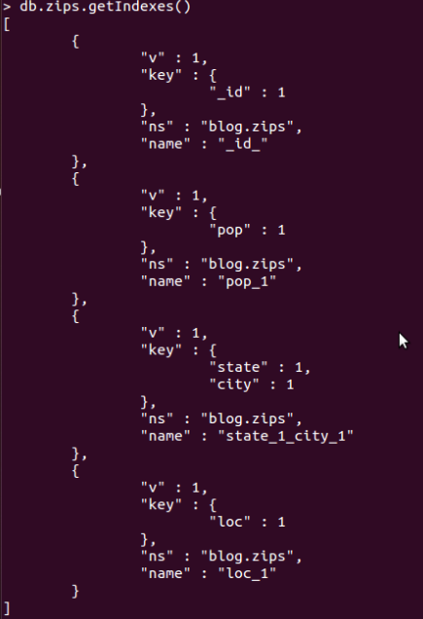
Demo of indexes in MongoDB
Import Data
Create Index
Single Field Index
Compound Field Indexes
Multikey Indexes
Show Existing Index
Hint
Single Field Index
Compound Field Indexes
Multikey Indexes
Explain
Compare with data without indexes

Slide 60
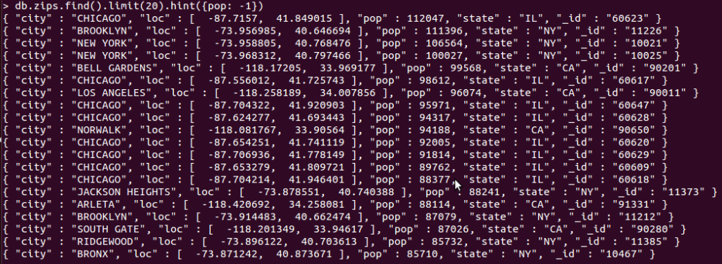
Demo of indexes in MongoDB
Import Data
Create Index
Single Field Index
Compound Field Indexes
Multikey Indexes
Show Existing Index
Hint
Single Field Index
Compound Field Indexes
Multikey Indexes
Explain
Compare with data without indexes

Slide 61
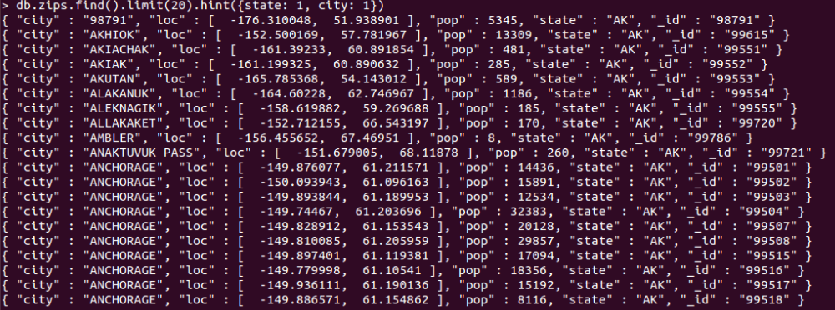
Demo of indexes in MongoDB
Import Data
Create Index
Single Field Index
Compound Field Indexes
Multikey Indexes
Show Existing Index
Hint
Single Field Index
Compound Field Indexes
Multikey Indexes
Explain
Compare with data without indexes

Slide 62
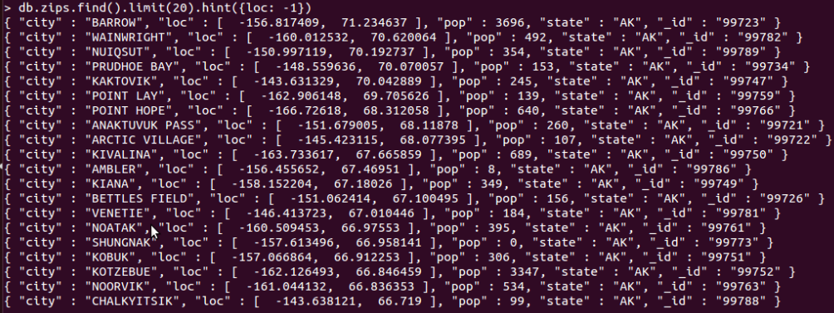
Demo of indexes in MongoDB
Import Data
Create Index
Single Field Index
Compound Field Indexes
Multikey Indexes
Show Existing Index
Hint
Single Field Index
Compound Field Indexes
Multikey Indexes
Explain
Compare with data without indexes

Slide 63
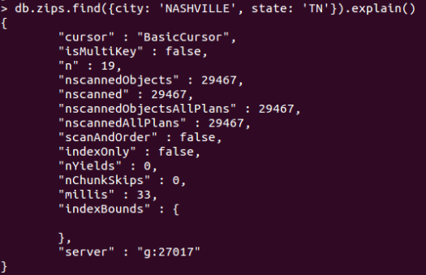
Demo of indexes in MongoDB
Import Data
Create Index
Single Field Index
Compound Field Indexes
Multikey Indexes
Show Existing Index
Hint
Single Field Index
Compound Field Indexes
Multikey Indexes
Explain
Compare with data without indexes

Slide 64
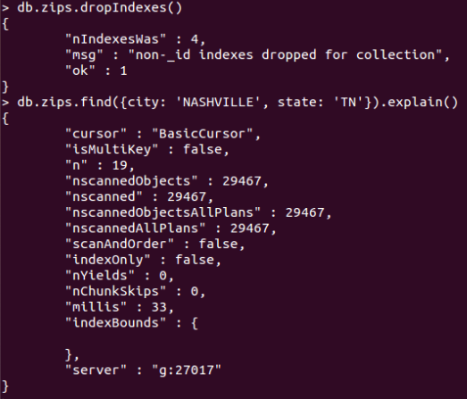
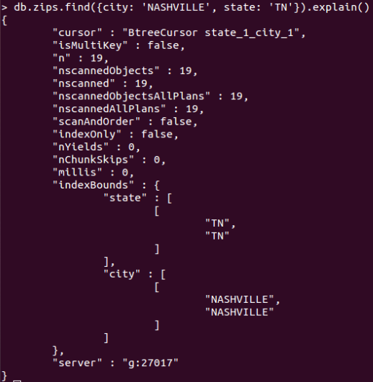
Demo of indexes in MongoDB
Import Data
Create Index
Single Field Index
Compound Field Indexes
Multikey Indexes
Show Existing Index
Hint
Single Field Index
Compound Field Indexes
Multikey Indexes
Explain
Compare with data without indexes
Without Index
With Index

Slide 65
Aggregation
Operations that process data records and return computed results.
MongoDB provides aggregation operations
Running data aggregation on the mongod instance simplifies application code and limits resource requirements.

Slide 66
Pipelines
Modeled on the concept of data processing pipelines.
Provides:
filters that operate like queries
document transformations that modify the form of the output document.
Provides tools for:
grouping and sorting by field
aggregating the contents of arrays, including arrays of documents
Can use operators for tasks such as calculating the average or concatenating a string.

Slide 67
Aggregation Framework Operators
$project
$match
$limit
$skip
$sort
$unwind
$group

Slide 68
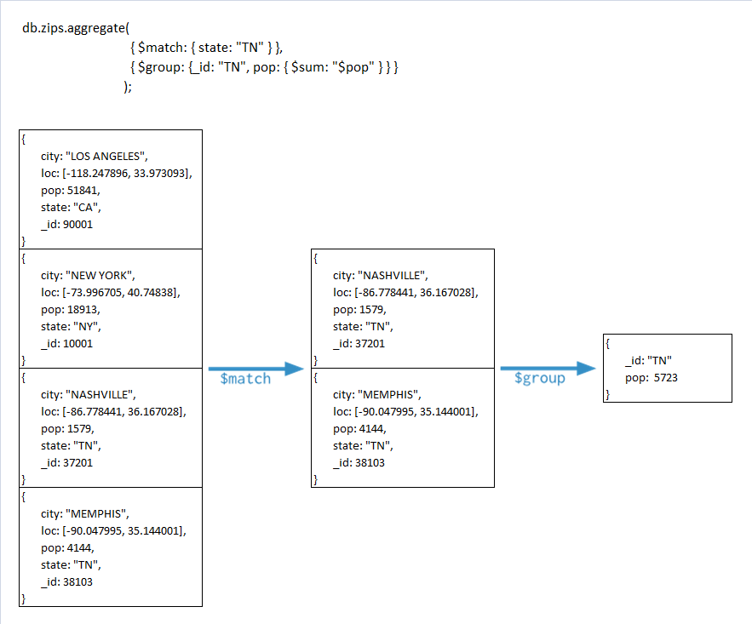

Slide 69
Pipelines
$limit
$skip
$sort

Slide 70
Examples
{
"_id": "10280",
"city": "NEW YORK",
"state": "NY",
"pop": 5574,
"loc": [ -74.016323, 40.710537 ]
}

Slide 71
Return States with Populations above 10 Million
db.zipcodes.aggregate( {
$group : { _id : "$state",
totalPop : { $sum : "$pop" } } },
{ $match : {totalPop :
{ $gte : 10*1000*1000 } } } )

Slide 72
Return Average City Population by State
db.zipcodes.aggregate( [
{ $group : { _id : { state : "$state", city : "$city" },
pop : { $sum : "$pop" } } },
{ $group : { _id : "$_id.state", avgCityPop :
{ $avg : "$pop" } } } ] )

Slide 73
Return Largest and Smallest Cities by State
db.zipcodes.aggregate( { $group:
{ _id: { state: "$state", city: "$city" },
pop: { $sum: "$pop" } } }, { $sort: { pop: 1 } },
{ $group: { _id : "$_id.state", biggestCity: { $last: "$_id.city" }, biggestPop: { $last: "$pop" }, smallestCity: { $first: "$_id.city" }, smallestPop: { $first: "$pop" } } },
// the following $project is optional, and // modifies the output format.
{ $project: { _id: 0, state: "$_id", biggestCity: { name: "$biggestCity", pop: "$biggestPop" }, smallestCity: { name: "$smallestCity", pop: "$smallestPop" } } } )

Slide 74
{ _id : "jane", joined : ISODate("2011-03-02"), likes : ["golf", "racquetball"] }
{ _id : "joe", joined : ISODate("2012-07-02"), likes : ["tennis", "golf", "swimming"] }

Slide 75
Return Usernames Ordered by Join Month
db.users.aggregate( [ { $project : { month_joined : { $month : "$joined" } } } ,
{ $group : { _id : {month_joined:"$month_joined"} , number : { $sum : 1 } } },
{ $sort : { "_id.month_joined" : 1 } } ] )

Slide 76
Return the Five Most Common “Likes”
db.users.aggregate( [ { $unwind : "$likes" },
{ $group : { _id : "$likes" , number : { $sum : 1 } } },
{ $sort : { number : -1 } }, { $limit : 5 } ]
)

Slide 77
$unwind
{ _id : "jane", joined : ISODate("2011-03-02"), likes : ["golf", "racquetball"] }
The $unwind operator would create the following documents:
{ _id : "jane", joined : ISODate("2011-03-02"), likes : "golf" } { _id : "jane", joined : ISODate("2011-03-02"), likes : "racquetball" }

Slide 78
Sales Data
{ "_id" : 1, "item" : "abc", "price" : 10, "quantity" : 2, "date" : ISODate("2014-01-01T08:00:00Z") } { "_id" : 2, "item" : "jkl", "price" : 20, "quantity" : 1, "date" : ISODate("2014-02-03T09:00:00Z") } { "_id" : 3, "item" : "xyz", "price" : 5, "quantity" : 5, "date" : ISODate("2014-02-03T09:05:00Z") } { "_id" : 4, "item" : "abc", "price" : 10, "quantity" : 10, "date" : ISODate("2014-02-15T08:00:00Z") } { "_id" : 5, "item" : "xyz", "price" : 5, "quantity" : 10, "date" : ISODate("2014-02-15T09:05:00Z") }

Slide 79
db.sales.aggregate( [
{ $group: { _id: "$item",
minQuantity: { $min: "$quantity" } } } ] )

Slide 80
Map-Reduce
Has two phases:
A map stage that processes each document and emits one or more objects for each input document
A reduce phase that combines the output of the map operation.
An optional finalize stage for final modifications to the result
Uses Custom JavaScript functions
Provides greater flexibility but is less efficient and more complex than the aggregation pipeline
Can have output sets that exceed the 16 megabyte output limitation of the aggregation pipeline.

Slide 81
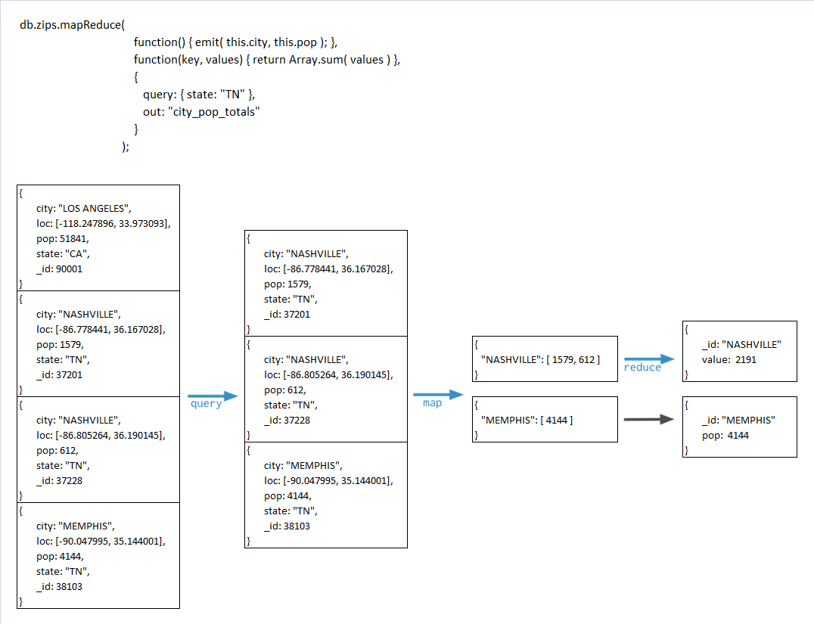

Slide 82
Single Purpose Aggregation Operations
Special purpose database commands:
returning a count of matching documents
returning the distinct values for a field
grouping data based on the values of a field.
Aggregate documents from a single collection.
Lack the flexibility and capabilities of the aggregation pipeline and map-reduce.

Slide 83
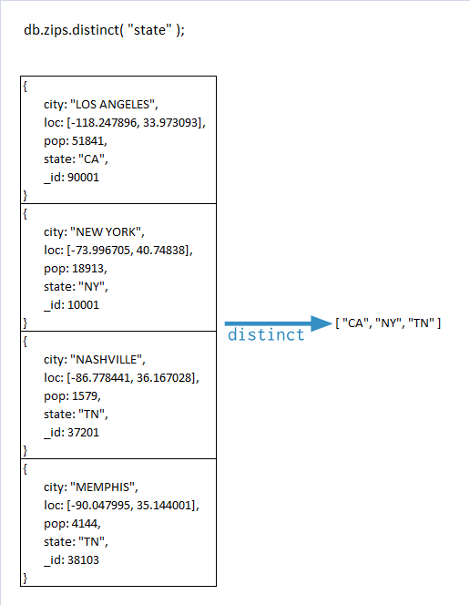

Slide 84
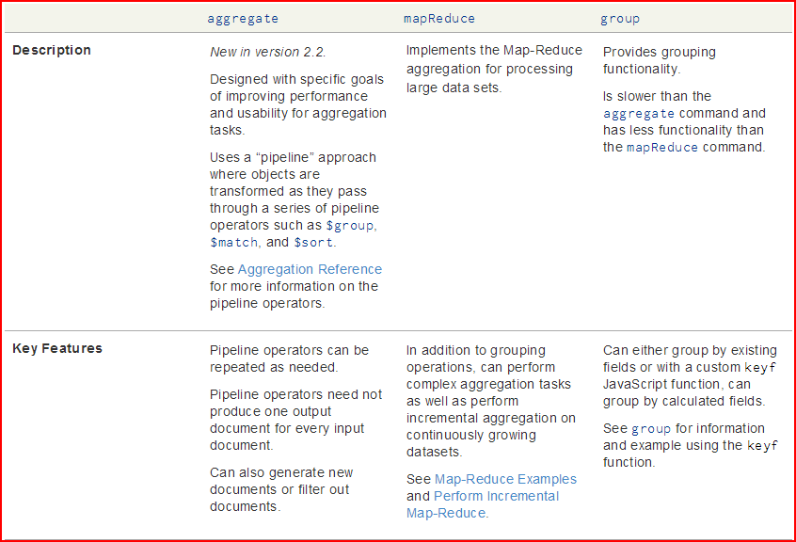

Slide 85
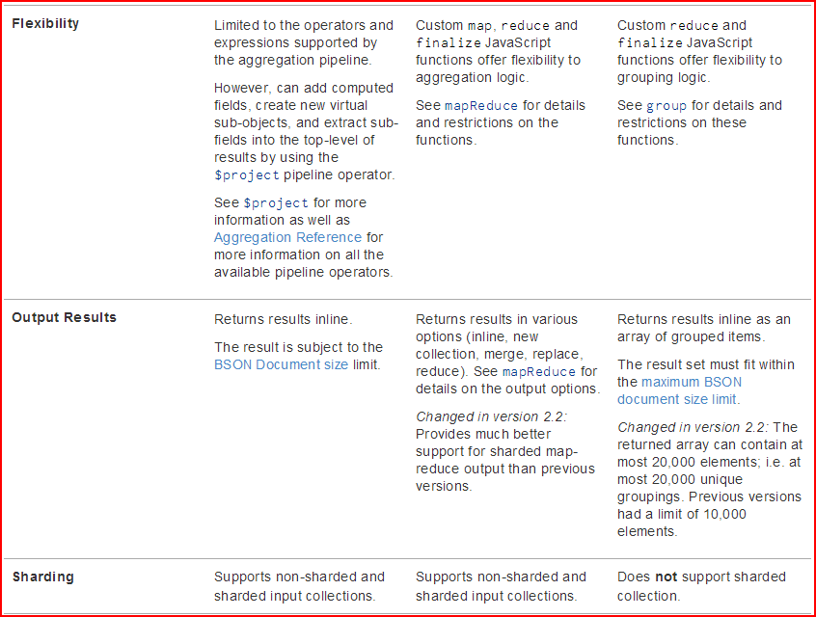

Slide 86
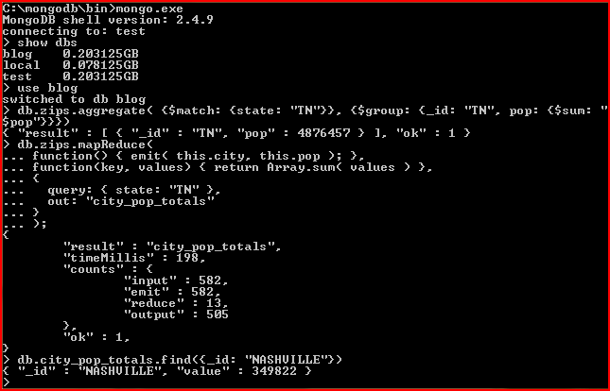

Slide 87
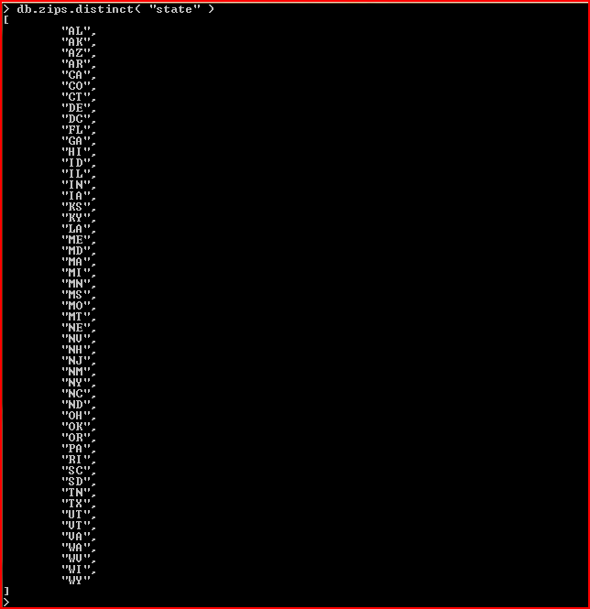

Slide 88
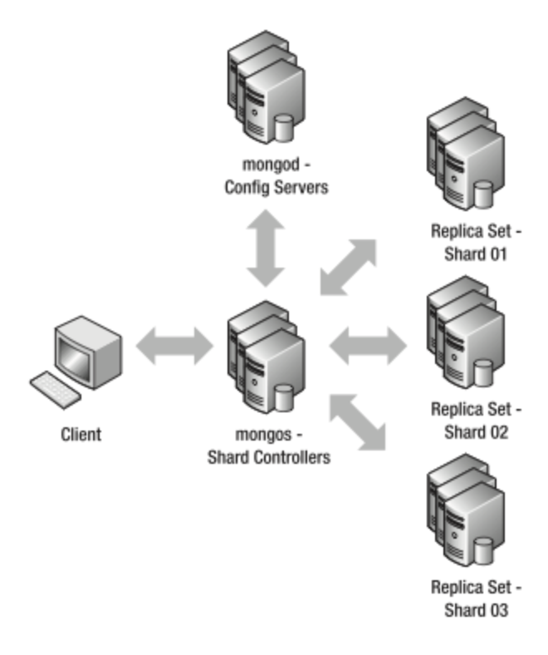
Replication & Sharding
Image source: http://mongodb.in.th

Slide 89
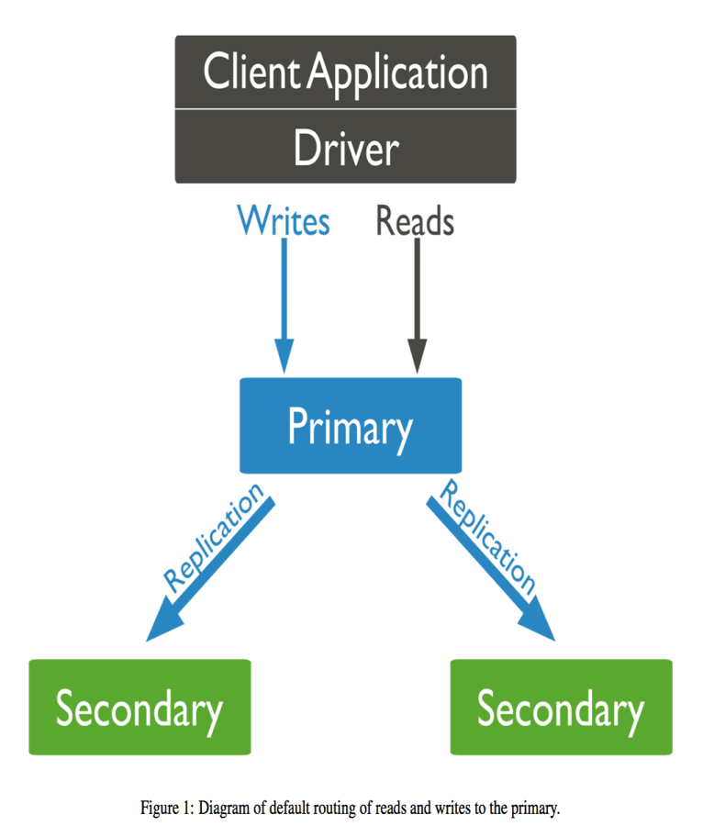
Replication
What is replication?
Purpose of replication/redundancy
Fault tolerance
Availability
Increase read capacity

Slide 90
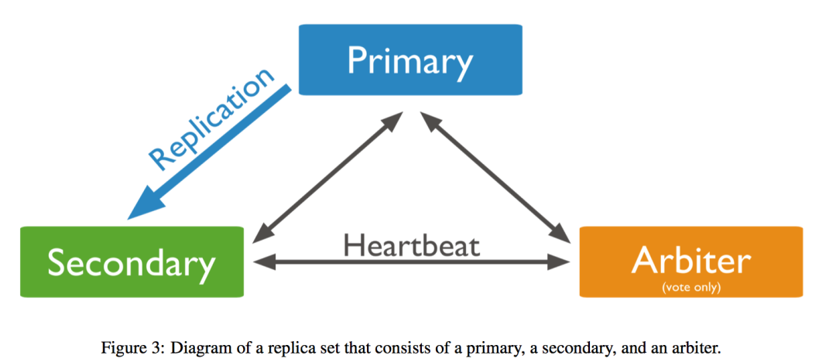
Replication in MongoDB
Replica Set Members
Primary
Read, Write operations
Secondary
Asynchronous Replication
Can be primary
Arbiter
Voting
Can’t be primary
Delayed Secondary
Can’t be primary

Slide 91
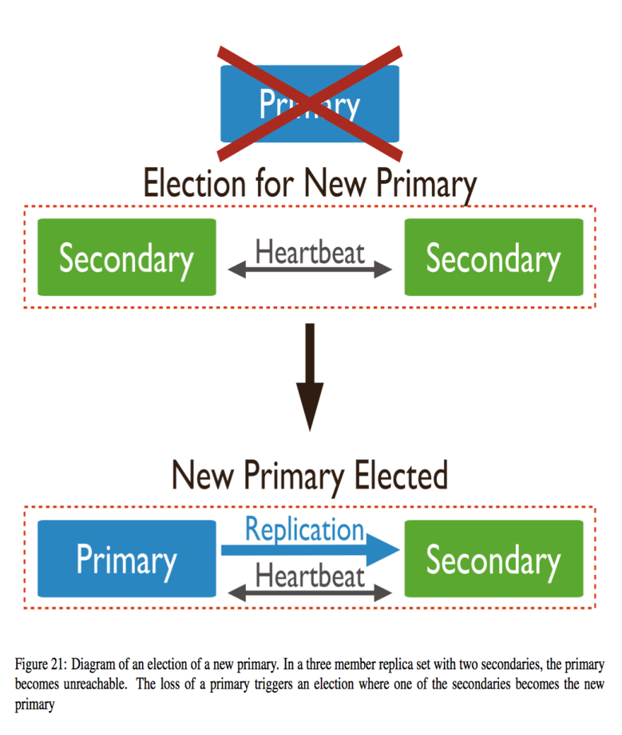
Replication in MongoDB
Automatic Failover
Heartbeats
Elections
The Standard Replica Set Deployment
Deploy an Odd Number of Members
Rollback
Security
SSL/TLS

Slide 92
Demo for Replication

Slide 93
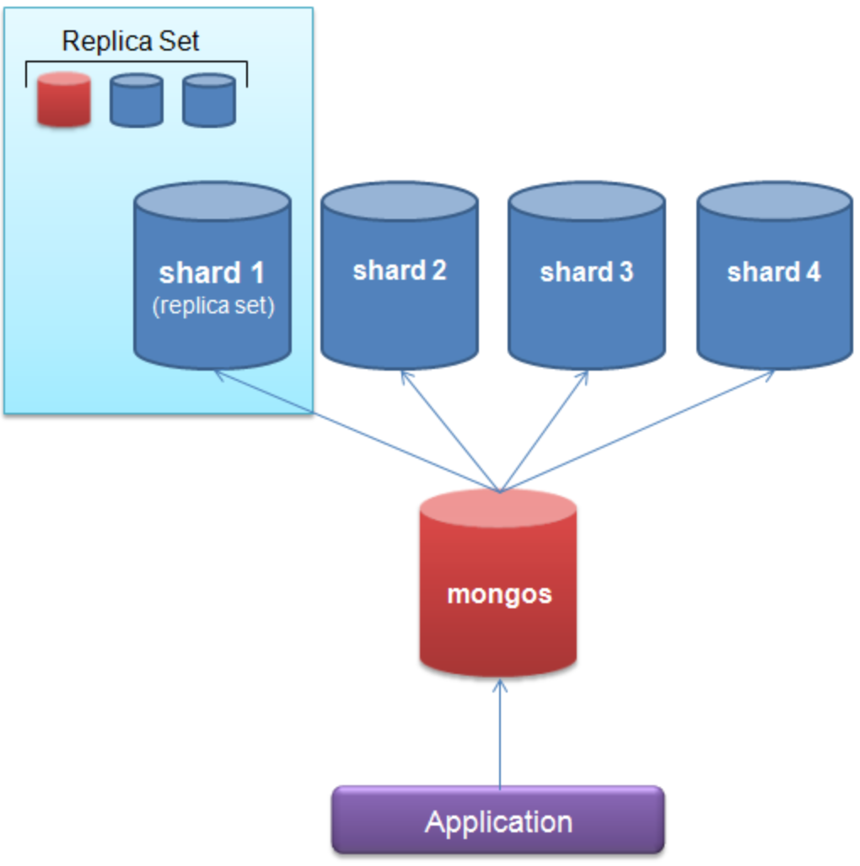
Sharding
What is sharding?
Purpose of sharding
Horizontal scaling out
Query Routers
mongos
Shard keys
Range based sharding
Cardinality
Avoid hotspotting

Slide 94
Demo for Sharding

Slide 95
Thanks

