Slide 1
Sitecore Demo Portal
GitHub
Vercel
Repo Url
Project-1
Deploy
Project-2
Project-3
Vercel Token
Project-4

Slide 2



Sitecore Demo Portal
GitHub
Vercel
Repo Url
Vercel Team
Deploy
Notify
Project
Vercel Token
Team Members

Slide 3
Sitecore Instance
Visual Studio Sln
Publish
Application Code
Publish
Hotfix Files

Slide 4
Sitecore Instance
Publish
Application Code
Visual Studio Sln
PS Script
Hotfix Files
File System

Slide 5
SIF PS Script
Plumber JSON File
Params
Tasks JSON File
Params
Params
Tasks JSON File
Params
Tasks JSON File
(XP0-SingleDeveloper.ps1)
(XP0-SingleDeveloper.json)
Individual Task list JSON File

Slide 6
True/False
Skip SetPermissions
True/False
SIF PS Script
Plumber JSON File
Task List JSON File
Update Param
Params
Update
Params
InstallWDP
True/False
True/False
Skip CreateLicenseFolder
(XP0-SingleDeveloper.ps1)
(XP0-SingleDeveloper.json)
(IdentityServer.json)
Individual Tasks

Slide 7
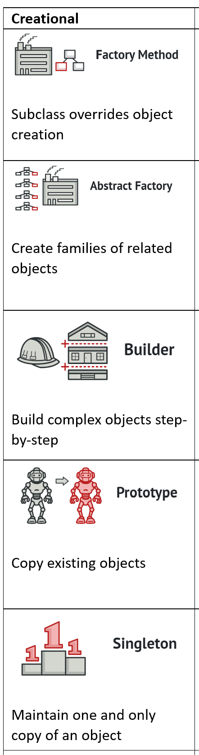
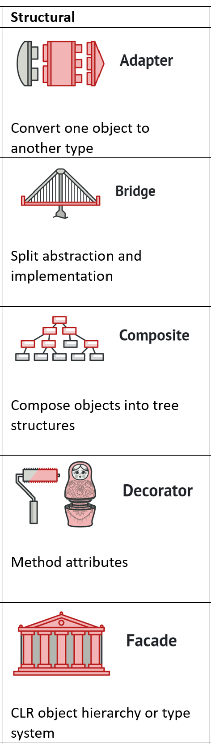
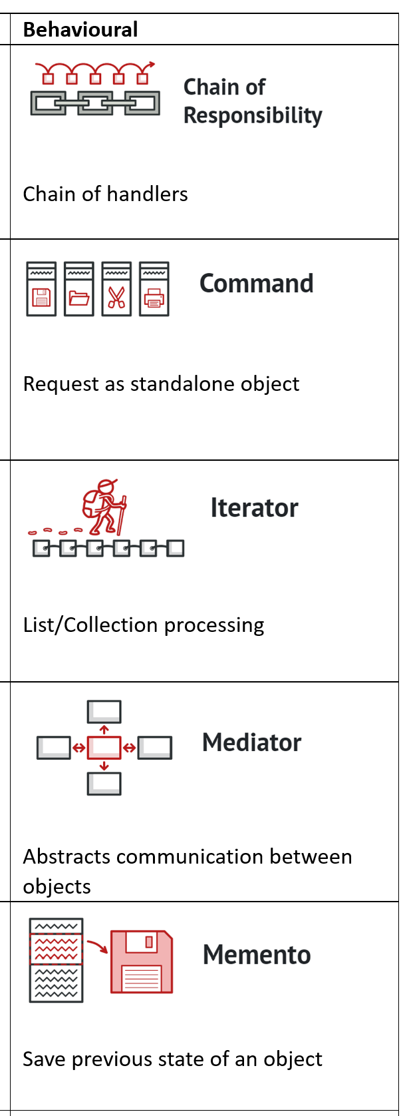
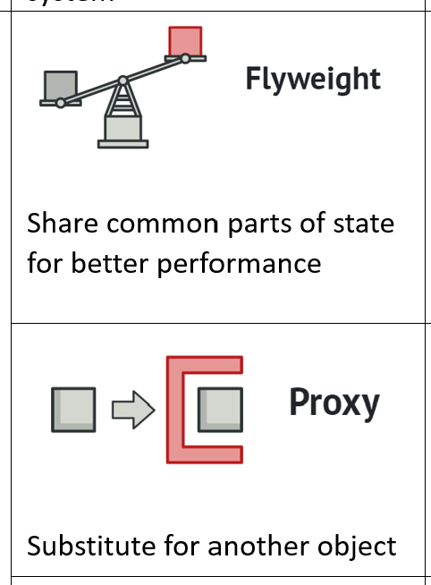
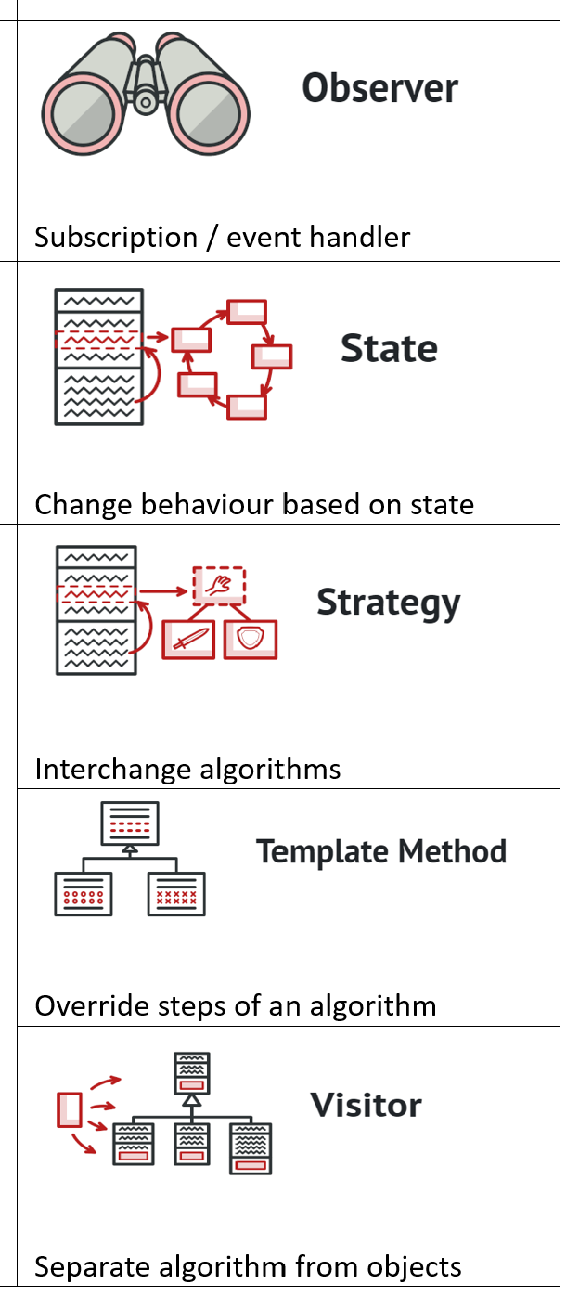

Slide 8


Call - 1
Singleton Lifetime
Call - 3
Global Settings
Longest lifespan
Inst-1
Inst-1
Call - 2
Call - 4
High memory usage
Inst-1
Inst-1
Most dominant
Request - 1
Request - 2
E.g. Logging, Caching
Call - 1
Scoped Lifetime
Call - 3
Stateful Request
Request lifespan
Inst-1
Inst-2
Call - 2
Call - 4
Dominant than transient
Inst-1
Inst-2
Request - 1
Request - 2
E.g., Shopping Cart
Stateless
Call - 1
Transient Lifetime
Call - 3
Call Lifespan
Inst-1
Inst-3
High CPU usage
Call - 2
Call - 4
Default
Inst-2
Inst-4
Request - 1
Request - 2
E.g., Card Payment

Slide 9
Layout Details
Device
Field Layout
RenderLayoutGridBuilder
BuildGrid
BuildDevice
LayoutDetails.xml
LayoutDetailsForm
LayoutGridBuilder
LayoutFieldDevice.xml

Slide 10

Sitecore Insert Options
Insert Option Rules
SPE Context menu Integration Point
=

Slide 11

Criteria | Sitecore Insert Options | Rule-based Insert Options | SPE Integration Point
SPE module installation
Rules by design
Customizable Dialog
Sync / scattered / Overhead
Easy Setup
Better structure / practice
Swiss knife

Slide 12
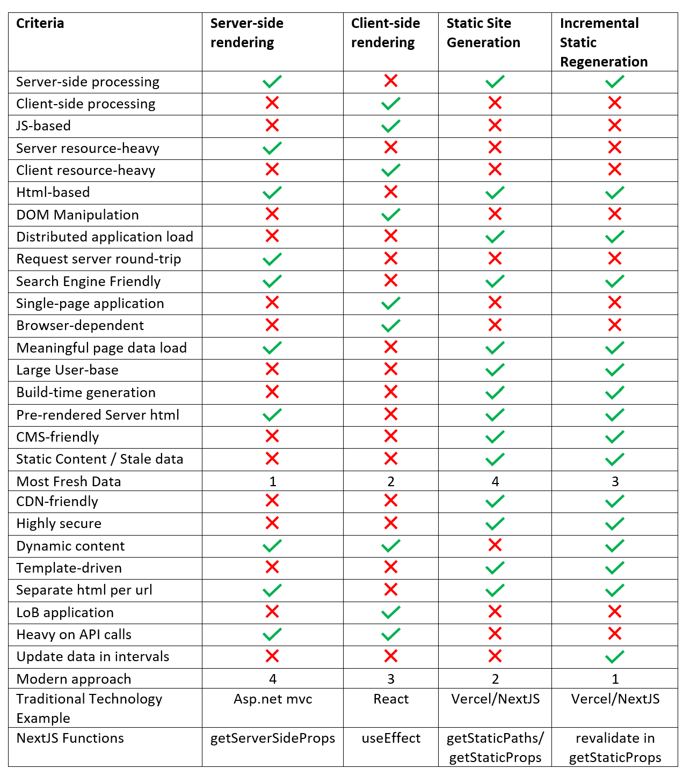

Server-side Rendering
Html
Html
Web Server
Client
Client-side Rendering
Html
JS
Web Server
Client
Static Site Generation
Build Server
CDN
Incremental Site Regeneration
Build Server
CDN

