Slide 1
Writing a Dissertation - Doing a research
Part 1 – Introduction to Research
Navaneeth T M
UGC Research Fellow (PhD),
Department of Journalism and Mass Communication,
University of Calicut

Slide 2
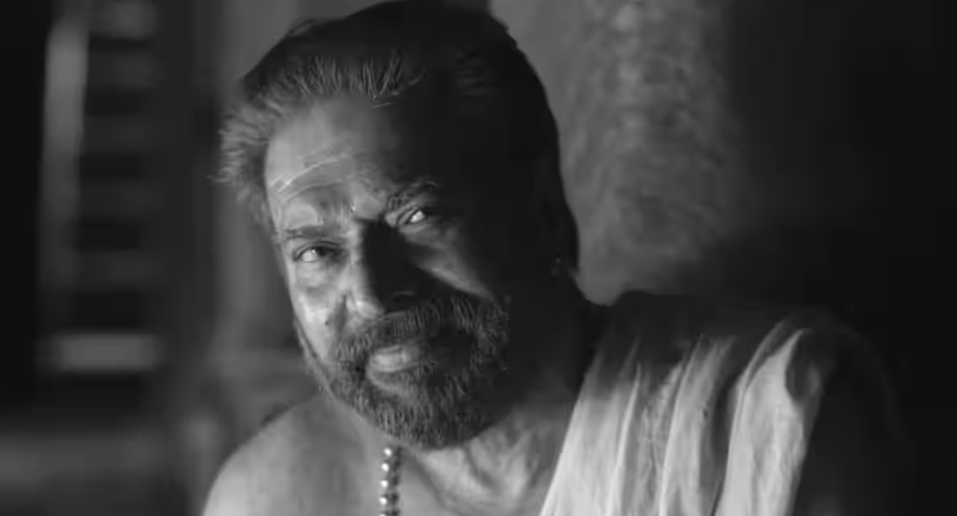
“Research is What I am doing when I don’t know what I am Doing”
- Werner Von Braun

Slide 3
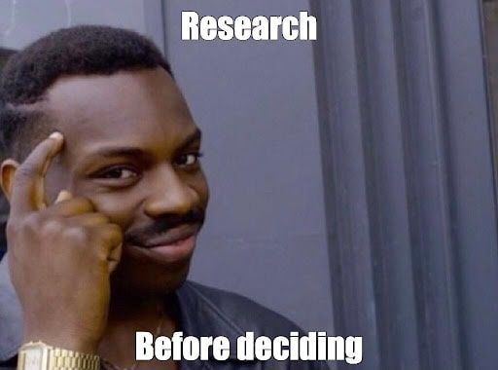
Research and Life
To submit dissertation / Thesis – To complete PG or PhD
Decision making in life – asking other people for opinion, experience
Problem solving
Exploring feasibility of new ideas
Critical thinking etc.

Slide 4
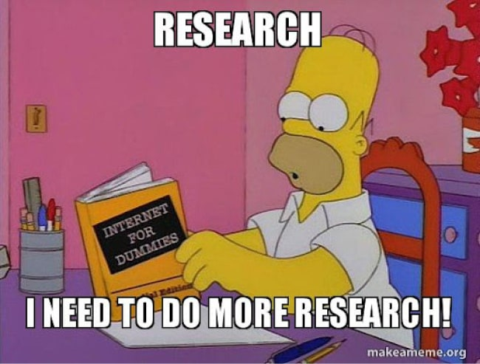
What is formalised research?
Re-Search - You have an area of interest > you Google for better knowledge in it > You do not find better knowledge > Then you conduct a formalised search out of your curiosity.
Process of this formalised search is called Research process

Slide 5
Formal Research as a career
Academic research (PhD or Post-doctoral)
Research projects (Non-profit organisations, think tanks etc.)
Research for private companies
Private research firms
Market research
Independent research and writing

Slide 6
Different types of research
Basic and Applied research
Quantitative, qualitative and mixed method research
Cross sectional research, Longitudinal research
Descriptive and correlational research

Slide 7
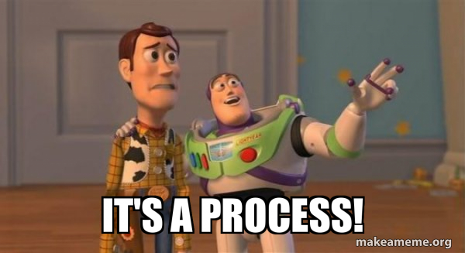
Research process is like many other process
Film production
Journalistic process
Process of writing a book etc.
It Has a Pre- and Post production process.
Pre-data collection, Post- data collection

Slide 8
Process consists of
Research Interest/ Problem
Background reading
Research Questions/ Objectives
Literature review
Making a conceptual framework
Designing the research
Data collection
Analysing the data and get the results
Interpret the data – Discussion
Pre- Data Collection
Introduction
Review of Literature
Methodology
Post- Data Collection
Data analysis
Discussion & Conclusion
Conclusion

Slide 9
Process consists of
Research Interest/ Problem
Background reading
Research Questions/ Objectives
Literature review
Making a conceptual framework
Designing the research
Data collection
Analysing the data and get the results
Interpret the data – Discussion
Pre- Data Collection
Introduction
Review of Literature
Methodology
Post- Data Collection
Data analysis
Discussion & Conclusion
Conclusion

Slide 10
Process consists of
Research Interest/ Problem
Background reading
Research Questions/ Objectives
Literature review
Making a conceptual framework
Designing the research
Data collection
Analysing the data and get the results
Interpret the data – Discussion
Pre- Data Collection
Introduction
Review of Literature
Methodology
Post- Data Collection
Data analysis
Discussion & Conclusion
Conclusion

Slide 11
Process consists of
Research Interest/ Problem
Background reading
Research Questions/ Objectives
Literature review
Making a conceptual framework
Designing the research
Data collection
Analysing the data and get the results
Interpret the data – Discussion
Pre- Data Collection
Introduction
Review of Literature
Methodology
Post- Data Collection
Data analysis
Discussion & Conclusion
Conclusion

Slide 12
Process consists of
Research Interest/ Problem
Background reading
Research Questions/ Objectives
Literature review
Making a conceptual framework
Designing the research
Data collection
Analysing the data and get the results
Interpret the data – Discussion
Pre- Data Collection
Introduction
Review of Literature
Methodology
Post- Data Collection
Data analysis
Discussion & Conclusion
Conclusion

Slide 13
Let’s focus on the writing side.
Pre- Data Collection
Introduction
Review of Literature
Methodology
Data collection
Post-Data Collection
4. Analysis
5. Discussion & Conclusion
6. Conclusion

Slide 14
Questions??

