Slide 1
1. Survey Method
Conceptual framework
Concepts and constructs
Demographic variables
Sampling method
Questionnaire design
Pilot test the survey
Data collection
Data cleaning and coding
Data analysis
Interpretation and findings

Slide 2
1. Survey Method
Conceptual Framework
Content Preferences: Examining the types of content preferred by Kerala youth on OTT platforms. This could include genres such as movies, TV shows, documentaries, or specific categories like comedy, drama, action, etc.
Platform Usage: Understanding which OTT platforms are most popular among Kerala youth and exploring reasons behind their preferences. For instance, are they more inclined towards international platforms like Netflix or Amazon Prime Video, or do they prefer regional platforms catering specifically to Malayalam content?
Consumption Habits: Investigating how frequently Kerala youth engage with OTT content, the duration of their viewing sessions, binge-watching tendencies, and whether they multitask while consuming content.

Slide 3
1. Survey Method
Conceptual Framework
Content Preferences: Examining the types of content preferred by Kerala youth on OTT platforms. This could include genres such as movies, TV shows, documentaries, or specific categories like comedy, drama, action, etc.
Platform Usage: Understanding which OTT platforms are most popular among Kerala youth and exploring reasons behind their preferences. For instance, are they more inclined towards international platforms like Netflix or Amazon Prime Video, or do they prefer regional platforms catering specifically to Malayalam content?
Consumption Habits: Investigating how frequently Kerala youth engage with OTT content, the duration of their viewing sessions, binge-watching tendencies, and whether they multitask while consuming content.

Slide 4
1. Survey Method
Conceptual Framework
Motivations and Preferences: Exploring the factors influencing their choice of OTT content, such as content quality, recommendations from friends or family, availability of subtitles or dubbed content, and affordability.
Technological Access and Infrastructure: Assessing the availability and quality of internet connectivity, devices used for OTT consumption (smartphones, tablets, smart TVs, etc.), and how these factors impact their viewing habits.
Cultural Influences: Considering how cultural factors unique to Kerala may shape OTT consumption patterns, including preferences for regional language content, local cultural references in content, and the influence of traditional media on OTT consumption.
Social Dynamics: Examining how social interactions, peer pressure, and social media influence the OTT viewing habits of Kerala youth. For example, do they discuss and recommend content on social platforms like WhatsApp or Facebook?

Slide 5
Objectives Reframed
1. To explore the motivations and preferences of Kerala youth across different demographics.
2. To study the consumption habits of Kerala youth across different demographics
3. To explore the usage patterns and preferences of Kerala youth across different demographics

Slide 6
1. Survey Method
Conceptual Framework / Conceptual Model
Demographic Variables
Age
Gender
Field of Study
Year of Study
OTT Watching Habits
Frequency
Duration
Subscribed Platforms
Types of Content
Motivations and Preferences
Content quality
Recommendations
Subtitle
Affordability

Slide 7
Questionnaire Construction
Generate Initial Pool of Items: Based on the identified variables and constructs, generate an initial pool of questionnaire items or questions that aim to measure each construct. Ensure that the items are clear, concise, and relevant to the research objectives.
Organize Questions: Organize the questions logically and coherently to guide respondents through the survey. Start with general introductory questions, followed by more specific and sensitive questions, and end with demographic questions.
Choose Question Types: Select appropriate question types based on the nature of the information being collected. Common question types include multiple-choice, Likert scale, semantic differential, open-ended, and ranking questions.

Slide 8
Multiple-Choice Question:
Which of the following OTT platforms do you use most frequently?
Netflix
Amazon Prime Video
Disney+ Hotstar
Other (please specify)
Likert Scale Question:
Please indicate your agreement with the following statement:
"I prefer watching Malayalam language content on OTT platforms."
Strongly Disagree
Disagree
Neutral
Agree
Strongly Agree

Slide 9
Semantic Differential Question:
How would you rate the quality of content available on OTT platforms?
Poor
Fair
Average
Good
Excellent
Open-Ended Question:
What factors influence your choice of OTT platforms or content? Please explain.
Ranking Question:
Please rank the following genres of content in order of your preference for watching on OTT platforms:
Comedy
Drama
Action
Thriller
Romance

Slide 10
Questionnaire construction
Draft Questions: Draft the questions using clear and simple language to ensure respondents understand them easily. Avoid ambiguous or leading questions that may bias responses.
Pilot Testing: Conduct a pilot test of the questionnaire with a small sample of respondents to identify any issues with question wording, response options, or survey flow. Use feedback from the pilot test to refine and improve the questionnaire.
Finalize Questionnaire: Incorporate revisions based on the pilot test feedback and finalize the questionnaire for data collection. Ensure that the questionnaire is well-structured, error-free, and ready for administration.

Slide 11
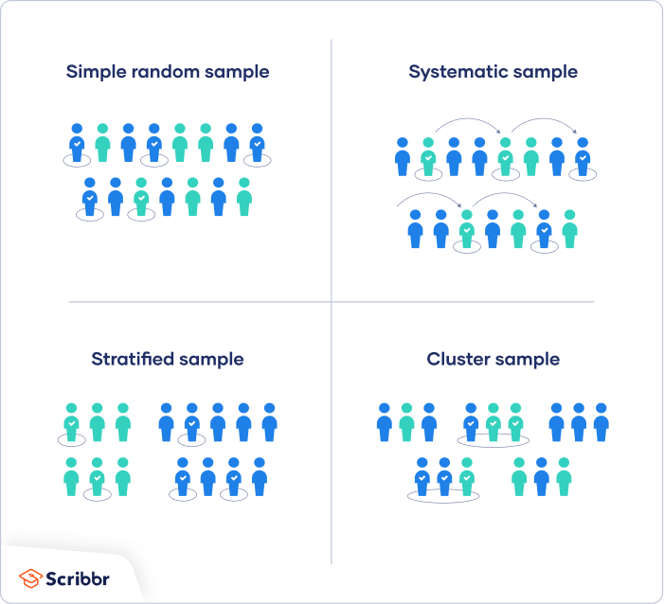
Sampling Method

Slide 12
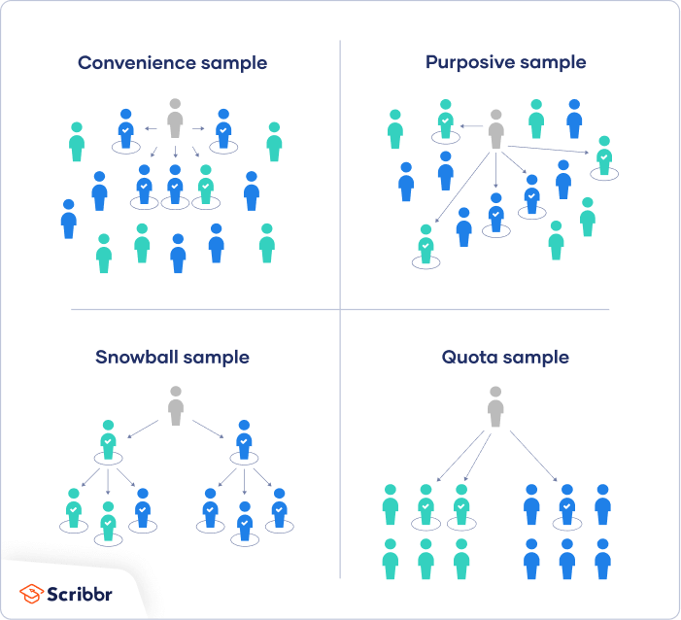
Sampling Method

