Slide 1
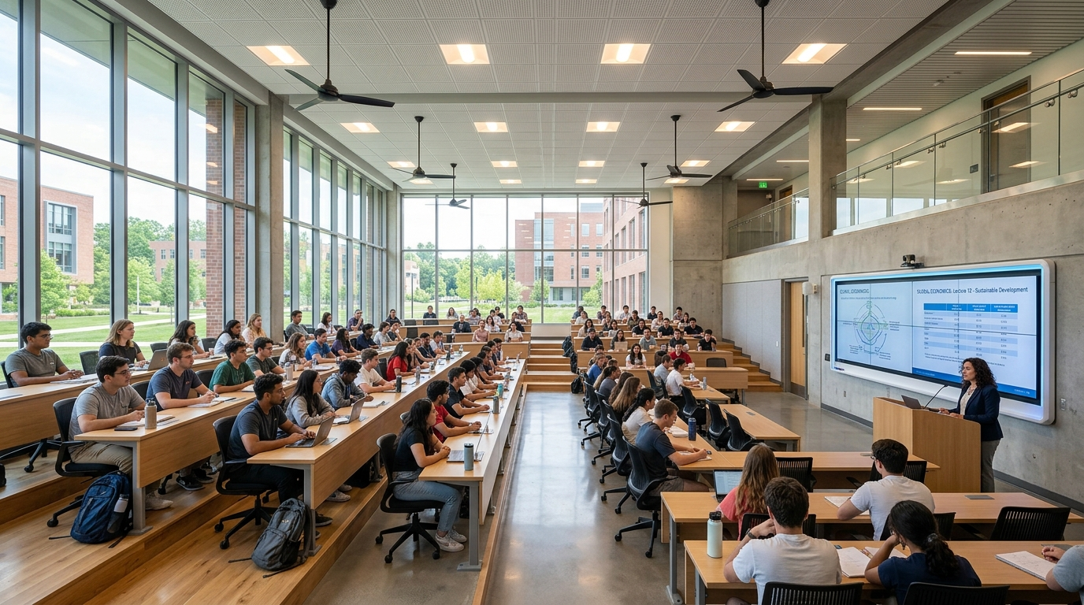
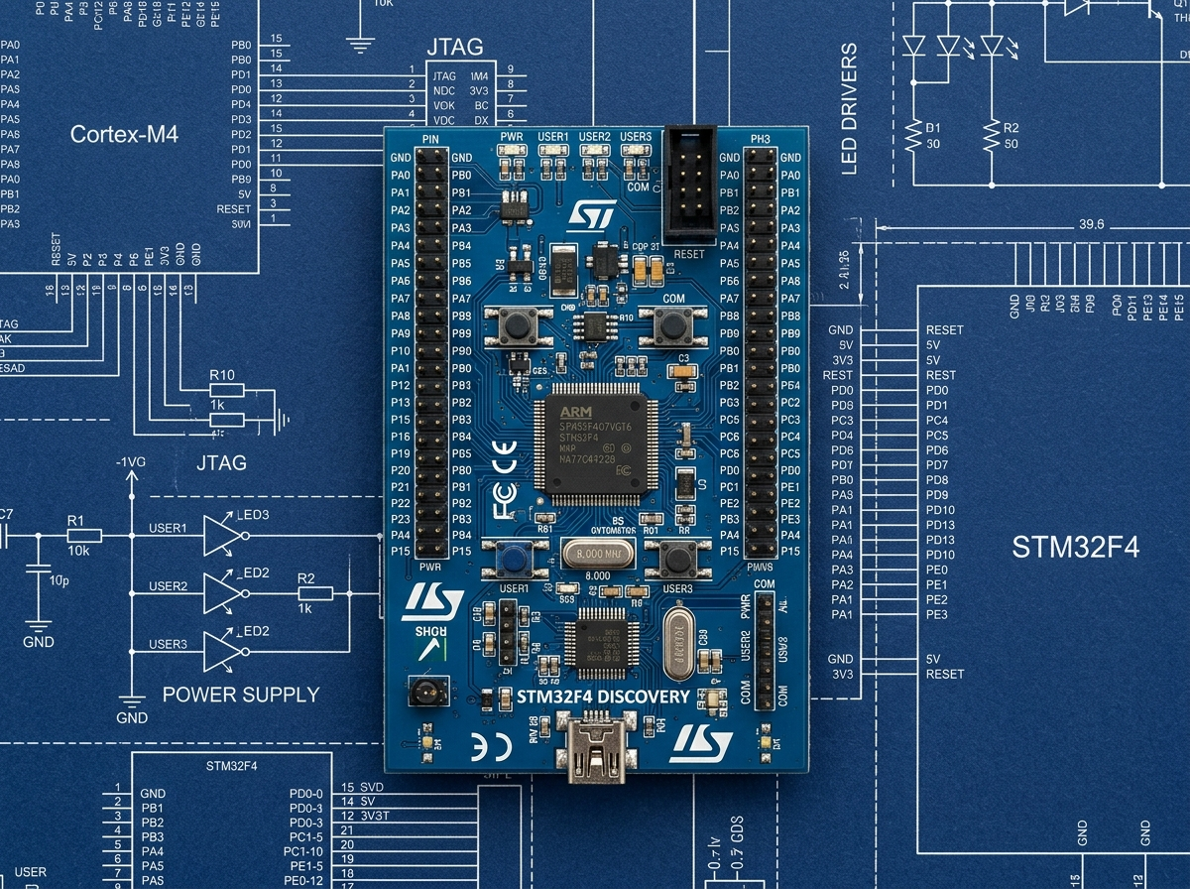
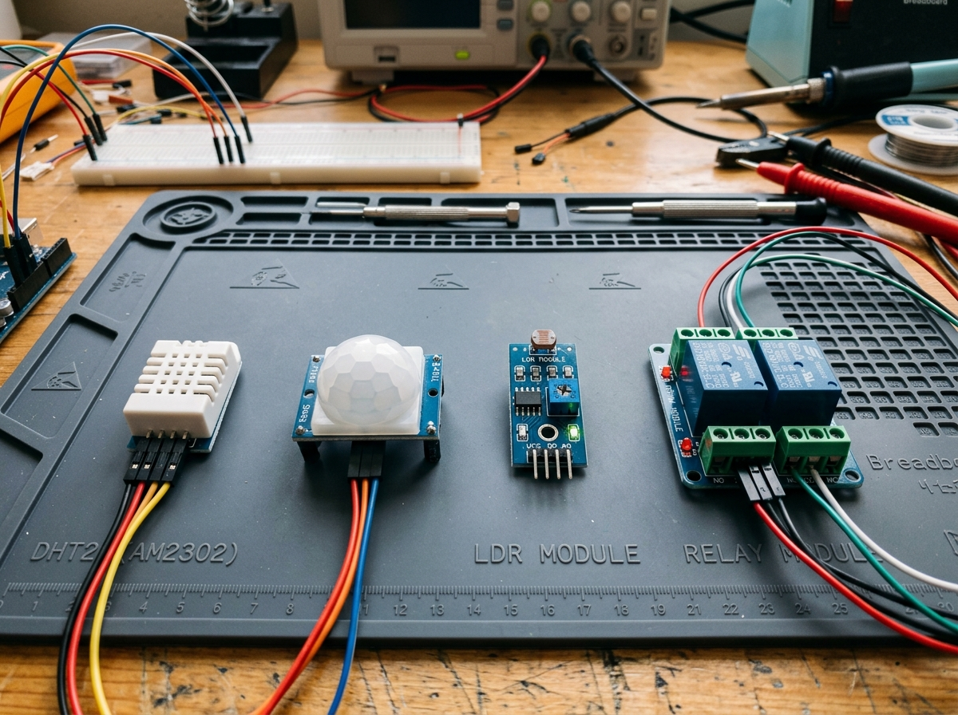
EMBEDDED SYSTEMS & IOT ENGINEERING PROJECT
Smart Classroom Automation System
Using STM32
"Smarter Classroom, Better Comfort, Efficient Energy Use"
A proposed closed-loop embedded automation architecture that integrates multi-sensor environmental acquisition with ARM Cortex-M processing to autonomously govern lighting, thermal comfort, and energy preservation in institutional learning spaces.
CORE MCU
STM32 (ARM Cortex)
IOT GATEWAY
ESP32 Wi-Fi
TARGET OUTPUT
Relay & PWM Cooling

Slide 2
PROJECT BACKGROUND
Introduction & Context
The Need for Intelligent Energy Management in Academic Spaces
Academic classrooms and university lecture halls present dynamic physical environments characterized by erratic student schedules, shifting thermal loads, and variable outdoor daylight availability throughout the academic day.
• Heavy Energy Footprint: High-bay fluorescent/LED lighting troffers and quad ceiling fan arrays run continuously regardless of whether rooms are populated.
• Static Manual Control Dependence: Human occupants frequently forget to switch off electrical loads upon dismissal, resulting in zero-occupancy overnight electrical waste.
• Dynamic Environmental Fluctuation: Solar daylight streaming through perimeter windows often renders artificial lighting redundant during midday periods.
CORE HYPOTHESIS
Automated embedded closed-loop regulation achieves up to 30–45% electrical energy savings while simultaneously improving student learning comfort.
Smart Classroom Automation System Using STM32 | Academic Engineering Presentation

Slide 3
CHALLENGES IDENTIFIED
Problem Statement
Quantifying Inefficiencies in Conventional Institutional Infrastructure
Daylight Ignorance
Artificial lights burn at 100% full capacity even when outdoor sunlight provides over 600 lux across student desktops through exterior windows.
Zero-Occupancy Waste
Ceiling fans and lights continue spinning and glowing during empty periods, between lecture slots, and after evening university closures.
Fixed-Speed Discomfort
Fans operate on primitive binary or manual rotary step switches that do not adapt dynamically to fluctuating thermal heat loads or humidity spikes.
Absence of Telemetry
Campus facility administrators possess no real-time telemetry regarding room thermal compliance, student presence, or device operational status.
Cumulative Utility Costs
Across campuses with 50+ lecture halls, manual negligence translates to thousands of kilowatt-hours wasted annually, straining institution budgets.
Smart Classroom Automation System Using STM32 | Academic Engineering Presentation

Slide 4
GOALS & SPECIFICATIONS
Project Objectives
Clear, Measurable Engineering Deliverables of the Proposed System
[01] Environmental Sensory Acquisition
Accurately sample ambient temperature, relative humidity, and daylight illuminance via digital & analog interfaces.
[05] Zero-Waste Inactivity Latch
Automatically de-energize all lighting and cooling circuits after confirmed absence to eliminate overnight parasitic power draw.
[02] Passive Human Occupancy Detection
Detect human entrance, movement, and physical occupancy vectors without invasive biometric tracking.
[06] Wireless Telemetry & IoT Gateway
Interface STM32 with ESP32 over UART to transmit continuous telemetry packets over Wi-Fi.
[03] Dual-Condition Smart Lighting
Automate high-voltage lighting circuits via solid-state relays only when both occupancy and daylight deficit occur.
[07] Remote Operator Override Capability
Enable facility managers to view live environmental trends and manually force actuators when specialized events require it.
[04] Proportional PWM Thermal Cooling
Dynamically modulate DC fan velocity across distinct thermal brackets (30%, 60%, 100%) based on ambient heat load.
Smart Classroom Automation System Using STM32 | Academic Engineering Presentation

Slide 5
SYSTEM TOPOLOGY
Proposed System Overview
High-Level Input-Process-Output Automation Topology
1. SENSORY INPUTS
• DHT22 Sensor
Digital Single-Bus temperature & humidity sampling
• LDR Module
Analog lux illuminance (0–3.3V to 12-bit ADC)
• PIR Sensor
Passive infrared pyroelectric motion detection via GPIO EXTI
2. MAIN CONTROLLER
STM32 (ARM Cortex-M)
✔ Hardware Timer PWM generation (TIM2_CH1)
✔ Continuous multi-variable decision evaluation
✔ Inactivity countdown latch state machine
✔ USART2 packet assembly & telemetry serialization
✔ Sub-50ms deterministic closed-loop cycle
3. ACTUATORS & GATEWAY
• Opto-Isolated Relay
Galvanic isolated 230V AC classroom lighting troffer control
• MOSFET Driver
High-frequency PWM speed regulation for DC ceiling fans
• ESP32 Wi-Fi Gateway
Wi-Fi TCP/HTTP telemetry uplink to campus facility dashboard
Smart Classroom Automation System Using STM32 | Academic Engineering Presentation

Slide 6
HARDWARE INTERFACING
Detailed System Architecture
Pin-Level Interfacing and Signal Protocol Topology
SYSTEM INTERFACE PIN MAPPING & PROTOCOL TOPOLOGY
MASTER MCU CORE
STM32 (ARM Cortex-M)
• ADC 12-bit Analog Conversion
• TIM2 General Purpose Timer (PWM)
• EXTI External Interrupt Controller
• USART2 Asynchronous Serial
• Brownout Reset & Watchdog Timer
• Sub-50ms Closed-Loop Execution
SENSORY TRANSDUCERS
DHT22: GPIO (Single-Wire Data Bus)
LDR Sensor: ADC1_IN0 (0–3.3V Analog)
PIR Motion: EXTI_Line0 (Interrupt Trigger)
ACTUATORS & GATEWAY
Relay (GPIO Output): 230V AC Classroom Lighting
MOSFET (TIM2_CH1): 12V/24V DC Fan Variable PWM
ESP32 (USART2): Wi-Fi Telemetry & Web Dashboard
Smart Classroom Automation System Using STM32 | Academic Engineering Presentation

Slide 7
BILL OF MATERIALS
Hardware Components Breakdown
Technical Selection, Specifications and Operational Roles
STM32 Microcontroller
32-bit ARM Cortex-M processor delivering deterministic timer interrupts for multi-channel PWM, hardware 12-bit ADC, and USART serialization.
Role: Master Automation Core
DHT22 (AM2302)
Capacitive humidity sensor & thermistor. Temperature range: -40 to 80°C (±0.5°C accuracy); Humidity: 0–100% RH (±2% accuracy).
Role: Climate Monitoring
LDR Sensor Module
Cadmium-sulfide photoresistor with voltage divider and LM393 comparator providing continuous analog light lux voltage directly to STM32 ADC.
Role: Lux Harvesting
PIR Motion Sensor
Pyroelectric sensor with faceted Fresnel lens (HC-SR501) detecting infrared radiation shifts caused by human occupant motion vectors.
Role: Occupancy Latch
Optocoupled Relay
Electromechanical relay with optocoupler galvanic isolation, allowing 3.3V logic signals to safely switch 230V AC classroom lighting troffers.
Role: High-Voltage Switching
MOSFET Motor Driver
Logic-level N-channel power MOSFET (e.g. IRLZ44N) driven by high-frequency STM32 PWM signals to smoothly regulate DC ceiling fan motor speed.
Role: PWM Speed Regulation
ESP32 Wi-Fi & BLE SoC
Dual-core 240MHz wireless microcontroller acting as a dedicated communications bridge: buffers UART packets and publishes telemetry to web dashboards.
Role: Wireless IoT Gateway
Smart Classroom Automation System Using STM32 | Academic Engineering Presentation

Slide 8
SYSTEM OPERATION
Working Principle & Closed-Loop Cycle
Autonomous Sense-Process-Actuate Cycle
STEP 01
Sensory Polling
• DHT22 queried every 2 seconds via single-wire bus.
• LDR analog output sampled via 12-bit ADC.
• PIR pin state latched via external GPIO interrupt.
STEP 02
Threshold Logic
• Compare LDR value to daylight threshold (< 40%).
• Compare temperature to thermal comfort brackets.
• Check occupancy status against timeout register.
STEP 03
Actuator Dispatch
• Trigger GPIO high/low to energize/open relay coil.
• Adjust PWM duty cycle register (TIM2->CCR1).
• De-energize all loads if inactivity timer expires.
STEP 04
Uplink Telemetry
• Assemble structured binary/JSON telemetry frame.
• Transmit packet over UART to ESP32 coprocessor.
• Publish data to cloud/web monitoring dashboard.
Deterministic Cycle Latency: Sub-50 millisecond decision processing loop guarantees immediate human-perceptible response.
Smart Classroom Automation System Using STM32 | Academic Engineering Presentation

Slide 9
LIGHTING AUTOMATION
Automatic Lighting Control Logic
Dual-Condition Occupancy & Daylight Harvesting Algorithm
EMBEDDED DECISION RULE
IF (Occupancy == TRUE && AmbientLight < 40%)
→ RELAY_STATE = ON (Lights Energized)
ELSE
→ RELAY_STATE = OFF (Lights Extinguished)
• Scenario A: Occupied + Dark
Students inside, cloudy day or evening -> LIGHTS ON
• Scenario B: Occupied + Ample Daylight
Students inside, bright window sunlight > 40% -> LIGHTS OFF
• Scenario C: Vacant Classroom
PIR inactive, zero occupants inside -> LIGHTS OFF
LIGHTING DECISION FLOW
1. Sample PIR Motion Interrupt
↓ [Human Motion Confirmed?]
2. Sample LDR Analog Lux Channel
↓ [Is Daylight < 40% Deficit?]
YES: Close Relay Coil (Lights ON)
NO: Open Relay Coil (Lights OFF / Energy Saved)
Smart Classroom Automation System Using STM32 | Academic Engineering Presentation

Slide 10
FAN SPEED CONTROL
Automatic Fan & Thermal Regulation
Multi-Stage Temperature-to-PWM Modulation Logic
BRACKET 1
< 25.0°C
Cool Baseline
0% PWM (Fan OFF)
BRACKET 2
25.0°C – 29.9°C
Warm Mild Heat
30% PWM (Low Speed)
BRACKET 3
30.0°C – 34.9°C
Moderate Thermal Load
60% PWM (Medium Speed)
BRACKET 4
≥ 35.0°C
High Heat Load
100% PWM (Maximum)
HARDWARE PWM GENERATION
Configured via STM32 General Purpose Timer (TIM2), clocked at 10 kHz with an 8-bit duty cycle counter (0–255 steps), yielding silent, smooth motor torque control.
VACANCY CUT-OFF SAFETY
Regardless of high room temperature, if PIR reports zero occupancy for longer than the inactivity timeout, the fan automatically cuts power to 0%.
Smart Classroom Automation System Using STM32 | Academic Engineering Presentation

Slide 11
ALGORITHM FLOW
Embedded System Software Flowchart
Deterministic Main Loop Execution Model
[ START / POWER ON ]
↓ Init Clocks, GPIO, ADC, TIM2 PWM, USART2
↓ Sample Sensors (DHT22 Temp/Hum, LDR ADC, PIR State)
↓ < Is Classroom Occupied? >
YES: Evaluate Light (Lux < 40%) | Evaluate Fan PWM
NO: Decrement Inactivity Latch -> Cut All Loads
↓ Assemble & Transmit Serial Telemetry Packet to ESP32
↓ Deterministic Non-blocking Delay -> Repeat Cycle
DETERMINISTIC EMBEDDED CONTROL
• No Blocking Delays: Hardware interrupts and non-blocking timers maintain continuous responsiveness.
• Fail-Safe Design: In the event of sensor timeout or disconnection, actuators default to safe unpowered state.
• Hardware Watchdog: Independent Watchdog (IWDG) automatically reboots system if main loop hangs.
• Brownout Protection: Embedded BOR ensures reliable reset during power fluctuations.
Smart Classroom Automation System Using STM32 | Academic Engineering Presentation

Slide 12
COMMUNICATION PROTOCOL
Software Stack & IoT Communication
STM32 Embedded Firmware & ESP32 Network Bridge
STM32 EMBEDDED FIRMWARE
Bare-Metal C / STM32CubeIDE / HAL
• Hardware Abstraction Layer (HAL): Clean register abstractions for GPIO, ADC1, TIM2, and USART2 peripherals.
• Interrupt Service Routines (ISR): EXTI pin trigger for immediate PIR motion event capture without CPU polling overhead.
• Structured Serial Packet Format: Serializes telemetry frames: #TEMP:28.5,HUM:55,LUX:32,PIR:1,FAN:60,LIGHT:1$
• Deterministic Timing: Strict loop scheduling with zero memory fragmentation.
ESP32 WIRELESS GATEWAY
Wi-Fi 802.11 b/g/n / FreeRTOS
• Hardware UART Ring Buffer: Reads STM32 packet stream via UART RX/TX without loading the main STM32 control core.
• Campus Wi-Fi Stack: Establishes connection to institutional Wi-Fi access points using WPA2-Enterprise / WPA2-PSK.
• Telemetry Serving: Hosts asynchronous WebSocket or HTTP REST endpoints for real-time monitoring and manual override commands.
• Decoupled Reliability: STM32 control continues operating safely even if Wi-Fi disconnects.
Smart Classroom Automation System Using STM32 | Academic Engineering Presentation

Slide 13
SIMULATION & VALIDATION
Expected Operation & Test Scenarios
System Response Under Realistic Field Conditions
Scenario 01: Classroom Vacant at Morning (7:00 AM) -> Lights: OFF | Fan: 0% (Idle Baseline)
PIR reports 0 occupancy, external lux 20%, room temp 22°C.
Scenario 02: Students Enter on Rainy Morning (8:00 AM) -> Lights: ON (Auto Relay) | Fan: 0%
PIR triggers active, external lux drops to 15% (insufficient daylight).
Scenario 03: Sunny Afternoon Lecture (1:00 PM) -> Lights: OFF (Daylight Harvest) | Fan: 60% PWM
Classroom fully occupied, outdoor solar lux surges to 85%, room temp hits 32°C.
Scenario 04: Summer Heat Wave Peak (3:00 PM) -> Lights: Evaluated | Fan: 100% PWM Max Airflow
Classroom occupied, thermal load surges to 37.5°C.
Scenario 05: Class Dismissal / Evening Exit (5:00 PM) -> Zero Waste Shutdown: All Actuators OFF
Students exit through doorway; PIR latches clear; inactivity countdown expires.
Smart Classroom Automation System Using STM32 | Academic Engineering Presentation

Slide 14
EVALUATION & ROADMAP
Advantages & Future Expansion
Quantifiable Engineering Benefits and Next-Phase Roadmap
CORE ADVANTAGES
✔ Up to 40% Energy Reduction: Eliminates human error, parasitic overnight loads, and unnecessary midday artificial lighting troffers.
✔ Autonomous Student Comfort: Continuous proportional cooling prevents classroom thermal fatigue during intense lectures.
✔ Decoupled Dual-Processor Architecture: STM32 ensures rock-solid deterministic safety even if Wi-Fi or cloud networks disconnect.
✔ Low Institutional Retrofit Cost: Compatible with standard legacy 230V fluorescent/LED arrays and common ceiling fan installations.
FUTURE EXPANSION ROADMAP
➔ Campus-Wide Mesh Deployment: Implement ESP-NOW or LoRaWAN mesh networking across hundreds of university lecture halls and labs.
➔ Predictive Pre-Cooling with ML: Integrate academic timetable databases to automatically pre-condition rooms 5 minutes before scheduled classes.
➔ Hardware Current Shunt Monitoring: Integrate INA219 current sensors to log exact real-time kilowatt-hour power consumption curves.
➔ Automated Window Blind Actuation: Modulate motorized motorized blinds based on sun glare angle.
Smart Classroom Automation System Using STM32 | Academic Engineering Presentation

Slide 15
FINAL SUMMARY
Conclusion
Project Summary & Engineering Value Proposition
PROJECT SUMMARY
The proposed Smart Classroom Automation System Using STM32 delivers an integrated, cost-effective, and highly reliable embedded solution to combat energy waste in institutional academic facilities.
• Multi-Sensory Closed-Loop Control: Combines ambient lux (LDR), passive motion (PIR), and digital temperature/humidity (DHT22) for accurate decisions.
• Energy & Comfort Balance: Eliminates daylight redundancy and empty classroom waste while maintaining adaptive proportional ventilation.
• Dual-Layer IoT Scalability: Robust STM32 hardware controller paired with ESP32 Wi-Fi gateway for centralized facility oversight.
"Smarter Classroom, Better Comfort, Efficient Energy Use"
Smart Classroom Automation System Using STM32 | Academic Engineering Presentation

Slide 16
THANK YOU
Questions, Discussions & Evaluator Feedback
Project: Smart Classroom Automation System Using STM32
Department of Electronics & Communication / Embedded Systems Engineering
Interactive 3D Digital Twin Simulation Available for Live Evaluation Demonstration

