Slide 1
MSDS 692 • DATA SCIENCE PRACTICUM
FloodNet
Prioritizing NYC Street-Flooding
Monitoring with Sensor Evidence
A transparent, deployment-normalized screening approach for identifying monitored locations that deserve closer review.
BOTTOM LINE UP FRONT
Use high-burden sensor sites as candidates for closer review — not as a citywide risk ranking.
Navaneeth Bitla • October 16, 2026

Slide 2
WEEK 6 | RECOMMENDATION
Use FloodNet sensor locations with consistently high normalized flooding burden as candidates for closer review.
The recommendation connects the flooding signal to a physical location, then checks whether the same locations remain important.
01
FIND THE SIGNAL
02
CONNECT IT TO PLACE
03
VERIFY BEFORE ACTING
Use severe-and-persistent flooding events per 100 deployment-days instead of raw event counts.
Use the sensor’s street name, borough, latitude, longitude, and location fields.
Check whether the same locations stay near the top under reasonable threshold definitions.
Screening recommendation — not a final citywide ranking, because the sensor network is not a random sample of NYC streets.

Slide 3
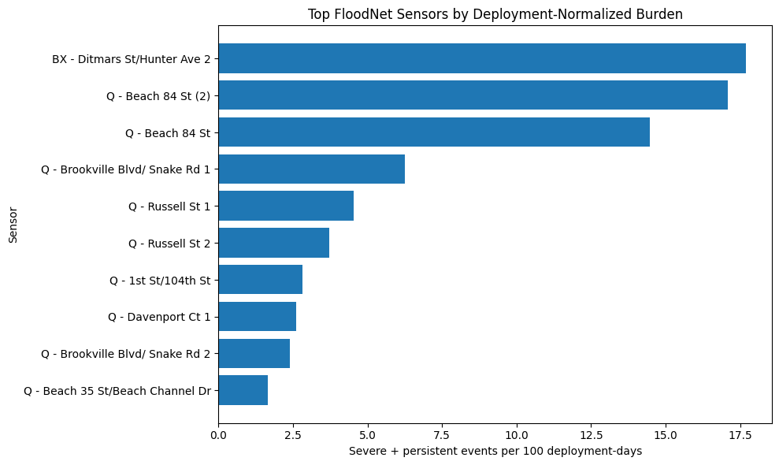
A small group of sensors carries the highest persistent-flood burden — prioritize monitoring there first.
Screening group shown sensors with at least 30 recorded events; rates are severe + persistent events per 100 deployment-days.

Slide 4
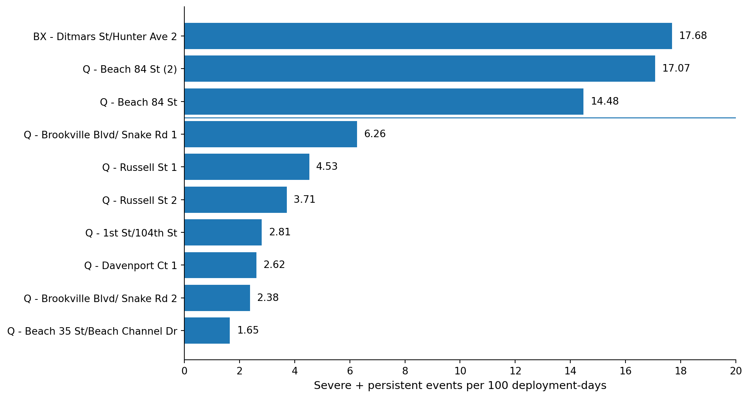
The top three qualifying sensors sit well above the rest.
FloodNet sensors with ≥30 recorded events; severe + persistent events per 100 deployment-days.

Slide 5
An interpretable model is the best starting point for FloodNet
Why this method fits the data and the stakeholder decision
2,927 events
Main outcome
Key factors
296 sensors
Severe + persistent
4 variables
Repeated observations from the same sensors need to be handled appropriately.
Focuses on conditions associated with more serious flood events.
Tidal influence, season, sensor height, and borough.
METHOD TRADE-OFF
CHOSEN: Interpretable approach
ALTERNATIVE: Flexible ML model
Clearer to explain and defend to flood-management stakeholders.
More flexibility for complex patterns, but harder to explain.

Slide 6
Use high-burden FloodNet sensor locations as candidates for closer review—not a citywide ranking.
The shortlist is a screening signal; check whether it holds under reasonable definitions of severe and persistent flooding.
WHAT THE DATA SHOW
WHY NORMALIZE
WHAT MUST BE CHECKED
Among sensors with at least 30 recorded events, three locations have much higher normalized severe-and-persistent burden.
Rates are expressed per 100 deployment-days, so sensors with longer operating histories are not favored simply for recording more events.
Compare the shortlist across reasonable depth and duration thresholds, then connect each sensor ID to its street-level location.
TOP 3 SCREENING RATES
17.68 • 17.07 • 14.48
Severe + persistent events per 100 deployment-days
Important limitation: FloodNet sensors are not a random sample of every NYC street. These values identify candidate sensor locations for review, not the definitive “worst” streets citywide.
Source: NYC FloodNet event summaries and sensor-deployment metadata. Screening threshold: depth ≥ 4 in and duration ≥ 120 min.
MSDS 692 • FLOODNET • WEEK 7

Slide 7
DATA & SCOPE
Two linked datasets connect flood events to real places
Event summaries tell us what happened; deployment metadata tell us where and for how long a sensor was deployed.
1 FLOODNET EVENT SUMMARIES
2 SENSOR DEPLOYMENT METADATA
• One row represents one event at one sensor.
• Fields include start/end time, maximum depth and event duration.
• Supports defining severe-and-persistent events.
• Sensor ID links each event to its location.
• Adds street, borough, coordinates, deployment dates, tidal influence and ground height.
• Enables deployment-window checks and site context.
2,929
→
2,927
→
296
Sensor ID
Why this combination?
stable join key
Depth + duration + exposure time + location
raw event rows
inside deployment window
sensors in event records
IMPORTANT SNAPSHOT LIMIT
The reported results use the local event extract downloaded August 29, 2026. The project audit noted that the public feed was later updated (October 1, 2026). These numbers are snapshot-specific; refresh both files and rerun the pipeline before an operational decision.
Sources:
NYC Open Data — FloodNet Event Summaries | Sensor Deployment Metadata | FloodNet Methodology
MSDS 692 • FLOODNET • FINAL DEFENSE
7/10

Slide 8
MEASUREMENT
The main outcome requires both depth and duration
The cutoffs are project-defined screening rules—not FloodNet’s official event definition or a universal danger standard.
SEVERE
PERSISTENT
PRIMARY MODEL OUTCOME
Maximum depth ≥ 4 inches
Event duration ≥ 120 minutes
Severe AND persistent in the same event
1,294
1,371
945
PRIMARY SCREENING METRIC
(qualifying events ÷ deployment days) × 100
severe events
persistent events
meet both criteria
TOP SCREENING RATES • SENSORS WITH ≥30 RECORDED EVENTS
WHY THIS METRIC?
1
BX — Ditmars St / Hunter Ave 2
17.68
• Raw totals favor sensors with longer observation histories.
• The rate adjusts for nominal deployment time.
• It does not correct for every outage or missing reading.
2
Q — Beach 84 St (2)
17.07
3
Q — Beach 84 St
14.48
4
Q — Brookville Blvd area
6.26
Interpretation guardrail
These are rates—not percentages, probabilities, or model-accuracy scores. This project screens observed sites; it does not yet validate a future-flood prediction model.
MSDS 692 • FLOODNET • FINAL DEFENSE
8/10

Slide 9
MODEL & VALIDATION
GEE addresses repeated events at the same sensor
The model is an explanatory association analysis; the operational shortlist comes from the descriptive normalized rate.
SELECTED STARTING MODEL
WHY NOT ORDINARY LOGISTIC REGRESSION?
Logistic regression estimated with GEE
It assumes independent event rows. Repeated events within a sensor violate that simplifying assumption; GEE models within-sensor correlation.
• Cluster: Sensor ID
• Working correlation: exchangeable
• Uncertainty: robust / sandwich standard errors
• Outcome: severe-and-persistent event (binary)
WHY NOT RANDOM FOREST FIRST?
A forest can capture nonlinear patterns, but it is less direct for explaining adjusted associations. Consider it only if validated prediction changes the practical shortlist.
Factors considered
Tidal influence
Season
Sensor ground height
Borough
Why GEE? The 2,927 events come from 296 sensors; repeated events within one sensor may be correlated.
MODEL-INTEGRITY CHECK
The earlier Boolean outcome coding can reverse which class an odds ratio describes. Do not quote an adjusted odds ratio as final until the outcome is explicitly coded 0/1, reference categories are verified, and the GEE is rerun. The sensor-rate screen is a separate descriptive result.
MSDS 692 • FLOODNET • FINAL DEFENSE
9/10

Slide 10
DECISION & NEXT STEPS
A defensible solution is a screening workflow—not a citywide risk map
Use the evidence to direct the next check; do not jump from a rate ranking straight to expensive mitigation.
1 SCREEN
2 STRESS-TEST
3 VALIDATE ON SITE
Use severe-and-persistent events per 100 deployment-days and retain the ≥30-event eligibility rule as an explicit screening choice.
Recompute under alternative depth and duration cutoffs. The top two persisted under some alternatives; the third position was less stable.
Join sensor IDs to streets and coordinates, review field context, and decide whether closer monitoring or inspection is justified.
BEFORE OPERATIONAL USE
WHAT WOULD CHANGE MY ANSWER?
• Refresh the public event and metadata extracts; reproduce all counts/rates.
• Explicitly recode the model outcome and verify GEE references before reporting coefficients.
• Add precipitation only if it materially changes the priority order.
• A refreshed dataset changes the leading sites.
• The shortlist changes substantially under reasonable thresholds.
• Site checks contradict the sensor signal.
FINAL RECOMMENDATION
Use high normalized FloodNet burden to nominate monitored sites for closer review; validate the data, thresholds and physical locations before allocating major mitigation resources.
Questions
MSDS 692 • FLOODNET • FINAL DEFENSE
10/10

Slide 11

Thank you
I am happy to take any questions

